Slide 1
Experience: Implications of Roaming in Europe
Anna Maria Mandalari (University Carlos III of Madrid)
Andra Lutu (Telefonica Research, Simula Research Laboratory)
Ana Custura (University of Aberdeen)
Ali Safari (Politecnico di Torino)
Ozgu Alay (Simula Research Laboratory)
Marcelo Bagnulo (University Carlos III of Madrid)
Vaibhav Bajpai (Technische Universität München)
Anna Brunstrom (Karlstad Universitet)
Joerg Ott (Technische Universität München)
Marco Mellia (Politecnico di Torino)
Gorry Fairhurst (University of Aberdeen)

Slide 2


Slide 3
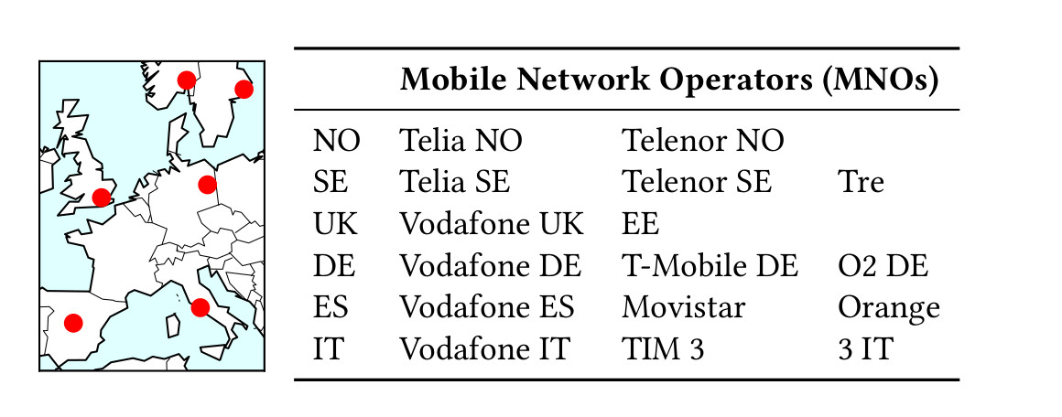
Experimental Setup

Slide 4
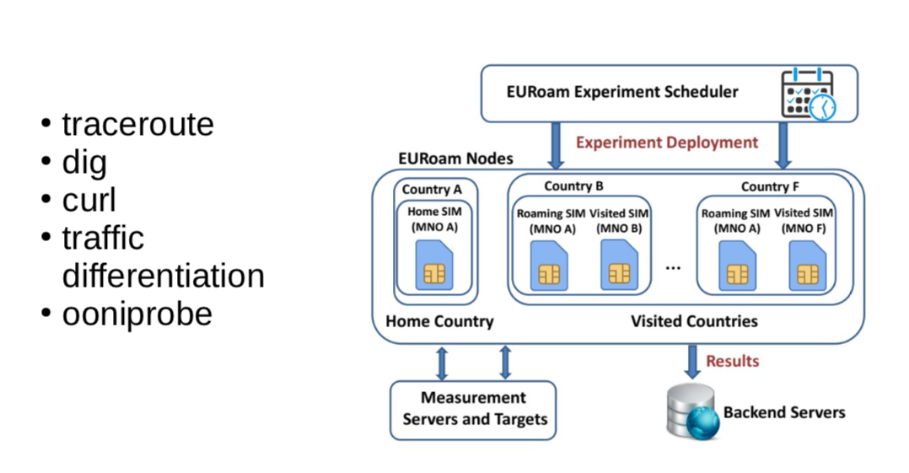

Slide 5
Accepted at MobiCom:The Annual International Conference on Mobile Computing and Networking
This work is funded by the European Union’s Horizon 2020 research and innovation programme under grant agreement No. 688421 (MAMI)

Slide 6
Results: Roaming configuration
HR used by all operators tested, based on:
MNO that allocates the public IP address
First public IP address on the path
Stability in selection of visited network
The number of hops to traceroute targets is the same (visited SGW→home PGW tunnel)
MNOs - different infrastructure deployments
O2 DE have 20 first IPs (20 PGWs?)
Vodafone UK have 1 first IP (1 PGW?)

Slide 7
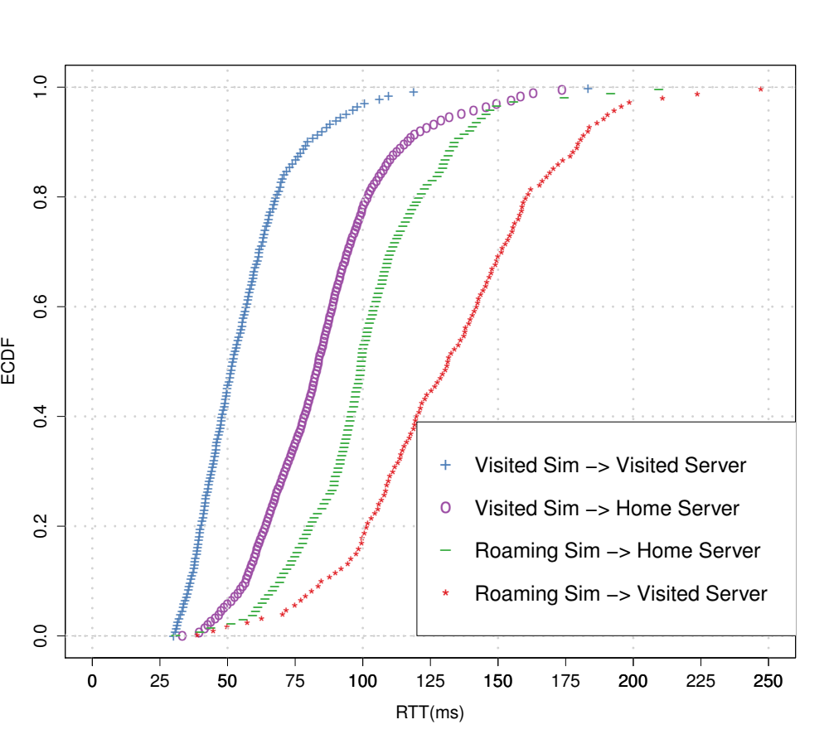
Results: HR penalty delay
TCP Handshake time delay penalty of approximately 60ms for roaming users

Slide 8
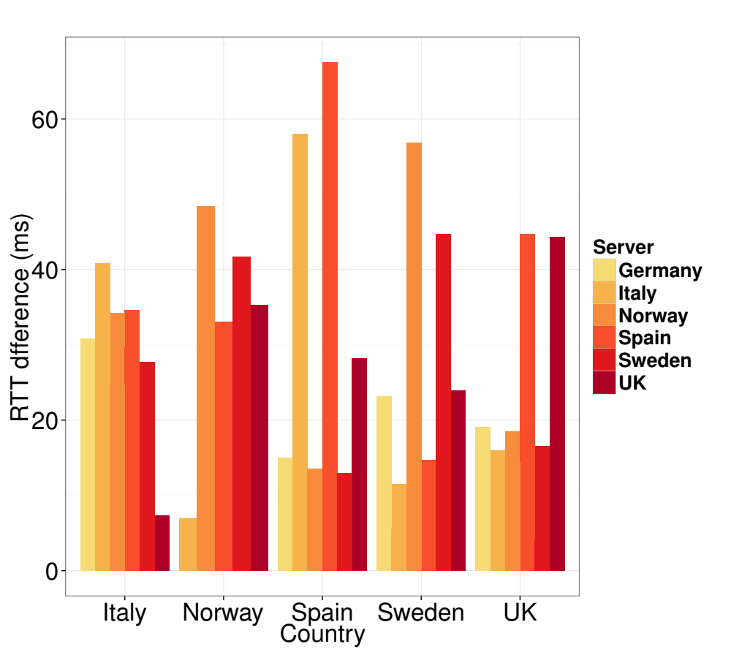
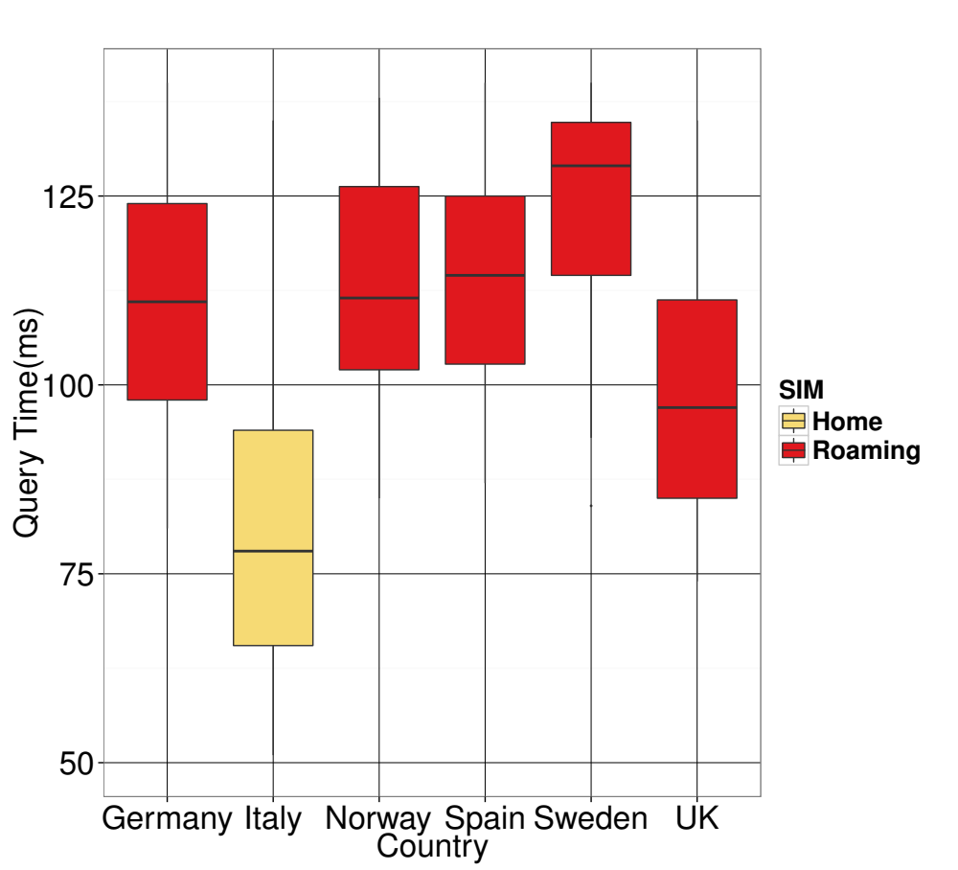
Results: HR penalty delay

Slide 9
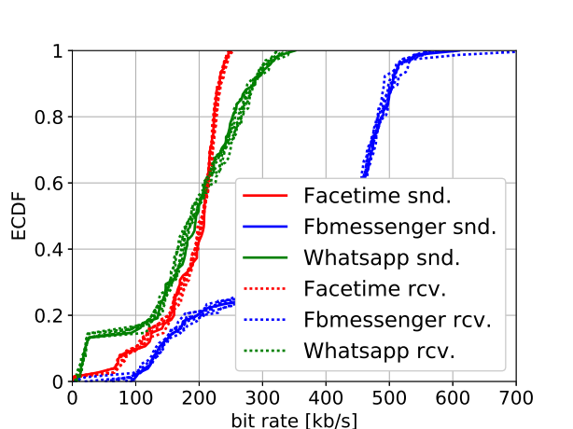
Results: VoIP call
Applications behave in the same way regardless of country SIM is roaming in

Slide 10
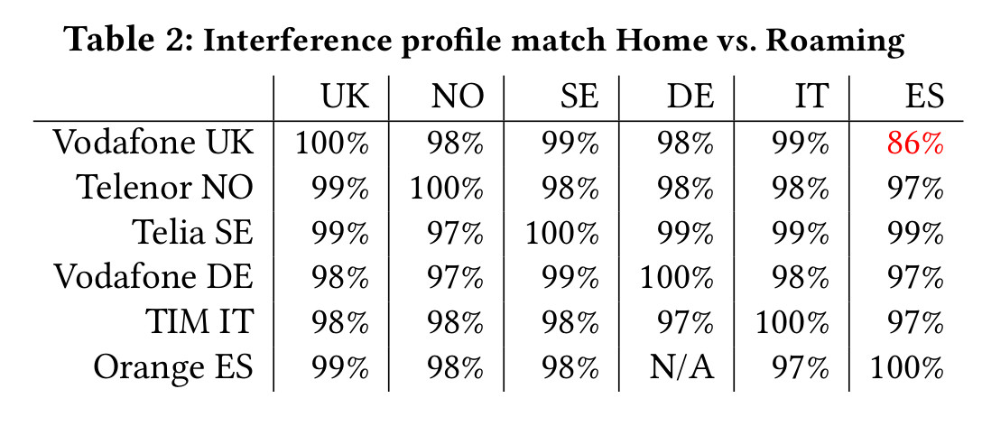
Results- ooniprobe

Slide 11
Next steps
Finish addressing the reviews
Web QoE measurements
Measure more MNOs
Journal publication

