Slide 1

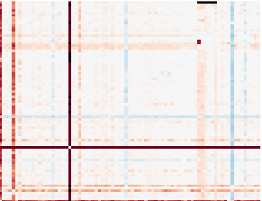
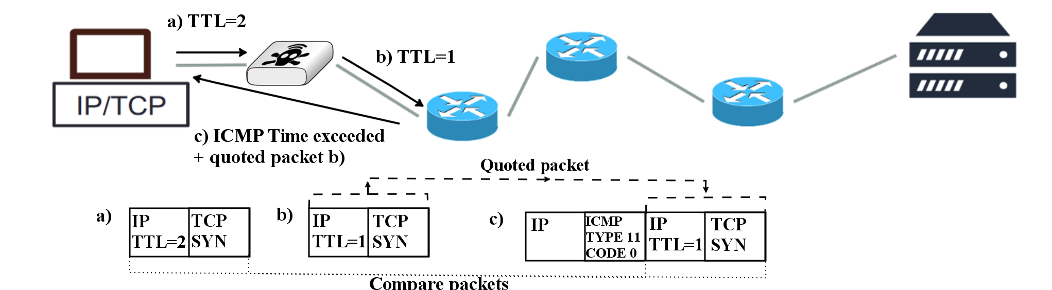
Towards an Observatory for Network Transparency Research
Stephan Neuhaus,
Roman Müntener
Zurich University of Applied Sciences
School of Engineering
Switzerland first.last@zhaw.ch
Korian Edeline,
Benoit Donnet
University of Liège
Montefiore Institute
Belgium first.last@ulg.ac.be
Elio Gubser
ETH Zürich
Communication Systems Group
Switzerland elio.gubser@tik.ee.ethz.ch
To understand middlebox
impairments, we must first
measure them.
Use Case: Internet-Over-UDP
Large-scale measurements of path impairments
  using FIRE MONROE as well as RIPE Atlas, CAIDA Ark…
  UDP/TCP/SCTP connectivity, TCP options
  (e.g. TFO, MPTCP), and other protocol (ICMP, DNS, …)
Development of new measurement tools
https://github.com/mami-project/
  Tracebox: tracing + impairment analysis
  Copycat: TCP/UDP differential on-path treatment
  PathSpider: A/B testing (currently on ECN support)
Path Transparency Observatory
  Active measurements by the project + external measurements
  Public query interface (end of 2016) to access path impairment data:
What is the likelihood that a certain path impairment impacts my traffic (modifications/stripping/dropping/blocking)?
  Common data model for all observations of path conditions
  t: time of observation
  p: path to which observation applies
  c: condition observed, e.g. “feature X ⇨ packet loss”
  v: vector of condition-specific values
Copycat
  Runs simultaneously pairs of TCP and TCP-controlled UDP flows between two endpoints
  Evaluates differences in connectivity and QoS due to differential treatment based on transport protocol.
Main Conclusions
  No path-dependent impairments
  Endpoint-based blocking
  Between 1% and 5% of UDP flows are blocked (red dots)
  Absence of UDP/TCP initial RTT bias
The end-to-end
ideal
Today’s middleboxed
reality
3 2 1
0
1
Use Case: Presence of
Middleboxes Over Time
Tracebox
  Traceroute-like middlebox detection tool
  Detect and localize middleboxes impairments
Future Work
  Characterize middleboxes evolution over time
active A/B test
(PathSpider)
observations
{t,p,c,v}
traceroute
mod trace
(tracebox)
preanalysis
preanalysis
looking glass
etc.
Learn more, and follow our progress: https://mami-project.eu

