Slide 1
PLUS (Work-In-Progress)
Roman Müntener, Stephan Neuhaus (ZHAW)

Slide 2
Implementation

Slide 3
Layering --- Traditional View
Application
Application
Transport
Transport
Network
Network
Network
Network
Medium Access
Medium Access
Medium Access
Medium Access
Physical
Physical
Physical
Physical

Slide 4
Layering With PLUS
Crypto context needed for authentication of PLUS header material
Works well with AEAD ciphers, probably not so well with more traditional auth (HMAC etc; insert personal rant about AEAD ciphers here)
Also feedback channels, flags
Crypto
Context
Transport
Path (PLUS)
UDP/IP

Slide 5
Design Questions
How do we separate a layer into two layers?
PLUS can not be treated as a transparent layer
  PLUS feedback channels/flags need cooperation from transport layer
  OK, you can use defaults/compatibility layer, but you lose transport/PLUS interaction
How do we make it easy to integrate into existing code?
By making it as transparent as possible

Slide 6
About PLUS
PLUS mandates encryption and integrity protection, also mandates that it uses overlaying transport for that
  Needs help from transport layer implementation
PLUS mandates feedback channels
  Should the PLUS code deal with encryption/integrity or should this be delegated to the outer layer code.
PLUS introduces connection semantics
  Should the PLUS code deal with ...
Should these be as transparent as possible?
  Compromise: Design the API to be usable either way.

Slide 7
API
High level API
  Provides connection objects that can be used by existing code as if it were a normal connection object (like TCP).
    Thus handles connection multiplexing, encryption and PCF feedback/requests transparently.
Low level API
  Provides raw access to sending and receiving packets, does not perform connection multiplexing, encryption/integrity/pcf can be handled by the outer layer completely if wanted.

Slide 8
Crypto Context & Feedback Channel
Each connection has a crypto context and a feedback channel provided by the outer layer.
Crypto context needs to provide two methods:
  EncryptAndProtect(header, payload): integrity protection and encryption.
  DecryptAndValidate(header, payload): Perform integrity check and decryption.
Feedback channel needs to provide one method:
  SendFeedback(data): Sends data back as PCF feedback.

Slide 9
Control Flow
Upon sending the PLUS layer calls the crypto context’s EncryptAndProtect.
Upon receiving the PLUS layer calls the crypto context’s DecryptAndValidate.
Upon receiving an extended header with a PCF request the PLUS layer invokes the feedback channel’s SendFeedback.
Upon receiving PCF feedback the outer layer will call the AddFeedback method provided by the PLUS layer.

Slide 10
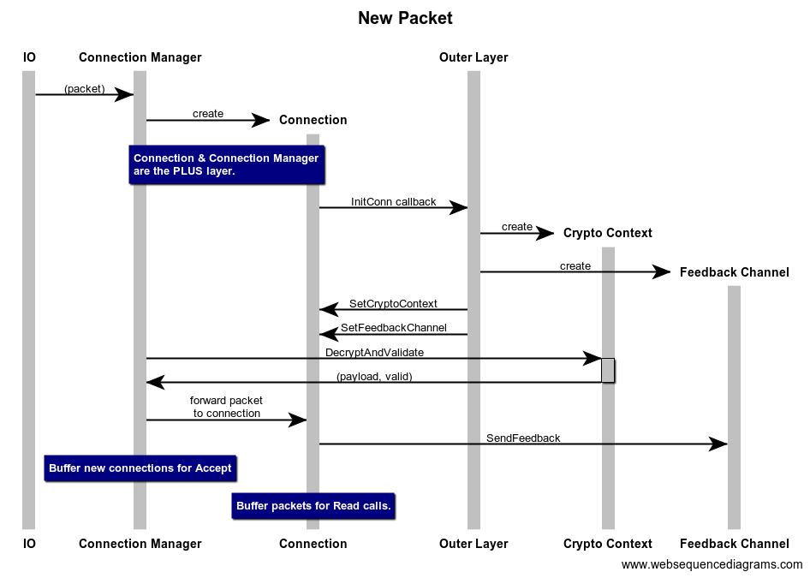
Control Flow: New CAT

Slide 11
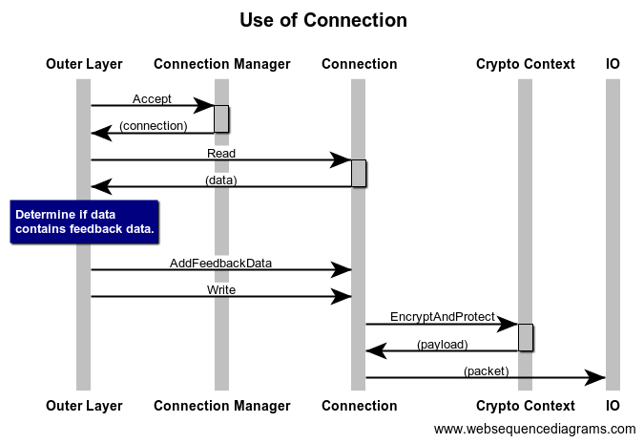
Control Flow: Use of Existing Connection

Slide 12
Issues
PLUS layer performs callbacks to the crypto context and feedback channel
  should be non-blocking.
PLUS layer may hold locks to internal state that should not be modified during these callbacks.
  Callbacks should not attempt to read or send data from the connection and should only perform read access to the connection object’s internal state.
  Otherwise deadlocking may occur.

Slide 13
Issues
Callbacks may receive live buffers that can be modified safely as far as the PLUS layer is concerned, but outer layer might hold references to these buffers too
It’s up to the outer layer to decide whether to modify buffers in callbacks directly or work on copies.
Since integrity protection likely requires additional space, buffers will need to be allocated.
To reduce the number of allocations, an outer layer may provide buffers to the Write methods that are large enough to hold additional data that is filled in in-place by the crypto context’s methods.

Slide 14
Issues
A PLUS connection can be treated as a regular connection except that explicit stop signaling will not be possible as go’s net.Conn interface does not provide any methods to set PLUS flags as well as PCF feedback handling will not be possible.
ALL existing protocols that will run (directly) on top of PLUS will have to be modified to account for PCF feedback handling.

Slide 15
GUIC
QUIC-GO (GUIC) has been modified to support PLUS
We introduced a new frame type PLUSFeedbackFrame that is used to send feedback back
We did not change anything to the crypto, meaning:
  Crypto is as it was.
  PLUS headers are not integrity protected.
Uses the Low level API because GUIC has its own connection multiplexing mechanism (layer connection multiplexing is strange)

Slide 16
Tools

Slide 17
plus-pcap
Support added to gopacket to decode PLUS packets
Command line tool plus-pcap using gopcap/gopacket
Reads PCAP files containing PLUS packets or dump traffic live
Outputs JSON

Slide 18
pluspector
Pluspector: A command line tool for debugging.
Can relay connections (does not use raw sockets).
Can generate packets and echo packets.
Can generate packets and randomly modify bytes:
  Serves as a trivial fuzzing tool to detect bugs.
NOT a tool to debug transport protocols using PLUS.

Slide 19
plus-debug
PDbg: A dummy protocol running on top of PLUS providing trivial encryption and integrity protection and packet retransmissions.
Serves as a reference on how to use PLUS.
Useful in testing.
Not a production transport protocol. Encryption and integrity protection are deliberately very weak and packet retransmission is not designed to be efficient. Its sole purpose is in testing.

Slide 20
Open Questions

Slide 21
PCF
Exact PCF mechanics and semantics:
The spec initially required to only send the non-integrity protected part back. This was a problem because it made it impossible to know to what request this is feedback to and thus the type/format of the data remained unknown.
We decided that a receiver sends back the complete extended header instead.

