Slide 1
Oh, And One More Thing… (OK, Two Things)

Slide 2
PLUS Update
Performance improvements in plus-go since last meeting
No measurable overhead with guic w/PLUS vs. w/o PLUS
< 7% overhead when using raw data transfer
Interop testing with fd.io implementation underway
Experiment planning with fd.io soon

Slide 3
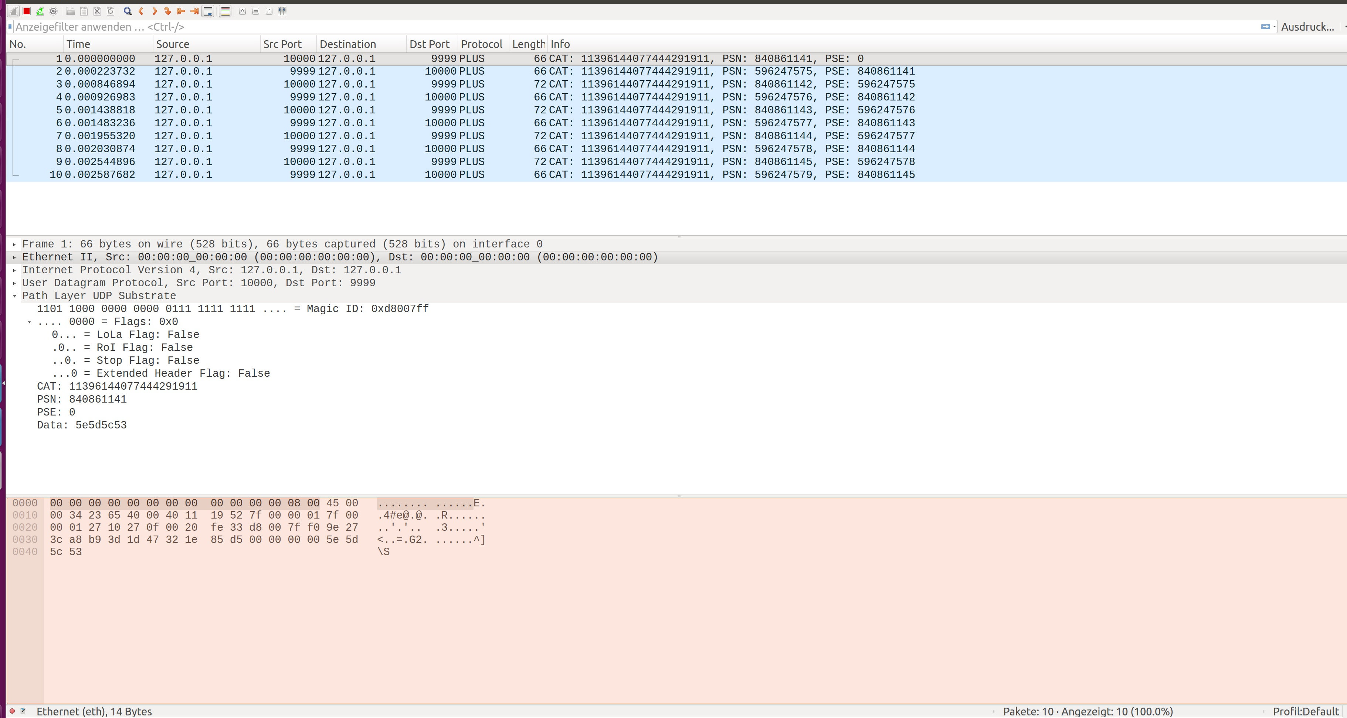

Slide 4
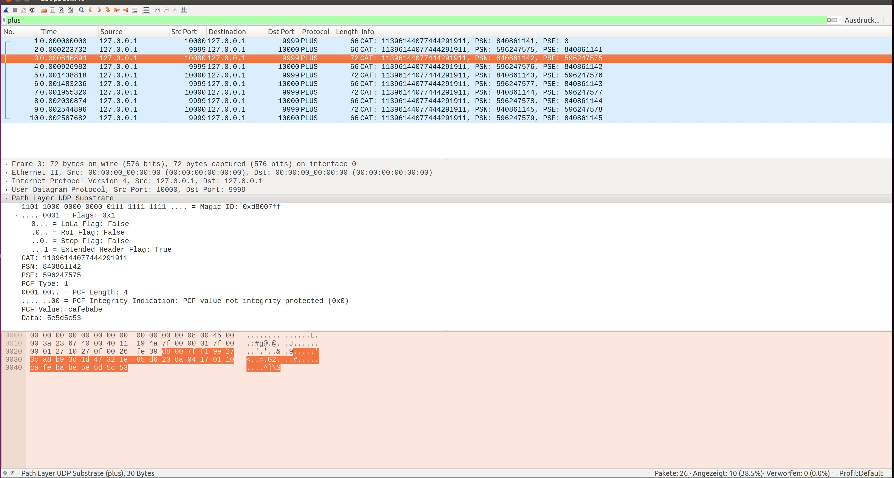

Slide 5
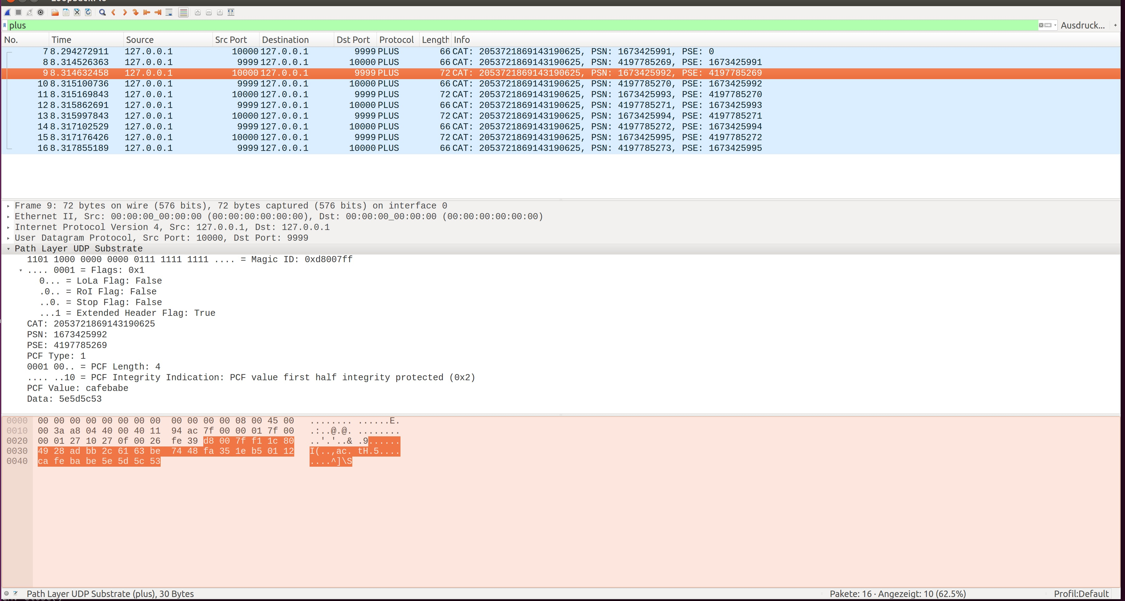

Slide 6
Some Statistics
123 lines of LUA code
...of which 47 are comments
…and 18 are blank lines
...leaving 58 lines of code
Doesn’t do “protocol handover” to other dissectors
Port 9999 hardcoded, but can use “Analyze > Decode as...”
No error handling
But it’s a start!

Slide 7
About that work...
Clone git@github.com:sten13/plus-dissector.git
(would push to mami-project, but can’t create repos)
Copy plus.lua to Wireshark plugin folder
  Preferrably personal plugin folder, see Help > About > Folders
My student is working on a fuzzer for shim-layer protocols
...and PLUS in particular
Works with Roman and (soon) with Tobias as well
Could write blog post…?

