Slide 1


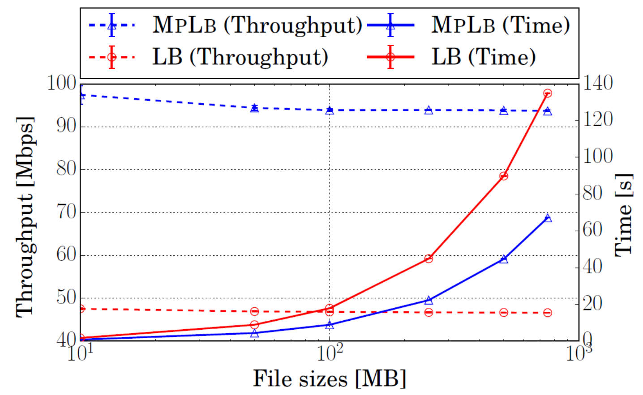
Simon Liénardy, Benoit Donnet (firstname.name@ulg.ac.be)
Université de Liège, Montefiore Institute, Belgium
Problem that arises with a load balancer that does not understand MPTCP
Servers
Client
LB
Servers
Subflow 1
1
Addr₁
Addr₂
SYN + MP_CAP(Key_{C})
1
2
N
SYN/ACK + MP_CAP(Key_{S})
Server is selected on the basis of the hash of the flow ID.
Client
LB
2
ACK + MP_CAP(Key_{C},Key_{S})
…
Subflow 2
…
…
N
SYN + MP_JOIN(Tok_{S},Nonce_{C})
?
Since the flow IDs are different, the selected servers can be different too.
Multipath TCP [1] is a TCP extension enabling to create multiple subflows between hosts. Each subflow has its own 5-tuple and is forwarded independently of the others in the Internet. But a load balancer (LB) could balance different subflows of a MPTCP connection to distinct servers.
RST
Proposed solution: a load balancer that is MPTCP aware
Servers
Client
MpLb
Servers
Subflow 1
1
Addr₁
Addr₂
SYN + MP_CAP(Key_{C})
1
2
N
New MPTCP connection, Server selected, mapping flow ID/server registered.
2
SYN/ACK + MP_CAP(Key_{S})
Token_{S} calculated and mapping Token_{S} /server registered. Packet forwarded thanks to flow ID/server mapping.
Client
Subflow 2
MpLb
…
ACK + MP_CAP(Key_{C},Key_{S})
…
N
SYN + MP_JOIN(Tok_{S},Nonce_{C})
Server selected thanks to Token/server mapping, flow ID/server registered.
SYN/ACK + MP_JOIN(HMAC_{S},Nonce_{S})
Our proposed solution registers the subflow authentication materials that are exchanged between the host during the first subflow establishment in the MP_CAPABLE option. Hence, new subflows belonging to a previously encountered MPTCP Connection can be recognized and forwarded to the proper server.
ACK + MP_JOIN(HMAC_{C})
Packet forwarded thanks to flow ID/server mapping
ACK
Proof of concept experimentation
Future work
We implemented both situations presented above. We used 4 VMs:
A Client;
A load balancer implemented using Click [2];
2 Servers.
Servers and Client are MPTCP capable (MPTCP linux version 0.89 [3]).
We implemented 2 versions of the load balancer.
The first load balancer (in RED) does not understand MPTCP and simply hashes the IP_src and IP_dest of the Client.
The second load balancer (in BLUE) is our MpLb implementation.
The client is connected to the LB thanks to two links limited
at 50 Mbps (this is a software limitation).
We can see in the graph that there is a factor 2 between both time and throughput curves. In fact, MpLb manages to use both links between the client and the LB to transmit data.
The link between the LB and the server was set up to not be the limiting factor of the exchange.
Deeper tests on more complex topologies;
Case of several load balancers in parallel.
References
[1] A. Ford, C. Raiciu, M. Handley, and O. Bonaventure, “TCP extensions for multipath operation with multiple addresses,” Internet Engineering Task Force, RFC 6824, January 2013.
[2] E. Kohler, R. Morris, B. Chen, J. Jannotti, and F. Kaashoek, “The click modular router,” ACM Transactions on Computer Systems, vol. 18, no. 3, pp. 263–297, August 2000.
[3] C. Paasch, S. Barré et al., “Multipath TCP in the Linux kernel,” available from http://www.multipath-tcp.org
MpLb performance vs. unaware load-balancer

