Slide 1

Rent the Runway Warehouse Optimization
Mami Takeuchi
Notes:
Hello, everyone. My name is Mami Takeuchi.
I am presenting Rent the Runway warehouse optimization by using Arena Simulation.
The reason why I chose this topic is that I adore the company, Rent the runway.
Their service is unique and innovative.
I personally don't like to own things, and hate shopping at the store.
Especially clothing, it is time consuming to browse item, pick item, queue for trying it on...
Plus i dont have a big apartment, and I dont have a place for new clothings.
let me quicky tour you with how it works....
When you go to their website, or app, you pick the item and reserve the item.
They will ship you the item you chose with a return label.
After the renting period ends, you just drop off at UPS.
The best part of this service is you rent the clothe for 10 percent of the retail price.

Slide 2
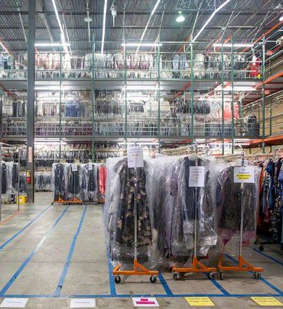
Agenda
Introduction
Scenario
Modeling process
Process improvements
Verification and Validation
Conclusion

Slide 3
Introduction
Rent the Runway is an online service that provides designer dress and accessory rentals for 10% of its retail price.
Their warehouse where all the inventory is controlled is located in Secaucus, NJ.
(This warehouse is known as the biggest cleaning facility in the world!)
The company was founded in 2009, and became 1 billion value.
In spite of their success, a recent news reported that hundreds of customers experiences delivery delays.
Analyze the current operation model and explore what improvements can be added to reduce the total operation time.
Notes:
A little more information about the company to do a simulation, and the objective of this project.
Rent the Runway is an online service that provides designer dress and accessory rentals for 10% of its retail price. (they also have a monthly subscription, and they have only women's clothing at the moment)
Their warehouse where all the inventory is controlled. It is located in Secaucus, NJ.
(This warehouse is known as the biggest cleaning facility in the world!)
The company is founded in 2009, and became 1 billion value in 10 years!
In spite of their success, a recent news reported that hundreds of customers experiences delivery delays.
This is my research statement:
Analyze the current operation model and explore what improvements can be added to reduce the total operation time.

Slide 4
Scenario
All the Rent the Runway’s returns start flowing into its facility between 7 and 11 a.m. Shipment must be out by 3 p.m.
Their goal is to ship all the returned items on the same day.
(Max 4 hours )
Their facility opens 24 hours per day, from Monday to Saturday.
After the return items arrive, it goes to the quality check process to decide if any repair is necessary. This process takes 30 seconds by a worker.
Nearly 50% of garments returned with stains that require hand treatment.
Notes:
The simulation model for the Rent the Runway warehouse operation is from the process of the order returns arrival to ship-ready. The initial idea was to include a new order arrival to ship out the order. Still, their issue of the operation is to process the returned item, and this process is the primary concern of achieving same-day shipping. Therefore, the model is built based on the process of the returned item and simulate to optimize the processing time.
All the Rent the Runway’s returns start flowing into its facility between 7 and 11 a.m. Shipment must be out by 3 p.m.
Their goal is to ship all the returned items on the same day.
(Max 4 hours from the latest return item arrival to 3pm. The goal is to achieve total process time less than 4 hours )
Their facility opens 24 hours per day, from Monday to Saturday.
After the return items arrive, it goes to the quality check process to decide if the repairment is necessary. This process takes 30 seconds by a worker.
Nearly 50% of garments returned with stains that require hand treatment.

Slide 5
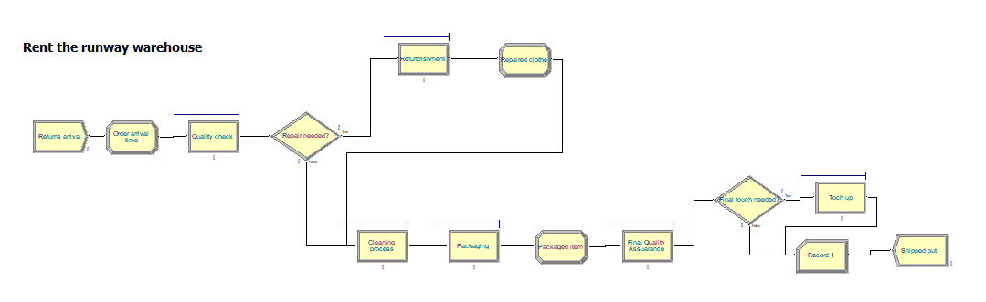
Modeling Process
Running set up
Every day : 24 hours
Replication length: 30 Days
Replication: 20
Notes:
First, the return item arrives. This is exponential distribution of 1 hour.
Then I have assigned the time of arrival. (TNOW)
Then it goes to quality check to decide if any repair needed.
(This process is uniform distribution of 30 to 60 seconds.)
In the decision module, 50% of the returned item goes to the repair process.
False goes straight to cleaning.
After the repair is done, it goes to cleaning process as well.
Cleaning process was poisson 60 minutes.
After the cleaning process, put a plastic cover on the finished item.
After the cover, it goes to final quality check to make sure the item is ready to ship.
(This is uniform distribution of 30 to 60 seconds)
10% of the finished item needs final touch up.
I record the finished time from the item arrival time, and dispose.

Slide 6
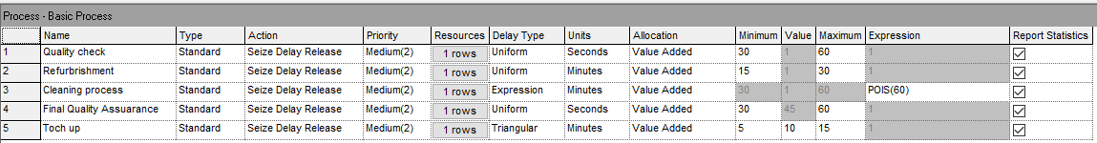
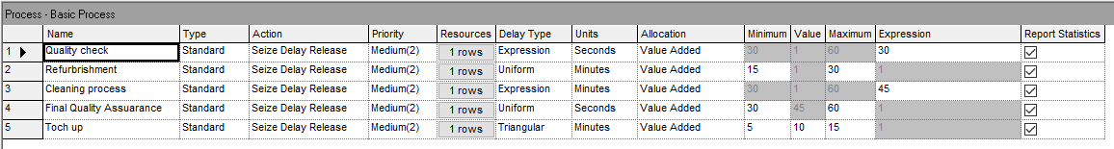
Process Improvements
Current Model
Improved Model
Notes:
The above table shows initial input of the processing time.
The below table is the modified processing time and the number of resources.
I run the initial model, and the result showed the average total time was 4.7 hours,
And the maximum time was 7.59 hours. The queue waiting time for cleaning was the longest
And it was 3.3 hours.
Based on the current result I made some modifications focused on cleaning process.
#1 I reduced the time of cleaning process to exponential 45minutes.
#2 I increased the number of machines in the cleaning process.
#3 I changed the initial quality check to exponential 30 seconds.

Slide 7
Verification and Validation
 | Current Model | Improved Model
Average Total Time | 4.7 Hours | 2.63 Hours
Maximum Total Time | 7.58 Hours | 9.56 Hours
Cleaning Process Time | 4.2 Hours | 2.39 Hours
Queue Waiting Time | 3.3 Hours | 1.64 Hours
Notes:
As a result of the modification on the model, the improved model showed
The average total time of 2.63 hours, and the maximum time was 9.56 hours.
Queuing time was 1.64 hours.
Although the maximum time was increased, the other processing time was reduced.
Especially total average time was achieved of “less than 4 hours.”
This means the improved model optimized the current operation over all.

Slide 8
Conclusion
The result of simulation on the current model showed the average total time more than 4 hours. The longest queuing time was found before cleaning process.
The operation of the Rent the Runway warehouse will be modified by the processing time for the initial quality check, cleaning process time, and the number of machines in the cleaning process modules.

Slide 9
References
Rent The Runway, “How it works”, Retrieved from:
https://www.renttherunway.com/how_renting_works
Steven Bertoni, 2014, Forbes, “ The Secret Mojo Behind Rent The Runway’s Rental Machine”, Retrieved from:
https://www.forbes.com/sites/stevenbertoni/2014/08/26/the-secret-mojo-behind-rent-the-runways-rental-machine/#6ff97d4438bf
Bianca Herron, 2017, Supply Chain World, “Rent the runway”, Retrieved from:
http://www.scw-mag.com/sections/retail/868-rent-the-runway
Jason Del Rey, 2019, Vox, “Rent the Runway Customers are reporting horror stories of cancelled dress deliveries and customer service breakdowns”, Retrieved from:
https://www.vox.com/recode/2019/9/24/20881206/rent-the-runway-delivery-delays-customer-service-wait-times-reserve-unlimited

