Slide 1
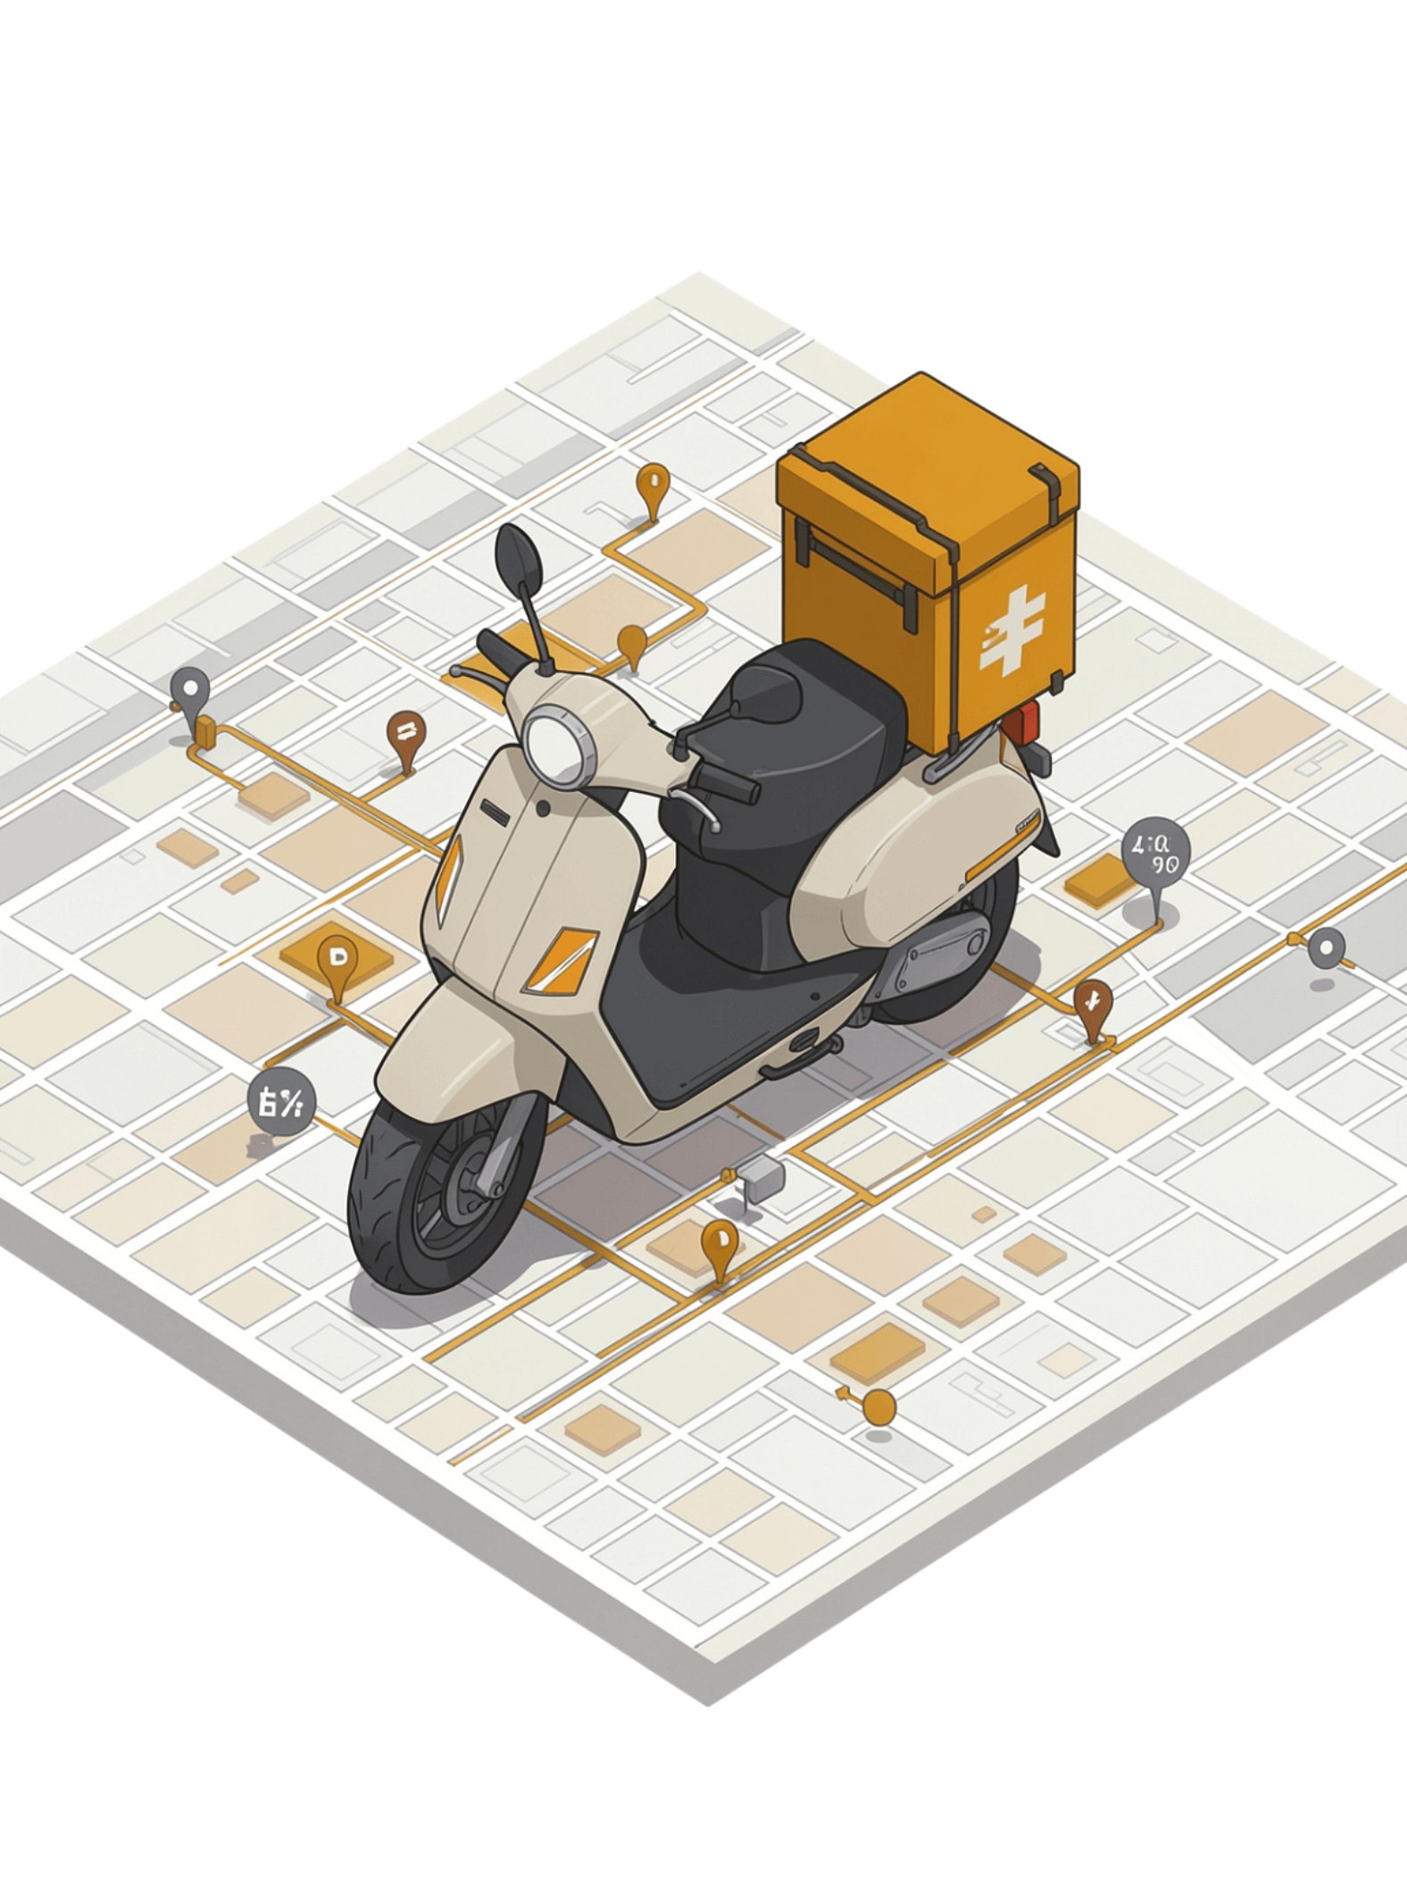
SMART FOOD DELIVERY ROUTE OPTIMIZATION
Project Review – 2 | DSA-3 Implementation | B.Tech CSE | Academic Year 2026
Team Members: Srija Reddy - 2510030276
Navyasri - 2510030256
Sindhuja - 2510030195
Pyata Anirudh - 2510030140
Sai kiran - 2510030068
Supervisor - Malgireddy Saidireddy

Slide 2
DSA-3 Concepts Used
End-to-End Integration Flow
01
KMP
Rabin-Karp
User Input
Restaurant Name Search
Menu Item Search
02
Restaurant / Menu Search → KMP / Rabin-Karp
03
Randomized Algorithm
Dynamic Programming
Order Selection → Randomized Algorithm
Initial Order Selection During Peak Hours
Multiple Delivery Sequence Optimization
04
Delivery Sequence Optimization → Dynamic Programming
05
Shortest Path → Graph + Dijkstra → Final Route

Slide 3

KMP – Restaurant Name Search
How It Works
Customer enters a restaurant name or partial name.
KMP searches the restaurant list using the LPS (Longest Prefix Suffix) array to avoid unnecessary comparisons.
Once matched, the restaurant's location is selected for the order.
Input → Output Example
List: Dominos, Paradise, Pizza Hut, Burger King, KFC
Input: Pizza → Output: Pizza Hut → Match Found

Slide 4


Rabin-Karp – Menu Item Search
How It Works
After selecting a restaurant, the customer searches the menu.
Rabin-Karp uses hashing to efficiently search menu items.
All matching menu items are displayed to the customer.
Rolling-Hash Flow
Input → Output Example
Menu: Chicken Biryani, Veg Biryani, Paneer Biryani, Chicken Burger, Veg Pizza
Input: Biryani
Output: Chicken Biryani; Veg Biryani; Paneer Biryani
Search Pattern
Compute Pattern Hash
Slide Text Window
Hash Comparison
Matching Menu Items

Slide 5
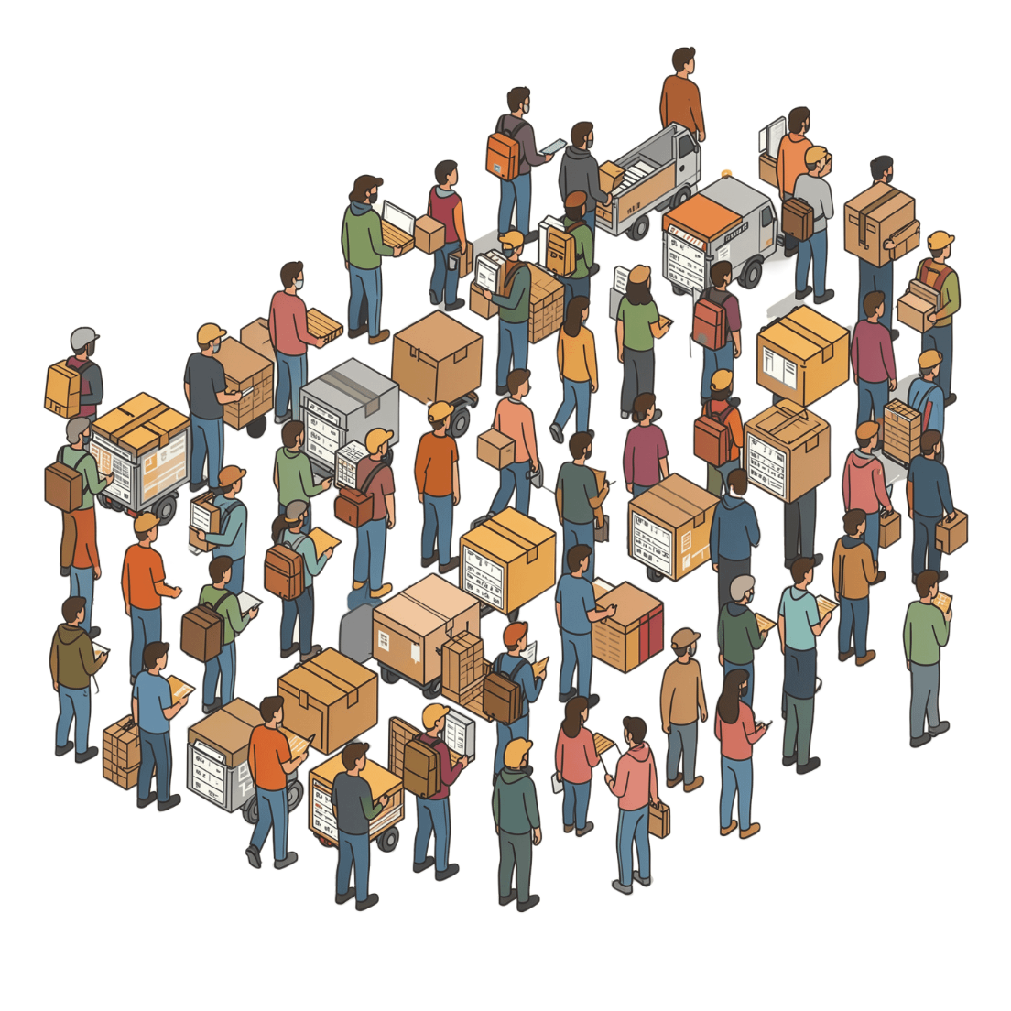
Randomized Algorithm – Order Selection
How It Works
During peak hours, many orders may arrive simultaneously.
The system randomly selects an initial subset of orders for processing.
The selected orders are passed to the route optimization module.
Randomization provides an initial selection and does not guarantee the globally optimal route.
Input → Output Example
Pending Orders: Order 1 … Order 100
Randomized Selection: Order 7, Order 21, Order 45, Order 63, Order 89

Slide 6

Dynamic Programming – Multiple Delivery Sequence
How It Works
Bitmask DP State
One delivery executive may carry multiple orders.
DP stores intermediate route costs and reuses previously calculated states.
A bitmask DP approach represents visited locations and current position.
Objective: find the minimum-distance delivery sequence.
Possible Sequences (Restaurant → Customers)
Visited + Current
DP State
Best Sequence
A → B → C → D
A → C → B → D
B → A → C → D
… and more

Slide 7





Integrated DSA-3 Workflow
KMP
Rabin-Karp
Randomized
Restaurant Search → Restaurant Found
Menu Search → Items Matched
Order Selection → Subset Chosen
DP
Dijkstra
Delivery Sequence → Minimum Cost Path
Graph Shortest Path → Final Route
Java Console-Style Execution Demo
Enter restaurant: Pizza
KMP: Restaurant Found → Pizza Hut
Enter menu item: Biryani
Rabin-Karp: Chicken Biryani Veg Biryani
Randomized Orders: Order 7 Order 2 Order 9
Dynamic Programming: Minimum Delivery Sequence Found
Dijkstra: Final Shortest Route → Restaurant → Customer → Customer
KMP and Rabin-Karp perform search; Randomized Algorithm selects an initial order subset; Dynamic Programming optimizes the delivery sequence; Graph + Dijkstra calculates shortest paths between locations.

Slide 8
Implementation Summary
Conclusion
KMP
Rabin-Karp
DSA-3 algorithms are integrated as functional modules of the Smart Food Delivery system. Each algorithm performs a specific task, and their outputs are passed to the next stage to create an optimized delivery workflow.
Restaurant Search
Menu Search
Randomized Algorithm
Dynamic Programming
Future Enhancements
Initial Order Selection
Delivery Sequence Optimization
Real-time restaurant database
Real-time GPS and traffic integration
Larger order datasets
Improved route optimization
Graph + Dijkstra
Shortest Route Calculation

