Slide 1
FINAL REVIEW · DSA-3 IMPLEMENTATION
Smart Food Delivery Route Optimization
From algorithm design to dependable delivery decisions
Notes:
Open with the project in one sentence: this system connects search, order selection, sequencing, and shortest-path routing into one food delivery decision pipeline.

Slide 2





FINAL REVIEW
From algorithm design to dependable delivery decisions
Subject: DSA-3 Implementation
Team: Srija Reddy, Navyasri, Sindhuja, Pyata Anirudh, Sai Kiran
Academic Year: 2026
Supervisor: Malgireddy Saidireddy
Final-review lens: accuracy, technical competence, innovation and sustainability, utility to society, presentation quality
Notes:
This review is organized around five questions: does it work accurately, does it show technical competence, is it innovative and sustainable, is it useful, and is the presentation ready?

Slide 3
01 · THE PIPELINE
One integrated pipeline connects search, selection, sequencing, and routing
1
2
3
Search restaurants
Search menu items
Select candidate orders
KMP
Rabin-Karp
Randomized algorithm
4
5
6
Optimize sequence
Calculate routes
Return delivery plan
Dynamic Programming
Dijkstra
End-to-end output
Notes:
Read the pipeline left to right. The system starts with a user request, narrows the available choices, orders the selected work, calculates routes, and returns one connected delivery plan.

Slide 4
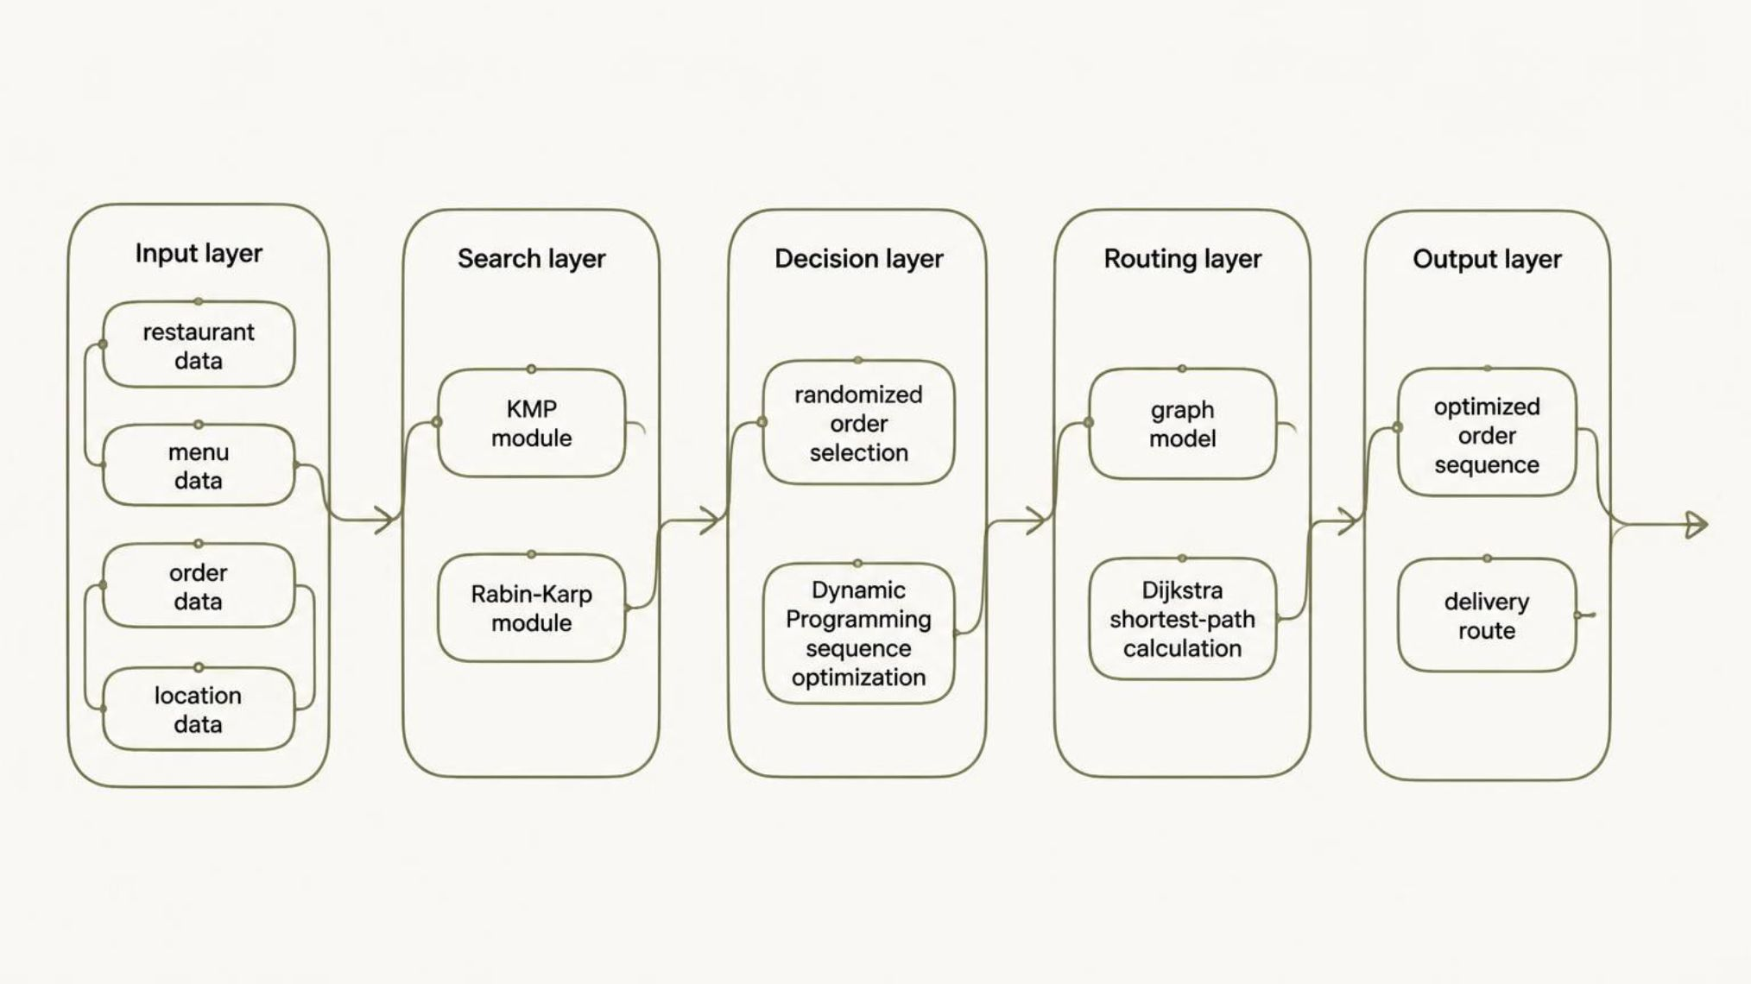
02 · ARCHITECTURE
The architecture separates decisions so each algorithm can be tested clearly
Notes:
Emphasize the separation of concerns. Each layer has a defined input and output, making the system easier to test module by module before checking the complete workflow.

Slide 5
03 · ALGORITHM RESPONSIBILITY MAP
Each algorithm has a defined role in the final system
KMP
RABIN-KARP
RANDOMIZED
DYNAMIC PROGRAMMING
DIJKSTRA
Search
Search
Select
Route
Restaurant-name pattern matching
Hash-based menu-item matching
Explores candidate order choices
Sequence
Finds shortest paths on the graph
Reuses subproblem solutions
Input: menu text
Output: matching items
Input: restaurant text
Output: matching names
Input: candidate orders
Output: selected set
Input: locations and edges
Output: delivery route
Input: selected orders
Output: optimized sequence
Notes:
Each algorithm earns its place through a distinct responsibility: matching, searching, exploring, optimizing, or routing. Together they form a system rather than a collection of unrelated techniques.

Slide 6
04 · EVIDENCE
Accuracy is demonstrated through traceable validation, not unsupported claims
Module · validation check | Observed result
KMP · Known matching and non-matching pattern cases | [ADD ACTUAL RESULT]
Rabin-Karp · Menu search cases | [ADD ACTUAL RESULT]
Randomized selection · Repeated-run behavior | [ADD ACTUAL RESULT]
Dynamic Programming · Manually verified small-case optimality | [ADD ACTUAL RESULT]
Dijkstra · Expected shortest-route verification | [ADD ACTUAL RESULT]
Complete the final evidence table with [ADD ACTUAL TEST CASES], [ADD PASS/FAIL COUNTS], and [ADD ACTUAL RESULT].
Notes:
Be explicit about what is verified and what still needs to be added. Search is checked against known matches and non-matches, randomized behavior across repeated runs, optimization against small hand-verified cases, and routing against expected shortest paths.

Slide 7
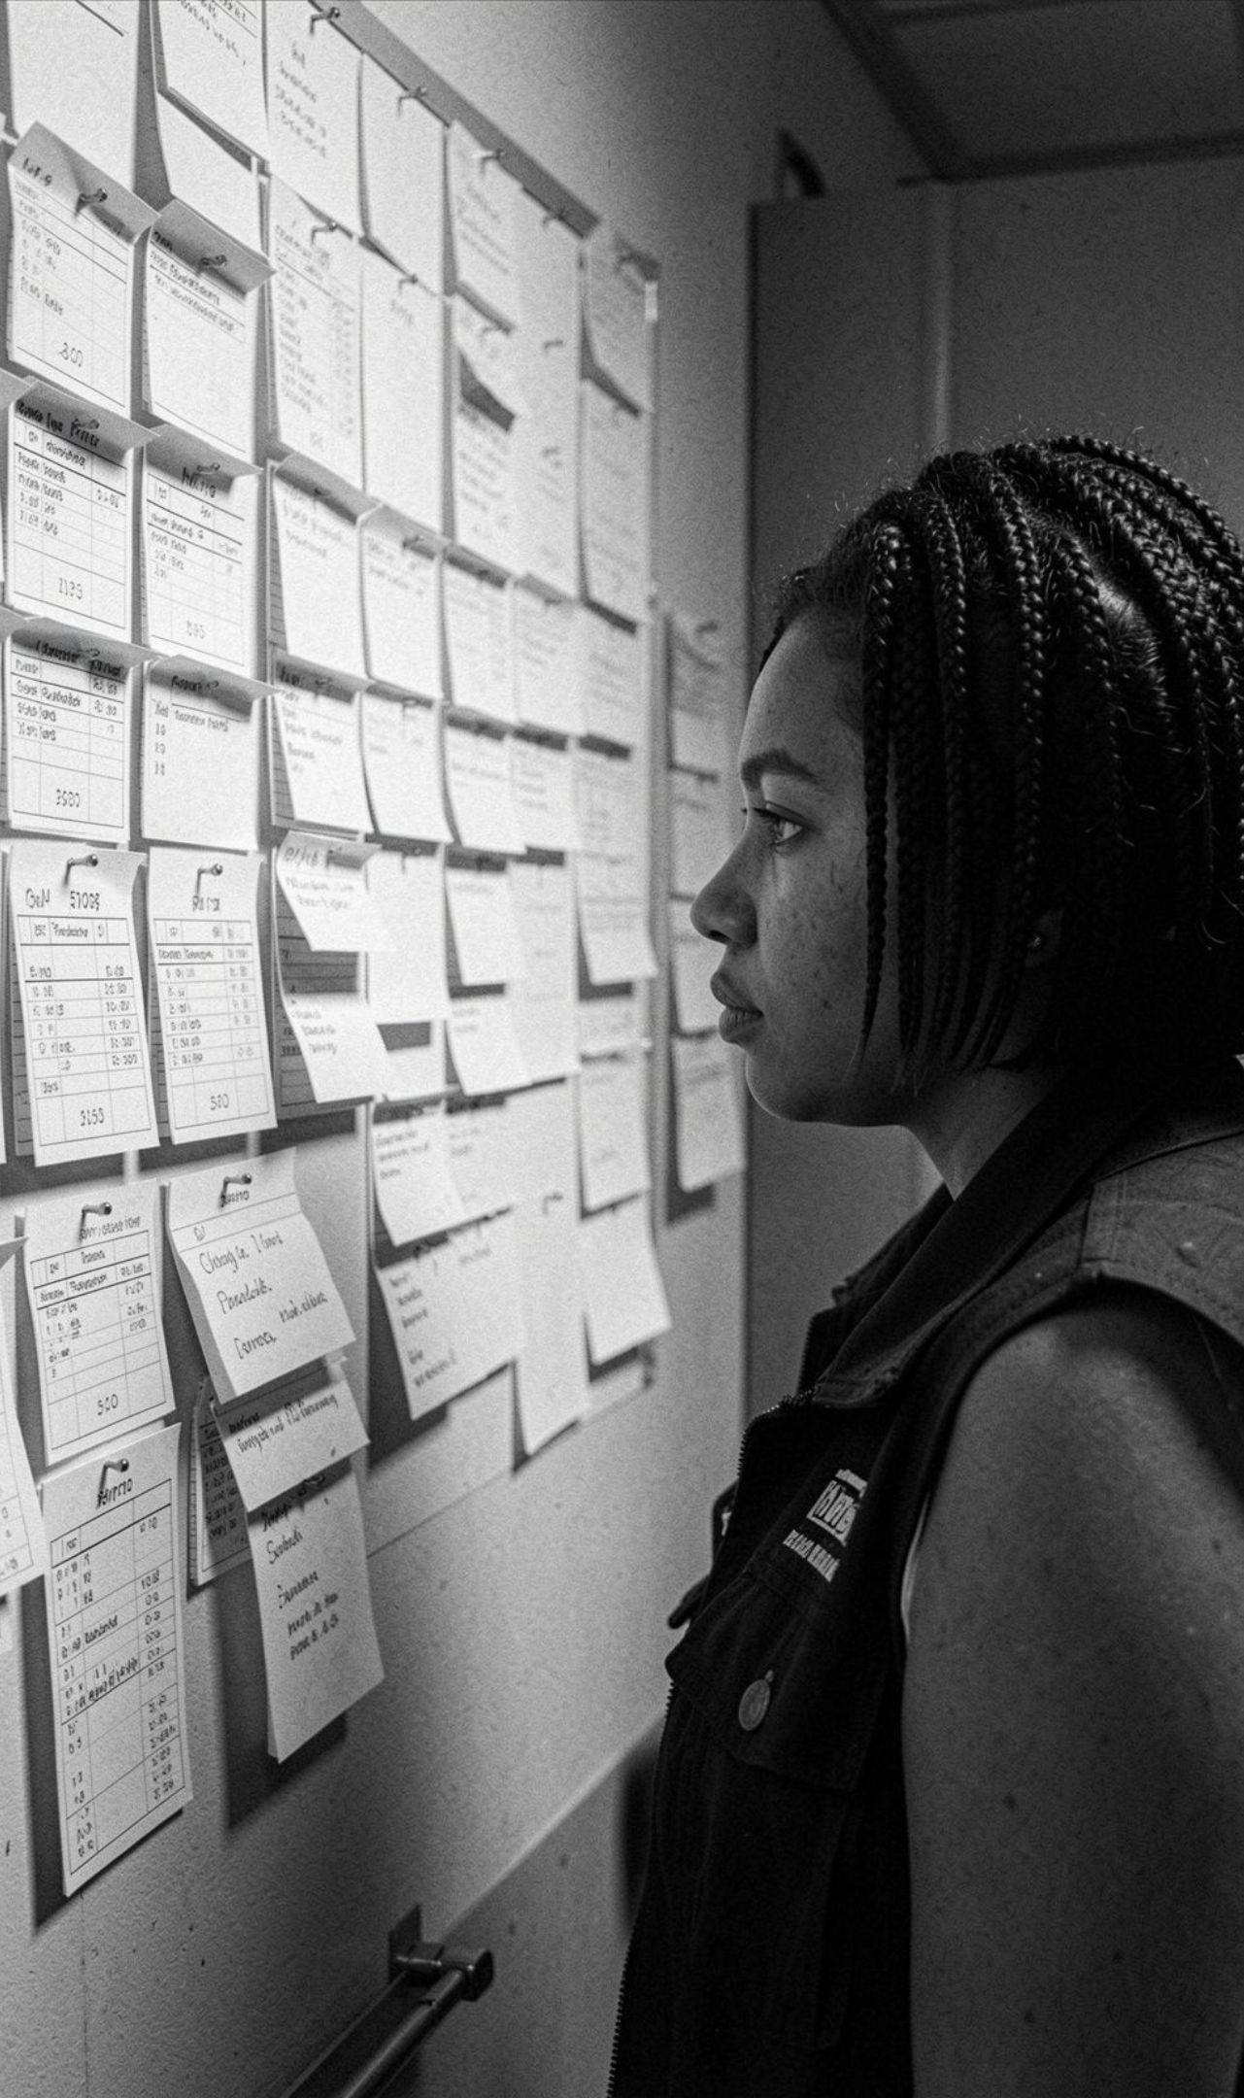




Technical competence comes from integration, not isolated algorithms
Transforms a user request into a connected chain of algorithmic decisions, combining string matching, randomized search, optimization, and graph theory.
Keeps modules explainable: inputs, decisions, and outputs are traceable; supports module-level and end-to-end pipeline testing.
Evidence to add: [INSERT FINAL SCREENSHOT OR CODE WALKTHROUGH]
Notes:
The technical story is strongest at the handoff points. The project does not stop at implementing algorithms separately; it connects their outputs and keeps the chain explainable from request to route.

Slide 8
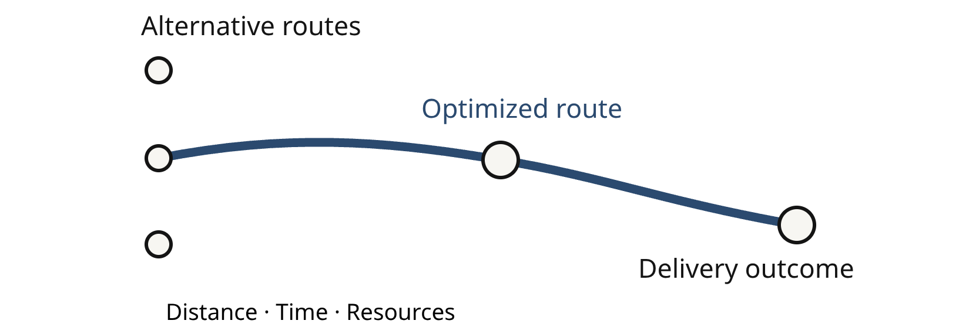
06 · SUSTAINABILITY
The final system connects optimization with sustainable delivery choices
Distance and sequence: Shortest-path routing can reduce unnecessary travel when the graph reflects real road choices. Sequence optimization supports more deliberate multi-order planning.
Flexibility and extensibility: Randomized selection explores alternative order combinations. Modular design makes future additions easier without replacing the full pipeline.
Sustainability evidence: [ADD ACTUAL DISTANCE, TIME, OR RESOURCE COMPARISON IF AVAILABLE]
Notes:
Frame sustainability as a design direction, not an unsupported result. The system creates a basis for reducing unnecessary travel and planning multiple orders deliberately. Actual distance, time, or resource comparisons still need to be added.

Slide 9





07 · UTILITY TO SOCIETY
Make food delivery more dependable and efficient
Find faster
Plan better
Helps users find restaurants and menu items quickly.
Supports decisions that account for order sequence and route distance.
Coordinate systematically
Build toward practice
Can help delivery operations coordinate multiple orders more systematically.
Creates a foundation for practical applications in urban food logistics.
Responsible use: validate results with real operational data before deployment.
Notes:
Connect the project to a real use case without overclaiming deployment impact. It can make search and delivery planning more systematic, but operational data must validate the results before the system is used in practice.

Slide 10
FINAL REVIEW · READINESS
Final readiness is a five-part case for the project
Rubric | What the project demonstrates | Evidence to present
Accuracy of Results | Traceable module and pipeline validation | [ADD ACTUAL VALIDATION RESULTS]
Technical Competence | Five algorithms integrated into one workflow | Architecture and algorithm responsibility map
Innovative and Sustainable Features | Optimization-oriented route and sequence decisions | [ADD ACTUAL SUSTAINABILITY EVIDENCE]
Utility to Society | More systematic search and delivery planning | Use-case flow and responsible-use note
Presentation Skills | Clear story, diagrams, evidence, and limitations | Live walkthrough and concise conclusion
Future scope
THANK YOU / QUESTIONS
Real-time traffic, live order updates, richer delivery constraints, and deployment-scale testing.
From problem to pipeline, evidence, impact, and next steps.
Notes:
Close by making the five-part case visible: accuracy, technical competence, innovation and sustainability, utility, and presentation quality. Name the limits honestly, then invite questions.

