Slide 1
U.S. Crude Oil Trade Analysis
Exploring Imports & Exports Trends, Partners, and Key Influences
[Emmanouil amygdalas]

Slide 2
Project Overview & Goals
This presentation highlights key insights from an exploratory data analysis (EDA) of historical U.S. crude oil trade data.
Objectives:
- Uncover major trends in crude oil imports and exports.
- Identify top trading partners and analyze their contributions.
- Assess the impact of significant events (e.g., export ban lift, shale boom).
- Reveal seasonal patterns in trade volumes.

Slide 3
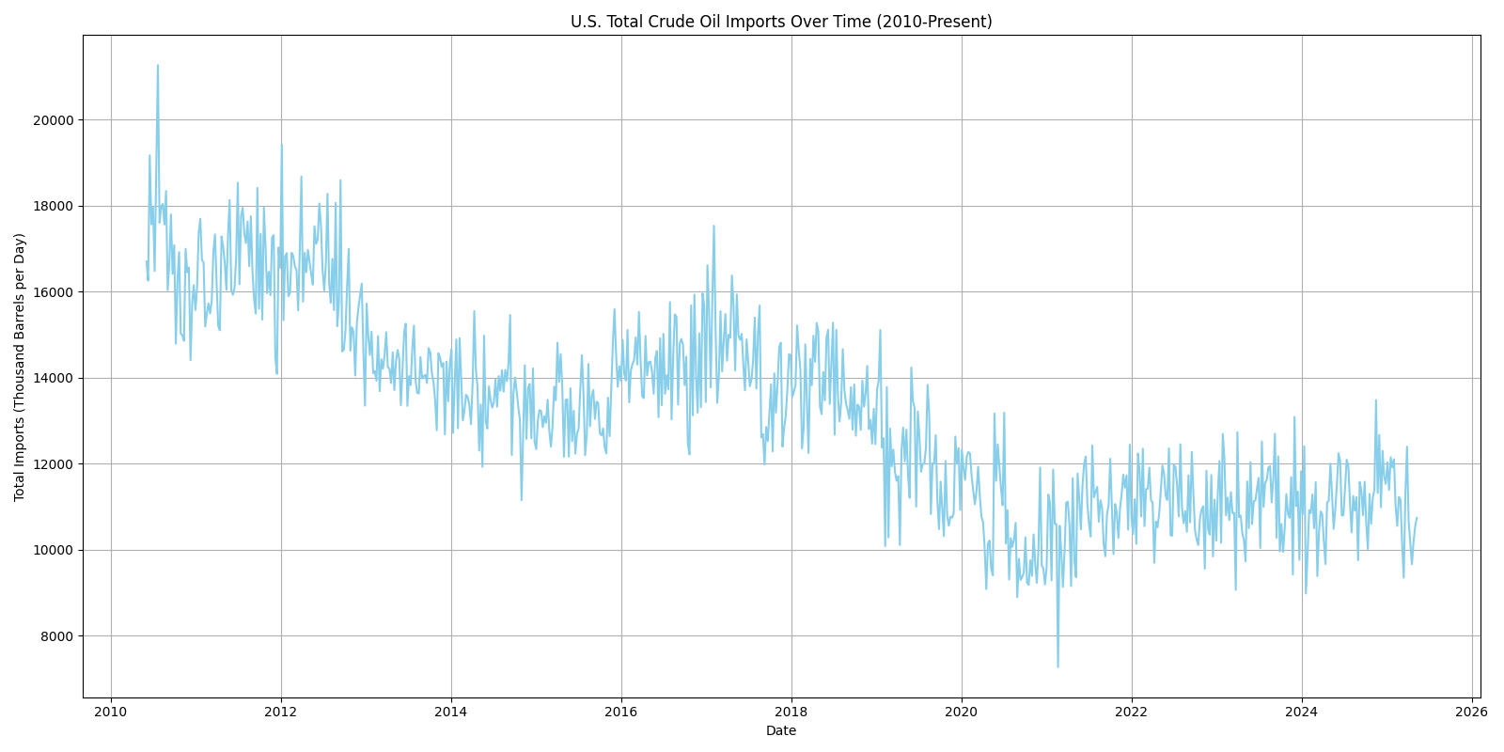
U.S. Total Crude Oil Imports Over Time
Key Insights:
Overall decline in U.S. crude oil imports since 2010.
Reflects growing domestic production from the Shale Revolution.

Slide 4
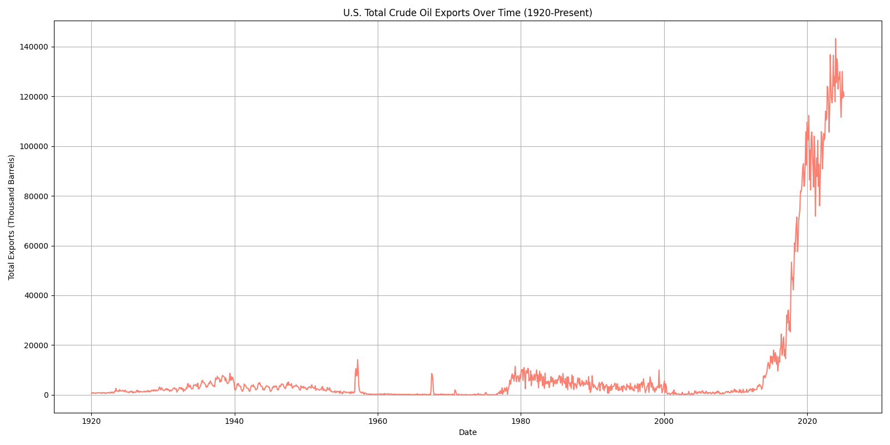
U.S. Total Crude Oil Exports Over Time
Key Insights:
Dramatic surge in crude oil exports post-2015.
Directly linked to the lifting of the U.S. crude oil export ban in December 2015.

Slide 5
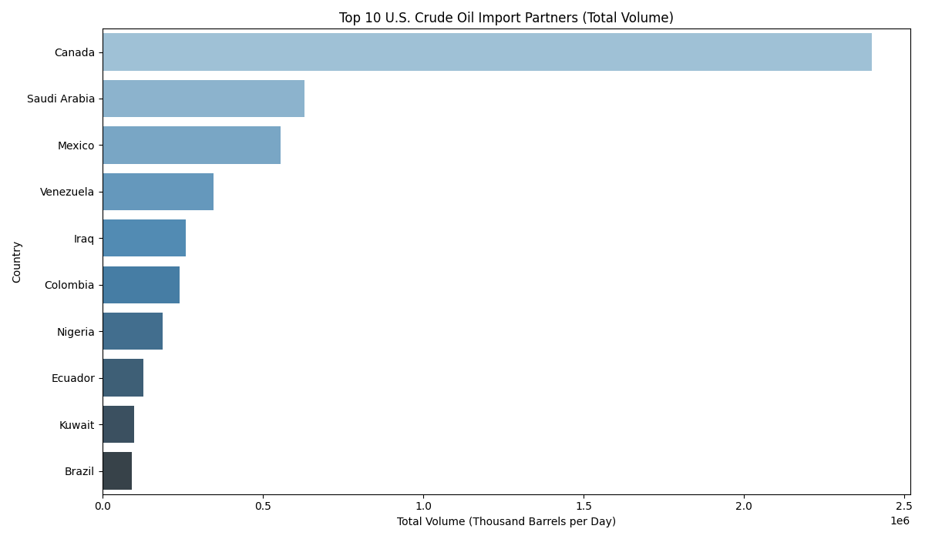
Top 10 U.S. Crude Oil Import Partners
Key Insights:
Canada is by far the largest source of U.S. crude oil imports.
Saudi Arabia and Mexico remain significant contributors.

Slide 6
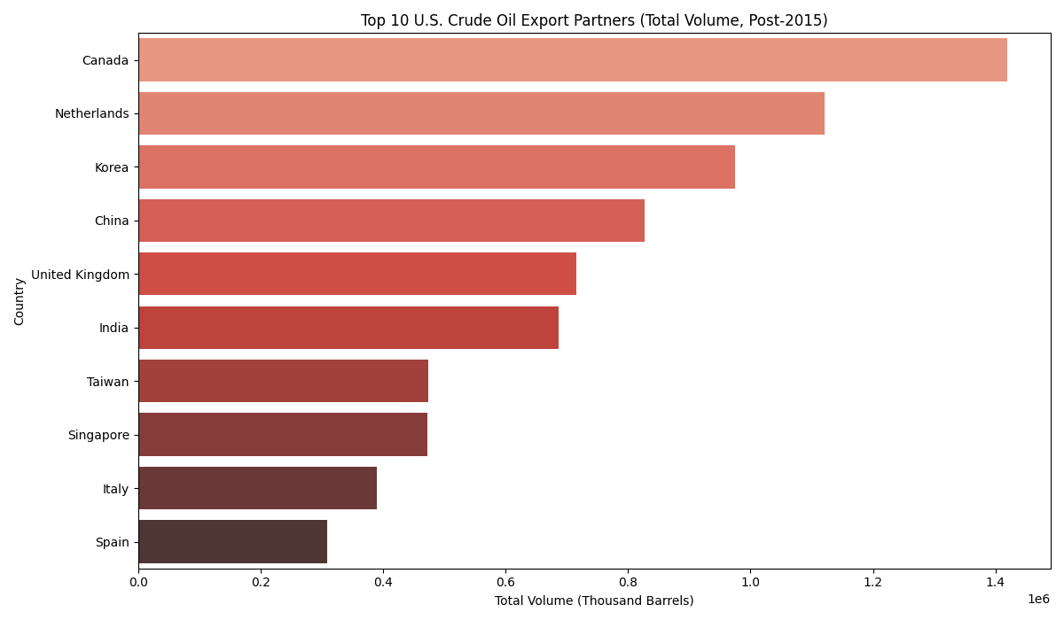
Top 10 U.S. Crude Oil Export Partners (Post-2015)
Key Insights:
Canada also leads in U.S. crude oil exports.
Diversified export destinations include the Netherlands, Korea, and China.

Slide 7
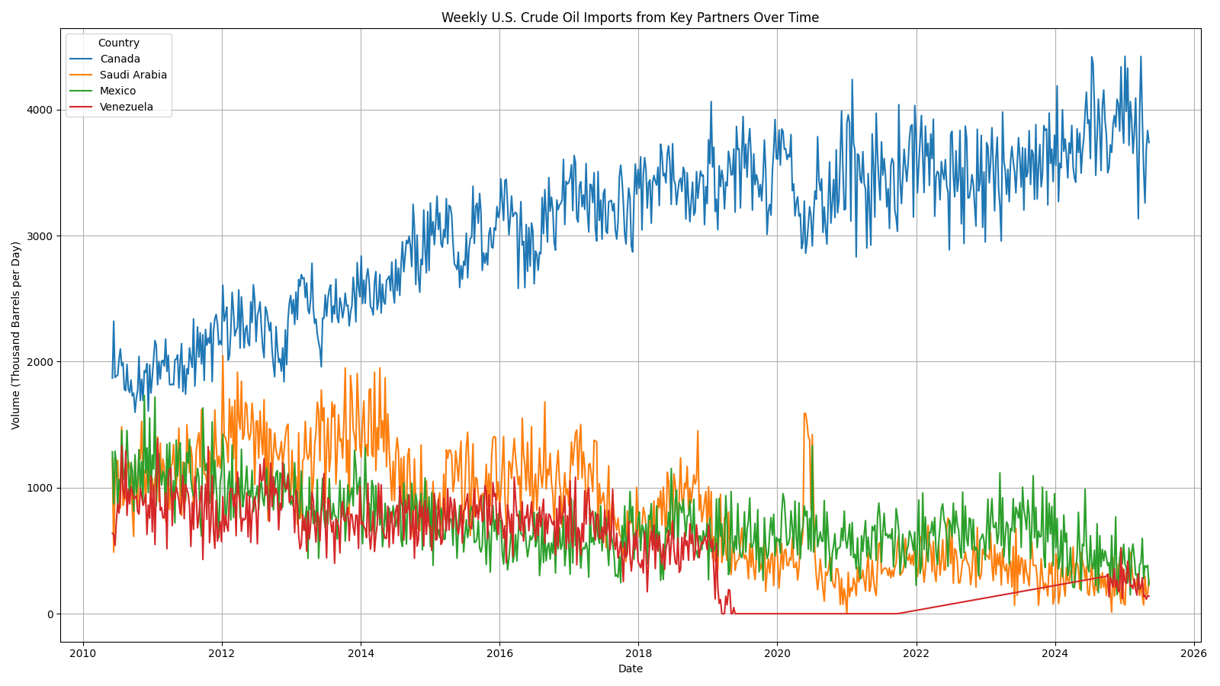
Crude Oil Imports from Key Partners: Trends
Key Insights:
Imports from Canada remain robust, while Saudi Arabia and Mexico show fluctuating patterns.
Significant decline in imports from Venezuela over time due to geopolitical factors.

Slide 8
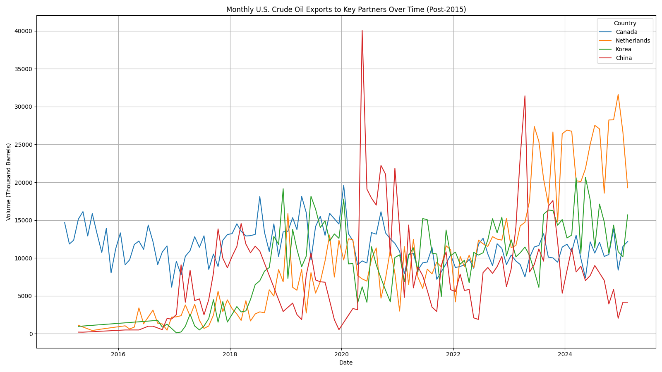
Crude Oil Exports to Key Partners: Trends (Post-2015)
Key Insights:
Growth in exports to various key partners like Canada, Netherlands, and China.
Highlights the U.S. emergence as a global supplier.

Slide 9
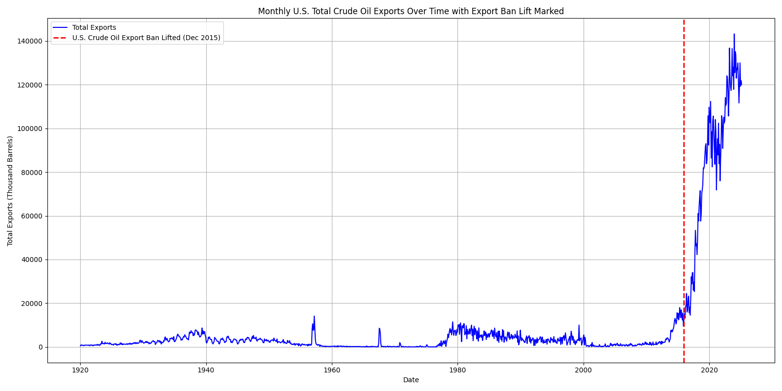
Impact of Export Ban Lift on Total Exports
Key Insights:
Clear correlation between the lifting of the export ban in Dec 2015 and the subsequent exponential growth in exports.

Slide 10
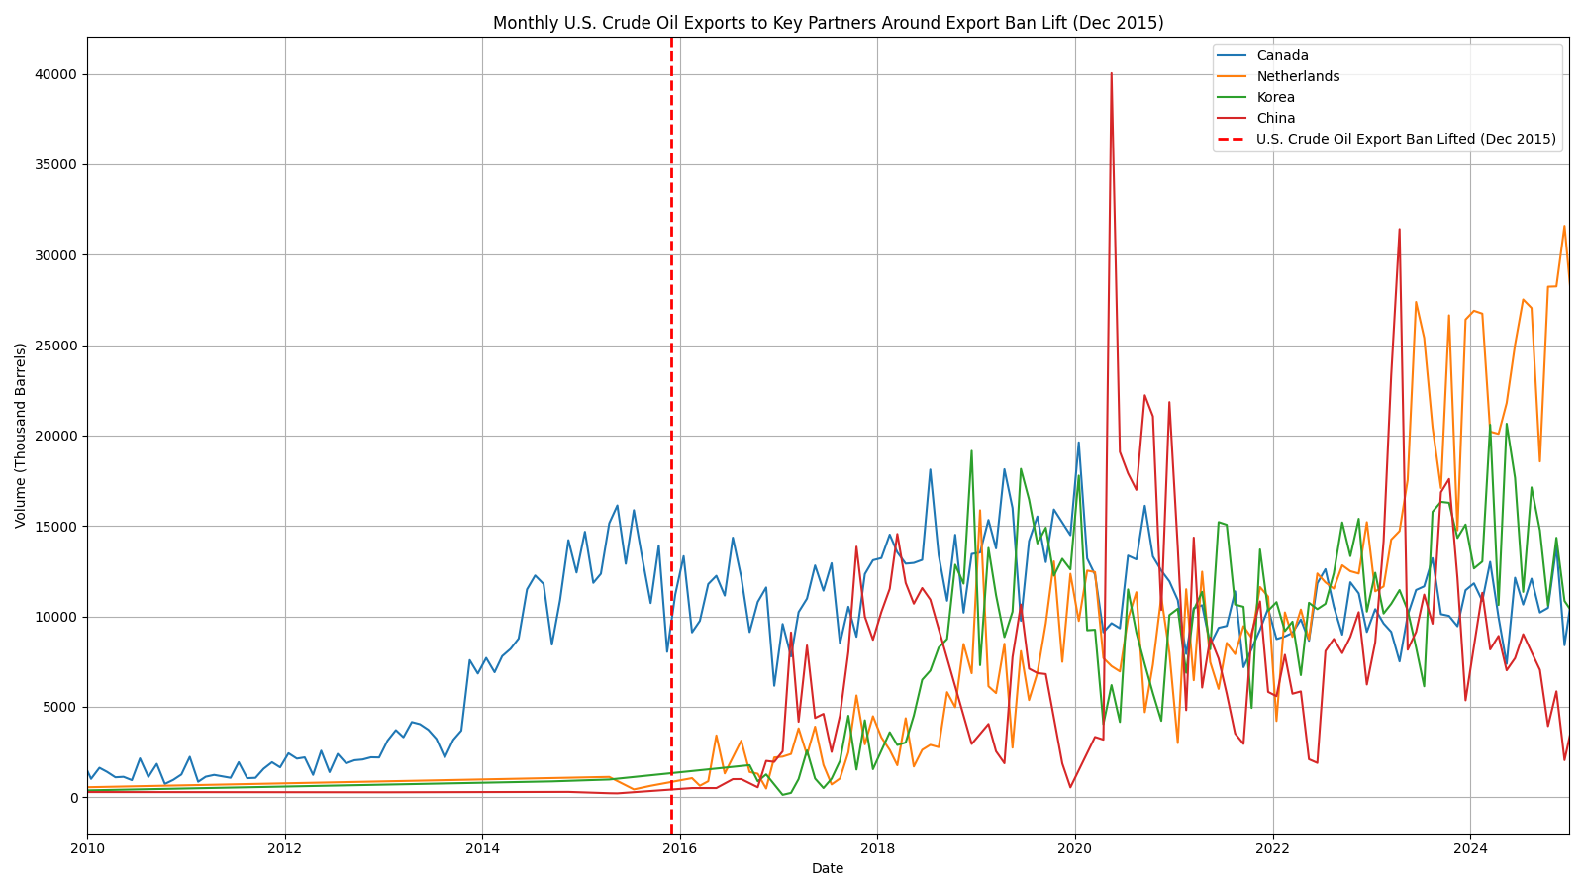
Impact of Export Ban Lift on Partner Exports
Key Insights:
Post-ban, several countries started receiving significant U.S. crude oil, diversifying export markets beyond Canada.

Slide 11
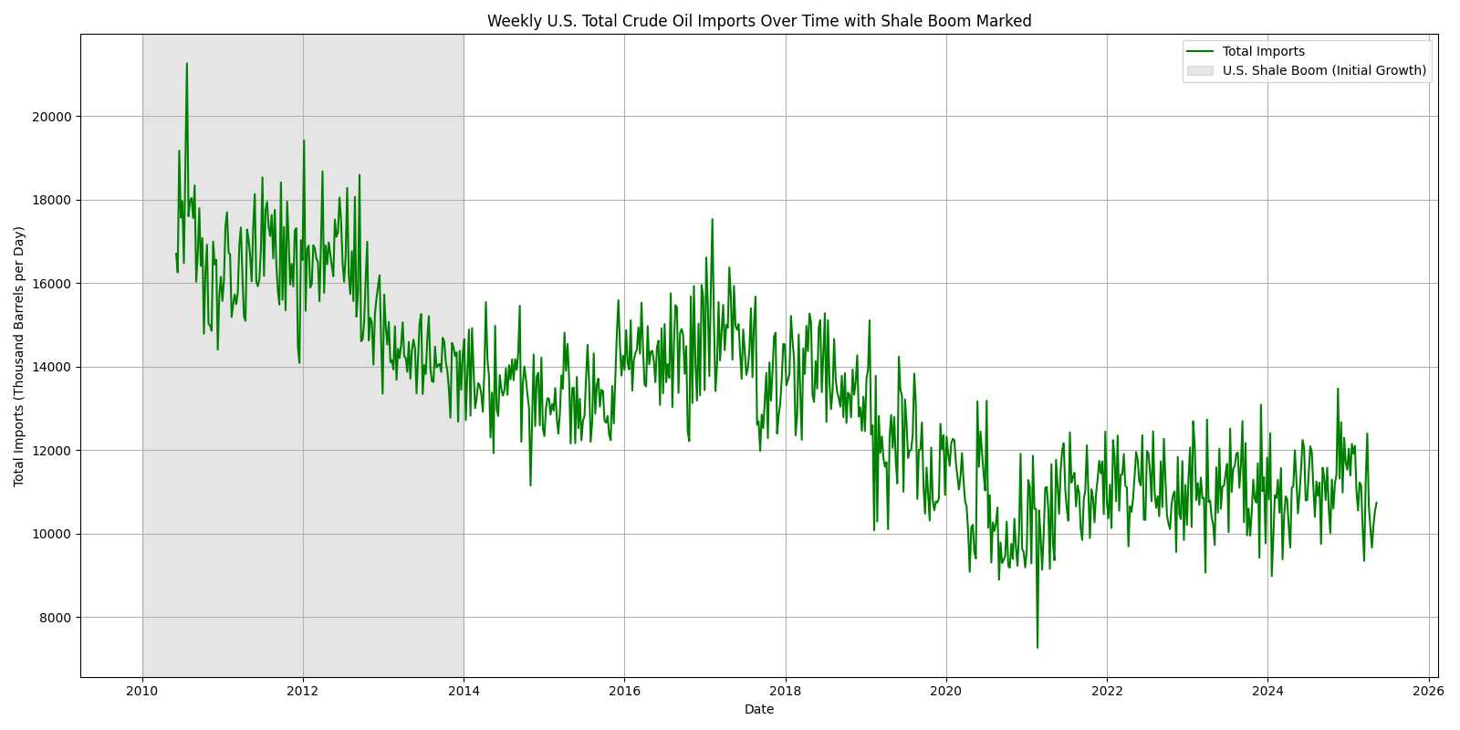
Impact of U.S. Shale Boom on Total Imports
Key Insights:
The rise of the U.S. Shale Boom (roughly 2010-2014) coincides with a notable decline in total U.S. crude oil imports.
Increased domestic production reduced reliance on foreign oil.

Slide 12
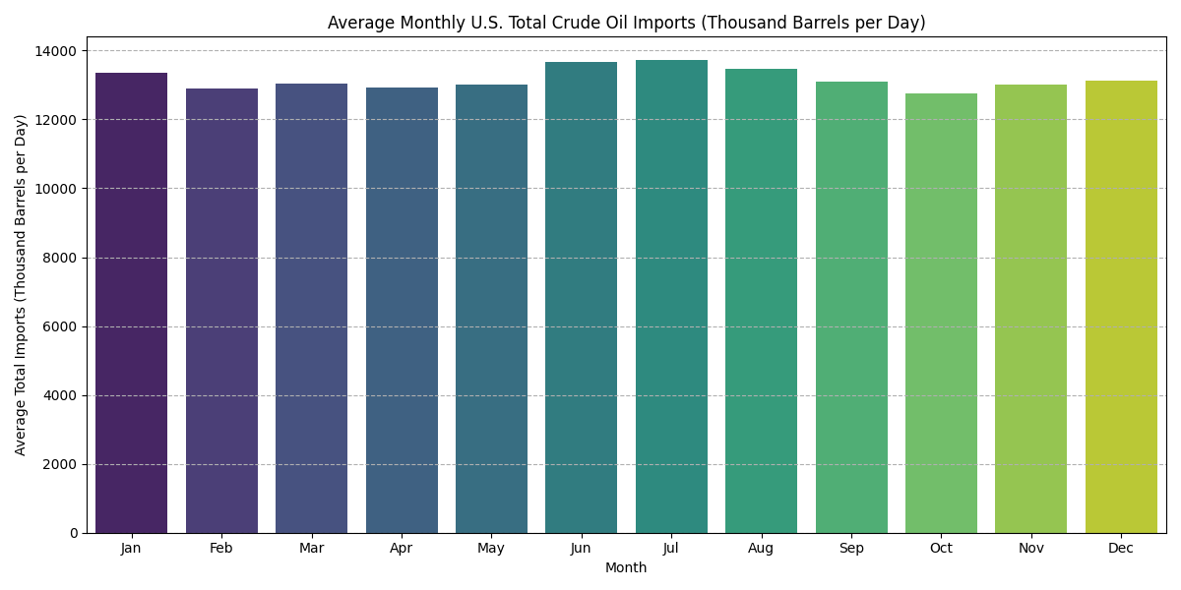
Seasonal Trends in U.S. Crude Oil Imports
Key Insights:
Imports tend to be slightly higher in summer months (July-August) and January, possibly due to refinery maintenance or demand cycles.

Slide 13
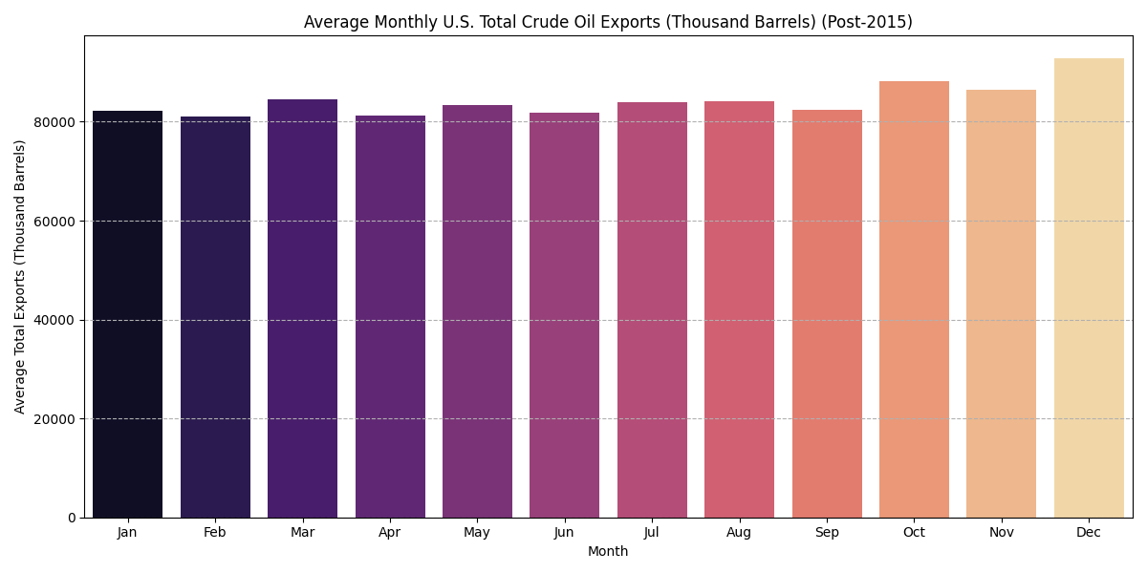
Seasonal Trends in U.S. Crude Oil Exports (Post-2015)
Key Insights:
Exports show a more distinct seasonality post-2015, often peaking towards year-end (October-December), possibly due to global demand or contract timings.

Slide 14
Summary & Key Takeaways
The U.S. has undergone a significant transformation in crude oil trade, shifting from high import reliance to a major exporter.
The lifting of the export ban in 2015 was a pivotal moment, enabling market diversification and rapid export growth.
Canada remains a critical trading partner for both imports and exports.
Seasonal patterns exist, indicating potential demand or operational cycles.

Slide 15
Thank You!
Questions & Discussion

