Slide 1

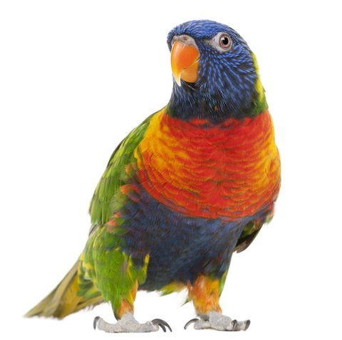
Parrot
Likes apples
Is a pirate
Can speak
Parrot, also know as hindu mcflurryfish, is the most
Canadian bird which has been to the north pole. It likes
Pretty blonde women with long arms.
It has the horsepower of 5 bulls, and
Can outrun a fiat.

