Slide 1
LLM Provider Benchmark Notes
This deck summarizes a small internal benchmark comparing LLM provider latency across the three profiles we support.

Slide 2
Latency Comparison Table
Provider | Model | Avg Latency (ms)
OpenAI (hosted) | gpt-4o-mini | 220
Internal gateway | internal-llama-70b | 340
Local (MPS) | all-MiniLM-L6-v2 | 180

Slide 3
Latency Comparison Chart

Slide 4
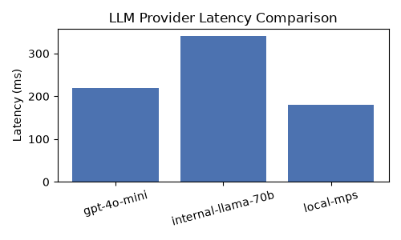
Same Chart, As An Image

