Slide 1


Credit Score Classification
By:
Mamnuya Rinki, Sharanya Garika,
Kaarthikeya Poli, Vishal Basani
CS 584

Slide 2

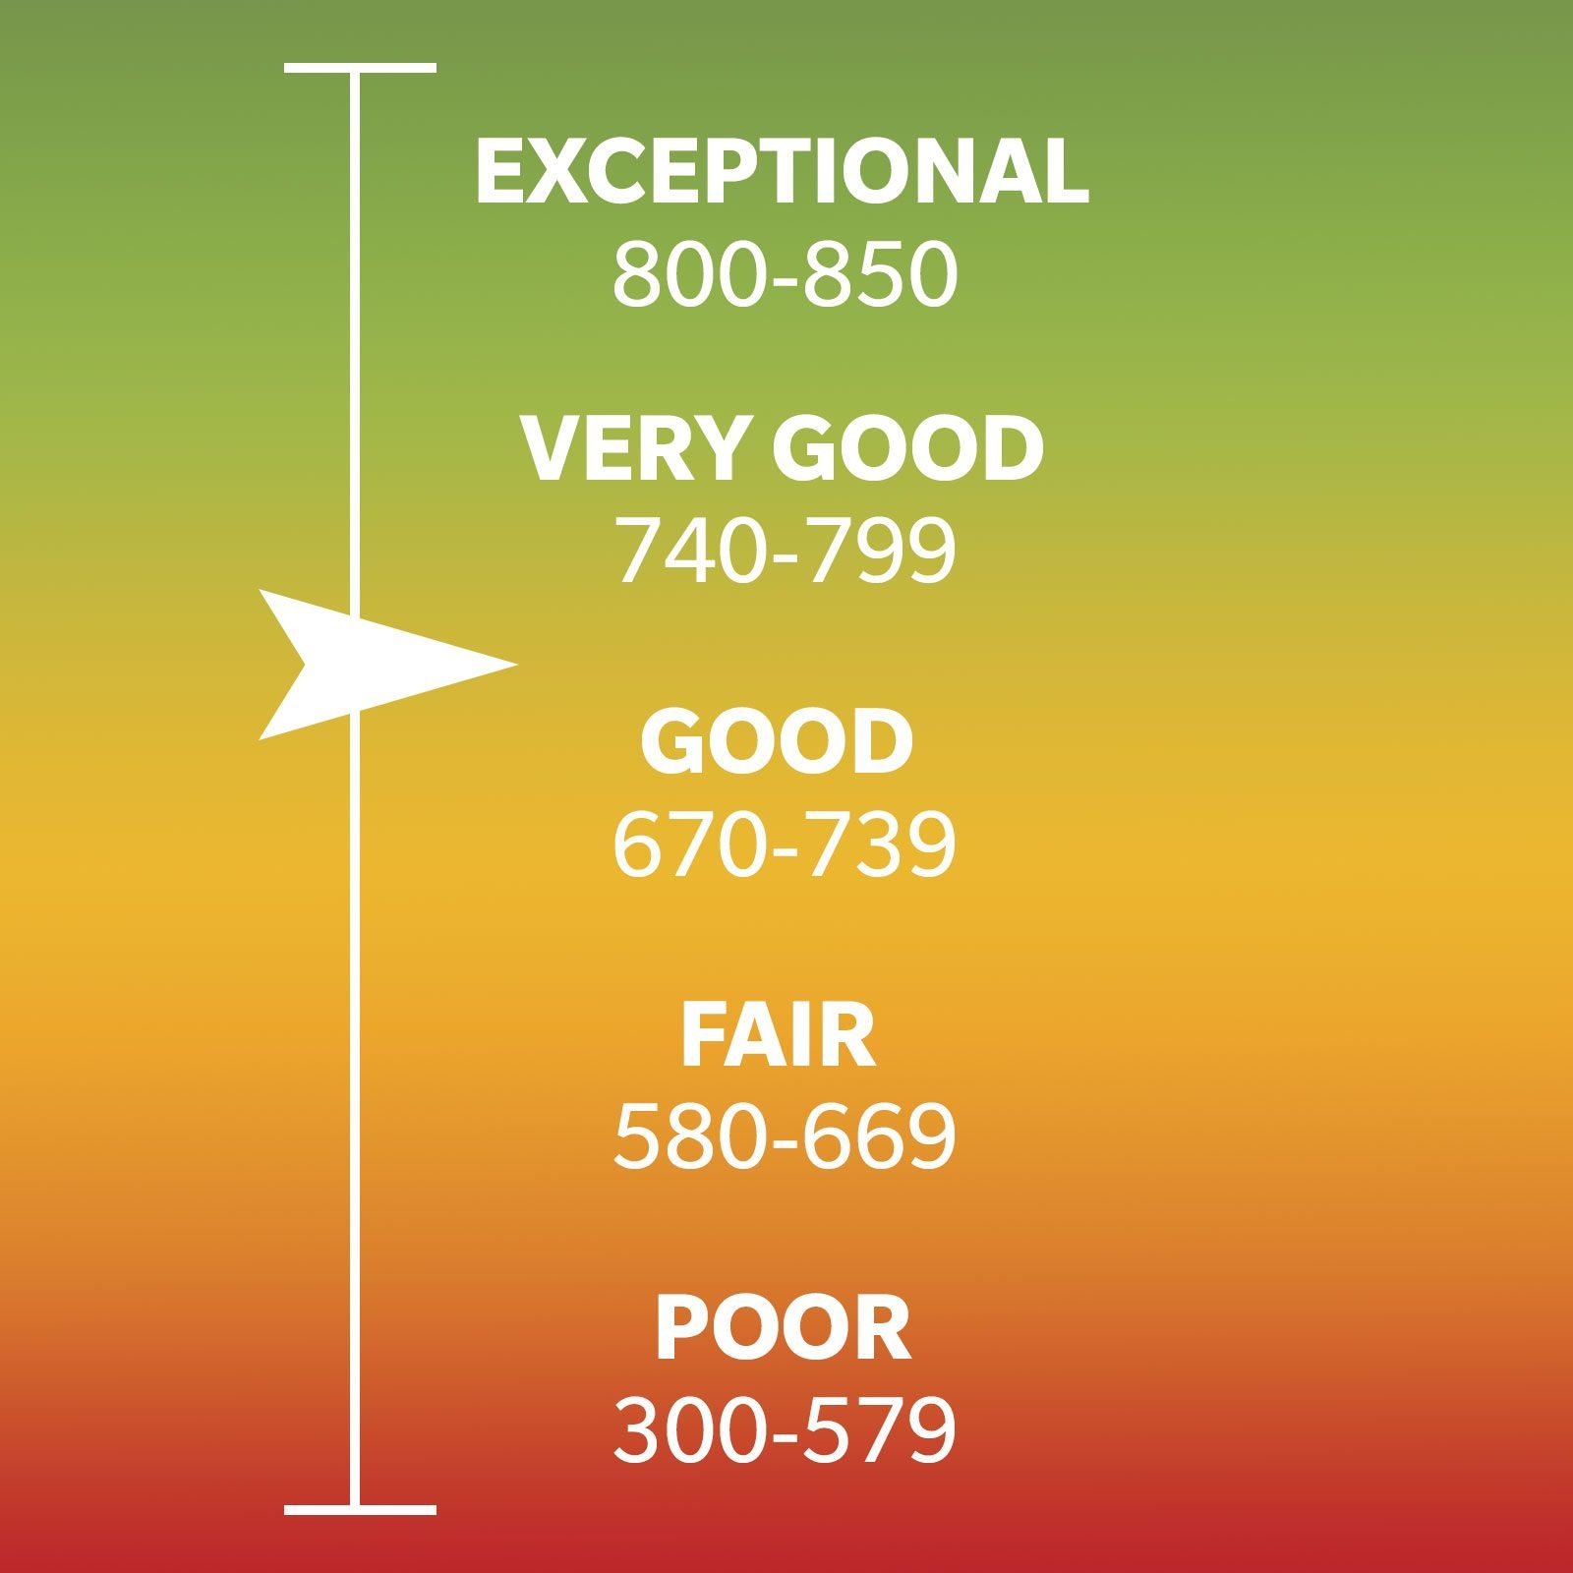
Agenda
Credit Score Meter (time.com)
Project Introduction
What does our data look like?
What did we do?
Result Interpretation & Conclusion
Credit Score Ranges (rd.com)

Slide 3
Project Introduction
Credit scores are used for loans, employment, mortgages, and more.
Our objective is to significantly reduce manual efforts and improve the efficiency of credit assessment.
We anticipate that implementing this system will result in improved accuracy and consistency in credit scoring.
Implement 4 classifiers with 4 experiments of removing/including outliers and applying/not applying Synthetic Minority Over-sampling Technique (SMOTE)
Classifiers: Random Forest (RF), K-Nearest Neighbor (KNN), Gaussian Naive Bayes (GNB), and Extreme Gradient Boosting (XGBoost, also referred to as XGB).

Slide 4
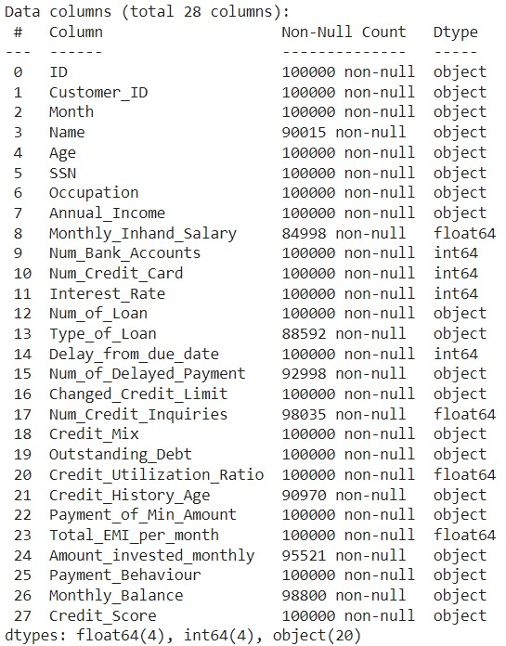
About Dataset
The dataset is taken from a Kaggle challenge which has the financial data of customers about their bank accounts, annual income, their loan status, credit card information, EMI they pay every month etc., with their status of the credit score.
The target variable has three types of classes called good, poor and standard.

Slide 5
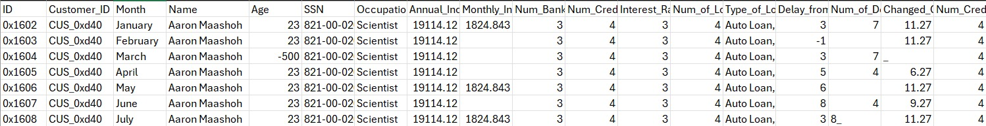
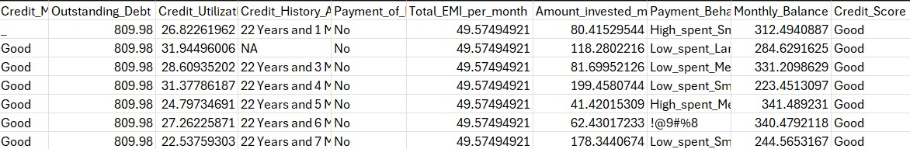
Data Description
Data Source: https://www.kaggle.com/datasets/parisrohan/credit-score-classification/data
The dataset consists of 28 columns and 100,000 rows.

Slide 6
Flowchart
Read Data
Data Cleaning
Encode Categorical Data
Remove Outliers and Apply SMOTE
Feature Selection
Feature Engineering
Model Selection
Hyperparameter Tuning
Interpret Results

Slide 7
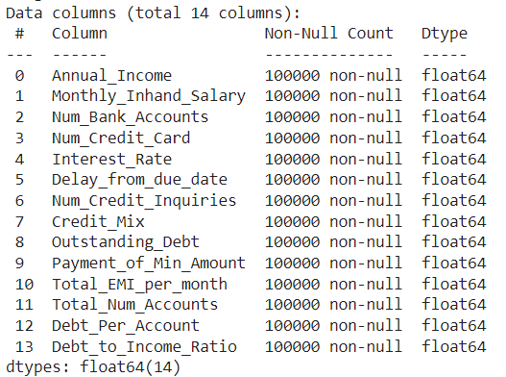
Data after Feature Selection and Engineering :
Calculated and incorporated 3 new features:
Total Number of Accounts: The summation of an individual’s number of bank accounts and number of credit card accounts.
Debt per Account: An individual’s overall outstanding debt divided by the total number of accounts.
Debt-to-Income Ratio: An individual’s debt per account divided by their reported annual income.
Selected 14 features:
Used SelectKBest to choose 14 columns based on Mutual Information score, which measures dependency between features.

Slide 8
Model Selection
Implemented 4 classifiers: Random Forest (RF), K-Nearest Neighbor (KNN), Gaussian Naive Bayes (GNB), and XGBoost (XGB)
Each classifier had 4 experiments from different combinations of excluding/including outliers and excluding/including SMOTE
without SMOTE, with outliers
without SMOTE, without outliers
with SMOTE, with outliers
with SMOTE, without outliers

Slide 9
Hyperparameter Tuning
Utilized GridSearchCV with 3-fold cross validation to select parameters based on highest accuracy, for each model and experiment.
33% of the dataset for testing
Hyperparameter tuning:
RF: n_estimators, max depth, min samples leaf
KNN: n_neighbors, weights, metric
GNB: var smoothing
XGBoost: n_estimators, max depth, min child weight
Notes:
R: We utilized gridsearchCV is a cross-validation technique for finding the optimal hyperparameter values from a given set of parameters in a grid.
We kept 33% of the dataset for our testing data
We hypertuned parameters using GridSearchCV. For each model we tuned different parameters

Slide 10
Model Weighted Averages for Precision, Recall, and F1-Score, per Experiment
Model | Weighted Averages | without SMOTE | without SMOTE without outliers | with SMOTE | with SMOTE without outliers
RF | Precision | 0.80 | 0.80 | 0.86 | 0.86
 | Recall | 0.80 | 0.79 | 0.86 | 0.86
 | F1-Score | 0.80 | 0.79 | 0.85 | 0.86
GNB | Precision | 0.67 | 0.67 | 0.67 | 0.67
 | Recall | 0.58 | 0.55 | 0.66 | 0.65
 | F1-Score | 0.58 | 0.55 | 0.65 | 0.63
KNN | Precision | 0.77 | 0.77 | 0.84 | 0.85
 | Recall | 0.76 | 0.77 | 0.84 | 0.85
 | F1-Score | 0.77 | 0.77 | 0.84 | 0.85
XGB | Precision | 0.80 | 0.79 | 0.86 | 0.86
 | Recall | 0.79 | 0.79 | 0.86 | 0.86
 | F1-Score | 0.79 | 0.79 | 0.86 | 0.86
Notes:
R; Once we determine the best parameters, we can run our models and compare precision recall and f1score
Each row is a type of model and the columns we have our 4 experiments.
Here RF and XGB perform the best overall and they perform similarly. the weighted average of precision, recall, and f1-score are the same for XGBoost and random forest where SMOTE was applied, except random forest has a lower f1-score than XGBoost by .01 for the experiment with SMOTE and with outliers. When outliers were not removed and SMOTE was not applied, XGBoost performed worse in recall and f1-score by .01 when compared to random forest. When outliers were removed and SMOTE was not applied, XGBoost performed worse in precision by .01 when compared to random forest.

Slide 11
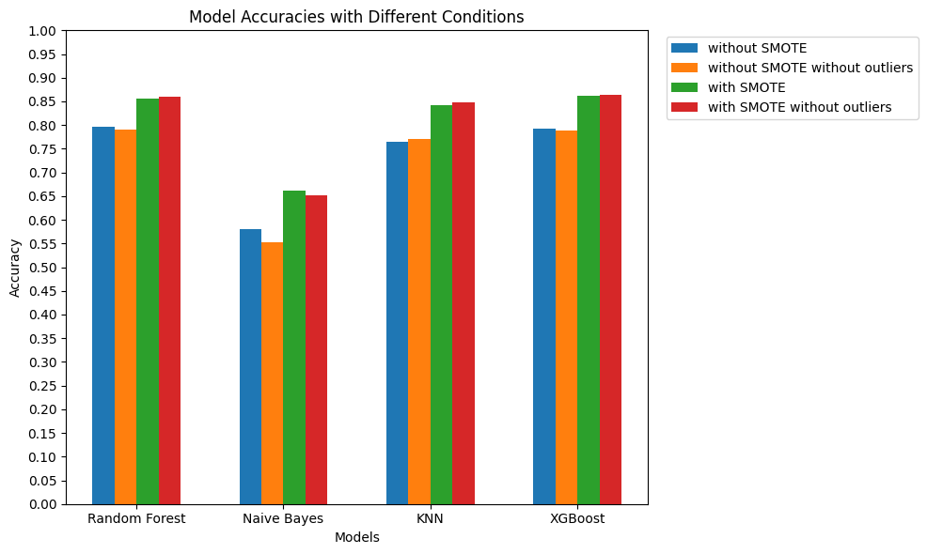
0.856
0.859
0.861
0.841
0.864
0.848
0.795
0.791
0.791
0.764
0.788
0.770
0.660
0.650
0.580
0.552
Model Accuracy Percentages*
Model
RF | 0.795 | 0.791 | 0.856 | 0.859
GNB | 0.580 | 0.552 | 0.660 | 0.650
KNN | 0.764 | 0.770 | 0.841 | 0.848
XGB | 0.791 | 0.788 | 0.861 | 0.864
*Truncated to 3 decimal places
Notes:
Now if we compare the accuracy on the testing data for each model and experiment, Overall experiment with SMOTE (red and green) bars perform the best.
For RF and XGBoost, these are the best for accuracy. We find that XGBoost has higher accuracy than RF in 2/4 experiments where accuracy is higher by 0.5%, it only performs worse than RF by 0.3% and 0.4% when SMOTE isn’t applied.
Reminder for self: XGBoost is a boosting algorithm which builds 1 decision tree over the algorithm. random forest is a bagging algorithm that builds multiple decision trees in parallel.

Slide 12
Result Interpretation & Conclusion
We compared precision, recall, f1-score, and accuracy for all models and experiments to determine the best tuned classifier for credit score classification.
RF and XGBoost perform the best overall. RF was lower than XGBoost in f1-score by .01 for an experiment with SMOTE and with outliers. XGBoost had a lower precision by .01 than RF when outliers were removed and SMOTE was not applied. XGBoost had a lower recall and f1-score by .01 than RF when outliers were not removed and SMOTE was not applied. However, XGBoost had the same metrics as RF for most of the experiments. Additionally, XGBoost had 0.5% higher accuracy than RF for ½ of the experiments, with 0.3%-0.4% lower accuracy than RF for the other ½ of the experiments where SMOTE was not applied.
XGBoost with SMOTE and without outliers was the best model for classifying credit scores in terms of accuracy, and had nearly the best f1-score, precision, and recall metrics when compared to RF.
Notes:
Here RF and XGB perform the best overall and they perform similarly. the weighted average of precision, recall, and f1-score are the same for XGBoost and random forest where SMOTE was applied, except random forest has a lower f1-score than XGBoost by .01 for the experiment with SMOTE and with outliers. When outliers were not removed and SMOTE was not applied, XGBoost performed worse in recall and f1-score by .01 when compared to random forest. When outliers were removed and SMOTE was not applied, XGBoost performed worse in precision by .01 when compared to random forest.

Slide 13
Thank You

