Slide 1
UART
Universal Asynchronous Receiver/Transmitter
Michael Mollica

Slide 2

History Of UART
Gordon Bell – Digital Equipment Corporation (1960’s)
Idea was to create a “Universal” communication protocol
Data Format
Transmission Speed
Less common in modern electronics due to USB and Ethernet protocols

Slide 3
BACKGROUND

Slide 4
Asynchronous vs. Synchronous
NO CLOCK
CLOCK
Combinational Logic
Push Buttons
Switches
Flip-Flops
State Machines
Processors
*Note: UART still requires speed to be configured even though it does not operate with a clock.

Slide 5
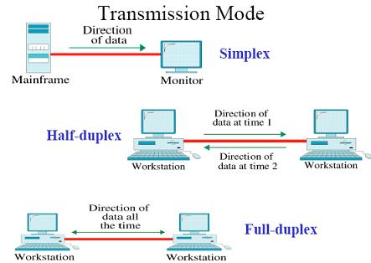
Serial Communication
Simplex / Half Duplex / Full Duplex
Receiver & Transmitter
Bits are sent/received one at a time
Much more widely used compared to Parallel Communication
Trouble in High Frequency Systems

Slide 6
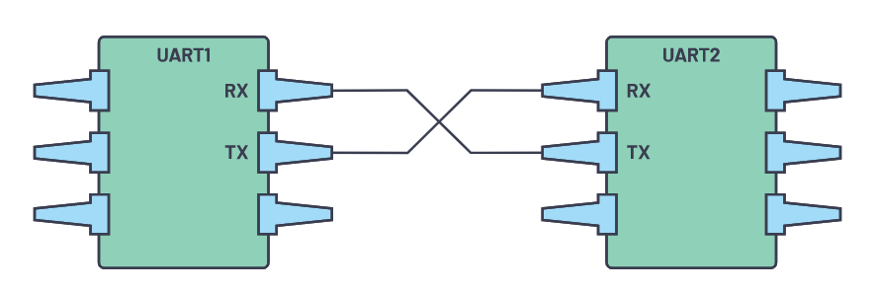
UART Connectivity
Two lines for serial data (Rx, Tx)
One line for common ground
Device 1 Rx connects to Device 2 Tx (and vice versa)
1 Master and 1 Slave
Both devices must have the same Baud Rate

Slide 7
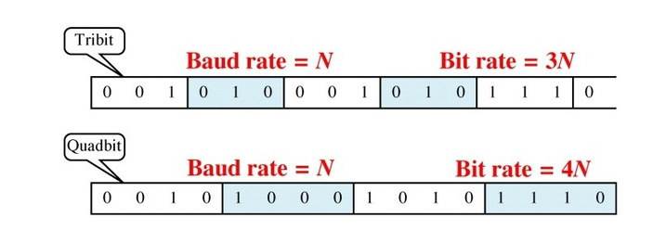
Baud Rate
Baud Rate != Bit Rate
Bit Rate = # of Bits / Time
Alternatively, Bit Rate = Baud Rate x Bits per symbol
Baud Rate = # of symbols / Time
9600, 57600, 115200, etc.

Slide 8
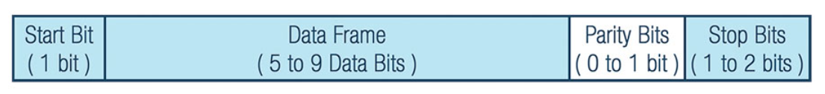
UART Packet
Data is sent in packets
Packets contain: Start bit, Stop bit, Parity bits, and Data bits
Start bit denotes the beginning of a data frame and begins the process of reading in the UART (Usually LOW)
Parity bits are used for error checking (Even, Odd)
Stop bit(s) denotes the end of a data frame (Usually HIGH)

Slide 9
HARDWARE

Slide 10
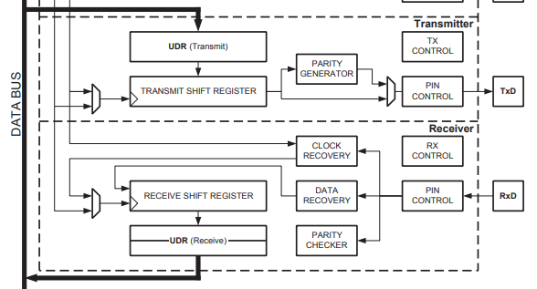
ATMega8U2 USART Block Diagram (Chip on Arduino UNO) [3]

Slide 11
Key Hardware Components
Parity Generator
Even Parity = Dn-1 xor … xor D1 xor D0 xor 0
Odd Parity = Dn-1 xor … xor D1 xor D0 xor 1
Clock Recovery
Synchronizes the receiver input with the system clock
Data Recovery
Samples each received bit three times and outputs the majority value
Parity Checker
Compares receiver parity bit with calculated parity
UDR (Transmit & Receive)
Buffer used to store transmitted and received data (FIFO)

Slide 12
SOFTWARE
*Particularly for Arduino

Slide 13
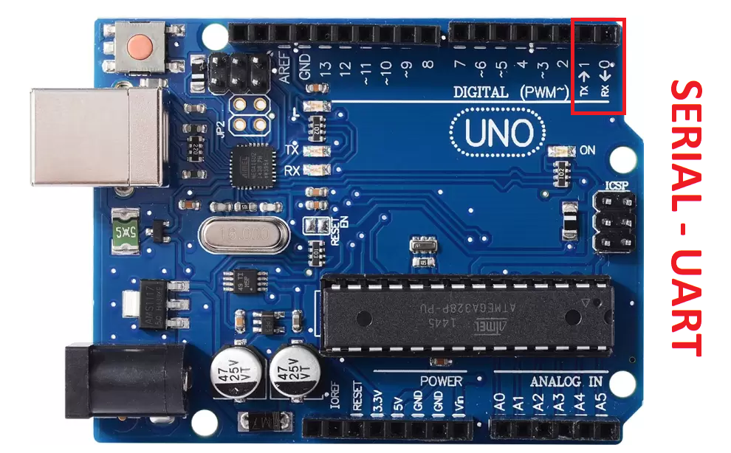
UART Configuration
Software must initialize the following:
Baud Rate
Parity
Data Bits
Arduino Serial Functions:
Serial.begin(BR) → void
Serial.available() → bool
Serial.read() → byte
Serial.write(val) → void

Slide 14
Why Choose UART?
Advantages
Disadvantages
No Clock required
Two wires needed
Error checking
Modifiable data packet
Long distance (Up to 1000 meters)
No addressing needed
One-to-One communication
Must configure Baud Rate
9-bit maximum data packet

Slide 15
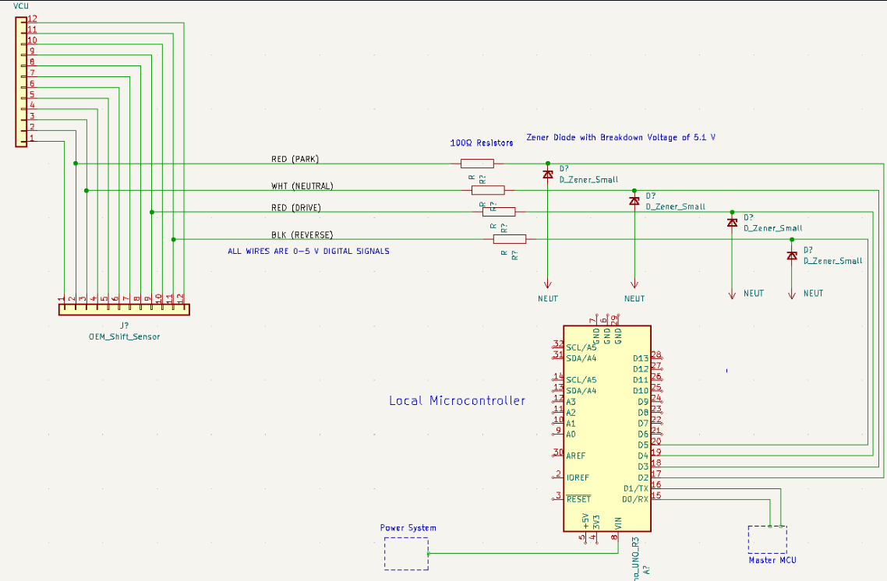
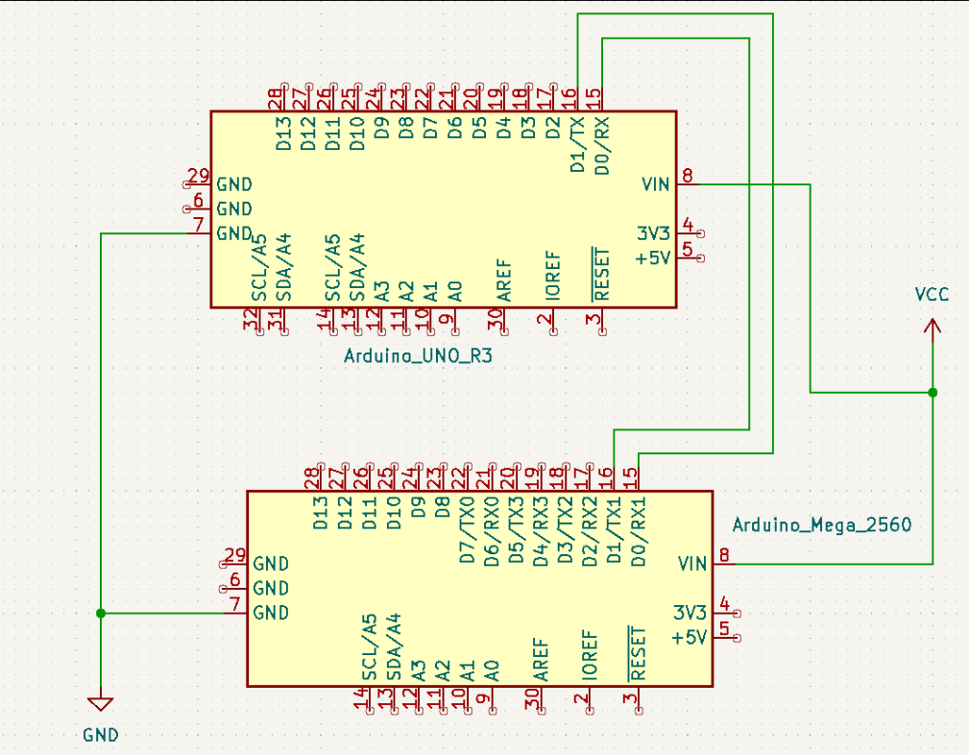
Application in Capstone
Master MCU connection
Shifter MCU connectivity
Send shifter data captured on Arduino UNO to Arduino Mega Master MCU
UART sends shifter position at 115200 Baud Rate

Slide 16
Sources
[1] UART: A Hardware Communication Protocol Understanding Universal Asynchronous Receiver/Transmitter | Analog Devices
[2] Baud Rate and its importance – GeeksforGeeks
[3] ATmega8U2 | Microchip Technology
[4] What is UART? Basics of UART | Instrumentation and Control Engineering (automationforum.co)
[5] UARTs Provide Reliable Serial Communication | DigiKey

