Slide 1
Zener Diodes
By: Ethan Powers

Slide 2
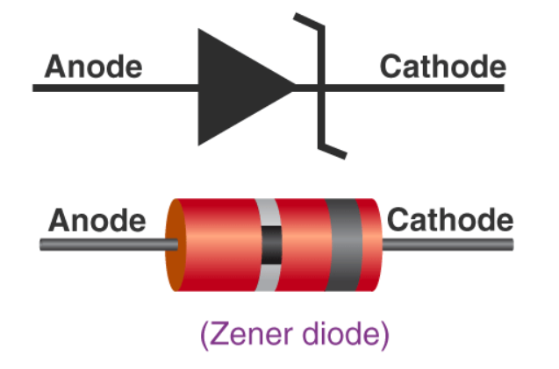
What are Zener Diodes?
Diode designed to allow current to flow backwards when the Zener voltage is reached
Have a sharp highly doped p-n junction
Come in a great variety of Zener voltages

Slide 3
P-N Junction
P-type semiconductors- created by doping an intrinsic semiconductor with an electron accepter element
N-type semiconductors- created by doping an intrinsic semiconductor with an electron doner element
Doping- the intentional introduction of impurities into an intrinsic semiconductor with the purpose of modulating its properties
Hole- a quasiparticle which has a lack of an electron at a position where one could exist
Depletion Region- insulating region where mobile charge carriers have been diffused away or forced away by an electric field

Slide 4
P-N Junction

Slide 5
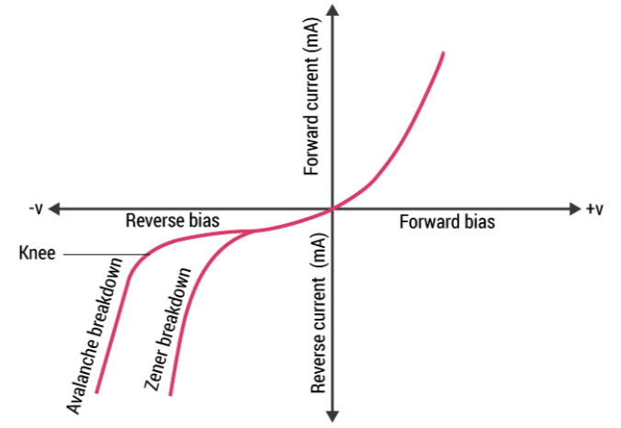
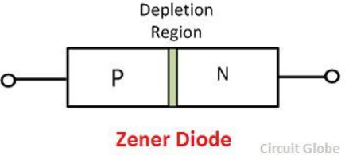
How do Zener Diodes Work?

Slide 6
Zener Effect
Is a type of an electrical breakdown discovered Clarence Melvin Zener in 1934
Under low reverse voltages the electric field intensity increases and creates free electrons
These free electrons then pass through the barrier by quantum tunneling

Slide 7
Quantum Tunneling
Quantum mechanical phenomenon where an electron or atom passes through an energy barrier when the object does contain sufficient enough energy
Electrons pass through the barrier when the electric field is very strong

Slide 8
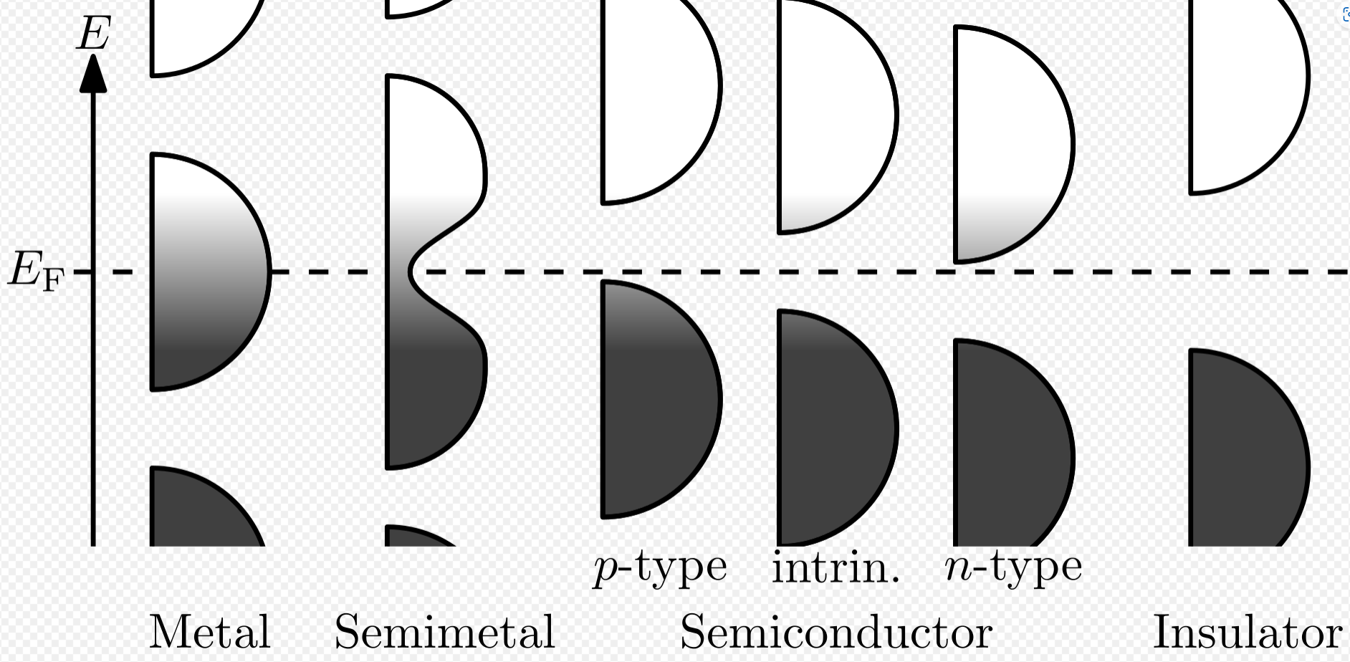
Valence and Conduction Bands

Slide 9
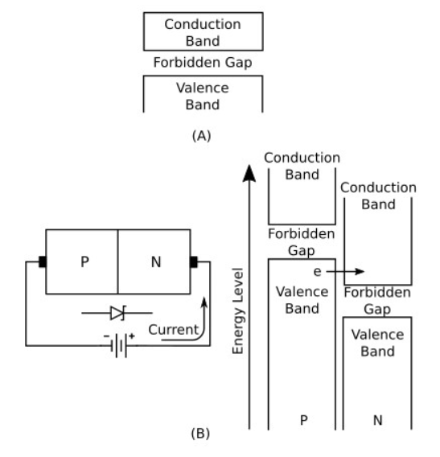
Energy Diagram for Zener Effect

Slide 10
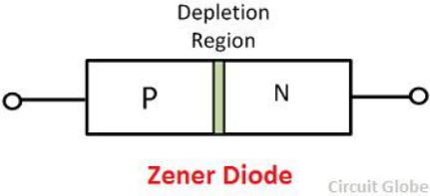
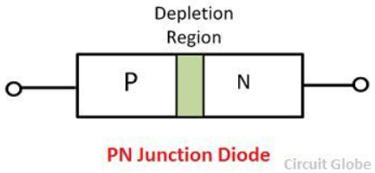
Difference Between Zener Diodes and Other Diodes
Can allow current to pass in the reverse direction
Have a smaller depletion region
Can operate in the avalanche region
Has a slower reverse recovery time

Slide 11
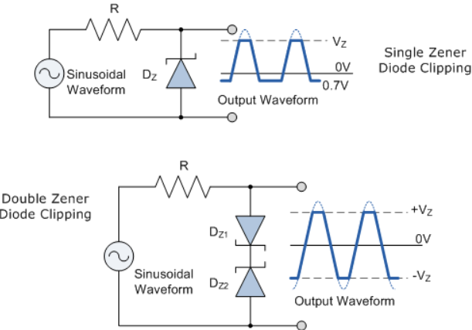
Waveform Clipper

Slide 12
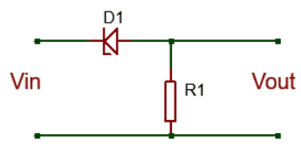
Voltage Shifter

Slide 13
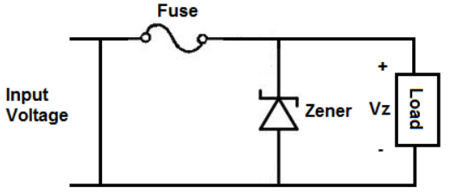
Voltage Regulator

Slide 14
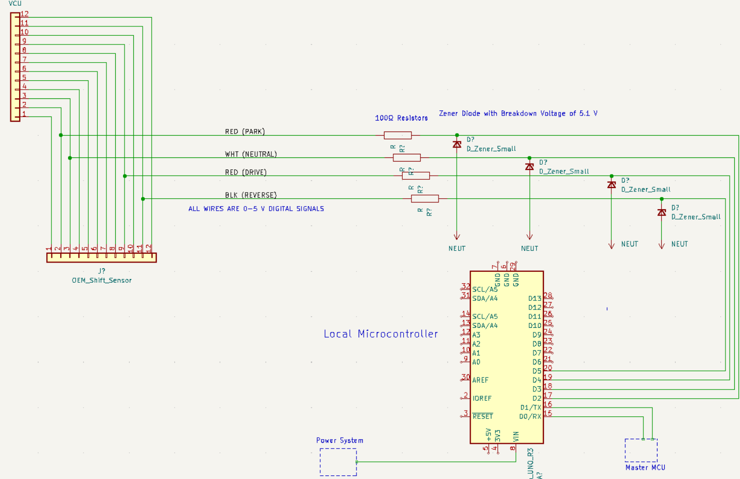
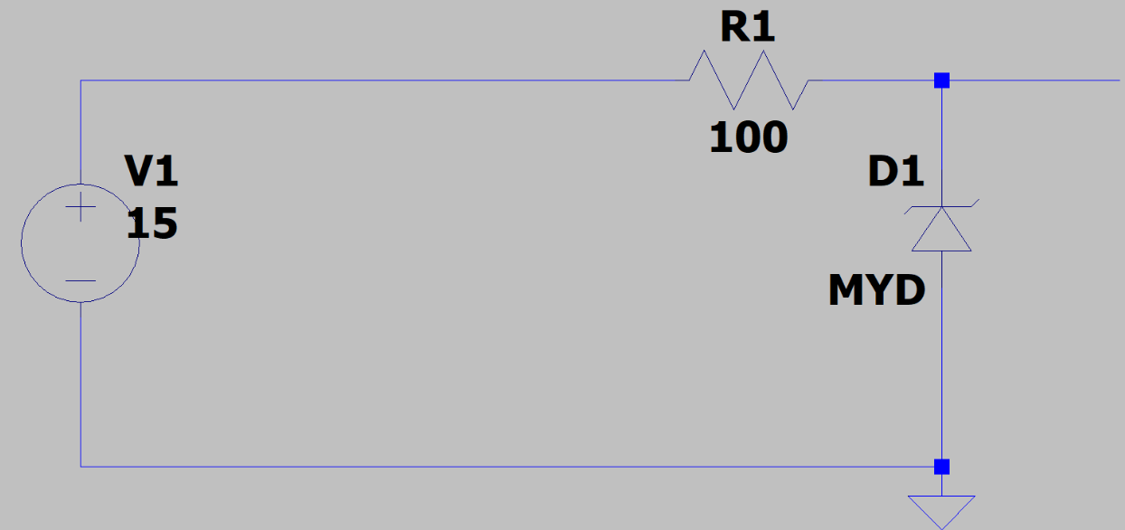
How I Used Zener Diodes

Slide 15
Pros and Cons of Zener Diodes
Pros
Cons
Very Cheap
Circuitry involved around using them is very simple
High performance standard
Great for regulating voltage
Wastes power when used as a voltage regulator
Slower reverse recovery time when used in forward bias
A variance in temperature can cause problems if not addressed

Slide 16
Sources
Valence and conduction bands – Wikipedia
Zener Diode - Special Devices - Solid-State Devices (ecstudiosystems.com)
Depletion region – Wikipedia
Zener diode – Wikipedia
Difference Between PN Junction & Zener Diode (with Comparison Chart ) - Circuit Globe
What is a Zener diode and how does it work? -… | CircuitBread
Zener Diode - Working, Characteristics and Applications (vedantu.com)
ECSTUFF4U for Electronics Engineer: Advantages and disadvantages of zener diode
What is Zener Diode? Operation Principle, Types & Uses of Zener Diode as Voltage Regulator, Waveform Clipper and Voltage Shifter (circuitdigest.com)

