Slide 1
Bioanalyzer

Slide 2
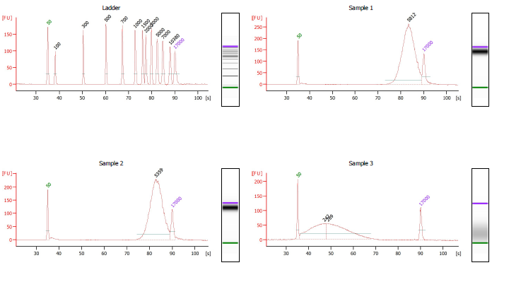
UP13 NP large fragment
UP14 PittGG large fragment

Slide 3
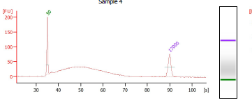
UP15 NP small fragment
UP16 PittGG small fragment
UP14 PittGG large fragment

