Slide 1

Employee Retention Analysis
Mamoun Alghaslan
Khaled Almurairy

Slide 2
Introduction
There are always people starting new jobs and retiring, and some move between jobs.
Talent retention is imperative for organizational success, therefore understanding employee behavior is key to sustaining a good economy.
Kaggle Employee dataset contains anonymized information about employees in a company, including their educational backgrounds, work history, demographics, and employment-related factors, providing valuable insights into the workforce.

Slide 3
Introduction
Feature | Description
Education | Level of Education(Bachelors, Masters and PHD)
JoiningYear | The year of joining
City | To which city the employee belongs to
PaymentTier | Salary Tiers
Age | The age of the Employee
Gender | Male and Female
EverBenched | If the employee has ever benched (yes or no)
ExperienceInCurrentDomain | Employee experience in terms of years
LeaveOrNot | The target column which is a binary column (0 or 1)

Slide 4
Phase 1: Problem Understanding
In the initial phase of our proposed data science project, our aim is to gain a deep understanding of the problem with the following objectives:
Analyze the distribution of each feature over leave or not.
Identify patterns in leave-taking behaviors.
Build a model to predict whether an employee will leave or not.

Slide 5
Phase 2: Data Preparation
In this stage, we will prepare the data to ensure it is clean, consistent, and free from errors for analysis exploring basic information about the dataset and identifying outliers if present.
The dataset has 4653 records.
All records have no null values or outliers.

Slide 6
Phase 2: Data Preparation
Feature | Values
Education | 'Bachelors' 'Masters' 'PHD'
JoiningYear | 2012 2013 2014 2015 2016 2017 2018
City | 'Bangalore' 'Pune' 'New Delhi'
PaymentTier | 1 2 3
Age | [22-41]
Gender | 'Male' 'Female'
EverBenched | 'No' 'Yes'
ExperienceInCurrentDomain | 0-7
LeaveOrNot | 0 1

Slide 7
Phase 3: Exploratory Data Analysis
The goal in this stage is to gain preliminary insight into the data by utilizing graphical exploration. This stage is useful to uncover patterns and visualize relationships among variables. In this phase, we will:
Explore Univariate Relationships over Leave or Not: Identify relationships between predictors and the target variable “Leave or Not.”
Explore Multivariate Relationships: Identify correlations between multiple attributes.
The data has 4653 records, of which 3053 (65%) did not leave, and 1600 (35%) left. We will explore the distribution of each column in the dataset based on the target column “Leave or Not” as a count, then as normalized.

Slide 8
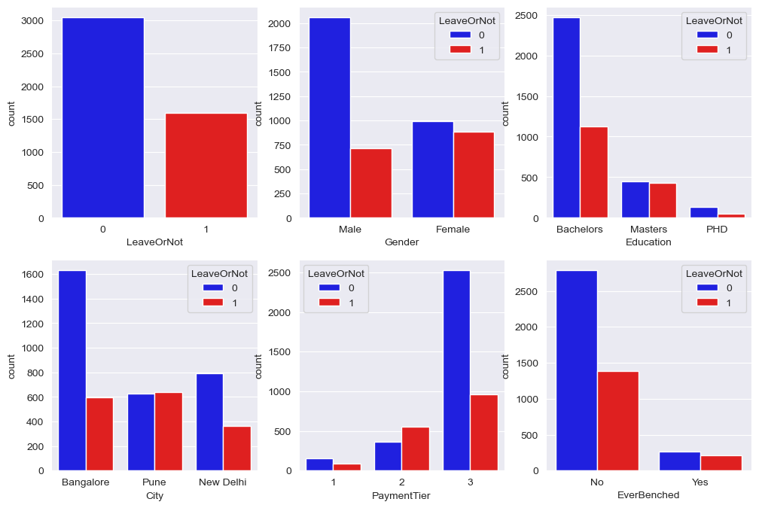
EDA Univariate Relationships
Females tend to leave more frequently
Employees with a bachelor’s degree tend to leave more frequently
Employees like to stay in Bangalore
Employees with higher salaries tend to leave less frequently
Employees who have been benched tend to leave more frequently and this will become clearer with the following plots.

Slide 9
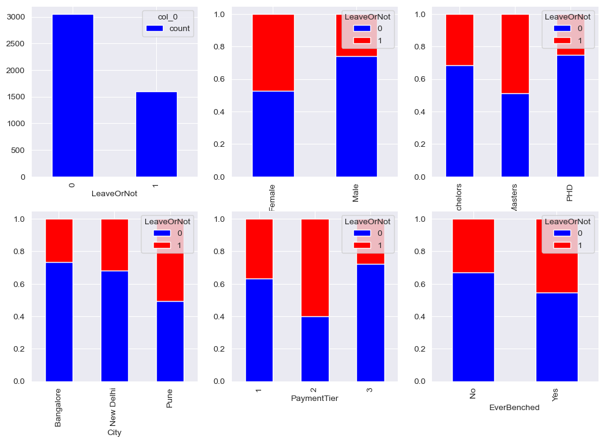
EDA Univariate Relationships
Females tend to leave more frequently
Employees with a master’s degree leave the most, then bachelor’s degree, then PHD.
Employees like to stay in Bangalore, then New Delhi, then Pune.
Employees in the middle tier tend to leave more frequently, probably looking for even better jobs or that that market is more competitive.
Employees who have been benched tend to leave more frequently.

Slide 10
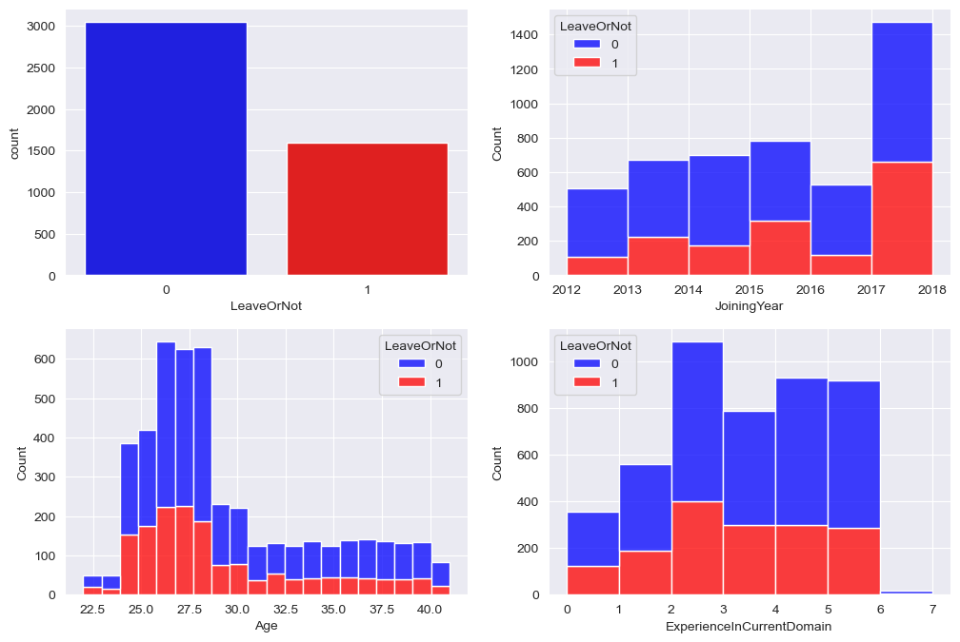
EDA Univariate Relationships
There are more employees with less years of experience except for the year 2016.
There are more employees with less age except for the age 30.
Most employees in the dataset have 2 to 6 years of experience.

Slide 11
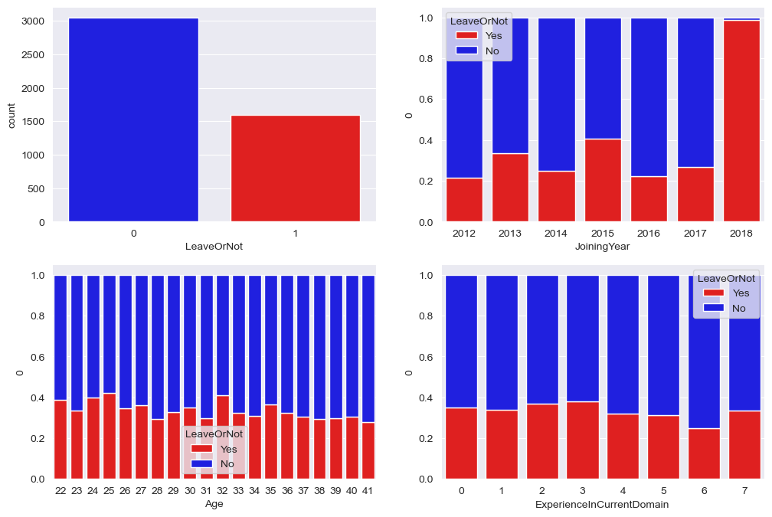
EDA Univariate Relationships
Almost all employees who joined in 2018 left their jobs.
There isn't a big variation in leave taking behavior based on age, but younger employees tend to leave slightly more frequently.
The same can be said to the experience in current domain, but employees with 2 or 3 years of experience tend to leave the most.

Slide 12
EDA Multivariate Relationships
Feature | Values
Education | 'Bachelors' 'Masters' 'PHD'
JoiningYear | 2012 2013 2014 2015 2016 2017 2018
City | 'Bangalore' 'Pune' 'New Delhi'
PaymentTier | 1 2 3
Age | [22-41]
Gender | 'Male' 'Female'
EverBenched | 'No' 'Yes'
ExperienceInCurrentDomain | 0-7
LeaveOrNot | 0 1

Slide 13
EDA Multivariate Relationships
Feature | Values
Education | 0 1 2
JoiningYear | 2012 2013 2014 2015 2016 2017 2018
City | 0 2 1
PaymentTier | 1 2 3
Age | [22-41]
Gender | 1 0
EverBenched | 0 1
ExperienceInCurrentDomain | 0-7
LeaveOrNot | 0 1

Slide 14
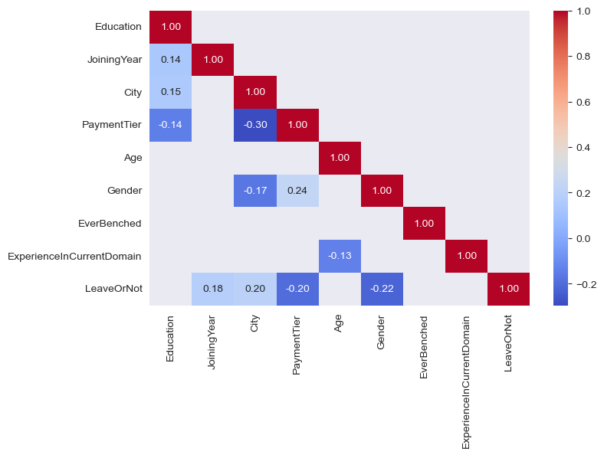
EDA Multivariate Relationships
From the plot, we can see that there is no strong correlation between any two columns, even after removing any correlation less than 0.1.
The remaining correlations are still weak, but most noticeable are:
PaymentTier and one of City or Gender
LeaveOrNot with Gender.

Slide 15
Phase 4: Setup
At this stage, we will have explored the data enough to understand the problem and the dataset, and we need to prepare it to be fed into the potential models by:
Separating the data into train, validation, and test sets
Balancing the dataset using SMOTE
Establishing baseline model performance
The baseline model is the simplest model that we can use to compare the performance of other models. In this case, we will use the most frequent class as the baseline model. Hence, the baseline model will predict 0 for all entries, and the accuracy will be 65.6%.
We split the dataset into train, validation, and test sets with a ratio of 70%, 15%, and 15% respectively. Then, we balanced only the training set using SMOTE to ensure that the model is not biased towards the majority class. Finally, we will compare the performances of different models to the baseline model.

Slide 16
Phase 5: Modeling
Now the dataset is set and ready, we will feed it to different algorithms/models to uncover the relationships between the columns and target. In this phase, we need to:
Implement three algorithms/models: At least three classification models.
Train the models on training set and validate using validation set: to achieve the best possible scores for the classification.
Train the best model on training and validation sets combined and validate on test set: to ensure the model is not overfitting.
We selected three algorithms:
Random Forest, Gradient Boosting, and Voting Gradient Boosting.

Slide 17
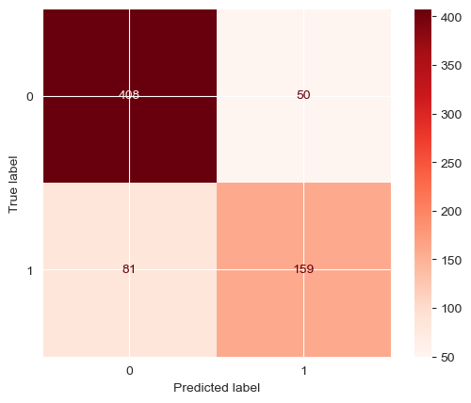
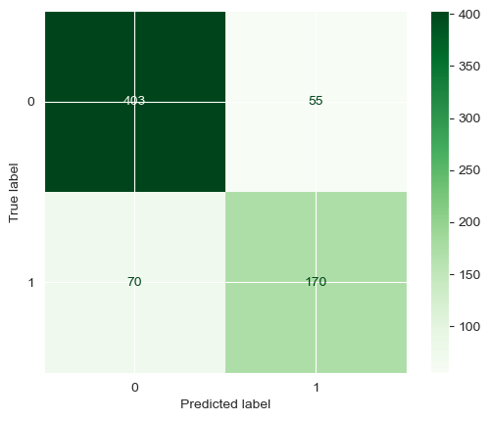
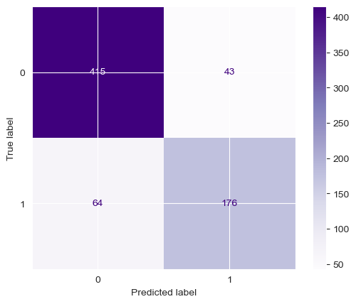
Phase 5: Modeling
Method/Algorithm | Accuracy | Precision | Recall | F1-Score
Random Forest | 0.812 | 0.662 | 0.761 | 0.708
Gradient Boosting | 0.821 | 0.708 | 0.755 | 0.731
Voting Gradient Boosting | 0.847 | 0.733 | 0.804 | 0.767

Slide 18
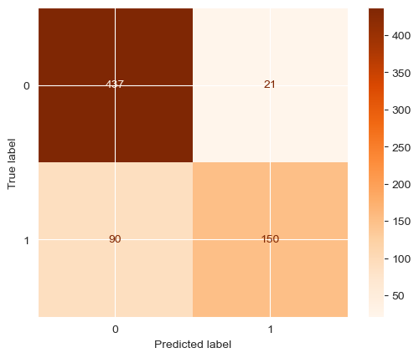
Phase 6: Evaluation
Method/Algorithm | Accuracy | Precision | Recall | F1-Score
Voting Gradient Boosting | 0.841 | 0.625 | 0.877 | 0.730

Slide 19
Phase 7: Deployment
The model is available at the request of the audience ☺

