Slide 1
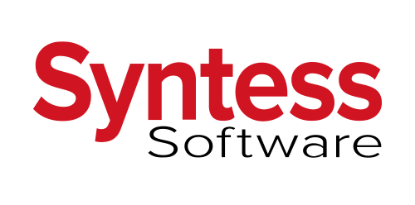
Syntess
Introduction
Syntess Software is producer of ERP- and mobile software in the Netherlands. Syntess’ customers include installation companies, companies in the construction sector, nautical sector, maintenance companies and mechanical engineering companies.
Syntess is established in Zierikzee and Gorinchem. The company has no fewer than 3,000 partners who use their software. Furthermore, the company has more than 130 active employees who make Syntess a little better every day.
Internship/Graduation possibilities
Syntess offers internship and graduation opportunities in various departments, in the form of graduation assignments or internships. Syntess tries to give his interns assignments that are like the assignments an employee could receive. In this way, the intern is as well prepared as possible.
Company Culture
What does Syntess offer their employees?
You could describe the culture at Syntess as collegial, professional, open, flexible and reliable, where pleasure in work forms the basis.
Room for own initiatives
A good internal training
With us you can be yourself and you get the space to develop yourself
Over 30 years of experience in Software Development
A pleasant working environment with a good atmosphere and collegiality
We are honest and result-oriented where ultimately helping our customers is central
A good salary that matches your education and experience
Travel allowance according to company scheme or a company car
Pension scheme and profit distribution
26 vacation days on an annual basis with full-time employment
In addition to coffee and tea, there is a nice piece of fruit per day for everyone
Technology
Syntess works with ERP Software. ERP stands for Enterprise Resource Planning. Instead of multiple software products, provides one integrated software package support for all processes within the company. With the help of our ERP software, all your business processes, such as stock-systems, business administration and logistics, are connected in such a way that all information entered can be used by your entire company. Data only needs to be entered once because one central database is used. In addition to eliminating the chance of inconsistent data, our ERP program Syntess Atrium can offer many benefits, such as working more efficiently, better communication and often cost reduction. Syntess Atrium gives you a grip on your business processes!
What does Syntess expect from their employees?
You have several years of experience in programming in Delphi, or you have knowledge of other OO development environments
You can work with .NET and C#
You want to make optimal use of your experience, knowledge and capabilities
You like to work in a team and are willing to delve into Agile Software Developmend based on Scrum

