Slide 1
OGUN
ORION Product

Slide 2
OGUN
Steel Manufacturing
ERP System
Brought to you by ORION

Slide 3
Agenda
ORION - Introduction
System Modules
Expectations

Slide 4
ORION - Introduction
ORION is a software solutions company running from 2015 all the way up till this moment.
We cooperate with companies from all over the globe to find them cutting-edge solutions that fit their business.
ORION contributes in the software community by many open-source packages available for free.
Companies, Research teams, Factories and even Software-houses are using our solutions on daily basis.

Slide 5
System Modules
Manufacturing
Accounting
HR and Payroll
Asset management.

Slide 6
System Modules
Manufacturing
OGUN Covers all the necessary features for steel manufacturing such as:
Bill Of Materials Management.
Production planing.
Taking Work Orders.
Downtime entry.

Slide 7
System Modules
Manufacturing - Bill Of Materials
A Bill of Materials is a list of items and sub-assemblies with quantities required to manufacture an Item.
A BOM may also contain the manufacturing operations required to manufacture the Item.
A Bill of Materials (BOM) is at the heart of the Manufacturing system and the most important document that will help to create other document types like Work Orders and Job Cards.
A BOM is the outcome of Items, Operations, Workstations combined.

Slide 8
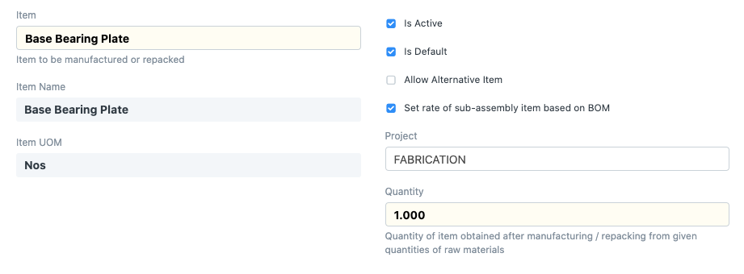
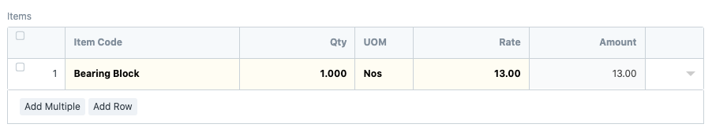
System Modules
Manufacturing - Bill Of Materials
This is an example of how BOM looks like:
The quantity of Raw Material used.
Item operation to be fetched in Work Orders later.
Source Warehouse to track inventory.
Remaining scrap percentage.

Slide 9
System Modules
Manufacturing - Production Plan
A Production Plan helps in production and material planning for the Items planned for manufacturing.
These production items can be committed via Sales Order (to Customers) or Material Requests (internally).
It also helps to plan production against multiple Sales Orders or the Material Requests.
A Production Plan helps in Material Procurement planning for the raw material item, based on the quantity of finished products to be manufactured.

Slide 10
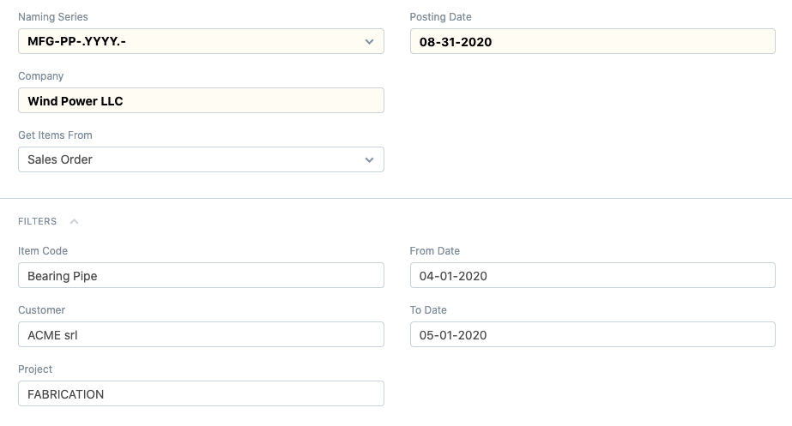
System Modules
Manufacturing - Production Plan
As mentioned earlier, a Production Plan can be used for planning the manufacture of Items against Sales Orders or Material Requests.
For Example; this is how Production against Sales order looks like:
The quantity of Raw Material used.
Item operation to be fetched in Work Orders later.
Source Warehouse to track inventory.
Remaining scrap percentage.

Slide 11
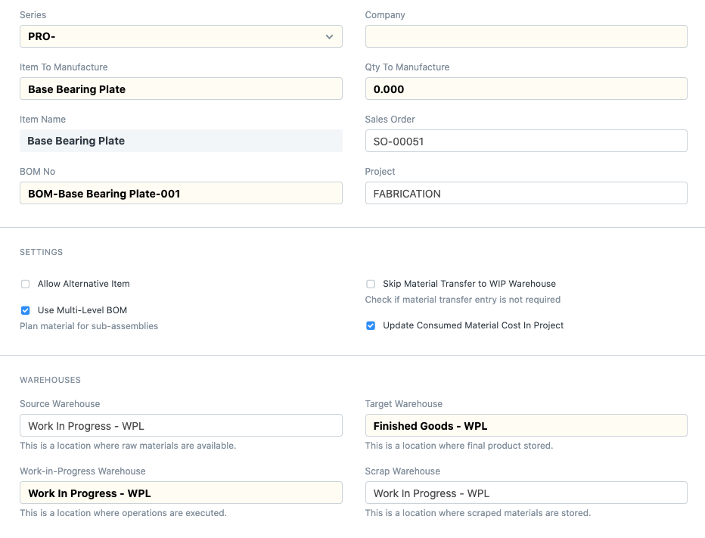
System Modules
Manufacturing - Work Orders
Woking Orders is your tool to flash the green light for new orders.
Select the Item to be manufactured.
Select the Bill Of Material (BOM).
Set the quantity to manufacture.
Set the planned start/end date.

Slide 12
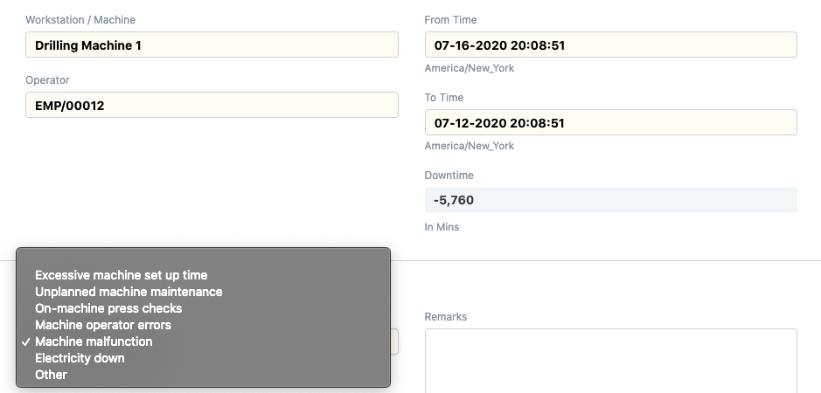
System Modules
Manufacturing - Down time Entry
Downtime Entry document is used to capture the machine's Downtime in minutes.
User needs to manually create the downtime record by selecting the proper machine alongwith the machine's downtime.
Using Downtime entry data operator knows which machine not performing well and needs maintenance.

Slide 13
System Modules
Accounting
At the end of sales and purchase cycle comes billing and payments, You may have an accountant in your team, or you may be doing accounting yourself, or you may have outsourced your accounting.
In all the cases financial accounting forms the core of any business management system like an ERP.

Slide 14
System Modules
Accounting
in OGUN; your accounting operations consists of 3 main transactions:
Sales Invoice
Purchase Invoice
Journal Entries

Slide 15
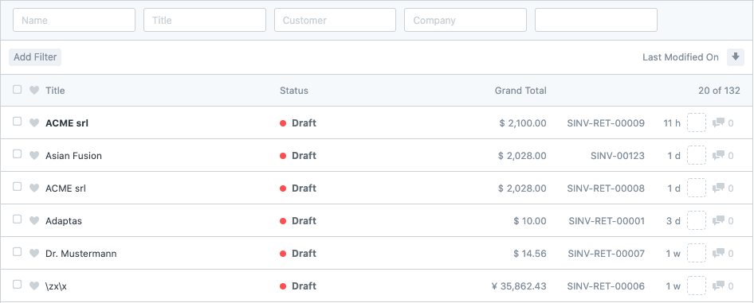
System Modules
Accounting - Sales Invoice
A Sales Invoice is a bill that you send to your customers, against which the customer processes the payment.
Sales Invoice is an accounting transaction.
On submission of Sales Invoice, the system updates the receivable and books income against a Customer Account.
Sales Invoice will also give you the following:
Accounting Impact
Accounting entries (GL Entry) for a typical double entry “Sale”
Automatically Fetching Item Batch Numbers
POS Invoices
Billing Timesheet with Project

Slide 16
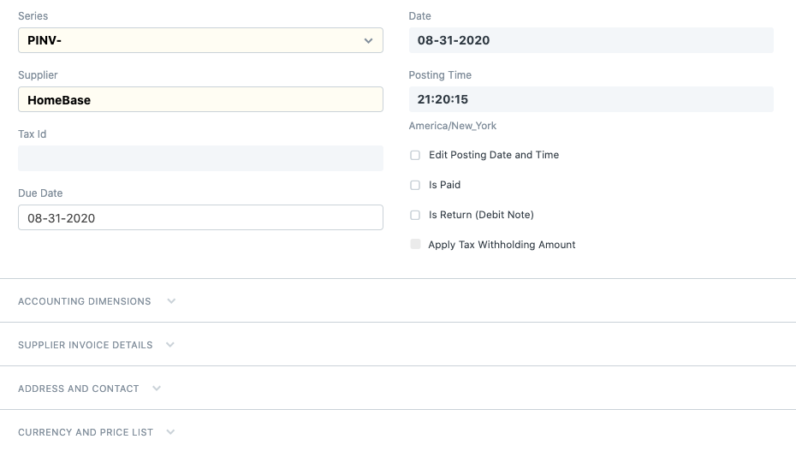
System Modules
Accounting - Purchase Invoice
A Purchase Invoice is the exact opposite of your Sales Invoice.
It is the bill that your Supplier sends you for products or services delivered.
Here you accrue expenses to your Supplier.
Making a Purchase Invoice is very similar to making a Purchase Order.
Purchase Invoice will also give you the following:
accounting Treatment When Is Paid is checked
Is purchase an “Expense” or an “Asset?
Deducting Taxes at Source
Hold Payments for a Purchase Invoice/Explicit Hold, Date Span Hold

Slide 17
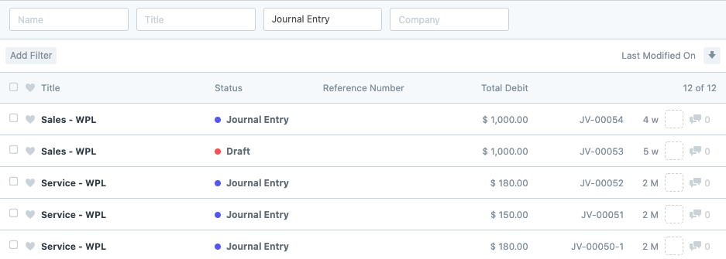
System Modules
Accounting - Journal Entry
All types of accounting entries other than Sales Invoice and Purchase Invoice are made using the Journal Entry.
A Journal Entry is a standard accounting transaction that affects multiple Accounts and the sum of debits is equal to the sum of credits.
Journal Entry will also give you the following:
Common Entries
Expenses
Bad Debts or Write Offs
Deprecation
Credit and Debit Notes

Slide 18
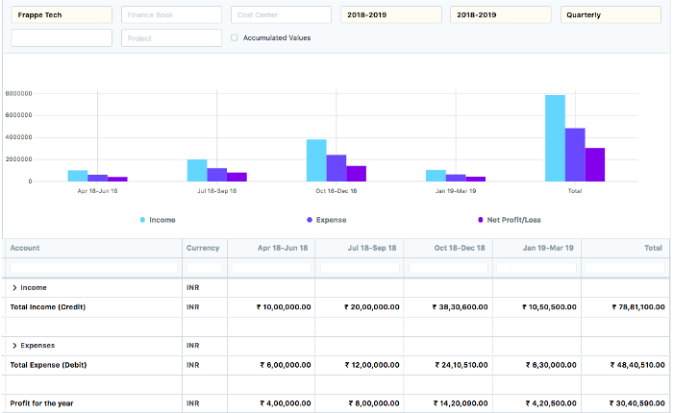
System Modules
Accounting - Financial Statements
Now that you have recorded all the information, you can check where your business stands using the financial statements.
Profit and Loss Statement:
Profit and loss statement reports a company’s revenues, expenses, and most of the gains and losses which occurred during the period of time specified in its heading.

Slide 19
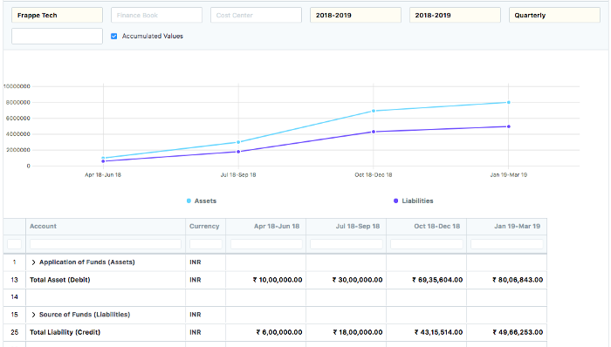
System Modules
Accounting - Financial Statements
Balance Sheet: Balance sheet report shows a company’s assets, it’s liabilities, and its stockholders’ equity.

Slide 20
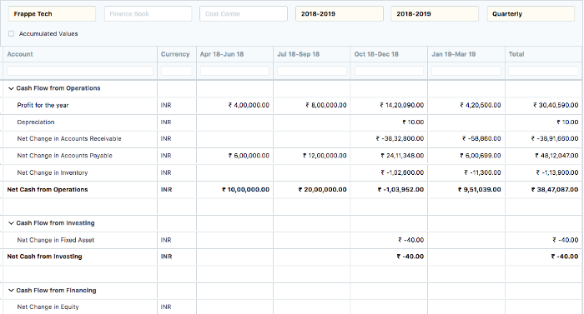
System Modules
Accounting - Financial Statements
Cash Flow: The cash flow statement reports a company’s major sources and uses of cash.

Slide 21
System Modules
HR and Payroll
Leave and Attendance Tracking, Expense Claims, Salary and Payroll, Recruitment, Performance and more are all handled with OGUN HR and Payroll Module
Employee
Employment Type
Various employment contracts you have with your employees.
Department
You can configure the Departments in your organization and assign them to your employees
Health Insurance
You can manage health insurance for your employees within OGUN
HR Settings
Global settings for HR related documents and workflow

Slide 22
System Modules
HR and Payroll - Recruitment
Staffing Plan
OGUN allows you to efficiently plan and budget new hiring for a period.
Job Opening
You can make a record of the open vacancies in your company using Job Opening.
Job Applicant
You can maintain a list of People who have applied for a Job Opening.
Job Offer
Job Offer is given to selected candidates after Interview & selection which states the terms of their employment.

Slide 23
System Modules
HR and Payroll - Leave Management
Leave Type
Leave Type refers to types of leave allotted to an employee by a company.
Leave Period
You can manage leaves based on a Leave Period, corresponding to a calendar year or the fiscal year.
Leave Allocation
Leave Allocation enables you to allot a specific number of leaves to a particular employee.
Leave Application
Employees can formally apply for a leave and can track it's approval.
Leave Encashment
For Leave Types which are encashable, you can submit Leave Encashment.
Holiday List
Holiday List is a list which contains the dates of holidays.
Leave Block List
Leave Block List is a list of dates in a year, on which employees can not apply for leave

Slide 24
System Modules
HR and Payroll - Attendance
Attendance is the record stating that an Employee has been present on a particular day.
Attendance Request
Employees can submit their attendance request for the days when their attendance wasn't marked.
Upload Attendance
This tool helps you to upload bulk attendance from a CSV (Excel) file.
Auto Attendance
Auto attendance marks the attendance for the Employees assigned to a shift based on records in the 'Employee Checkin' Document

Slide 25
System Modules
HR and Payroll - Lifecycle and Salary
Appraisal
You can manage appraisals by creating templates for each role with the parameters with appropriate weightage to each parameter.
Employee Onboarding
For the process of hiring an employee you can create a set of Tasks at the time of each Employee.
Employee Skill Map
Employee Skill Map is a record which helps your organization track your Employee's skill sets and trainings.
Employee Promotion
You can manage Employee Promotions using this document.
Employee Transfer
You can transfer Employees to different Company or Department by using Employee Transfer.
Employee Separation
For the process of relieving an employee you can create a set of Task at the time of each Employee.

Slide 26
System Modules
HR and Payroll - Payroll
Payroll Entry
Payroll Entry enables bulk processing of payroll for employees company wide or employees of a particular branch, department or designation.
Additional Salary
OGUN allows you to add additional Salary Components to Salary Slips while processing the payroll.
Employee Benefit Application
Employees are entitled to flexible benefits which they can either receive pro-rata or as a lump-sum amount when they claim the benefit.
Employee Tax Exemption Declaration
Employees can declare the contributions they plan to do in the payroll period which will reduce their net taxable income for the entire payroll period.
Payroll Period
Payroll Period helps you define Salary Structures and to calculate tax for a specific period based on applicable Income Tax Slab
Income Tax Slab
Income Tax Slab helps to define income tax rates based on different taxable income slab
Payroll Setup
Salary is a fixed amount of money or compensation paid to an employee by an employer in return for the work performed.
Setting Up Tax
In many countries regulations allow exempting a part of some type of spendings by individuals from being added to their annual taxable income

Slide 27
System Modules
HR and Payroll - Employee
In OGUN, you can manage Employee master.
The Employee master captures demographics, personal and professional details.
You can further use this Employee master for performing various HR functions like:
Processing Payroll
Leave Allocation and Application
Employee Advance and Expense Claim
Loan Application
Performance Appraisal

Slide 28
System Modules
HR and Payroll - Job Application
You can maintain a list of People who have applied for a Job Opening.
You can link Job Application with an Email account.
Suppose you link Job Application with an email job@example.com OGUN shall create a New Job Applicant against each email received on the mailbox.

Slide 29
System Modules
HR and Payroll - Holidays List
day List is a list which contains the dates of holidays.
Most organizations have a standard Holiday-List for their employees.
Some even have different holiday lists based on the different locations or departments.

Slide 30
System Modules
HR and Payroll - Loan Type
This module enables companies which provides loans to define and manage loans. Employees can request loans, which are then reviewed and approved.
For the approved loans, repayment schedule for the entire loan cycle can be generated and automatic deduction from salary can also be set up.

Slide 31
System Modules
Asset Management
Fixed asset management and tracking with depreciation, asset allocation and movement tracking
Asset
All the transactions related to an Asset like purchasing, sales, depreciation, scrapping, movement or maintenance will be managed against the Asset master.
Asset Maintenance
OGUN provides features to track the details of individual maintenance/calibration of various assets.
Asset Movement
You can track the location of an asset or to whom it is issued or whenever it is moved from one location to another.

Slide 32
System Modules
Asset Management - Asset Transactions
Asset Value Adjustment
In case of fixed asset management, sometimes the value of an asset needs some adjustment, this can be managed within OGUN.
Purchasing an Asset
You can follow the default purchase cycle after ensuring the the appropriate asset category exists.
Selling an Asset
You can sell an asset and even make all the necessary documents lile a Sales Invoice for it.

Slide 33
System Modules
Asset Management - Discarding Assets
Asset Depreciation
The system automatically creates a schedule for depreciation based on depreciation method and other related inputs in the Asset record.
Scrapping an Asset
When an asset is no longer usable, you can scrap an asset with the click of a button in the Asset record.

Slide 34
Expectations
OGUN grantees you:
Track all Invoices and Payments.
Know what quantity of which product is available in stock.
Identify and track your key performance indicators (KPI's).
Identify open customer queries.
Manage payroll.
Assign tasks and follow up on them.
Maintain a database of all your customers, suppliers and their contacts.
Prepare quotes.
Tracking your budgets and spending
Determine effective selling price based on the actual raw material, machinery and effort cost.
Get reminders on maintenance schedules.
Publish your website

Slide 35

OGUN
ORION Product

