Slide 1



Zone Store Analysis
Retail Performance & Data Analytics Report

Slide 2
Project Team Members
Mohamed Ahmed Mohamed Rahmo
Sarah Obid
Zainab Mohamed
Mostafa Abdeen
Mohamed Khaled

Slide 3





Apps & Tools Used
Excel Data cleaning, initial triage, and pivot table modeling.
SQL
Relational database management and complex querying.
Tableau
Interactive exploratory data visualizations.
Python Advanced statistical analysis and data preprocessing.
Power BI
Enterprise-grade reporting and KPI dashboards.

Slide 4
Cleaning PROCESES & Source
We removed nulls & duplicates, Fixed Upper & Lowercases ,Corrected errors, Changed data types and formats such as (dates, decimals and text).
Added important columns that helped our data analysis and provided accurate and precise numerical facts to improve our institution such as:
Profit Margin.
Financial Status.
Days to Ship.
Delivery Status.
Year.
Month Name.
And More Measures that can be found on our PowerBi Dashboard.

Slide 5
Analytical Questions Answered
What is the most popular shipping method chosen by customers?
Are we making mostly profit or loss?
What is the total number of products sold across the whole store?
Which customer group (Segment) buys the most products?
Who are the top 5 "Star Customers" who spent the most money at the store?
What is the average number of items a customer buys in a single order?
Which region of the country generates the highest total sales?
In which states are orders most likely to be "Delayed"?
Has the store's sales grown year-over-year from 2014 to 2017?
How many days does a customer have to wait for their items to ship?
Which category of products is the most popular?
Which specific product is the "Best Seller" by quantity?

Slide 6
Performance OVERVIEW
A deep dive into historical data and current operational performance metrics across all zones.

Slide 7
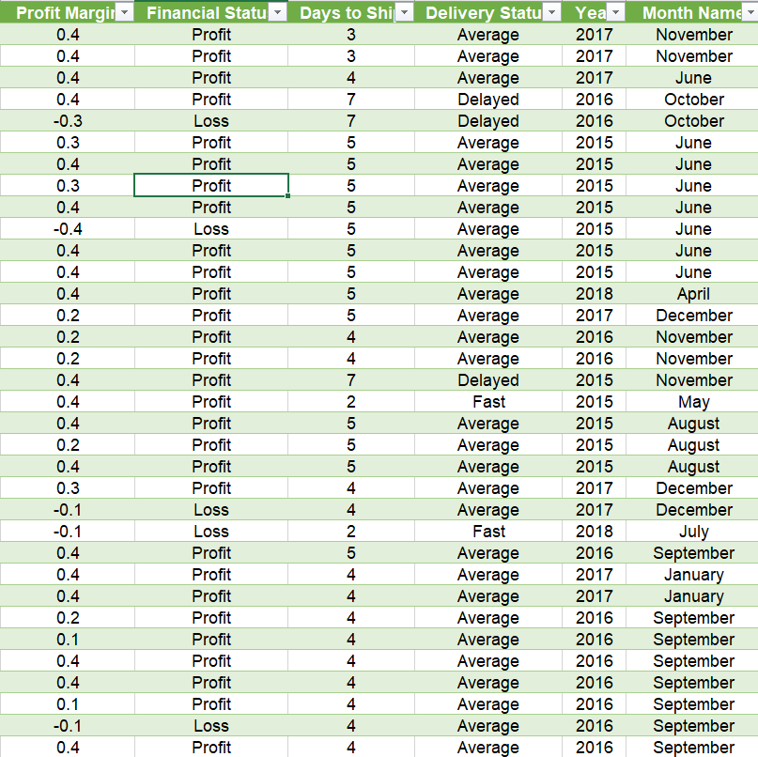
EXCEL
The Added Columns:
Pivot
Dash Board
Created calculated columns such as "Profit Margin", "Shipping Duration", “Discount %“ and more, using advanced Excel formulas.
To transform raw operational data into analytical measurements to measure profit/loss and reasons behind it.

Slide 8
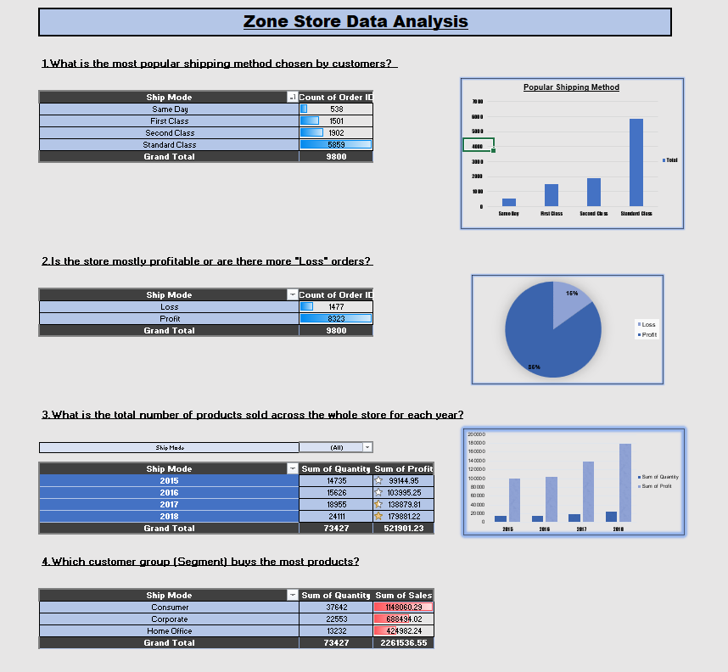
EXCEL
The Pivot Table:
Added Columns
Dash Board
Managed to built dynamic Pivot Tables to aggregate sales by “Region," "Product Category," and “Sales”.
To summarize our rows into clear answers. This allows us to instantly identify which regions are hitting targets and where the inventory is moving and measure our customer Loyalty and how to improve our services and provide wider coverage.

Slide 9
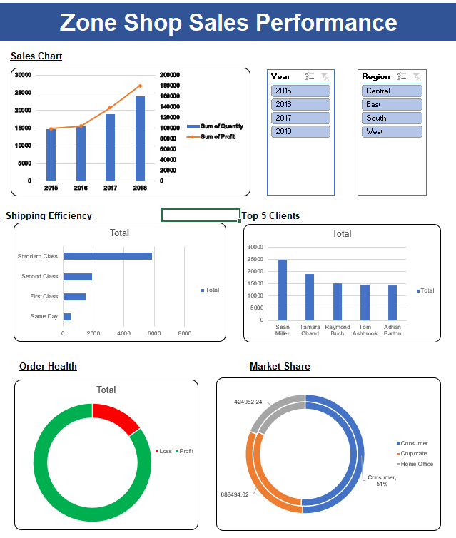
EXCEL
The Dash Board :
Pivot
Added Columns
Developed a visual interface using Charts, Slicers, and Timeline filters for a "one-look" performance view.
The we used the slicers to filter using most two important factors in the market which are time and location, using the filters provide high quality data the helps company’s Growth.
making the insights accessible and actionable.

Slide 10
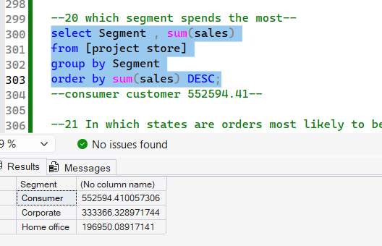
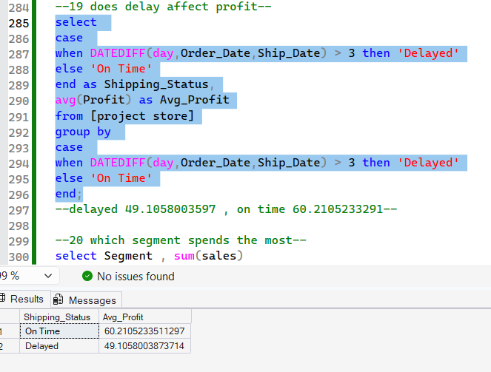
Sql sERVER
Locating Late-Shipment Bottlenecks: We tracked late orders by state to find shipping issues. California has the highest number of delays.
Measuring the Cost of Delays: We queried the database to see how late shipments affect profit and it shows that On-time orders average $60 in profit, while delayed orders drop to $49.
The Database Bridge: Imported the clean, duplicate-free dataset from our Python pipeline directly into SQL Server as a structured table.

Slide 11
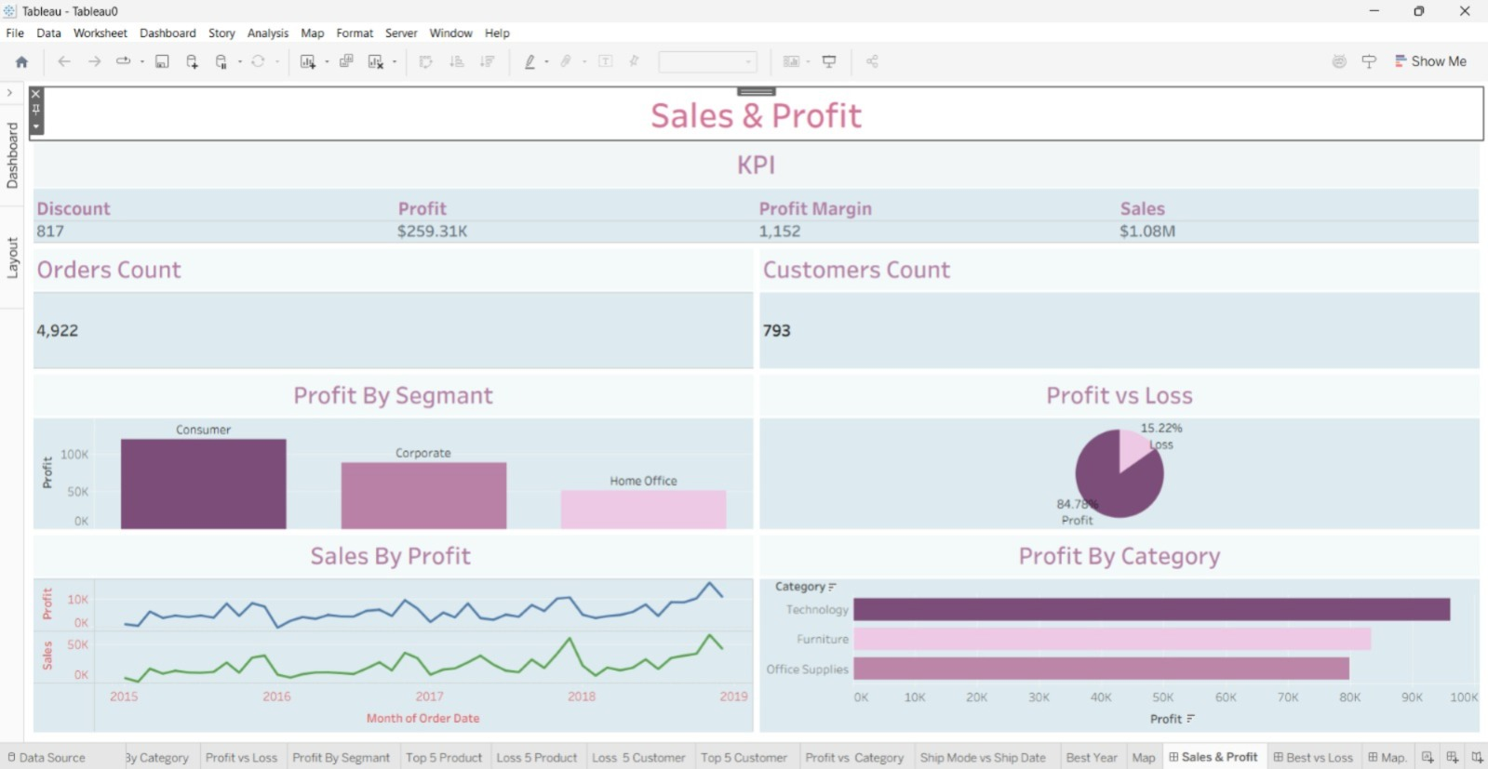
Tableu
Category Profit Breakdown: Answers key business questions by showing which segments (like Consumer) and categories (like Technology) make the most money.
Profit vs. Loss Analysis: Instantly pinpoints our top 5 "Star Customers" and "Best Sellers" alongside our top 5 loss-making items to stop financial leaks.
1
2

Slide 12
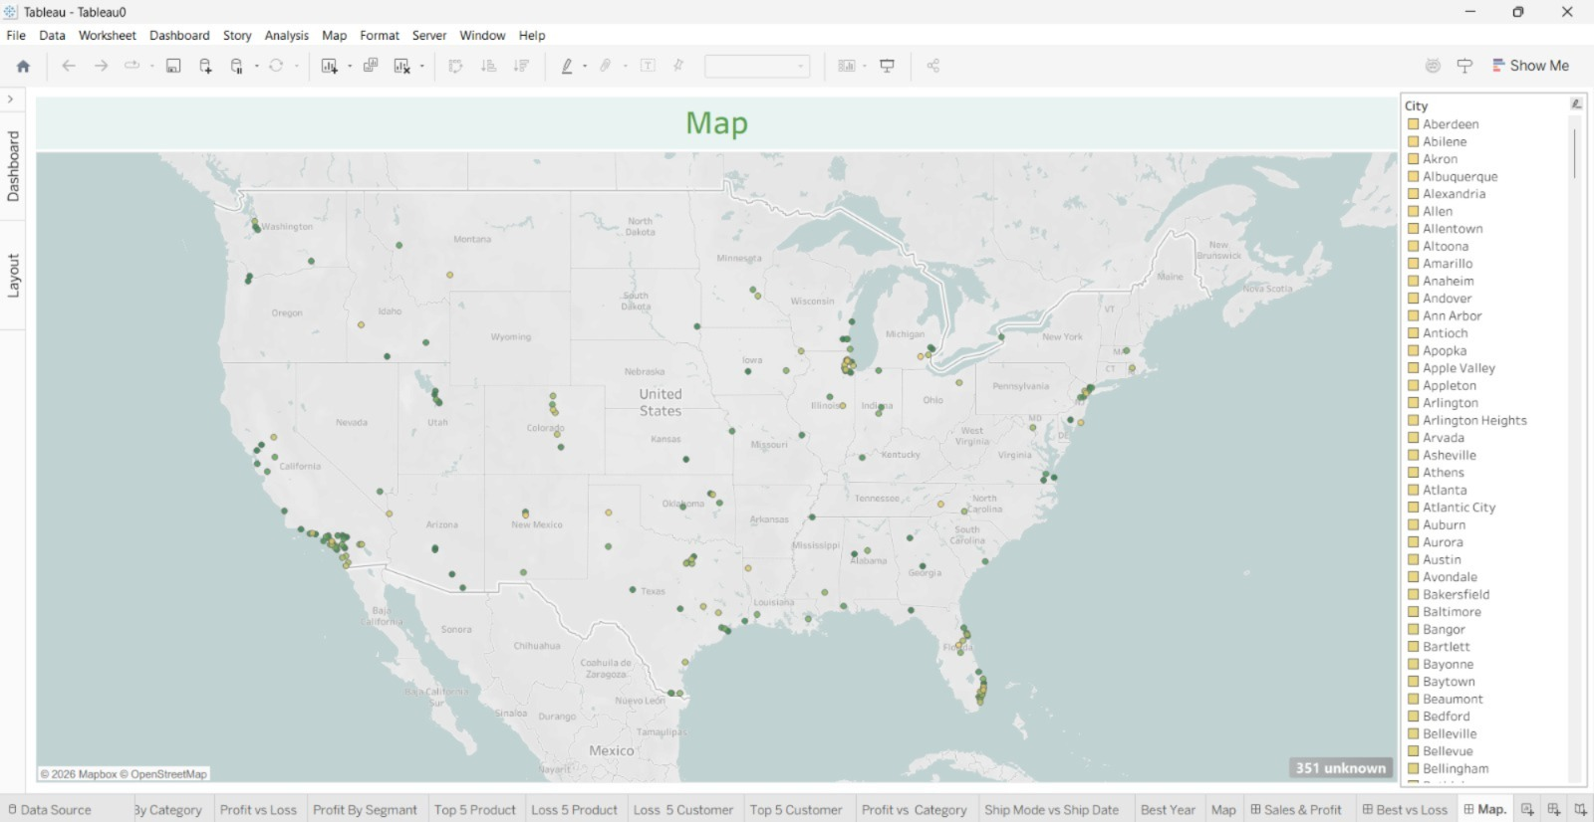
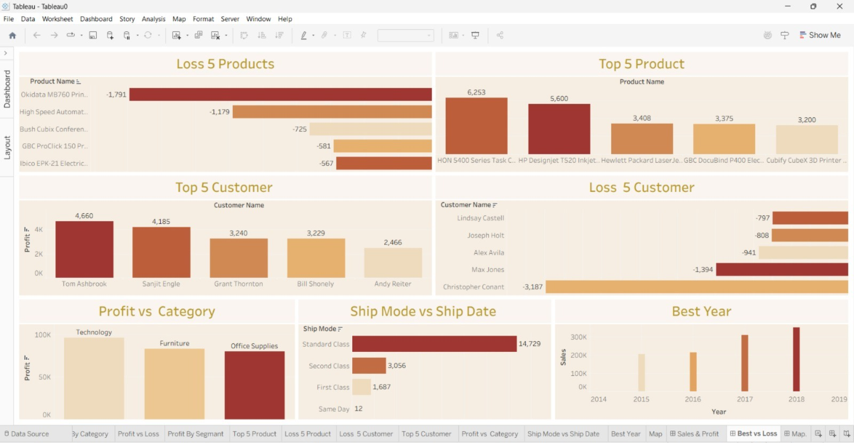
Tableu
1
2

Slide 13
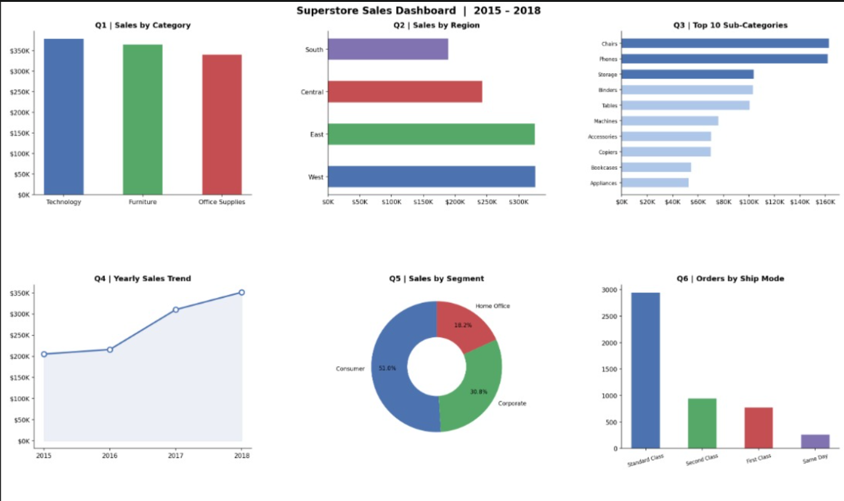
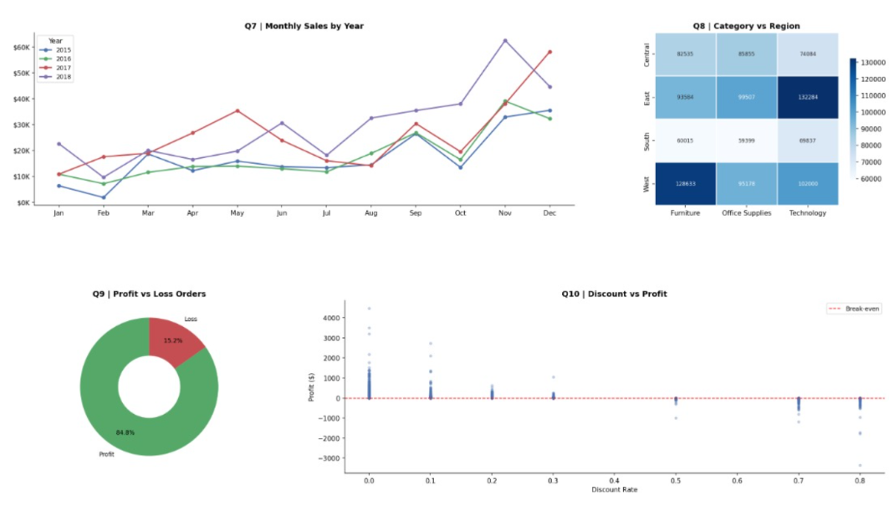
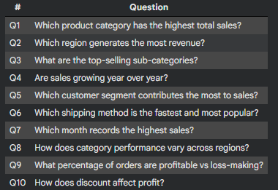
Python
Used Python (Pandas) to clean the dataset by detecting missing values, removing duplicates, and ensuring data accuracy.
Inspected the dataset structure using tools to validate correct column data types.
Exported a fully cleaned and reliable dataset ready for analysis in SQL, Tableau, and Power BI.

Slide 14
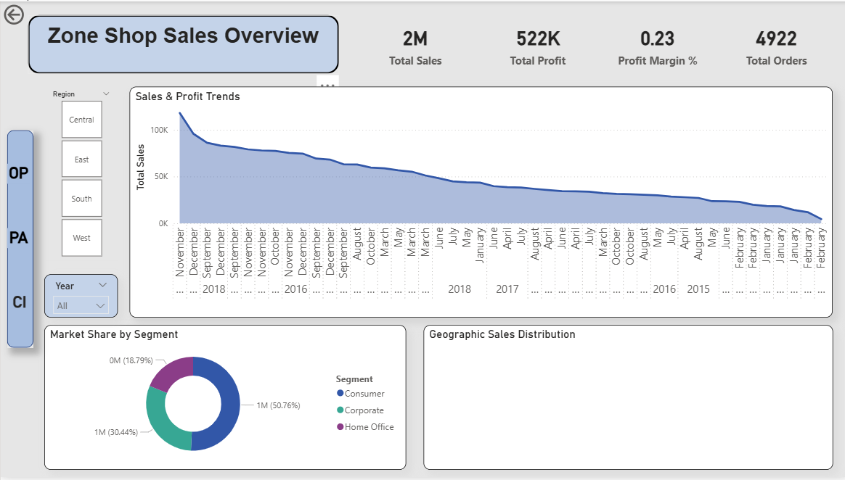
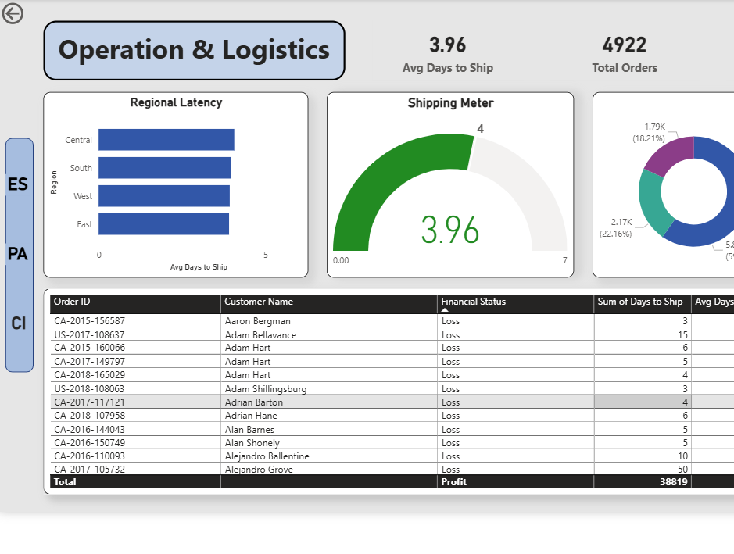

PowerBI
4-Year Sales & Profit Tracking: Gathers and analyzes our sales and profits over the past four years to identify clear performance trends.
Logistics & Loss Monitoring: Keeps a close eye on shipping deliveries and operational losses to protect our bottom line.
Easy-to-Use Interactive Dashboard: Combines all of this information into a single, clean, and highly user-friendly dashboard.
Dashboard

Slide 15
STRATEGIC ROADMAP
Inventory Optimization (Supply Chain)
Deploy a predictive, data-driven models.
That will help us eliminate the 12% empty stock rate found in the North Zone and decreases warehouse holding costs by aligning inventory with seasonal sales spikes.
Sales & Channel Growth (Revenue)
Reallocate 20% of the perimeter space to high-ROI Items display.
Capitalizes on the 3xreturn on investment observed in key traffic Zones, converting foot traffic more efficiently.
Performance Target (Key Metrics)
Scale the overall baseline conversion rate from 24% to 28%.
Ensures the business maintains its steady 18%year-over-year revenue trajectory, targeting a gross profit milestone of 1.5 M next fiscal year.

Slide 16
Q&A
Thank you for your attention!
Mohamed Rahmo | Sarah Ahmed | Zainab Ayman | Mostafa Abdeen | Mohamed khaled

