Slide 1

A Project Presentation on
Pune Vidyarthi Griha's College of Engineering & S.S.D. Institute of Management, Nashik
Dynamic Churn Prediction Using Machine Learning
Department of Information Technology
Under The Guidance of
Prof. S.N.Bhadane (HOD, IT Department)
Presented by
Sahil Bhatia (BEIT)
Mamta Borade (BEIT)
Gauri Randhir (BEIT)
Gaurav More (BEIT)

Slide 2

Presentation Outline
User and System Requirement
Functional and Non-Requirement
Software Requirement Specification(SRS)
Requirement Analysis / Models
UML/ER Diagram
Detail Architecture / System design / Algorithms with analysis /Methods / Techniques
Need to discuss Design models and Component level design
Data Flow Diagram(DFD levels as per problem statement).
Project Plan

Slide 3
Introduction
What is customer Churn:
Churn means customers or users who left the services or migrates to the competitor in the industry.
Customer churn (or customer attrition) is a tendency of customers to abandon a brand and stop being a paying client of a particular business.
It is important for telecom companies to analyze all relevant customer data and develop a robust and accurate Churn Prediction model to retain customers and to form strategies for reducing customer attrition rates.

Slide 4
Introduction
Problem Definition:
To develop a application to Prediction of Telecom Churn. The retention and acquisition of users are the major concerns in telecom industry. The fast growth of marketplace in every business is giving rise to increased subscriber base.
Accordingly, companies have recognized the significance of retaining the customers who is on hand. It has become necessary for service-providers to reduce the churn rate of customers since the inattention might negatively influence profitability of the company.
Churn prediction contributes to identify those users who are likely to switch a company over another.
Machine learning algorithm techniques facilitate these telecom firms to be protected with efficient approaches for lessening the rate of churn.
Objectives:
To explore the customer churn prediction in telecom using machine learning.
To investigate the impact of customer churn in telecom industry as a whole.
To discuss the significance of customer churn models in telecom industry.
To compare the algorithms that are effective in reducing churn rate in telecom companies.

Slide 5

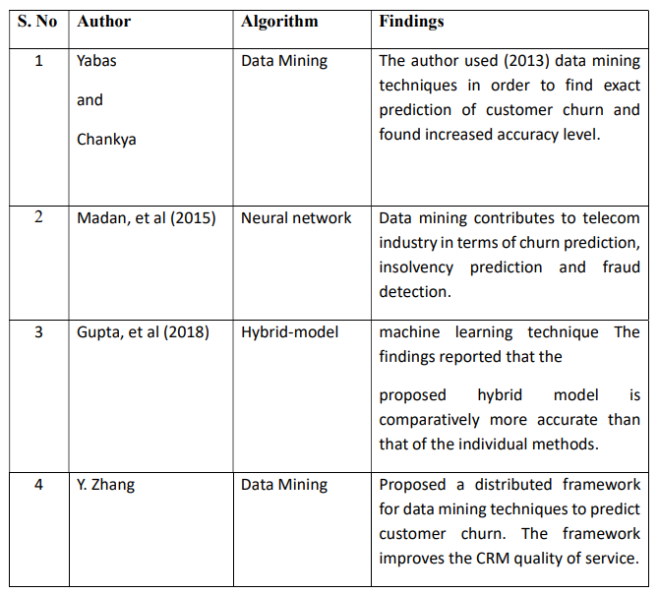
Litrature Survey

Slide 6
Proposed System
The basic model for predicting future customer churn is data from the past. We look at data from customers that already have churned (response) and their characteristics / behavior (predictors) before the churn happened.
The dataset contains demographic details of customers, their total charges and they type of service they receive from the company. It comprises of churn data of over customers spread over 21 attributes obtained from Kaggle.
By fitting statistical models that relate the predictors to the response, we will try to predict the response for existing customers. This method belongs to the supervised learning category.

Slide 7

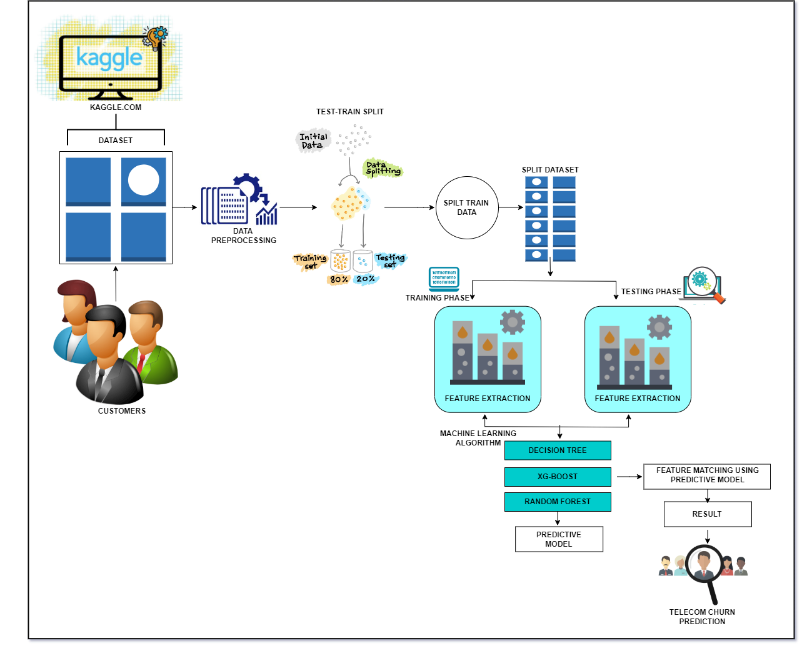
System Architecture

Slide 8

Software and Hardware Requirement
System Necessity
Hardware:
Processor – i3
Hard Disk – 5 GB
Memory – 1GB RAM
Software:
Operating System :Windows XP and later versions
Front End : HTML, CSS
Programming Language: Python
Dataset:Telecom Churn Prediction(Kaggle.com)
Domain:Machine Learning
Algorithm : Random Forest , Decision Tree, XGBoost.

Slide 9
SRS Documentation
Functional requirements:
The system shall be able to build Users profile.
The system should be able maintain the Users record.
The system will predict a Telecom Churn on the basis of the previous present record.
The system should be able to display the Users previous performance.
The system should be able to predict the Users next performance.
The system should be able to tell about the Telecom Churn.
To explore the customer churn prediction in telecom using machine learning
To compare the algorithms that are effective in reducing churn rate in telecom companies

Slide 10
SRS Documentation
Non-Functional requirements:
Performance requirements:
The system gives advice or alerts user immediately.
The System gives accurate results.
Interactive, minimal delays, safe info transmission
b) Safety requirements:
Nobody will be harm while developing the system.
Easy to use.
System embedded with management procedures and validation procedures

Slide 11
SRS Documentation
c) Security requirements:
The system keeps all students’ information’s with high security.
Identify all user, authenticate/verify user credentials, authorize user/third party, audit for user’s usability, backup, server clustering, system policies
d) Software quality attributes:
Predictability
Accuracy
Maintainability
Usability
Modifiability
Interoperability
Efficiency

Slide 12
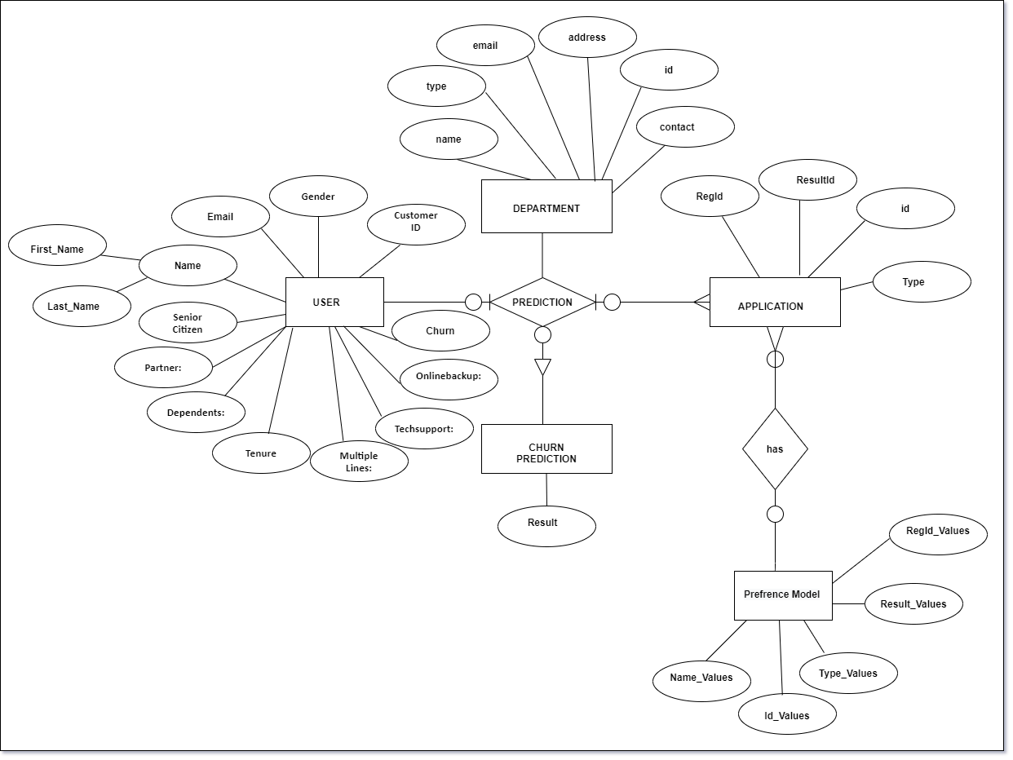
ER Diagram

Slide 13
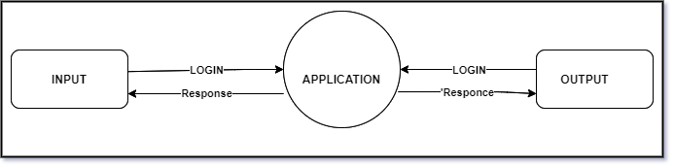
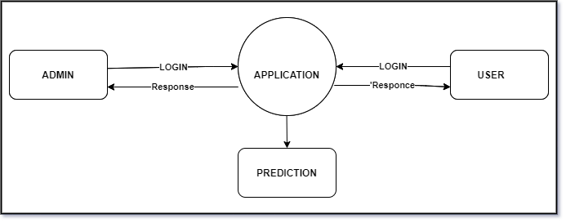
DFD Diagram
Fig:1 DFD Level 0
Fig:2 DFD Level 1

Slide 14
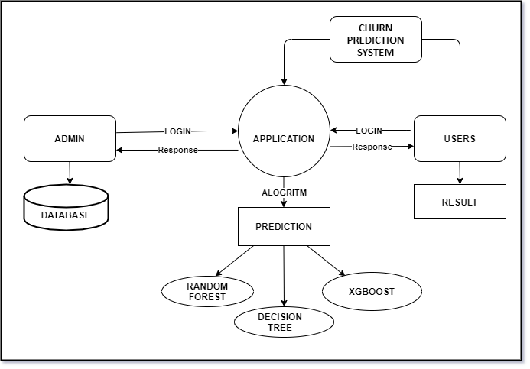
Fig:3 DFD Level 2

Slide 15

Conclusion
Churn prediction is one of the most effective strategies used in telecom sector to retain existing customers.It leads directly to improved cost allocation in customer relationship management activities, retaining revenue and profits in future. It also has several positive indirect impacts such as increasing customer’s loyalty, lowering customer’s sensitivity to competitors marketing activities, and helps to build positive image through satisfied customers.

Slide 16
References
Referance
Brandusoiu I, Toderean G, Ha B. Methods for churn prediction in the prepaid mobile telecommunications industry. In: International conference on communications. 2016. p. 97–100.
Ma, L., Zhao, X., Zhou, Z. and Liu, Y., 2018. A new aspect on P2P
He Y, He Z, Zhang D. A study on prediction of customer churn in fixed communication network based on data mining. In: Sixth international conference on fuzzy systems and knowledge discovery, vol. 1. 2009. p. 92–4.
Idris A, Khan A, Lee YS. Genetic programming and adaboosting based churn prediction for telecom. In: IEEE international conference on systems, man, and cybernetics (SMC). 2012. p. 1328–32.
Huang F, Zhu M, Yuan K, Deng EO. Telco churn prediction with big data. In: ACM SIGMOD international conference on management of data. 2015. p .607–18.
Gupta, M, Gandhi, A.B., Gupta, S.C. (2018). Machine Learning as Intelligent tool for Churn Prediction in Telecommunication Industry. International Journal of Computer Applications, 181(10), pp. 16-22.

Slide 17
THANK YOU

