Slide 1
Sentiment Analysis of Movie Reviews
Mamtaj Akter

Slide 2
Dataset Used
IMDB Movie Review
Two columns: Review and Sentiment
Two possible Sentiments: Positive or Negative
50000 reviews
25000 Positive
25000 Negative

Slide 3
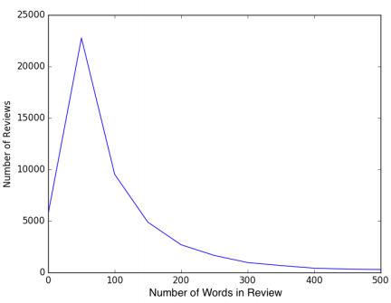
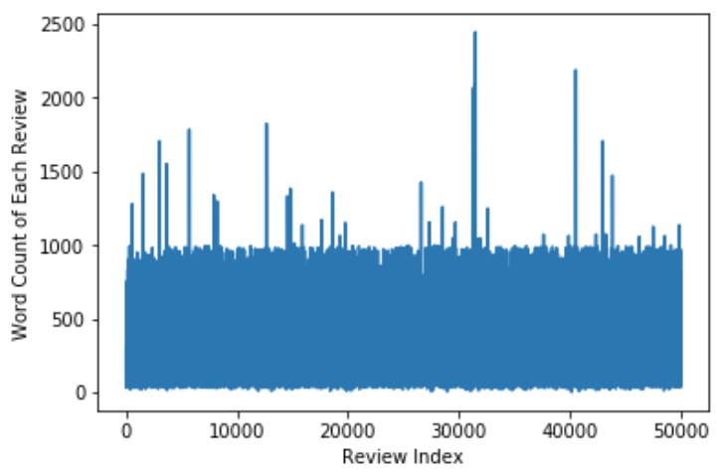
Average Word count in each review: 230

Slide 4
A Typical Review
This German horror film has to be one of the weirdest I have seen.<br /><br />I was not aware of any connection between child abuse and vampirism, but this is supposed based upon a true character.<br /><br />My hero is deaf and mute as a result of repeated beatings at the hands of his father. he also has a doll fetish, but I cannot figure out where that came from. His co-workers find out and tease him terribly.<br /><br />During the day a mild-manner accountant, and at night he breaks into cemeteries and funeral homes and drinks the blood of dead girls. They are all attractive, of course, else I wouldn't care about the fact that he usually tears their clothing down to the waist. He graduates eventually to actually killing, and that is what gets him caught.<br /><br />Like I said, a very strange movie that is dark and very slow as Werner Pochath never talks and just spends his time drinking blood.

Slide 5
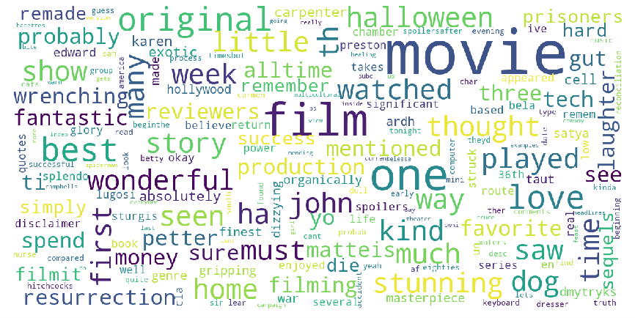
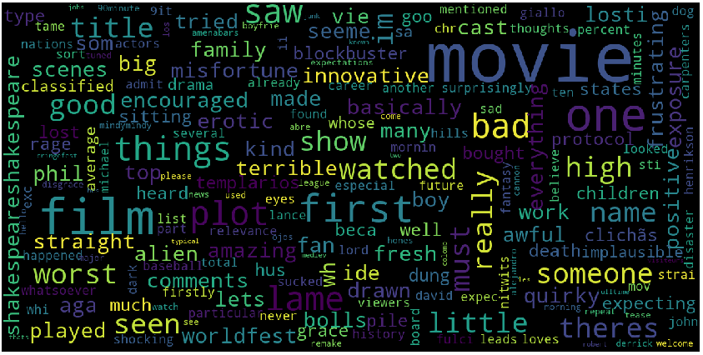
Positive: Negative:

Slide 6
Needs Preprocessing
Convert review text to all lowercase
Clean text :
HTML tag remove
Remove punctuation
Remove stop words
Do stemming

Slide 7
Methods
Logistic Regression
Support Vector Machine
Naïve Bayes
Random Forest Classification
Bi-LSTM

Slide 8
Features
Tockenized text
TF-IDF vector
Text-to-sequence

Slide 9
Accuracy
Method Name | F1 scores on Validation Dataset | F1 scores on Test Dataset
Multinomial Naïve Bayes | 0.85% | 0.86%
Support Vector Machine | 0.89% | 0.90%
Logistic Regression | 0.89% | 0.89%
Random Forest Classifier | 0.74% | 0.75%
Bi-LSTM | 0.87% | 0.87%

