Slide 1

HR Analytics Dashboard
Key insights into workforce demographics, attrition trends, and employee engagement metrics to drive data-driven retention strategies.

Slide 2
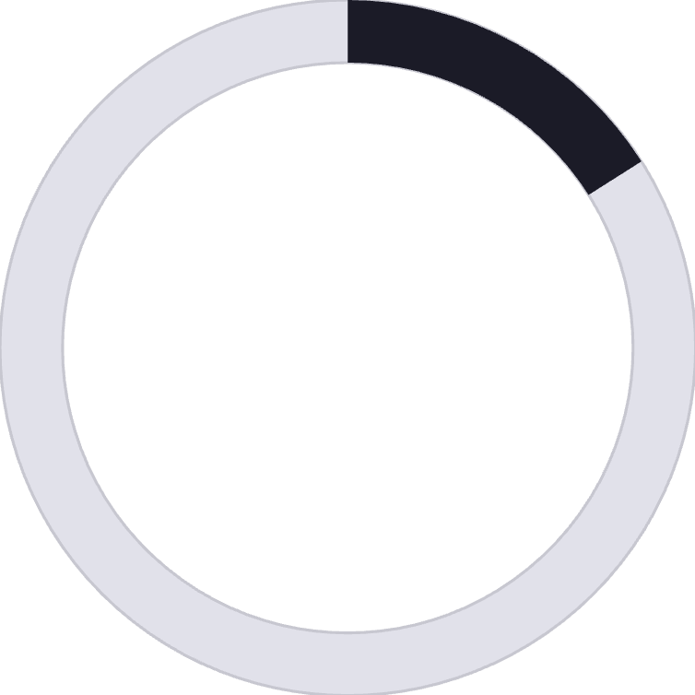
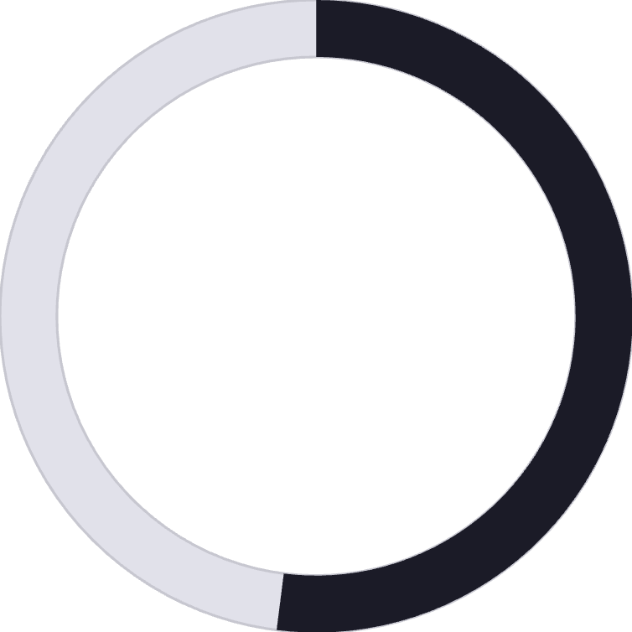
Workforce Overview
1,470
237
1,233
Total Employees
Attrition Count
Active Employees
16%
52%
Attrition Rate
Job Satisfaction
2.6 out of 5 rating
The organization maintains 1,470 employees with a 16% attrition rate. Average employee age is 37 years, with job satisfaction at 2.6/5 indicating room for improvement.

Slide 3
Gender & Attrition Patterns
Balanced Workforce
Female Attrition Concern
The organization maintains gender balance across the workforce, reflecting inclusive hiring practices.
Female attrition rates are slightly higher than male, suggesting a need for enhanced work-life balance initiatives and support programs.

Slide 4
Education-Wise Attrition
Bachelor's Degree
Master's Degree
Key Insight
99 employees
58 employees
Mid-level professionals seeking better career growth opportunities
Highest attrition group
Second highest attrition
Bachelor's degree holders show the highest attrition, indicating that mid-level professionals may be seeking advancement opportunities elsewhere.

Slide 5
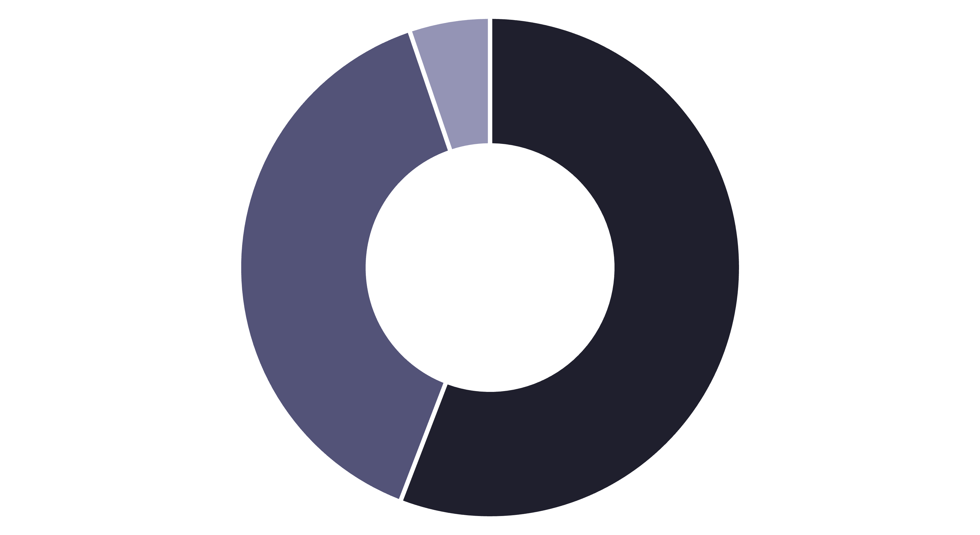
Department-Wise Breakdown
R&D
Sales
HR
R&D accounts for 56% of attrition, followed by Sales at 39% and HR at 5%. This indicates potential workload or engagement issues in technical and sales teams.

Slide 6



Age Group Analysis
55+ years
1
Low attrition
35-54 years
2
Moderate attrition
25-34 years
3
112 employees
Employees aged 25-34 have the highest attrition (112 employees). Early-career professionals are more likely to leave, potentially due to job satisfaction, career advancement, or compensation concerns.

Slide 7
High-Risk Job Roles
Sales Executives
Laboratory Technicians
Research Scientists
Highest contributor to attrition. Requires enhanced incentives and support.
Significant turnover in technical roles. Training programs needed.
Key talent loss in R&D. Targeted retention strategies essential.
These roles require immediate attention through targeted retention strategies, enhanced training programs, and competitive compensation packages.

Slide 8
Strategic Recommendations
01
02
Career Development Programs
Enhance Job Satisfaction
Implement mentorship programs for employees aged 25-34 to improve retention and career growth.
Launch recognition programs and flexible work policies to boost engagement scores.
03
04
Conduct Exit Interviews
Upskilling Opportunities
Understand reasons behind high attrition in R&D and Sales departments through structured feedback.
Provide career advancement pathways for Bachelor's degree holders to reduce mid-level attrition.

Slide 9


Focus Areas for Improvement
Career Growth
Address advancement opportunities for mid-level professionals, especially Bachelor's degree holders seeking progression.
Work-Life Balance
Implement flexible policies and support programs, particularly for female employees and high-stress departments.
Employee Engagement
Regular feedback sessions and well-being initiatives to improve the 2.6/5 job satisfaction score.

Slide 10




Path Forward
Attrition is mainly driven by mid-level professionals and specific job roles. By addressing career growth, work-life balance, and employee engagement, the organization can significantly reduce attrition and foster a more stable, motivated workforce.
Analyze
Strategize
Deep dive into department-specific issues
Develop targeted retention programs
Implement
Succeed
Execute initiatives and track progress
Build a stable, motivated workforce

