Slide 1
Course Title: Computer Network
Presented By,
  Amran Hossen Mamun
  IT-18018
  3rd year 2nd semester
  Dept. of ICT
  MBSTU
Presented To,
    Nazrul Islam
    Assistant professor
    Dept. of ICT
    MBSTU
1
1

Slide 2
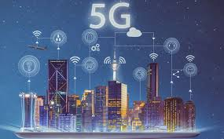
Presentation Topic:
5G Network
2

Slide 3
Contents…..
Introductions
Evaluation from 1G to 5G
Key concepts
Hardware and Software of 5G
Advantage
Disadvantage
Application
Conclusion
Voice presentation
3
Notes:
Gfdhgfdghfdjgfdhdgfdg
fdgfdnmgmfdgfdg
ggfdngmfdgfdg
gdfmg,.fdg

Slide 4
What is 5G?
5G wireless: 5th generation wireless technology
Complete wireless communication with almost no limitations
Can be called Real wireless world
Has incredible transmission speed
Concept is only theory not real
4

Slide 5
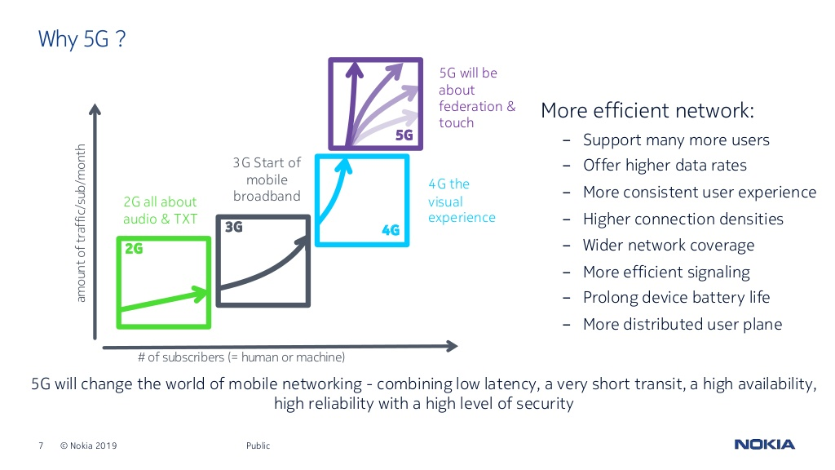
5

Slide 6
What does it offer?
I) Worldwide cellular phones.
ii) Extraordinary data capabilities.
Iii) High connectivity.
iv) More power & features in hand held phones.
v) Large phone memory ,more dialing speed ,more clarity in audio & video.
6

Slide 7
Evolution from 1G to 5G
1G
2G
3G
4G
5G
7

Slide 8
1G
Developed in 1980s & completed in early 1990s
Based on analog system
Speed up to 2.4 kbps
AMPS(Advance mobile Phone System)was launched by the US & it was the 1G mobile system
Allows user to make voice calls in 1 country
8

Slide 9
2G
Developed in 1980s & completed in late 1990s
Based on digital system
Speed up to 64 kbps
Services such are digital voice & SMS with more clarity
Semi global facility
2G are the handsets we are using today , with 2.5G having more capabilities
9

Slide 10
3G
Developed between late 1990s & early 2000s until present day
Transmission speed from 125 kbps to 2 Mbps
Superior voice quality
Good clarity in video conference
E-mail , PDA , information surfing,
On-line, Shopping/banking,games etc.
Global roaming
10

Slide 11
4G
Developed in 2010
Faster & more reliable
Speed up to 100 Mbps
High performance
Easy roaming
Low cost
11

Slide 12
5G
Next major phase of mobile telecommunication & wireless system
10 times more capacity than others
Expected speed up to 1Gbps
More faster & reliable than 4g
Lower cost than previous generation
12

Slide 13
Key concepts
Real wireless world with no more limitation with access & zone issues
Wearable devices
IPv6 , where a visiting care of mobile IP address is assigned according to location & connected network
One unified global standard
Smart ratio
The uses can simultaneously be connected with several wireless access technology
Multiple concurrent data transfer path
13

Slide 14
Hardware of 5G
Hardware of 5G architecture uses Ultra Wide Band( UWB) network with higher bandwidth even al low energy levels.
Bandwidth is of 400 times faster than today’s wireless network.
It uses Code Division multiple Access(CDMA) with smart antennas
14

Slide 15
Software of 5G
5G will be single unified standard of different wireless networks, including LAN technologies, LAN/Wan, WWWW(Wireless World Wide Web), unified IP & seamless combination of broadband.
This software define with ration, encryption, flexibility and anti-virus.
15

Slide 16
Advantage of 5G
Higher number of simultaneously connected devices.
Higher system spectral efficiency (data volume per unit area) .
Lower battery consumption.
Better coverage.
Higher bit rates in large portions of coverage area.
Lower cost than previous generation.
Dynamic information access.
Globally accessible
16

Slide 17
Disadvantage of 5G
Old devices can’t support this -Hardware replacement will required.
At present 5g technology is theoretical, it may take longer than expected to come into existence.
17

Slide 18
Application of 5G
Wearable devices with AL (Artificial Intelligence) capabilities.
Pervasive(Global)networks.
Media independent handover.
Radio resource management.
VoIP (Voice Over IP) enabled devices.
With 6th sense technology.
18

Slide 19
Conclusion
5G technology is going to be a new revolution in wireless system.
3G- Operator Centric, 4G-Service Centric where 5G-user Centric.
5G is the best mobile technology for data transfer and calling purpose.
The development of the mobile and wireless network is going towards higher data rates and all-IP principle.
The new coming 5G technology will be available in the market at affordable rates, high peak future & much reliability than preceding technologies.
19

Slide 20
Voice Presentation
Please play audio.
20

