Slide 1
Ahanullah University of Science and Technology
Department of Electrical and Electronic Engineering
3rd Year 2nd Semester
Microprocessor, Interfacing and System Design Lab
PROJECT REPORT

Slide 2

Project Name : IoT-enabled Home Automation and observation of power quality of incoming power from power grid using Oscilloscope.
Parts of Project :
Home Automation using IoT.
Oscilloscope
Temperature and Humidity Data Monitoring
LOAD-1
Distribution Board
LOAD-2
IoT
Switch Board
Transformer
Transmission Line
LOAD-3
Oscilloscope
Figure : Flow Diagram of IoT-enabled Home Automation and observation of power quality of incoming power from power grid.

Slide 3
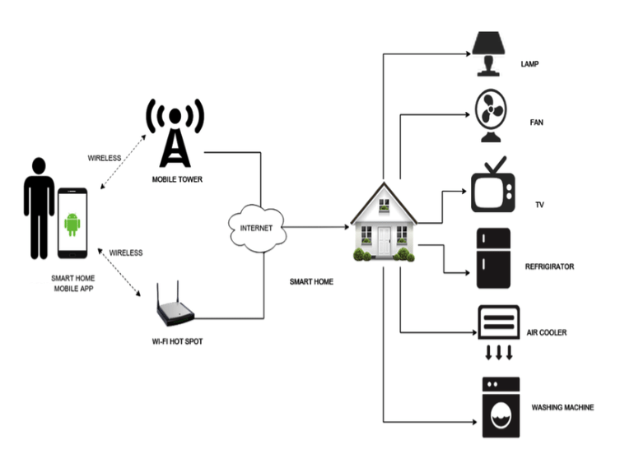
IoT-enabled Home Automation
Introduction : Home automation, powered by the Internet of Things (IoT) involves connecting everyday devices and appliances to the internet, allowing them to communicate and interact with each other through a centralized system. This technology enables homeowners to control various aspects of their homes remotely, creating a more responsive and intelligent living environment.
Figure : Flow diagram of IoT-enabled Home Automation.

Slide 4
Application of IoT-enabled Automation : IoT (Internet of Things) enabled automation has found numerous applications in both home and industrial settings, revolutionizing the way we interact with and manage devices, systems, and processes. Here are some examples of its uses in both contexts.
Home Uses
Smart Home Control : IoT-enabled devices like smart thermostats, lighting systems, and security cameras allow homeowners to remotely control and monitor their home environment through smartphones or other devices.
Home Security : Smart doorbell cameras, motion sensors, and window sensors connected to IoT platforms enable real-time monitoring and alerts, enhancing home security and providing peace of mind.
Energy Management : Smart energy meters, appliances, and lighting systems can be controlled remotely and optimized for energy efficiency, helping homeowners reduce energy consumption and utility bills.
Appliance Automation : IoT-enabled appliances like refrigerators, ovens, and washing machines can be controlled remotely or programmed to operate at specific times, improving convenience and efficiency.
Healthcare Monitoring : Wearable devices connected to IoT platforms can monitor health metrics and transmit data to healthcare professionals, allowing for remote patient monitoring and timely interventions.
Personal Assistants : Virtual assistants like Amazon Echo and Google Home use IoT to connect to the internet and provide information, control smart devices, and perform tasks through voice commands.
Entertainment Systems : Smart TVs, streaming devices, and audio systems can be integrated with IoT platforms for remote control, content streaming, and personalized entertainment experiences.

Slide 5
Industrial Uses
Supply Chain Management : IoT sensors can be placed on goods, vehicles, and containers to track their location, condition, and movement throughout the supply chain, enhancing logistics and inventory management.
Predictive Maintenance : Industrial equipment, such as manufacturing machinery and turbines, can be equipped with sensors that monitor performance and send data to predictive maintenance systems, enabling timely repairs and minimizing downtime.
Remote Monitoring : Industrial processes and equipment can be remotely monitored using IoT-enabled sensors and cameras, allowing operators to oversee operations from a central location and make informed decisions.
Asset Tracking : IoT-enabled tags and sensors can track the location and usage of valuable assets within industrial environments, improving asset utilization and reducing losses.
Environmental Monitoring : IoT sensors can monitor environmental factors such as temperature, humidity, air quality, and noise levels in industrial settings to ensure optimal conditions for operations and employee safety.
Smart Agriculture : IoT technology can be used in agriculture to monitor soil moisture, crop health, and livestock conditions, helping farmers make data-driven decisions for optimal yield and resource management.

Slide 6
Designing and Practical Implementation : In the process of designing the IoT-enabled Home Automation system we have to ensure the term which is very important for this project is, we have to make sure the system is user friendly. That’s why we are using a server and protocol named SinricPro and integrating it to Google Assistant. The significance of Google Assistant is it will help us to control the system over voice command and we will able to set timer to make schedule for a specific load considering the load will be activated or deactivated.
Required Components :
Microcontroller with WI-FI Connection. [ESP-32]
Temperature and Humidity Sensor. [DHT-11]
0.96” OLED Display.
LOAD. [220VAC-10A]
Tactile Switch.
3-Chanel Relay Module.
Power Supply [5VDC]
Power Supply[220VAC]
Connecting Plug.
Bread Board.
Connecting Wire.
Smart Device.
Internet Connection.

Slide 7
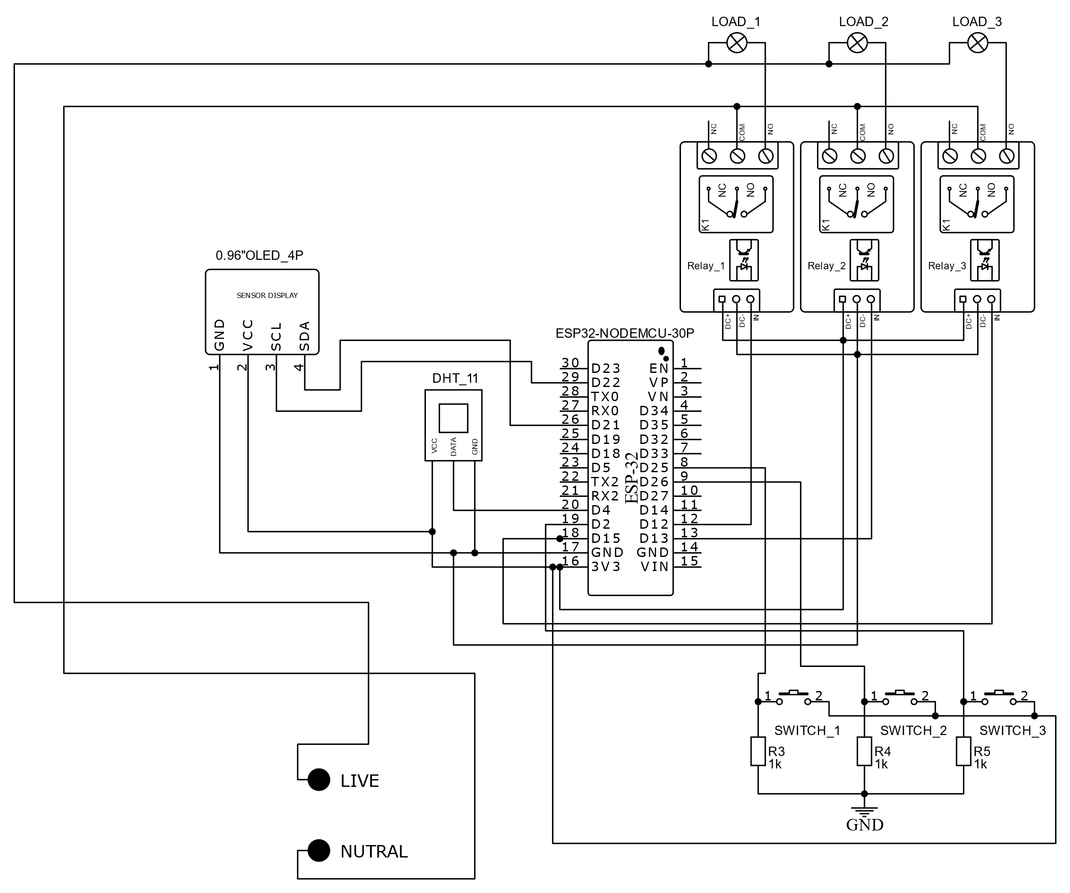
Circuit Diagram : IoT-enabled Home Automation.

Slide 8
Important Library and Codes : IoT-enabled Home Automation.
Significance of Function and Library used in IoT-enabled Home Automation
Library Name | Description
<wire.h> | The “Wire.h” library in Arduino provides functions for I2C communication, allowing devices to communicate with each other using a two-wire protocol.
<Adafruit_GFX> | The Adafruit_GFX library is a graphics library developed by Adafruit Industries for use with various microcontroller platforms, such as Arduino. It provides a set of functions and tools that make it easier to create graphical user interfaces (GUIs), display text, draw shapes, and manage graphics on displays, such as LCDs, OLEDs, and other types of screens.
<Adafruit_SSD1306> | The Adafruit_SSD1306 library is significant because it provides an easy way to control SSD1306-based OLED displays with Microcontroller.
<DHT.h> | The DHT library is commonly used to interface with DHT series sensors, which are used to measure temperature and humidity. The "dht.h" library provides functions that allow you to communicate with these sensors and retrieve temperature and humidity readings from them.
DHT dht(DHTPIN,DHTTYPE) | This function refers to the DHT-11 sensor operation.
<Arduino.h> | The “Arduino.h" library is a core part of the Arduino programming environment. It provides essential functions and definitions that allow you to interact with the hardware of an Arduino board.
<map> | Map libraries are significant tools in software development because they enable the integration of interactive maps into applications. They offer functionalities like displaying geographical data, creating custom markers, calculating routes, and providing location-based services.

Slide 9
Important Library and Codes : IoT-enabled Home Automation.
Significance of Function and Library used in IoT-enabled Home Automation
Library Name | Description
<SinricPro.h> | The “SinricPro.h" library is significant because it provides a way to easily integrate Amazon Alexa functionality into your projects. It allows you to create smart home devices that can be controlled using voice commands through Alexa. This library simplifies the communication process between your devices and the Alexa platform, enabling you to focus more on the functionality of your smart devices rather than the intricacies of the Alexa integration. It's a valuable tool for developers working on IoT projects and home automation systems.
<SinricProSwitch.h> | The “SinricProSwitch.h" library is used to interact with Sinric Pro, a platform that allows you to create virtual smart devices and integrate them with various voice assistants like Amazon Alexa and Google Assistant. This library enables you to easily control virtual switches using your voice or mobile apps. It's significant for developers creating smart home applications, as it simplifies the process of integrating voice control and remote access to their devices.
WiFi.begin(WIFI_SSID, WIFI_PASS); | To initialize the WiFi module of ESP-32 and connect the module to a WiFi network

Slide 10
Oscilloscope
Introduction : An oscilloscope is a vital tool in Electrical and Electronic Engineering, used to visualize electrical signals in real time. It displays waveforms graphically, allowing users to analyze voltage changes over time. Oscilloscopes help diagnose and troubleshoot electronic circuits, providing insights into signal frequency, amplitude, phase, and more. With their ability to capture transient events and provide a visual representation of complex waveforms, oscilloscopes are indispensable for anyone working with electronic systems.
For this project we are using the oscilloscope for analyzing the input power quality from power grid to out system. The term power quality analysis refers to this project, the electrical signal which is entering to our system is actually harmonics free and exactly 50 Hz or it’s fluctuating time to time. By this oscilloscope we will also able to observe any kind of wave shape of any node.
Analog Signal
Sampler
Quantizer
Encoder
Memory
Processor
Digital to Analog
Display
Display Memory
ADC
Figure : Flow diagram of working process of Oscilloscope.

Slide 11
Designing and Practical Implementation : In the process of designing the circuit parameter of oscilloscope we have used a microcontroller for reading analog value and the microcontroller convert this analog value into Digital signal or discreate in time and quantized value by using Analog to Digital Converter (ADC). As our microcontroller can work only 0 VDC to 5 VDC , to read the negative analog value we have to use a off-set value to recognize the alternating signal as a wave shape. In this design we have used voltage divider rule to protect our microcontroller board from high voltage.
Required Components :
Microcontroller. [Arduino Nano]
1.3” OLED Display.
Resistor.[1M ohm and 120K ohm]
Diode.[1N4148]
Tactile Switch.
Signal Testing Probe.
3.5 mm Jack.
3.5 mm Socket.
Power Supply [Pure 5VDC]
Vero Board.
Connecting Wire.

Slide 12
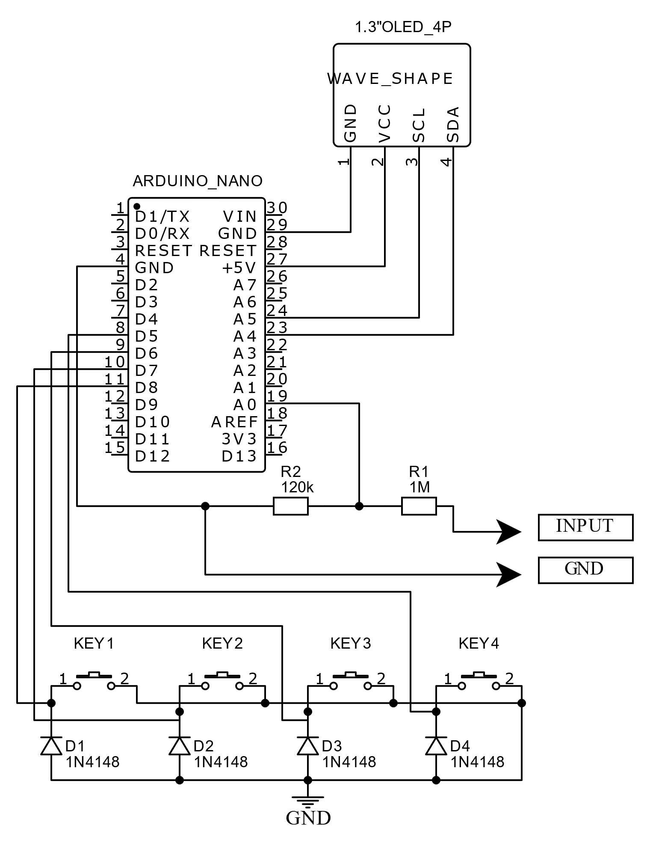
Circuit Diagram : Oscilloscope.

Slide 13
Important Library and Codes : Oscilloscope
Significance of Function and Library used in Oscilloscope
Library Name | Description
<Adafruit_SSD1306> | The Adafruit_SSD1306 library is significant because it provides an easy way to control SSD1306-based OLED displays with Arduino boards.
<EEPROM> | The "#include<EEPROM.h>" library in Arduino coding provides functions that allow you to read from and write to the Electrically Erasable Programmable Read-Only Memory (EEPROM) on the Arduino board. This allows you to store and retrieve data that persists even when the Arduino is powered off. It's useful for scenarios where you need to store configuration settings, calibration data, or any other data that needs to be retained across power cycles. The library simplifies working with EEPROM, providing functions to read and write various data types.
<Adafruit_SH1106> | The SH1106 controller is designed to drive OLED displays, and the "Adafruit_SH1106.h" library provides functions and methods to control these displays efficiently. The library is developed by Adafruit Industries, a company known for creating a wide range of open-source hardware and software for makers and DIY electronics enthusiasts.
analogRead() | analogRead is a function commonly used in microcontroller programming, especially in platforms like Arduino, to read analog voltage values from analog pins. Microcontrollers typically have a set of digital pins and a set of analog pins. Digital pins can only read or write binary (high or low) values, while analog pins can read continuous voltage levels within a specified range.

Slide 14
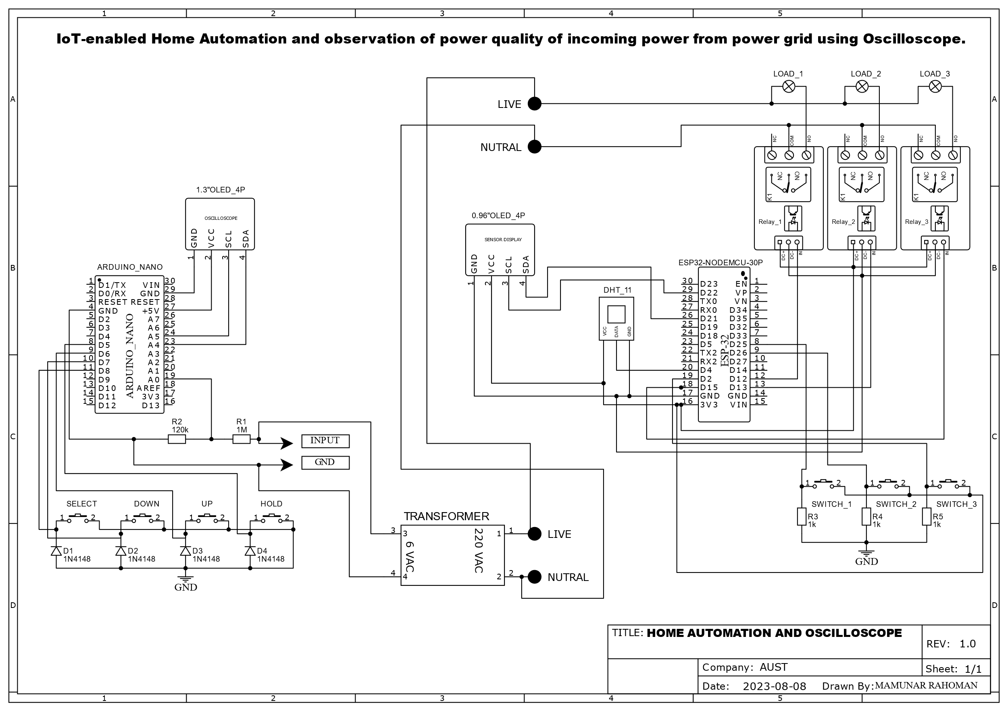
Combination of IoT-enabled Home Automation and Oscilloscope

Slide 15
Conclusion : By seamlessly integrating everyday devices with the power of the Internet of Things (IoT), this technology has redefined convenience, efficiency, and control within our homes. The ability to remotely monitor and manage appliances, lighting, security systems, and more, all through a central platform, has not only elevated our living experiences but also ushered in a new era of energy conservation and sustainable practices. As this field continues to evolve, we can anticipate even more sophisticated applications, increased interoperability, and heightened levels of personalization, ultimately transforming houses into smart, intuitive hubs that cater to our needs and preferences like never before. The microcontroller-based IoT-enabled home automation revolution is here to stay, promising a future where our living spaces are not just intelligent, but truly responsive to our lifestyles.
THANK YOU

