Slide 1
Ahsanullah University of Science and Technology
Department of Electrical and Electronic Engineering
4th Year 1st Semester
PROJECT PRESENTATION
Course No. : EEE-4134
Course Title : VLSI-I Lab
Submitted By[GROUP-01]
SL No. | Student Name | Student ID
01 | Md. Mamunar Rahoman Roton | 20200105196
Submitted To
Ms. Oli Lowna Baroi Assistant Professor Department of Electrical and Electronic Engineering Ahsanullah University of Science and Technology
Mr. Nafiz Imtiaz Lecturer Grade-II Department of Electrical and Electronic Engineering Ahsanullah University of Science and Technology

Slide 2
Project Name : A Novel Multiplexer-Based Low-Power Full Adder.
Objective : The objective of this project-
To present a novel low-power multiplexer based 1-bit full adder circuit called MBA-12T.
To demonstrate the advantages over conventional 28-transistor CMOS and other 10-transistor adders in terms of power consumption and speed.
To highlight the suitability of the new adder for building larger low-power high-performance VLSI systems.
Working Principle of Full Adder :
A
B
C
S0
Truth Table of Full Adder
A | B | Cin | SUM | Cout
0 | 0 | 0 | 0 | 0
0 | 0 | 1 | 1 | 0
0 | 1 | 0 | 1 | 0
0 | 1 | 1 | 0 | 1
1 | 0 | 0 | 1 | 0
1 | 0 | 1 | 0 | 1
1 | 1 | 0 | 0 | 1
1 | 1 | 1 | 1 | 1
HA
HA
C0
S0
C1
S
OR
C
Figure : Block Diagram for working principle of Full Adder

Slide 3
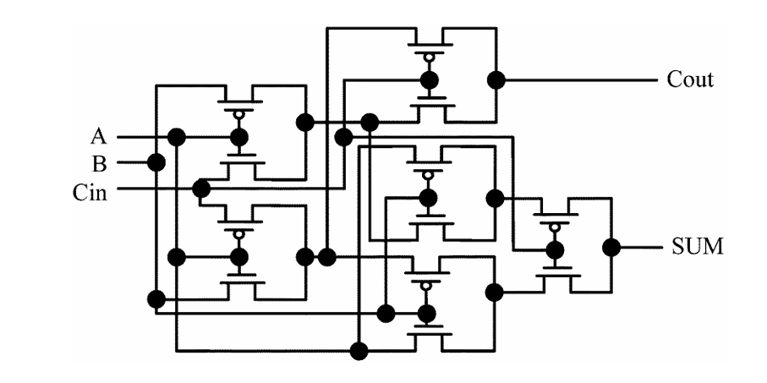
Circuit Name : New MBA(Multiplexer Based Full Adder)-12 Transistor Full Adder.
Schematic Diagram :
Figure : Schematic diagram of New MBA-12T Full Adder.

Slide 4
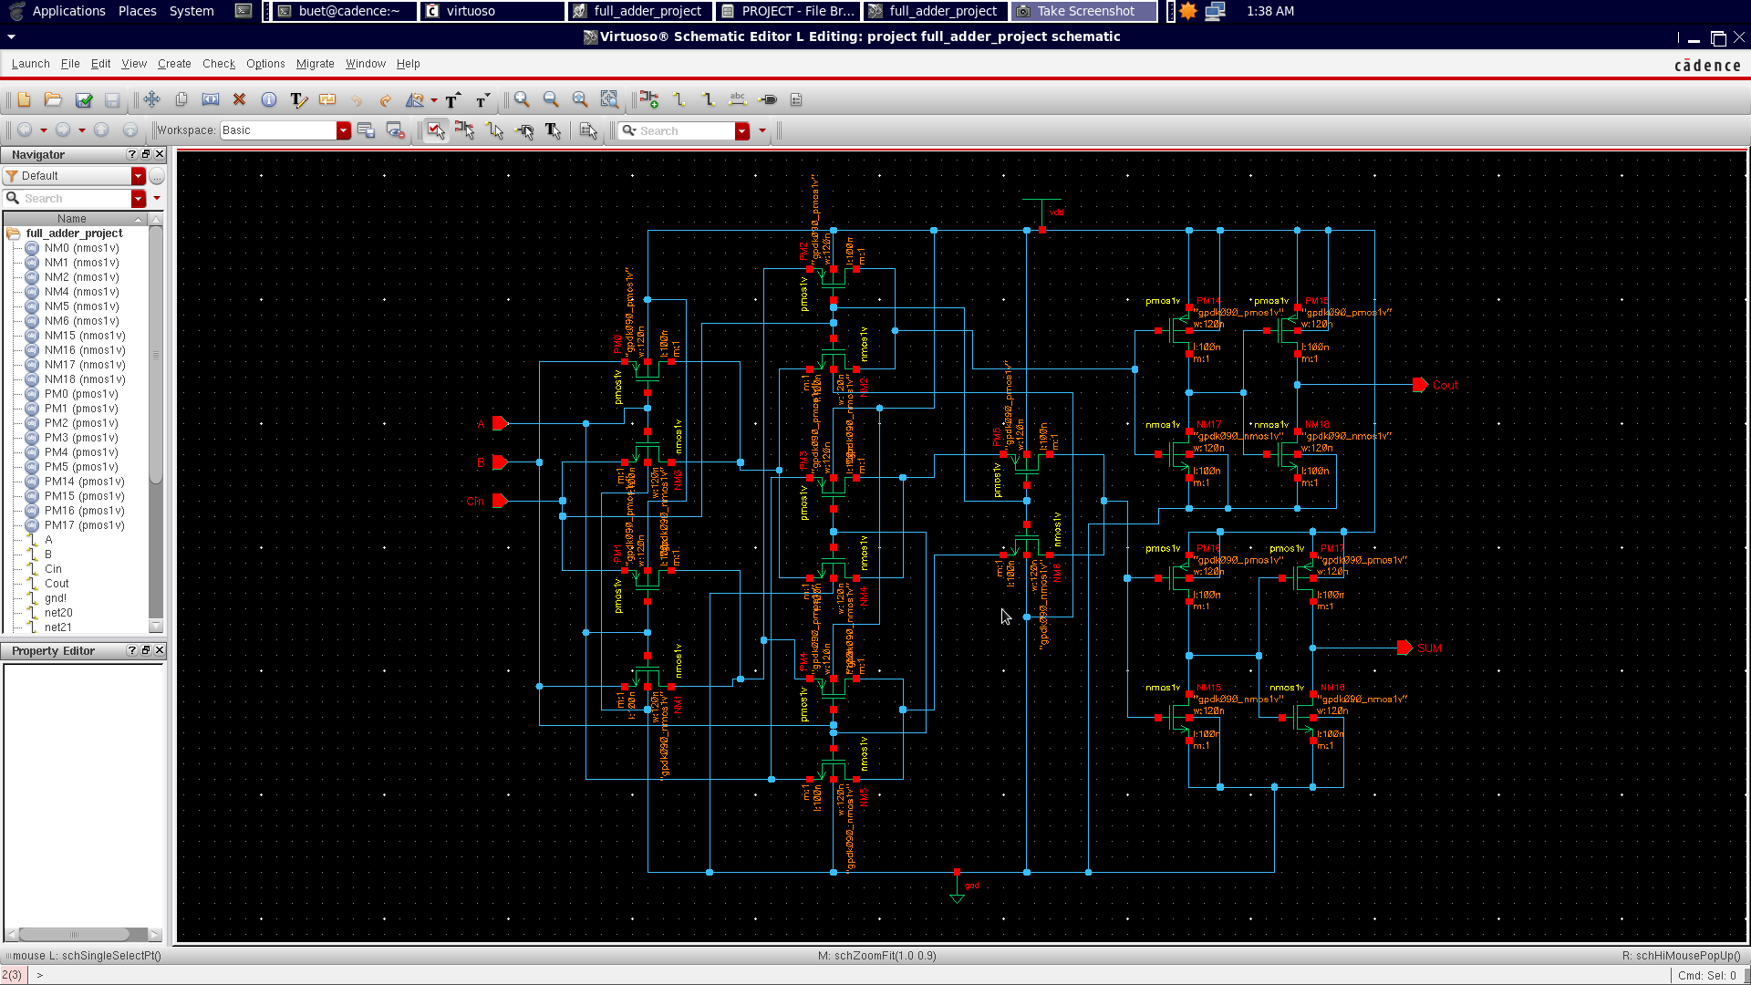
Schematic Diagram Over Cadence Virtuoso

Slide 5
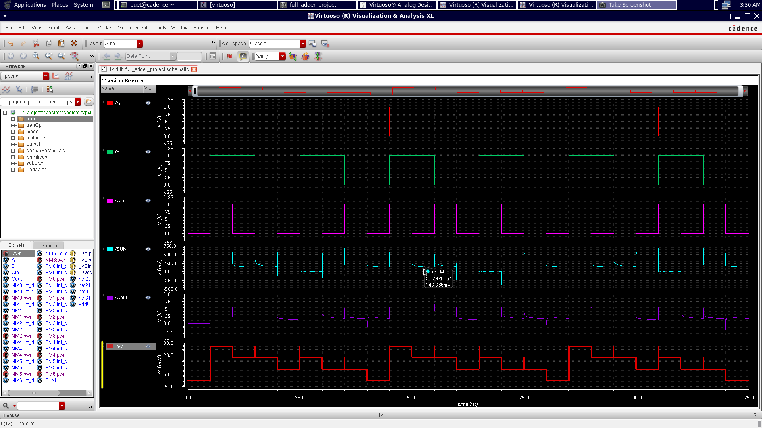
Output Logic-Level Over Cadence Virtuoso without using Buffer

Slide 6
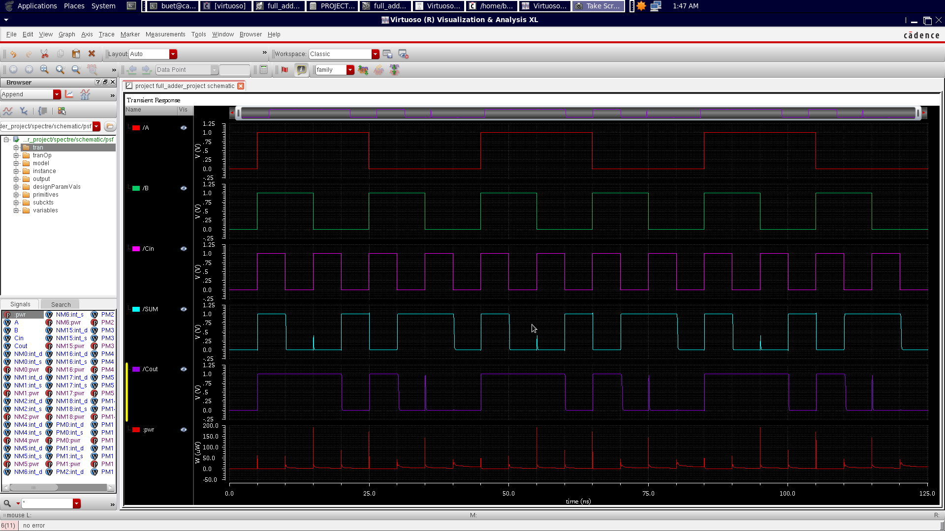
Output Logic-Level Over Cadence Virtuoso using Buffer

Slide 7
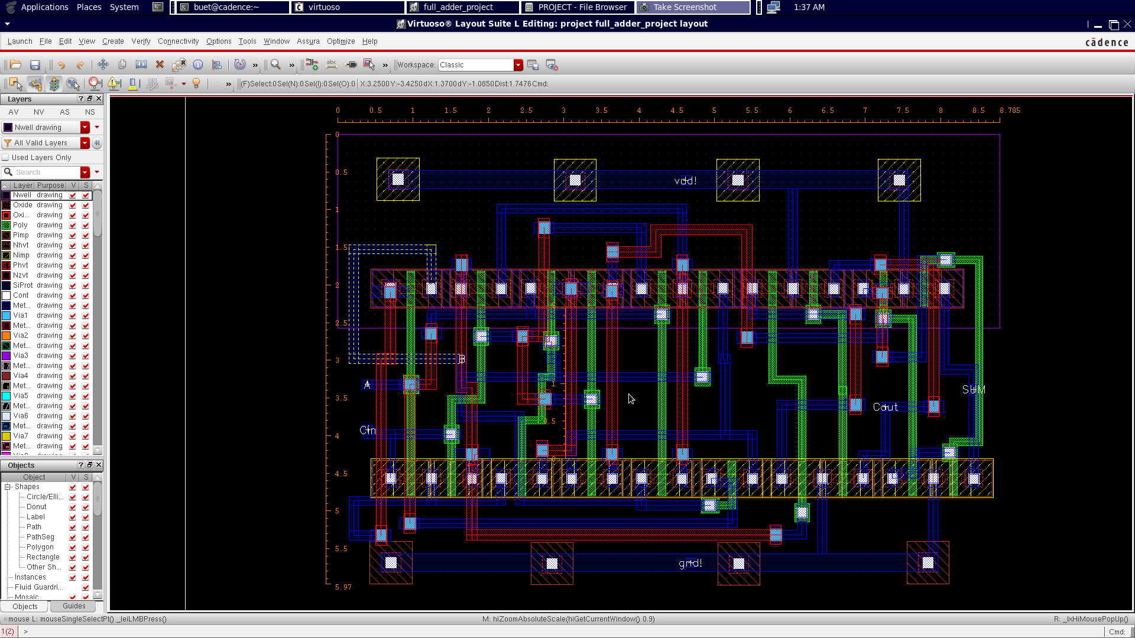
Layout diagram Cadence Virtuoso using Buffer

Slide 8
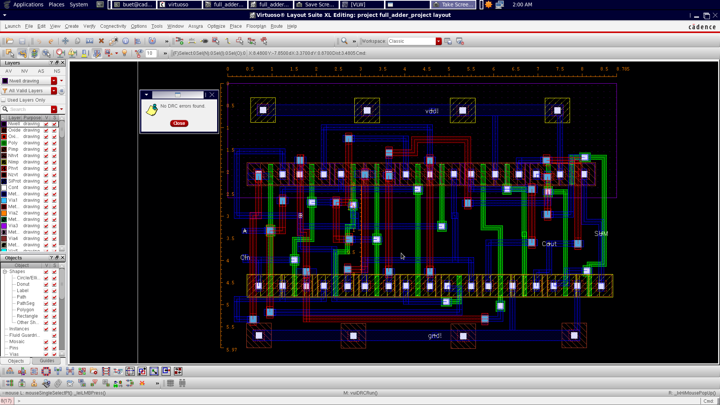
DRC Check over Cadence Virtuoso using Buffer

Slide 9
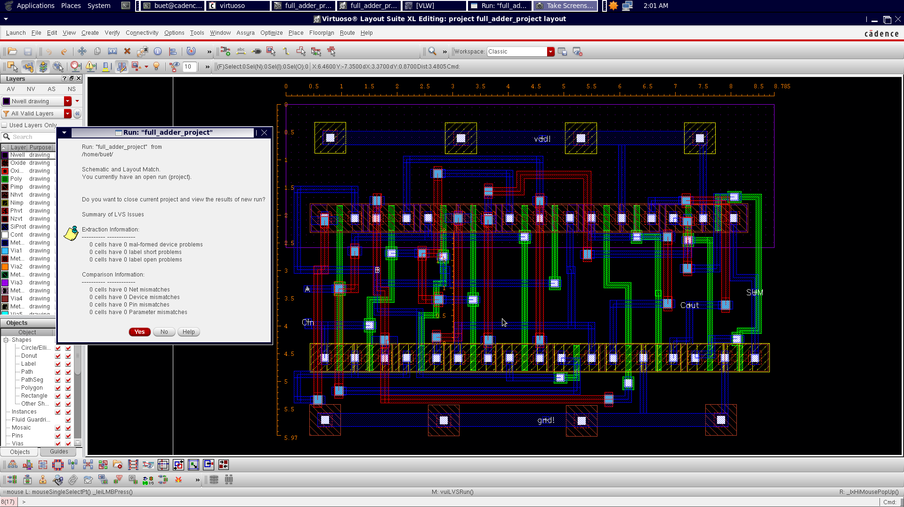
LVS Check over Cadence Virtuoso using Buffer

Slide 10
Results
Propagation Delay(s) | Average Power without Buffer(W) | Average Power with Buffer(W) | Power Delay Product(Ws) | Cell Area(m²) | No. of Transistor Without Buffer | No. of Transistor With Buffer | No. of DRC Error | No. of LVS Error
40.67E-12 | 13.11E-3 | 5.202E-6 | 2.114E-16 | 52.446E-6 | 12 | 20 | 0 | 0

Slide 11
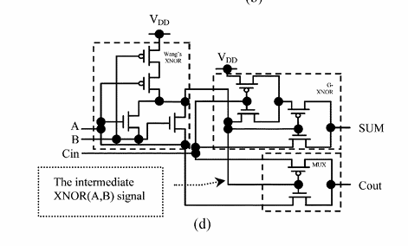
Circuit Name : Full Adder using intermediate XNOR (A,B) Signal.
Schematic Diagram :

Slide 12
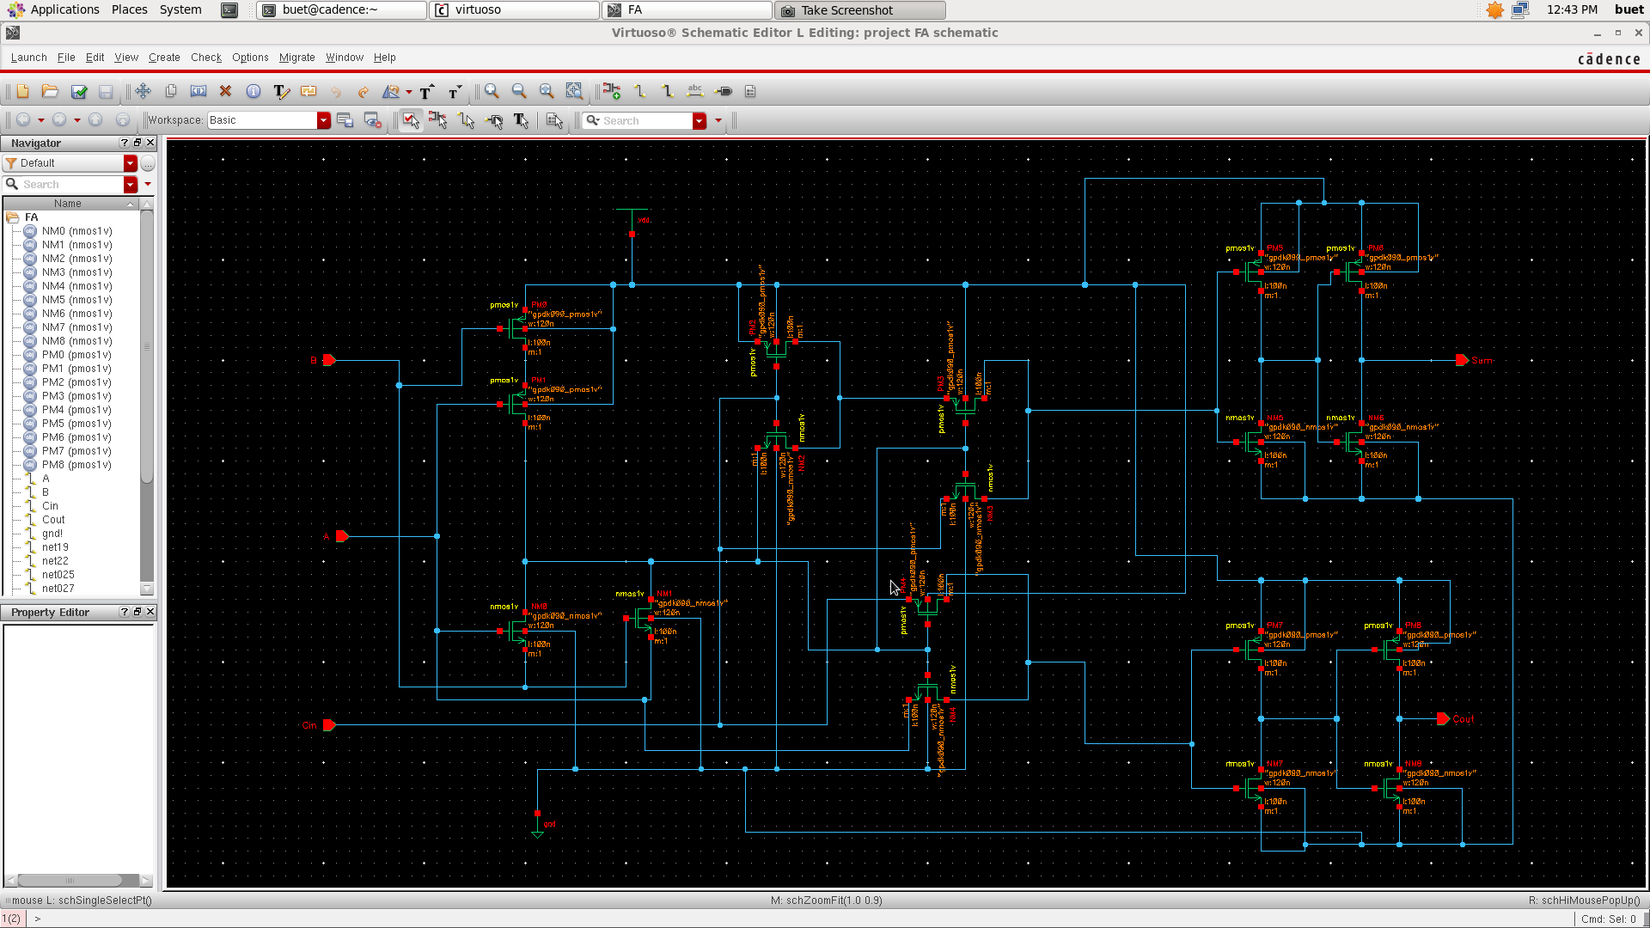
Schematic Diagram Over Cadence Virtuoso

Slide 13
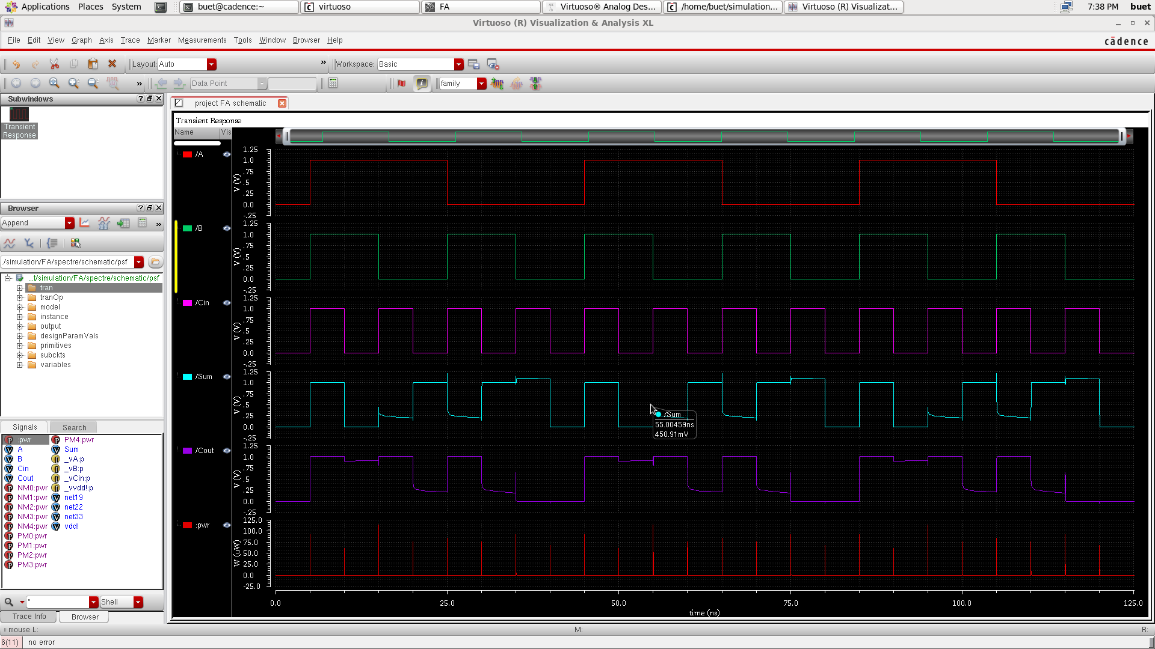
Output Logic-Level Over Cadence Virtuoso without using Buffer

Slide 14
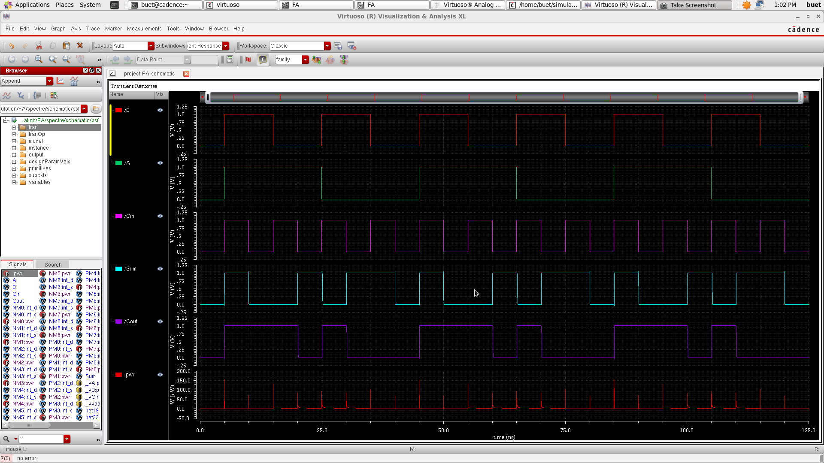
Output Logic-Level Over Cadence Virtuoso using Buffer

Slide 15
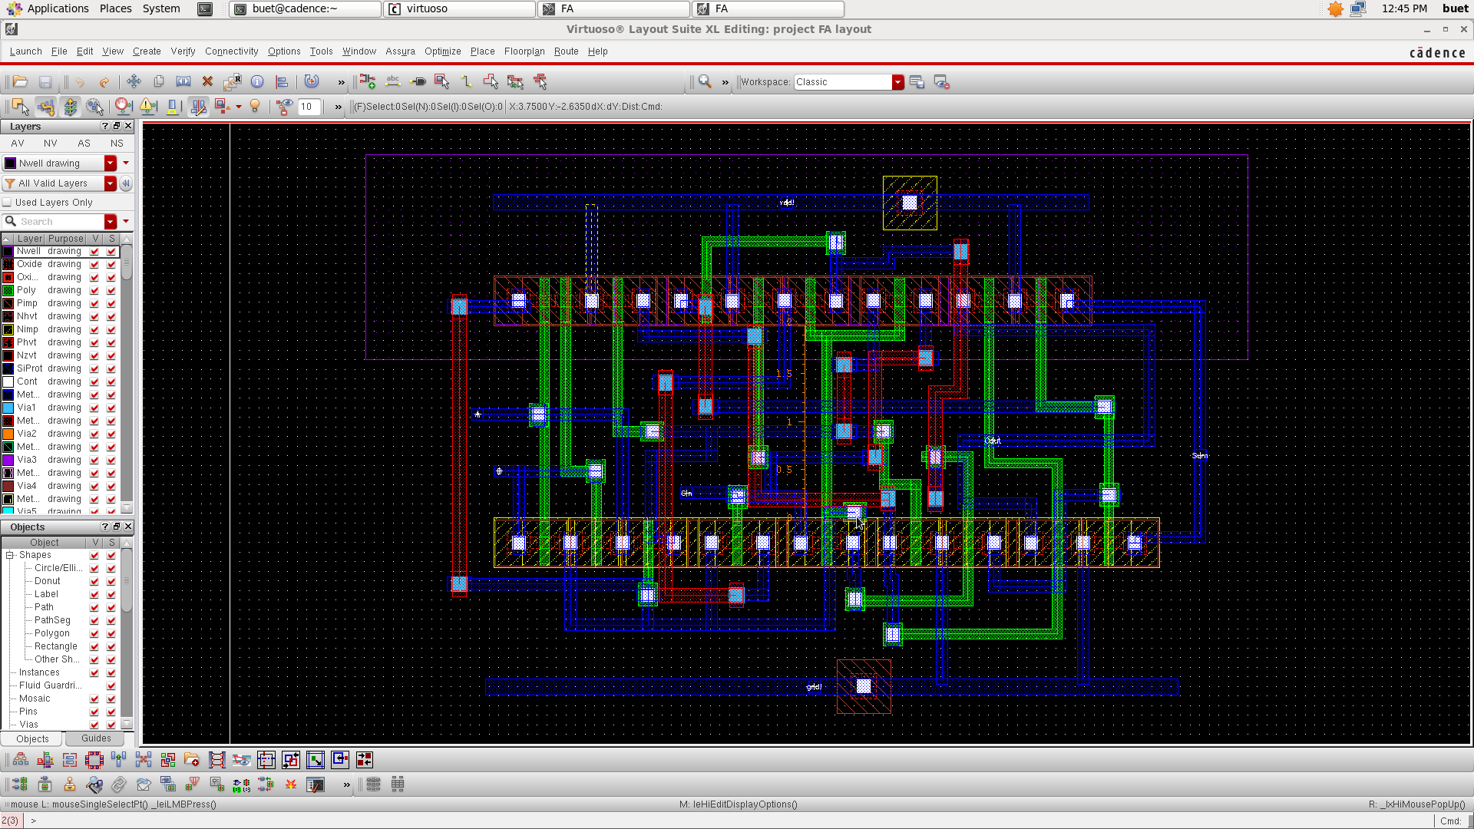
Layout diagram Cadence Virtuoso using Buffer

Slide 16
Results
Propagation Delay(s) | Average Power without Buffer(W) | Average Power with Buffer(W) | Power Delay Product(Ws) | Cell Area(µm²) | No. of Transistor Without Buffer | No. of Transistor With Buffer | No. of DRC Error | No. of LVS Error
51.32E-12 | 168.4E-9 | 2.44E-6 | 1.973E-16 | 38.677E-6 | 10 | 18 | 0 | 0

Slide 17
Results
Result Comparison
 | 12-T MBA | Intermediate X-NOR-I
Propagation Delay | 40.67E-12 s | 51.32E-12 s
Avg. Power Without Buffer | 13.11E-3 W | 168.4E-9 W
Average Power with Buffer | 5.202E-6 W | 2.44E-6 W
Power Delay Product | 2.114E-16 Ws | 1.973E-16 Ws
Cell Area | 52.446E-6 µm² | 38.677E-6 µm²
No. of Transistor without Buffer | 12 | 10
No. of Transistor with Buffer | 20 | 18
No. of DRC Error | 0 | 0
No. of LVS Error | 0 | 0
THE END

