Slide 1
Ahsanullah University of Science and Technology
Department of Electrical and Electronic Engineering
4th Year 1st Semester
PROJECT PRESENTATION
Course No. : EEE-4154
Course Title : Power System –II Lab
Submitted By[GROUP-01]
SL No. | Student Name | Student ID
01 | Md. Mamunar Rahoman Roton | 20200105196
Submitted To
Mr. Ata-E-Rabbi Assistant Professor Department of Electrical and Electronic Engineering Ahsanullah University of Science and Technology
Mr. Abdullah Saleh Lecturer Grade-II Department of Electrical and Electronic Engineering Ahsanullah University of Science and Technology

Slide 2
Project Name : Project on Over Voltage-Under Voltage and overload protection system of power system.
Objective : The objectives of this project are-
To Protect the devices are connected to the power system from Over Voltage.(OV)
To Protect the devices are connected to the power system from Under Voltage.(UV)
To protect the power system from Over Load Condition.(OL)
Working Principle :
Normal
Voltage
Under
Voltage
Working Conditions
Under Voltage[<200V] | Over Voltage[>230V] | Normal Voltage[200V-230V] | Over Load[1.2A] | Load
NO | NO | YES | NO | ON
NO | YES | NO | NO | OFF
NO | NO | YES | YES | OFF
YES | NO | NO | NO | OFF
Over
Voltage
Figure : Fundamental Concept for Over Voltage and Under Voltage Condition
According to this conditions we have to design our circuit which will able to protect the devices those are connected with the power system from Over Voltage Under Voltage and Over Load Condition.
For this project we used a microcontroller to make our project more controllable. As we used microcontroller in this project we will able to make changes in the condition and will able to tune the Volatge and current level when the devices will isolated from the power system.
Over Load Condition
Rated RMS Current Level
Figure : Fundamental Concept for Over Load Condition

Slide 3
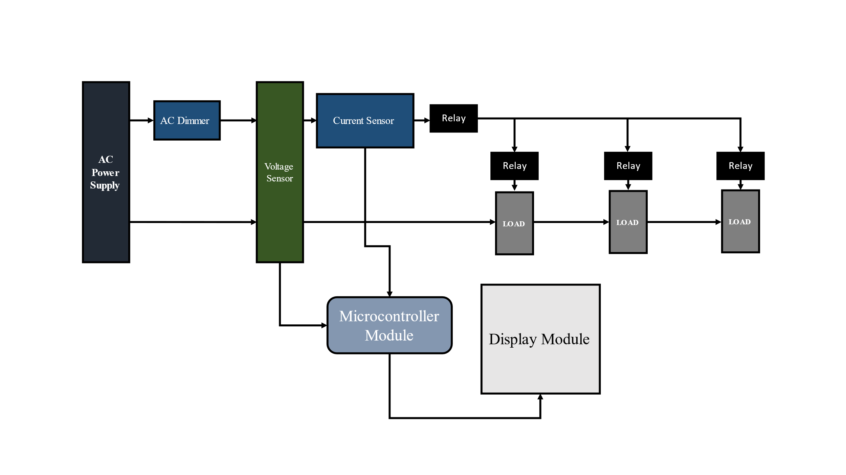
Block Diagram :
Figure : Block Diagram for working process of this project.

Slide 4
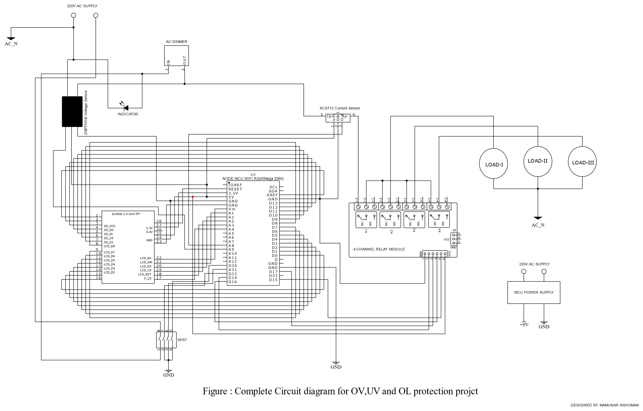
Circuit Diagram :

Slide 5
Component List :
Advantages :
Ensures the stable and reliable operation of electrical systems by preventing voltage fluctuations that could lead to malfunctions or failures.
Reduces the risk of downtime and the associated costs of repairs or replacements.
Protects electrical devices from overloads, helping to maintain optimal operating conditions and improving energy efficiency.
Overload protection prevents electrical equipment from being subjected to excessive current, which can lead to overheating and damage. This is crucial for extending the lifespan of the equipment.
By limiting the current flowing through the system to safe levels, overload protection contributes to the stability and reliability of the entire electrical system.
Overload protection prevents electrical equipment from being subjected to excessive current, which can lead to overheating and damage. This is crucial for extending the lifespan of the equipment.
Minimizes the risk of electrical fires or other safety hazards caused by excessive voltage or current.
Ensures the stable and reliable operation of electrical systems by preventing voltage fluctuations that could lead to malfunctions or failures.
SL No. | Component Name | Quantity | P.P. Unit(Tk) | Price(Tk)
01 | Node MCU Mega WI-FI R3 Atmega 2560 | 1 | 1890 | 1890
02 | 3.5 inch LCD Display | 1 | 1680 | 1680
03 | ACS712 Current Sensor | 1 | 219 | 219
04 | ZMPT101B Voltage Sensor | 1 | 270 | 270
05 | 4 Chanel Relay Module | 1 | 290 | 290
06 | Phase indicator | 1 | 45 | 45
07 | Filament Bulb(40W) | 3 | 20 | 60
Total Price |  |  |  | 4454

Slide 6
Disadvantages :
Protection systems may sometimes trigger false alarms or trips due to transient spikes or momentary fluctuations that are not necessarily harmful.
Some protection circuits may have a delay in their response time. In critical applications, a delayed response could lead to damage before the protection system activates.
Protection devices may dissipate some power, leading to energy losses in the system.
As the load switch are operating using electromechanical switch or relay there will have a extra power consuming term which is inductor inside the electromechanical switch.
In this project we used ATmega 2560 Microcontroller which clock frequency is 16MHz, this clock frequency is not sufficient for broad level of project. That’s why we will observe some delay in this project.
THE END

