Slide 1
DEMO NIGHT · AUGUST 29, 2026
Check Fraud
Detector System
An event-driven microservices platform that scores every check deposit in real time — rules, machine learning, computer vision, and cross-bank intelligence working as one.
Presented by Mamun

Slide 2




THE PROBLEM
One Bad Check Looks Random.
A Network of Them Looks Like a Pattern.
Check fraud rarely shows up as one obvious red flag — it hides across images, accounts, devices, and institutions:
Duplicate presentment
Altered checks
The same check, or a near-identical image, deposited more than once.
The amount or payee on the image doesn’t match what was submitted.
Counterfeit & forged checks
Cross-institution rings
Fake templates, copied layouts, or forged signatures.
The same payee, device, or account token reappearing across banks.
CHECK FRAUD DETECTOR SYSTEM
2

Slide 3



THE SOLUTION
Every Deposit Gets One Explainable Score
The moment a check deposit event is created, five services independently evaluate it — rules, ML, image forensics, and consortium history — and the platform turns that into a single action.
HOLD
MANUAL REVIEW
PASS
score ≥ 0.85
OR duplicate presentment
score ≥ 0.60
OR consortium high risk
below all thresholds
Deposit is blocked pending investigation.
Routed to a fraud analyst queue.
Deposit proceeds normally.
CHECK FRAUD DETECTOR SYSTEM
3

Slide 4
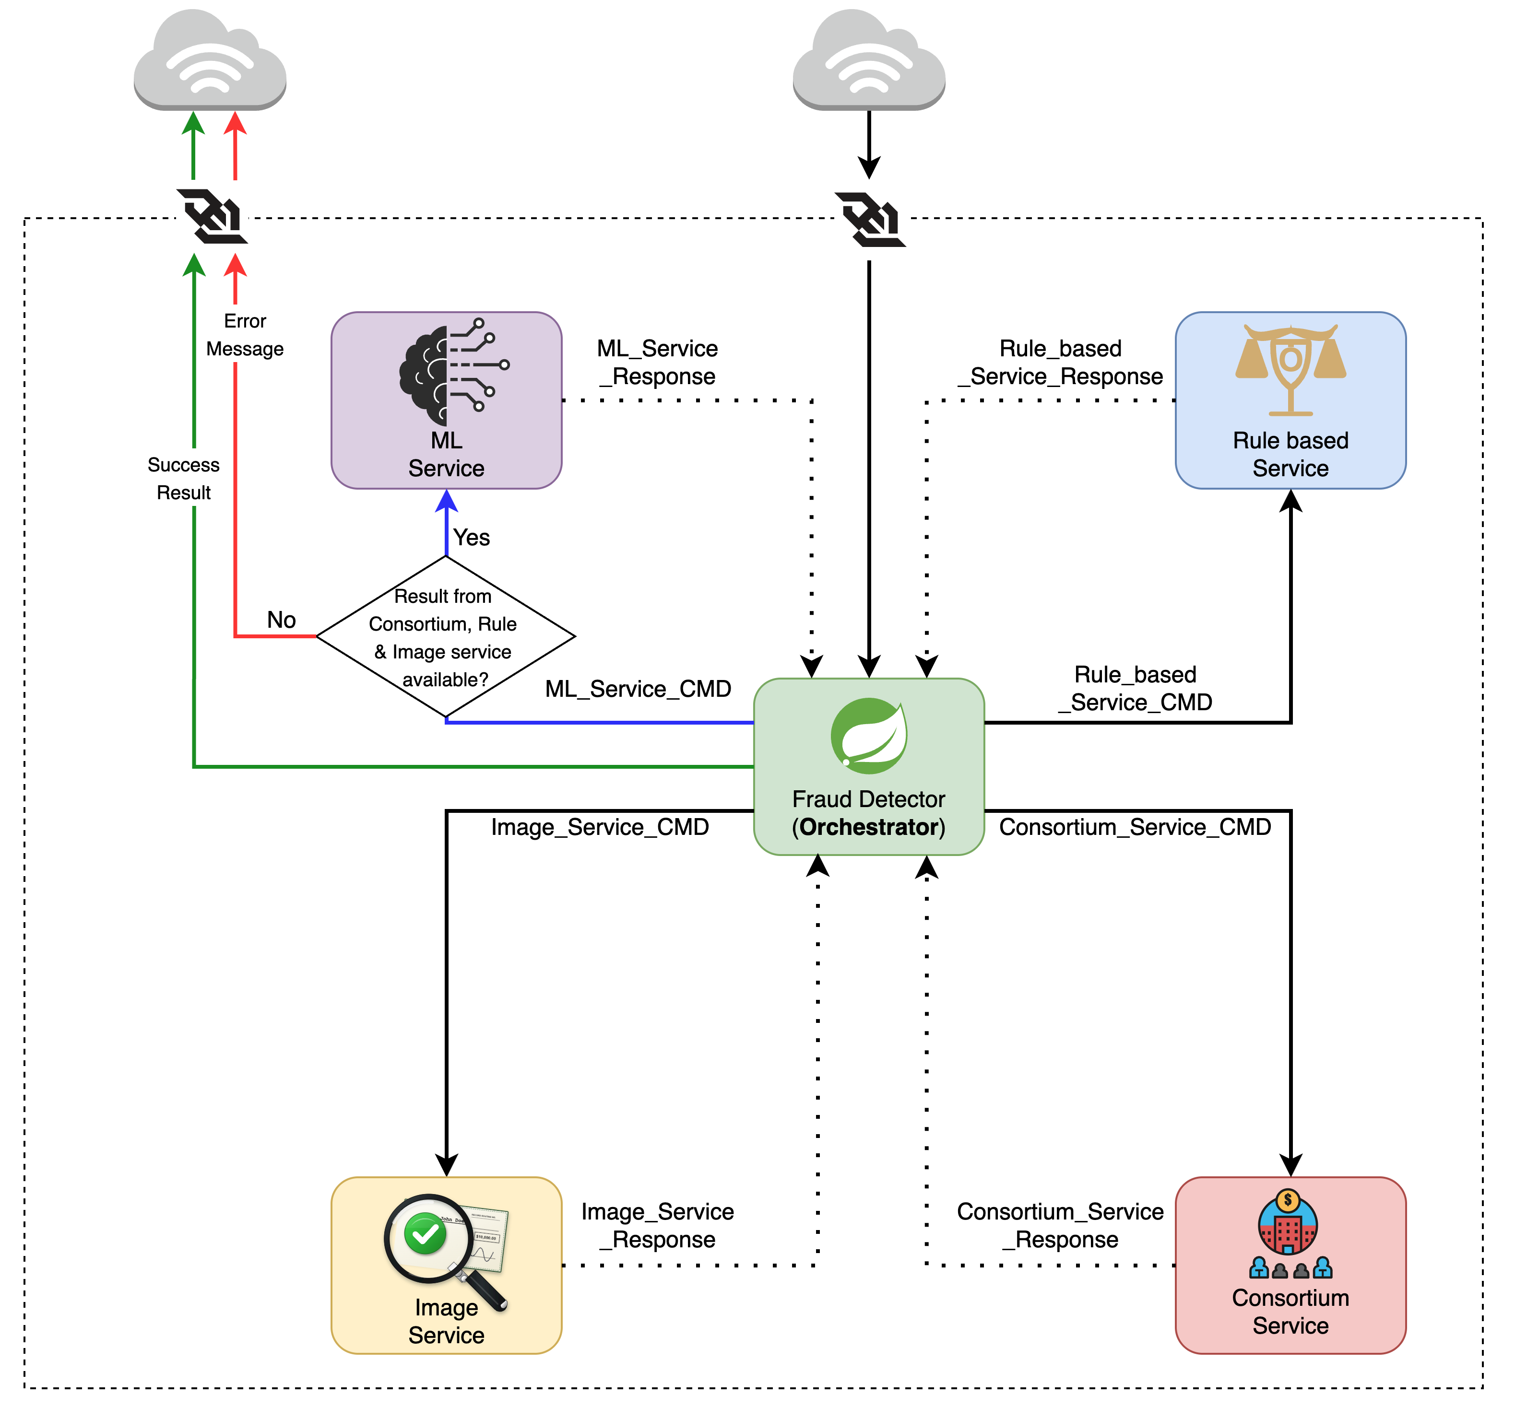
UNDER THE HOOD
System
Architecture
CHECK FRAUD DETECTOR SYSTEM
4

Slide 5




THE BUILDING BLOCKS
Five Microservices, One Decision
Fraud Detector
Consortium Service
Image Service
ORCHESTRATOR
CROSS-BANK INTEL
COMPUTER VISION
Ingests deposit events, fans out Kafka commands, aggregates results, streams status back over WebSocket.
Privacy-preserving matching across institutions using HMAC tokens — no raw PII ever leaves a bank.
Analyzes check images for duplicates, OCR mismatches, layout and font anomalies, signatures.
ML Service
Rules Service
RISK SCORING
POLICY ENGINE
Two-stage XGBoost models turn features into a calibrated fraud probability and risk band.
Evaluates deterministic rules and the final score into a HOLD / REVIEW / PASS action.
CHECK FRAUD DETECTOR SYSTEM
5

Slide 6




DEEP DIVE
Consortium Intelligence
“single-bank view → network-level fraud view”
Token index
Has this payee, device, or check image appeared at many institutions recently?
Cross-Institution Score
Relationship index
score = 0.55 × token risk + 0.25 × relationship risk + 0.20 × bank-flow risk
Is this payor – payee pair brand new, or does it have a history of confirmed fraud?
Bank-flow index
Does this deposit-bank → clearing-bank corridor show an elevated fraud rate?
Every event stores HMAC tokens and aggregate counts — never raw account, payee, or device PII. Result includes top reasons, linked counts, and recency windows for a full explanation.
CHECK FRAUD DETECTOR SYSTEM
6

Slide 7


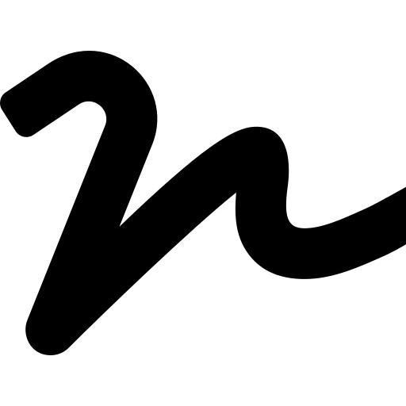
DEEP DIVE
Computer Vision + Machine Learning
Image Service
ML Service
Heuristic forensics on the check image
Two-stage, calibrated XGBoost scoring
Duplicate detection
deposit model → early risk from behavior, image & rule signals
Perceptual hashing (pHash) flags reused or near-duplicate check images.
OCR amount check
in-clearing model → refines using clearing-stage evidence
Tesseract OCR compares the printed amount to the submitted amount.
Layout anomaly
final = max( deposit, 0.45×deposit + 0.55×in-clearing )
Edge & line detection checks the check’s structure looks normal.
Signature / endorsement
HIGH ≥ .85
MEDIUM ≥ .60
LOW / MINIMAL
Ink-density scan of the signature and endorsement regions.
HOLD
REVIEW
PASS
Every score ships with feature-level reasons — e.g. image_duplicate_score, critical_rule_hit_count — so analysts see why, not just what.
CHECK FRAUD DETECTOR SYSTEM
7

Slide 8
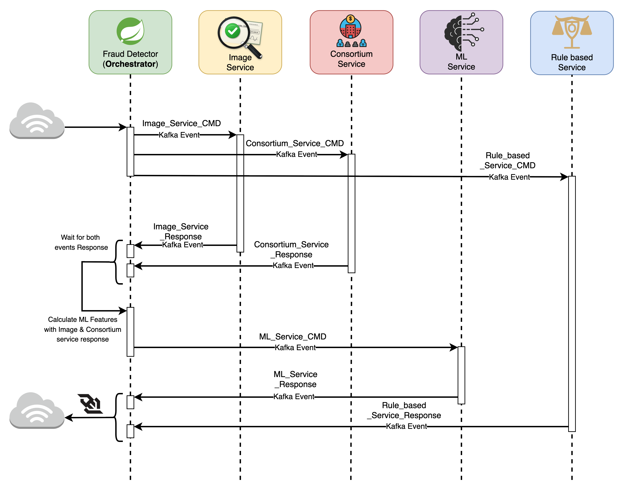
HOW IT RUNS
End-to-End
Workflow
CHECK FRAUD DETECTOR SYSTEM
8

Slide 9


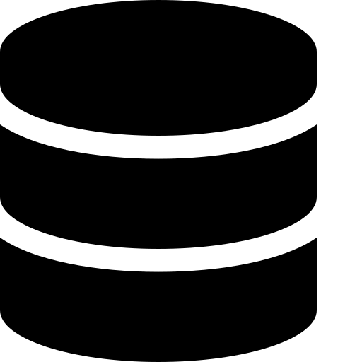
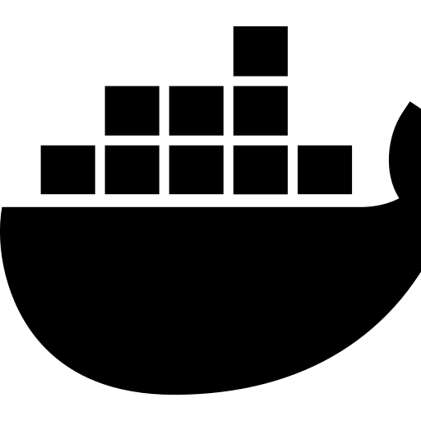


SEEING IT LIVE
From Kafka Event to Analyst Dashboard
React / TS UI
Kafka events
React + TypeScript Dashboard
Deposits stream in and update the dashboard live over a WebSocket — no polling, no refresh.
Every decision (HOLD / REVIEW / PASS) is color-coded with the contributing score, so an analyst can triage a queue in seconds.
PostgreSQL
Docker Compose
Submit a new deposit event from the UI and watch it move through consortium, image, ML, and rules scoring in real time.
Terraform / AWS
Prometheus / Grafana
CHECK FRAUD DETECTOR SYSTEM
9

Slide 10


WHAT'S NEXT
From MVP to Production-Grade Defense
Real ML on real data
Swap synthetic training data for real deposit history; add image embeddings & tamper detection.
Harden for production
KMS-backed HMAC keys, immutable audit logs, model registry, champion/challenger deploys.
Let’s stop check fraud,
one event at a time.
Track what matters
Precision/recall at-k, false-positive rate by institution, drift monitoring, latency SLOs.
Thank you — questions welcome
Mamun
CHECK FRAUD DETECTOR SYSTEM
10

