Slide 1
Big Mountain Resort Pricing Model
Osman Mamun

Slide 2
Introduction
The operating cost is increased by $1.5M in last year due to new addition to the resort.
Need to increase the pricing to generate enough revenue to offset the increased cost without losing visitors.
How to reduce the operating cost to minimize expense.
How to leverage the available resources in the best possible way to increase the ticket price.

Slide 3
Modeling the ticket price
Data was collected and cleaned.
Initial data wrangling shows promising signs that the resort is not fully utilizing its resources.
The most important factors identified are: vertical drop, snowmaking area, total number of chairs, and total number of runs.

Slide 4
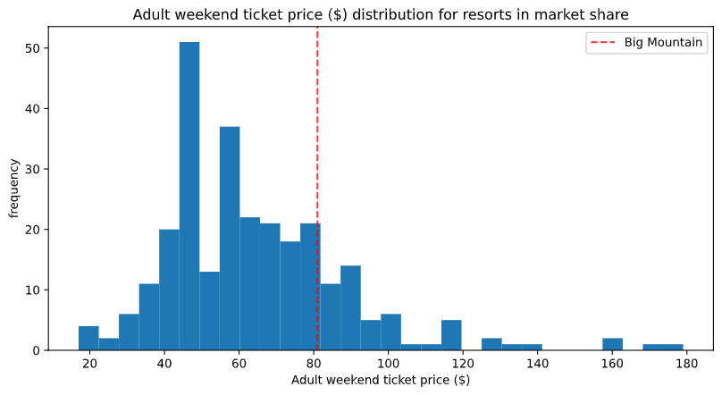
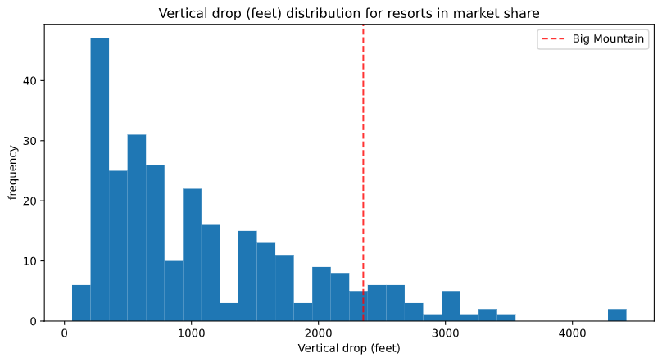
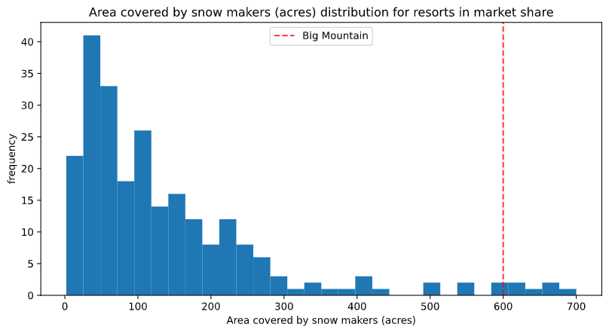
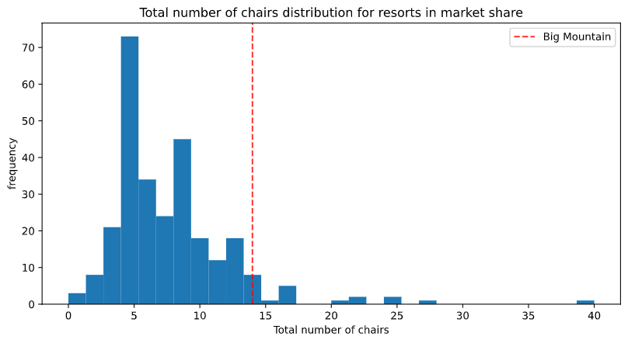
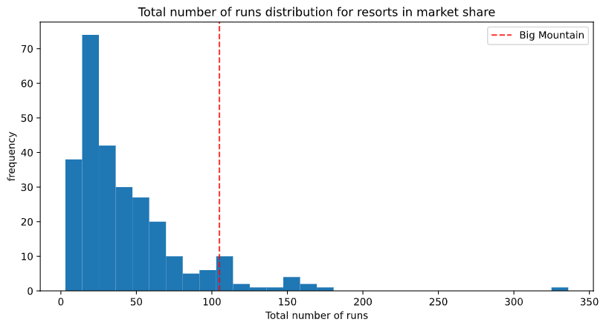
Where is Big Mountain Resort with respect to Other Resorts
Even though Big Mountain has better
facilities than most other resorts, but
It’s not claiming a good ticket price when
compared to similar resorts.

Slide 5
Modeling the ticket price
Our ticket price modeling suggests that the current price $81 is low considering all the amenities Big Mountain Resorts offer and it estimates the fair price to $96 bolstering the revenue by $2.6M per year.

Slide 6
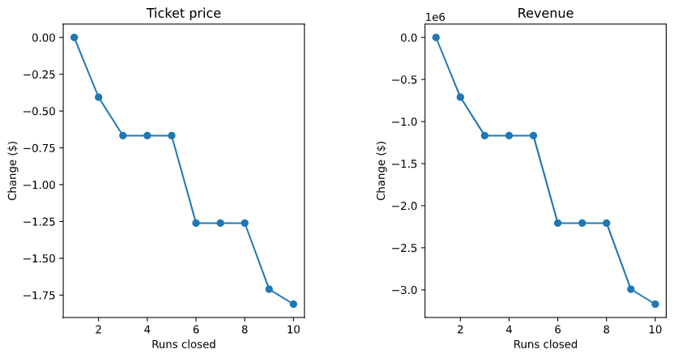
Price Sensitivity Analysis
Closing 1 run would lead to no change in ticket price.
Closing 3-5 may lead to marginal drop which could support closing them but no more than that.
Adding a run to increase the vertical drop may justify a $2 increase in ticket price.

