Slide 1
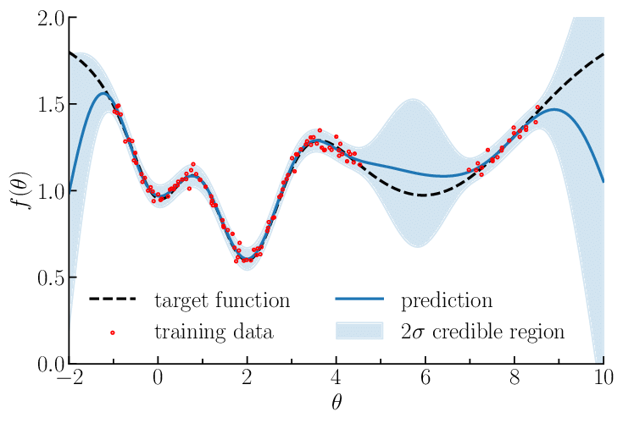
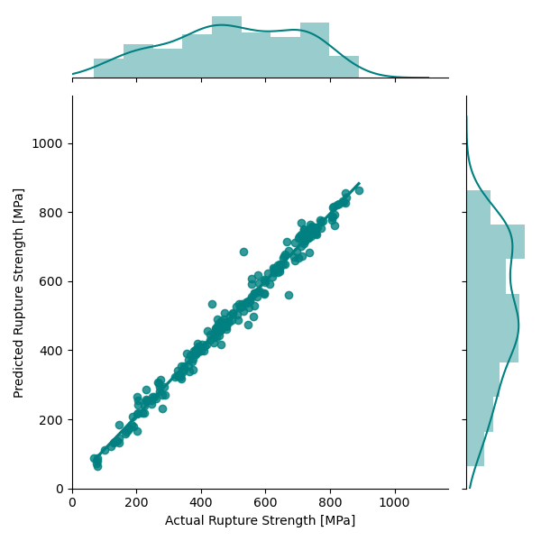
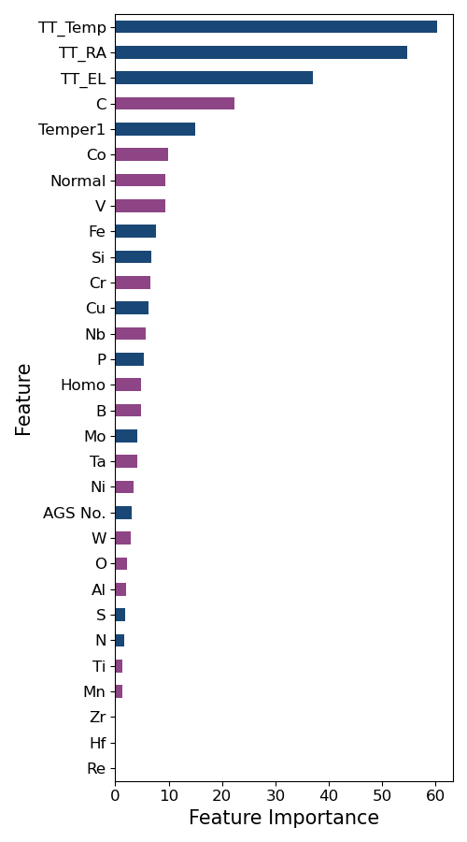
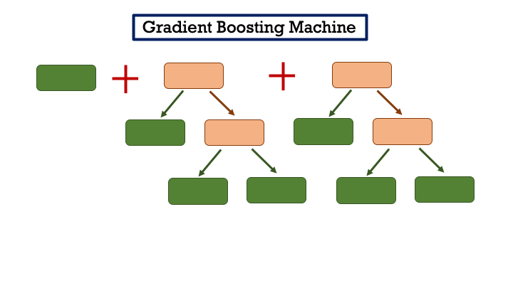
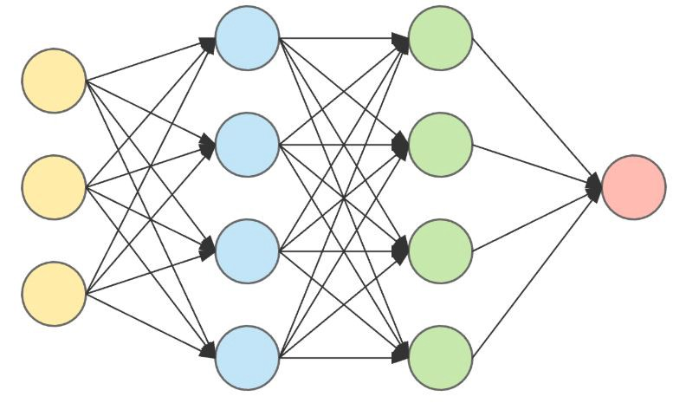
Rupture Strength
Prediction Model
Model Evaluation &
Feature Importance
1. Imputation 2. Scaling 3. Correlation Analysis
Gaussian Process
Data Preparation
Gradient Boosting Machine
Alloy Data for
9-12% Cr and
Austenitic steels
Neural Network

