Slide 1
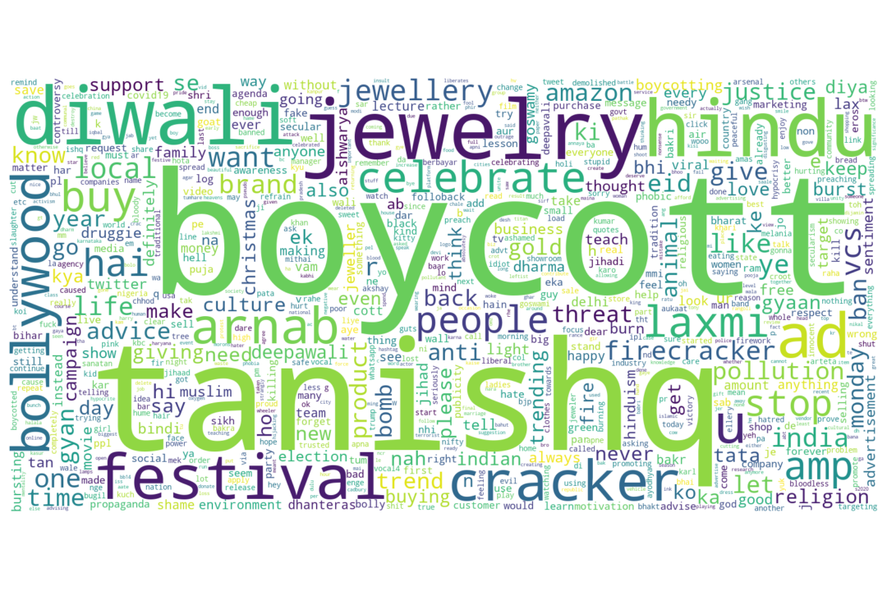
Sentiment Analysis of Tweets about Tanishq Ad Fiasco
Osman Mamun
Data Scientist, Pacific Northwest National Laboratory

Slide 2
Motivation
Springboard Capstone Two Presentation
During Diwali last year, Tanishq, an Indian Jewelry brand, made an ad featuring interfaith marriage which led to a widespread controversy throughout India. As a result, in initiative to boycott Tanishq was carried out on Twitter with the #BoycottTanishq slogan.
It is essential for company to understand public sentiment to quickly correct their actions to avoid any negative consequences for the business.
Here, I analyzed the twitter data related to this ad controversy to identify positive and negative twitter sentiment.

Slide 3
Approach
Springboard Capstone Two Presentation
Collect Twitter Data
Data Cleaning and Visualization
Manually Hand Label Data
Analyze the Feasibility of Pretrained Sentiment Analyzer
Unsupervised Learning Algorithm
Supervised Learning Algorithm
Weak Supervision Model with Pseudo Labeling
Synthetic Minority Oversampling Technique (SMOTE)

Slide 4
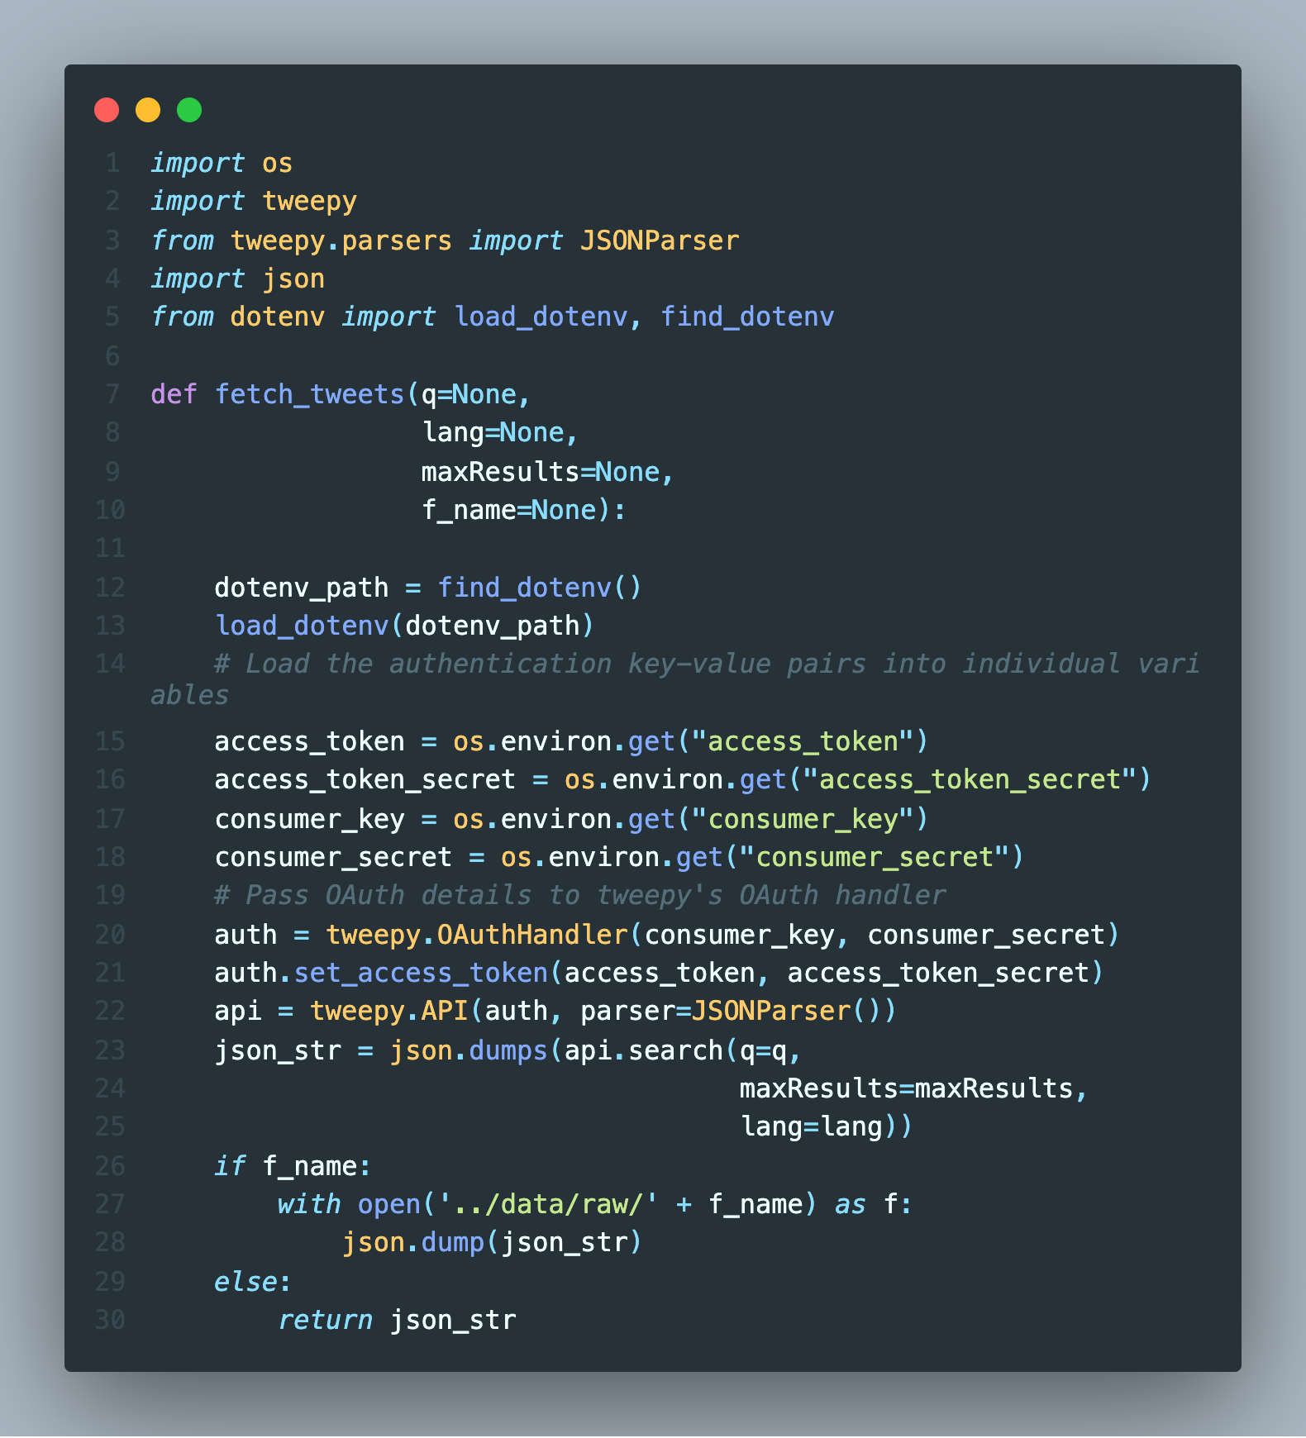
Collect Twitter Data
Springboard Capstone Two Presentation
Tweepy python package is used to scrape Twitter data with Twitter API
Sensitive information, i.e., access token, consumer key, secrets etc., are stored in .env file for easy retrieval by the code
Data can be saved as json file or converted to a pandas dataframe to store selected information.

Slide 5
Data Cleaning and Visualization
Springboard Capstone Two Presentation
Hashtags (#), URL, emoji, mentions, and numbers were removed using tweet preprocessing python package.
All the texts were converted to lowercase and any special characters were removed.
WordNetLemmatizer and TweetTokenizer from nltk package were used to lemmatize and tokenize the sentences.

Slide 6
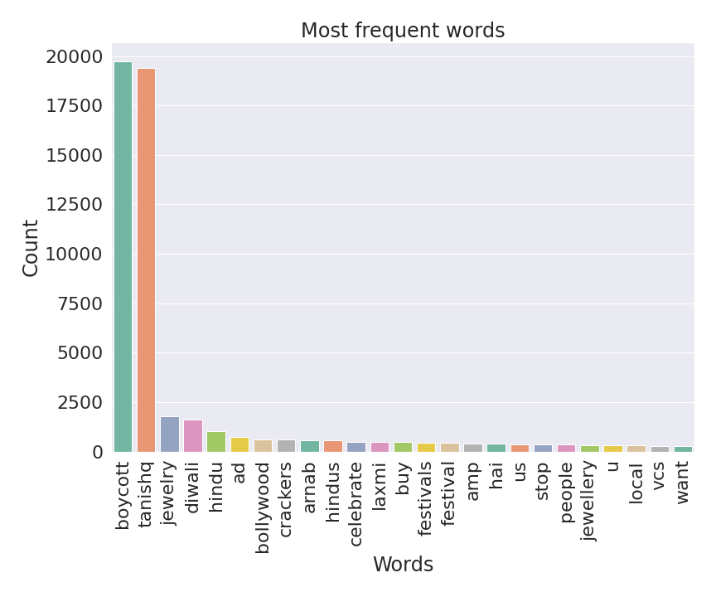
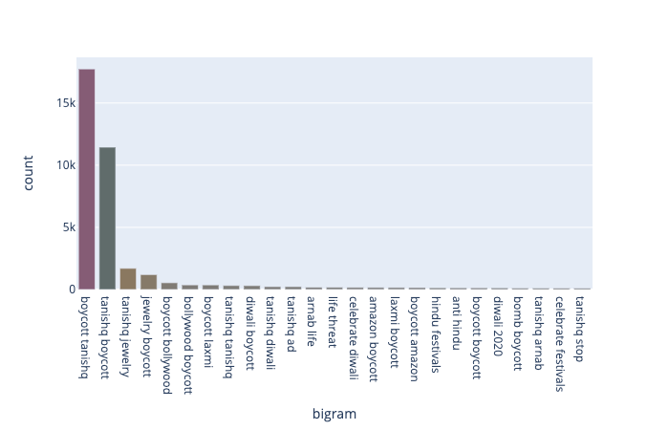
Data Cleaning and Visualization
Springboard Capstone Two Presentation
Word Frequency
Bigram Frequency

Slide 7
Manually Hand Label Data
Springboard Capstone Two Presentation
In order to quantify the performance of different approaches, I manually hand label about 1000 data. It is of note that only about 300 labels were either positive or negative.
Due to the ambiguity and sarcasmic nature of tweets, it was very difficult to label tweets as either positive or negative, even by a human observer.
For better modeling for business application, it is recommended to manually hand label about 2-3K more data. However, in the interest of time efficiency, we refrained from further hand labeling the data.

Slide 8
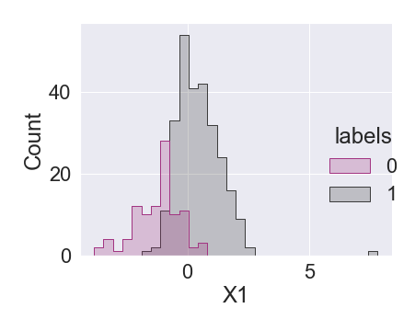
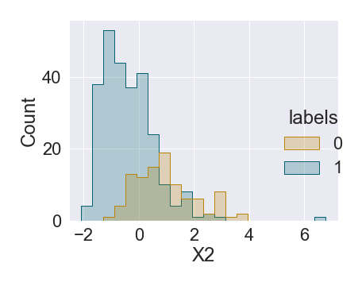
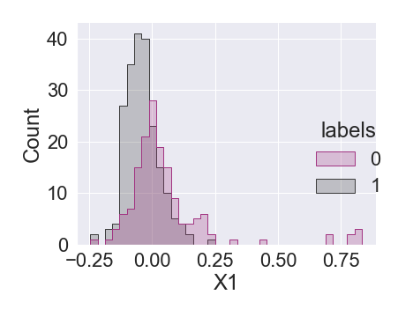
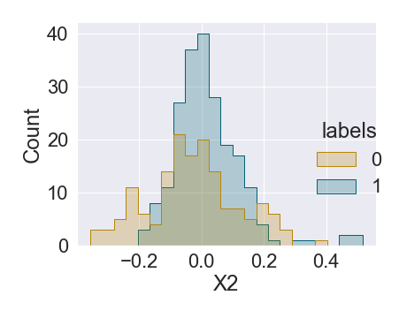
Why is It a Challenging Problem
Springboard Capstone Two Presentation
Count Vectorizer
Significance feature space overlapping with both the count vectorizer and tfidf vectorizer approach.
Tfidf Vectorizer

Slide 9
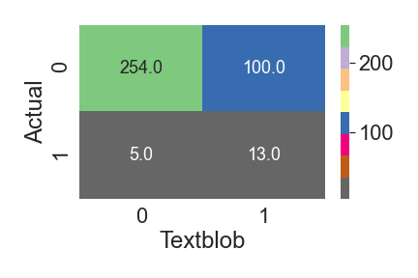
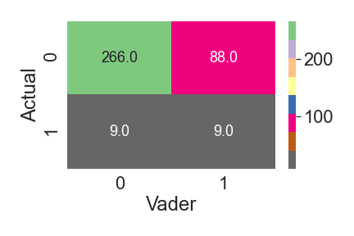
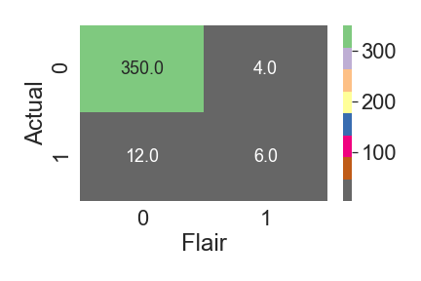
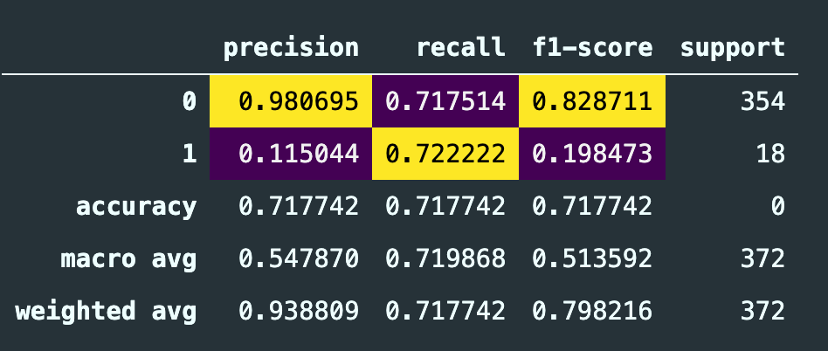
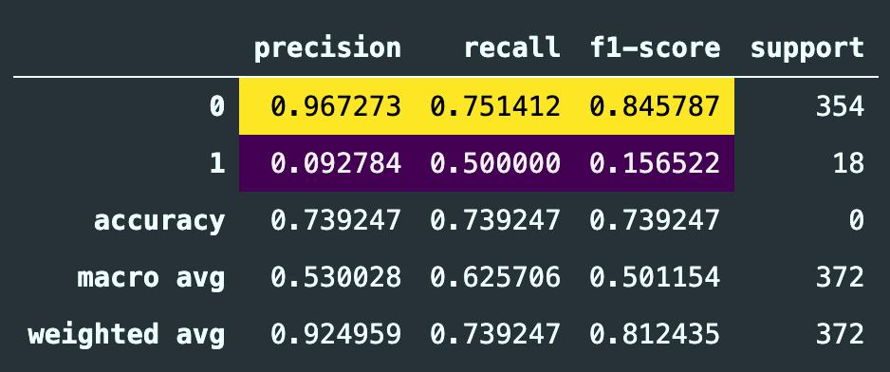
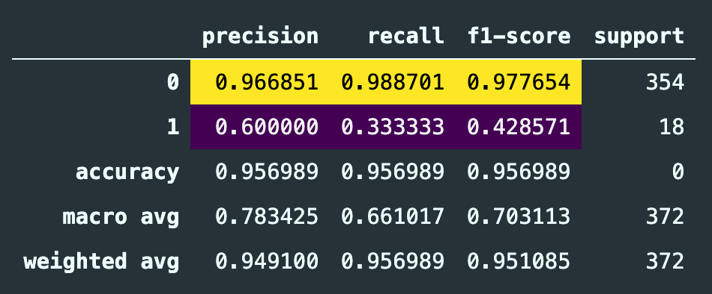
Analyze the Feasibility of Pretrained Sentiment Analyzer
Springboard Capstone Two Presentation
ROC AUC: 0.72
ROC AUC: 0.63
ROC AUC: 0.66
Textblob
Vader
Flair

Slide 10
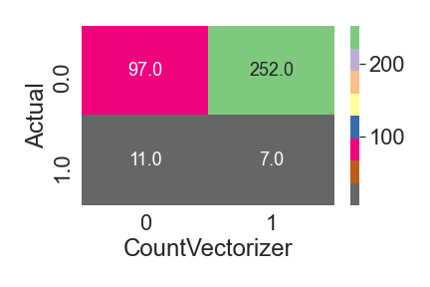
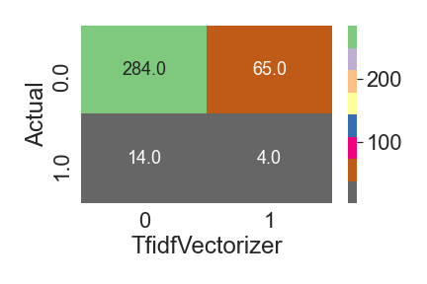
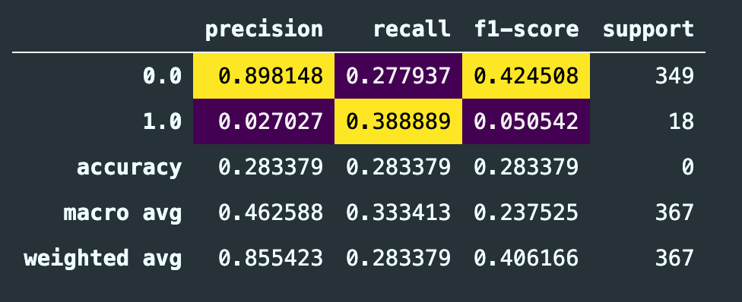
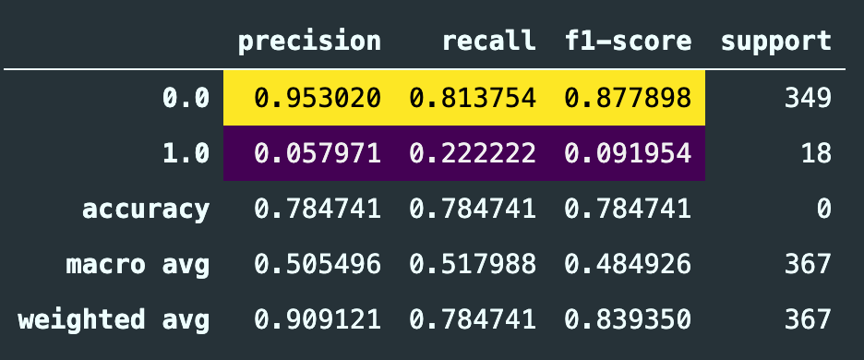
Unsupervised Learning Algorithm
Springboard Capstone Two Presentation
Pretrained Model Performance are inarguably better than the unsupervised learning algorithm.
ROC AUC: 0.33
ROC AUC: 0.51

Slide 11
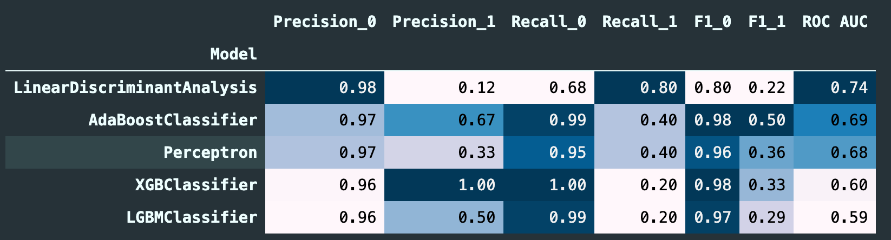
Supervised Learning Algorithm (Count Vectorizer)
Springboard Capstone Two Presentation
Very high precision and recall for negative sentiment with most of the classifier
ROC AUC is also reasonably high
Low precision and recall for positive sentiment class; however, XGBoost has high precision and Linear Discriminant Analysis has high recall (need proper cross-validation)

Slide 12
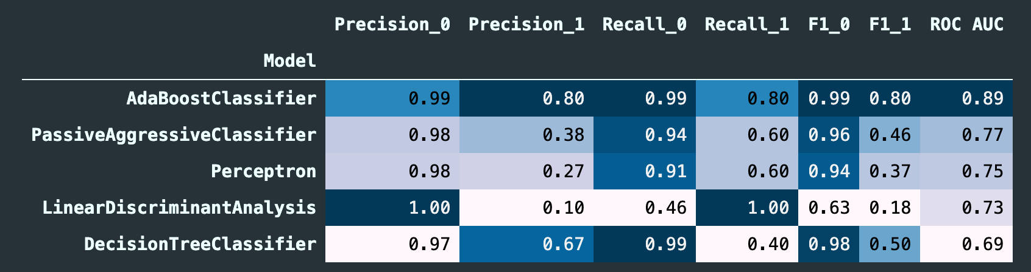
Supervised Learning Algorithm (Tfidf Vectorizer)
Springboard Capstone Two Presentation
Overall better performance than the count vectorizer
ROC AUC is also very impressive across the board
Low precision and recall for positive sentiment class (high precision in AdaBoost and high recall in AdaBoost and Linear Discriminant).

Slide 13
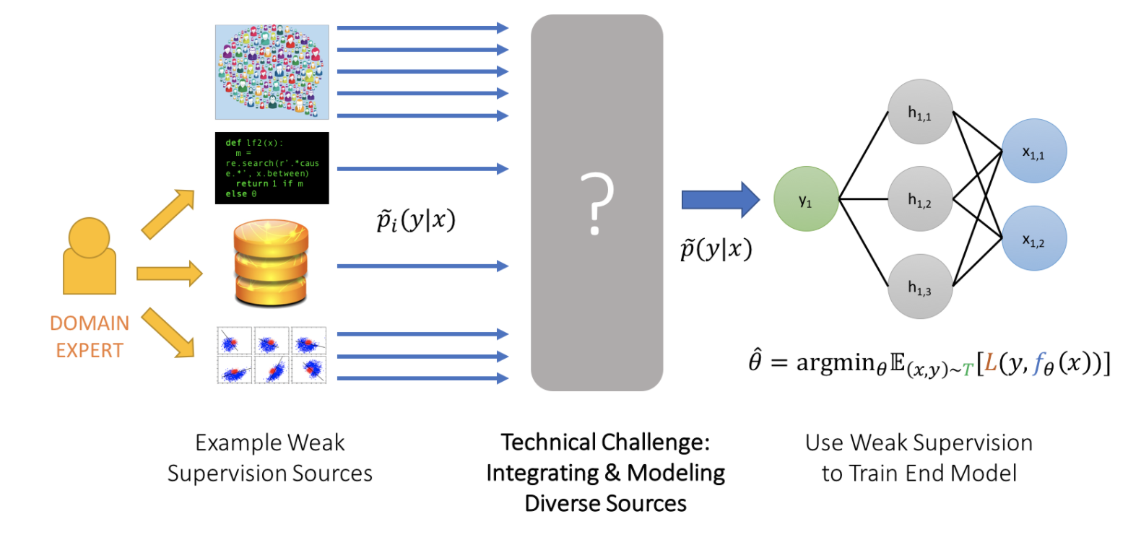
Weak Supervised Model with Pseudo Labeling
Springboard Capstone Two Presentation
Snorkel python package was used which is a probabilistic approach to infer the data label given approximate labels
Requires expensive MCMC sampling
Once the generative model is trained and labels are generated, a discriminator based on traditional ML algorithm can be trained to decouple expensive generator model
Image credit: https://www.snorkel.org/blog/weak-supervision

Slide 14

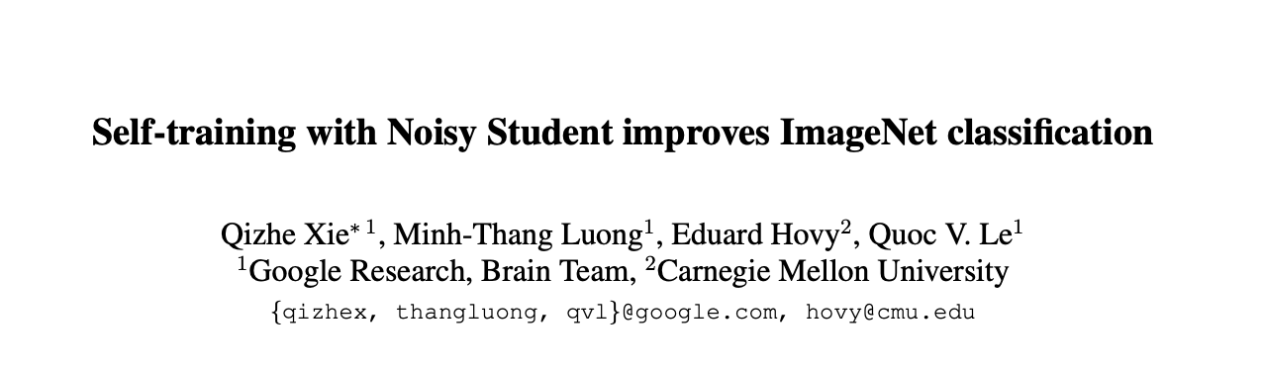
Labeling Function
Springboard Capstone Two Presentation
Label based on presence and absence of certain keyword or phrases in the tweet
Learned labels from the previously discussed supervised model.
The rational for using supervised model learned labels is that a team from Google and CMU reported significant improvement of performance with this approach

Slide 15
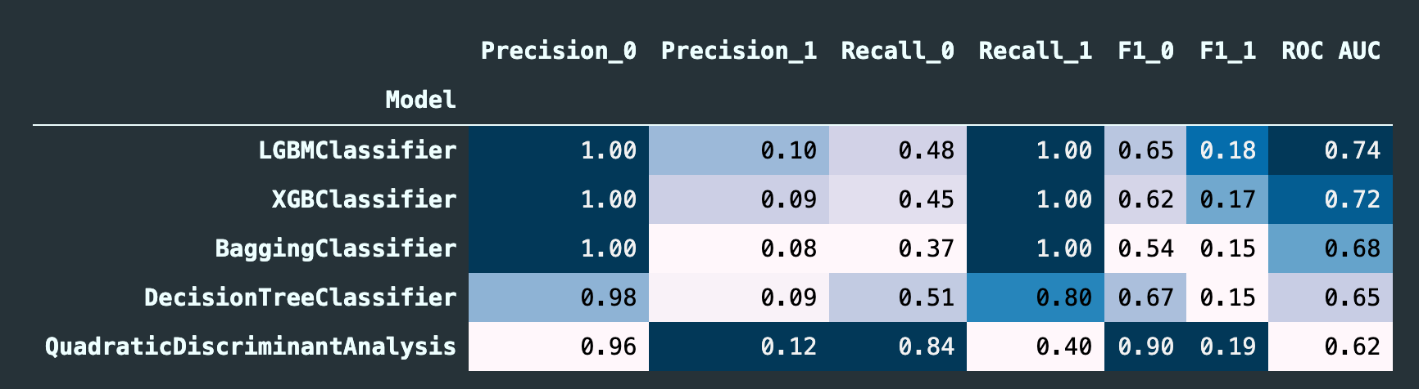
Weak Supervised Model with Pseudo Labeling
Springboard Capstone Two Presentation
With weak supervision, precision for negative sentiment and recall for positive sentiment is very high, but recall for negative and precision for positive is very low
The algorithm is having trouble navigating a wide overlapping feature space

Slide 16
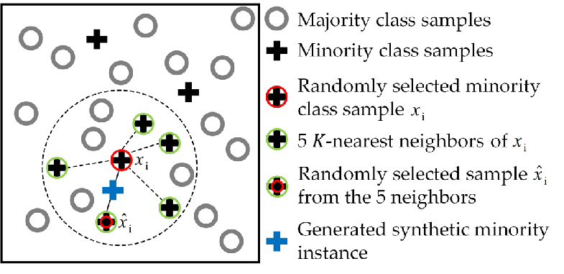
Synthetic Minority Oversampling Technique (SMOTE)
Springboard Capstone Two Presentation
Based on the nearest neighbor and efficient interpolation, synthetic minority data samples are generated
In contrast, ENN (edited nearest neighbor) artificially removes samples of majority class, resulting in oversampling.
Image credit: https://www.mdpi.com/2072-4292/11/7/846

Slide 17
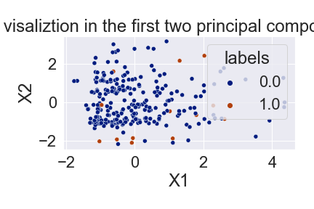
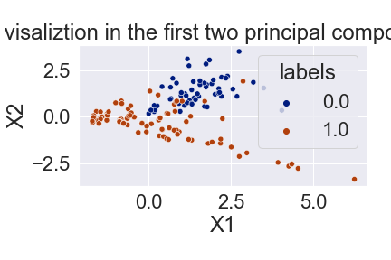
Synthetic Minority Oversampling Technique (SMOTE)
Springboard Capstone Two Presentation
With SMOTEENN, two well defined cluster has been formed by over sampling the minority class and under sampling the majority class in the low PCA region

Slide 18
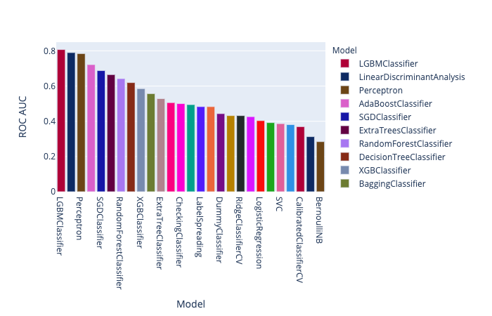
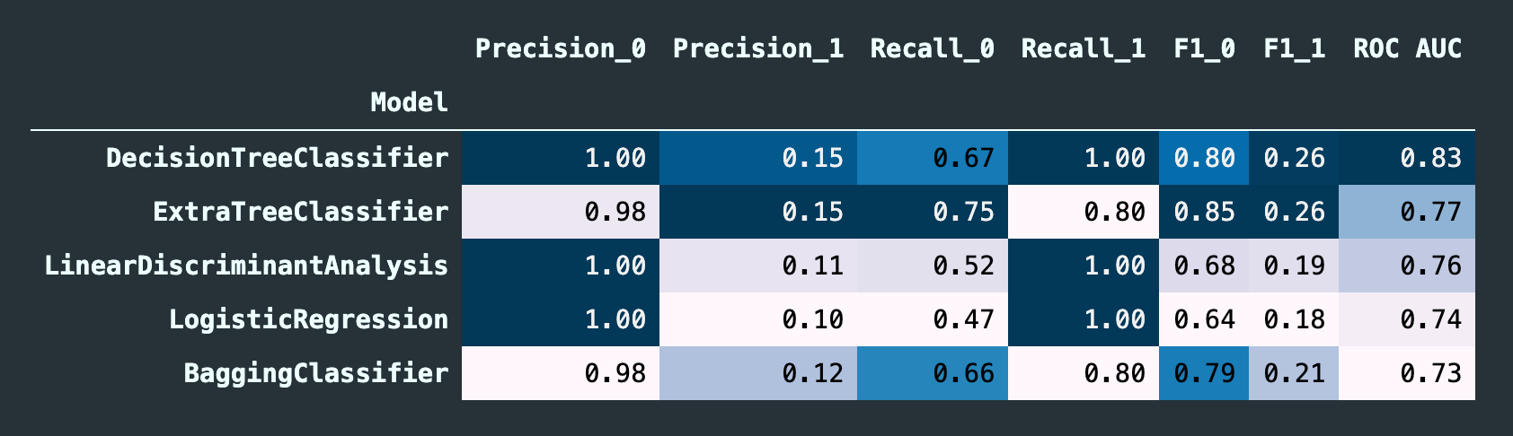
Synthetic Minority Oversampling Technique (SMOTE)
Springboard Capstone Two Presentation
The performance is not much better than the supervised learning on the labelled dataset only. Next, we will try to perform hyperparameter optimization to improve the performance of SMOTEENN.

Slide 19
Hyperparameter Optimization
Springboard Capstone Two Presentation
AdaBoostClassifier (GridSearchCV): learning_rate, n_estimators , base_estimator
DecisionTreeClassifier (GridSearchCV): max_depth, min_samples_split, max_features
XGBClassifier (Bayesian optimization): n_estimators, max_depth, reg_alpha, reg_lambda, eta, gamma, subsample, colsample_bytree
Hyperparameter optimization didn’t improve performance much. It seems like, I need to invest more time into tuning the supervised learning hyperparameter to improve the performance

Slide 20
Conclusion
Springboard Capstone Two Presentation
Out of all the approach, Supervised learning with just the labelled data performed better than other approaches
For real data analytics, investing more time into labeling data will be crucial to make more reliable model
Acknowledgement: Prasad Seemakurthi (Data Scientist, Navi Ltd.)
Thank You!

