Slide 1
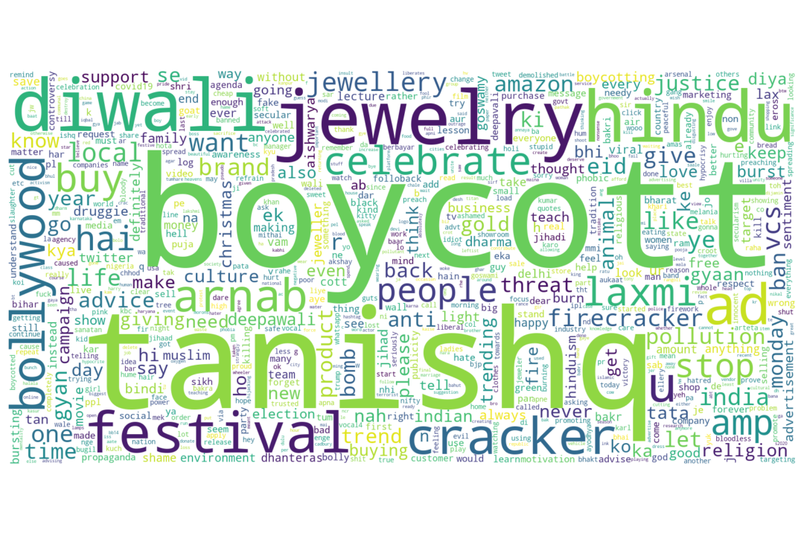
Sentiment Analysis of Tweets about Tanishq Ad Fiasco
Osman Mamun
Data Scientist, Pacific Northwest National Laboratory

Slide 2
Motivation
Springboard Capstone Two Presentation
During Diwali last year, Tanishq, an Indian Jewelry brand, made an ad featuring interfaith marriage which led to a widespread controversy throughout India. As a result, in initiative to boycott Tanishq was carried out on Twitter with the #BoycottTanishq slogan.
It is essential for company to understand public sentiment to quickly correct their actions to avoid any negative consequences for the business.
Here, I analyzed the twitter data related to this ad controversy to identify positive and negative twitter sentiment.

Slide 3
Approach
Springboard Capstone Two Presentation
Collect Twitter Data
Data Cleaning and Visualization
Manually Hand Label Data
Analyze the Feasibility of Pretrained Sentiment Analyzer
Unsupervised Learning Algorithm
Supervised Learning Algorithm
Weak Supervision Model with Pseudo Labeling
Synthetic Minority Oversampling Technique (SMOTE)

Slide 4
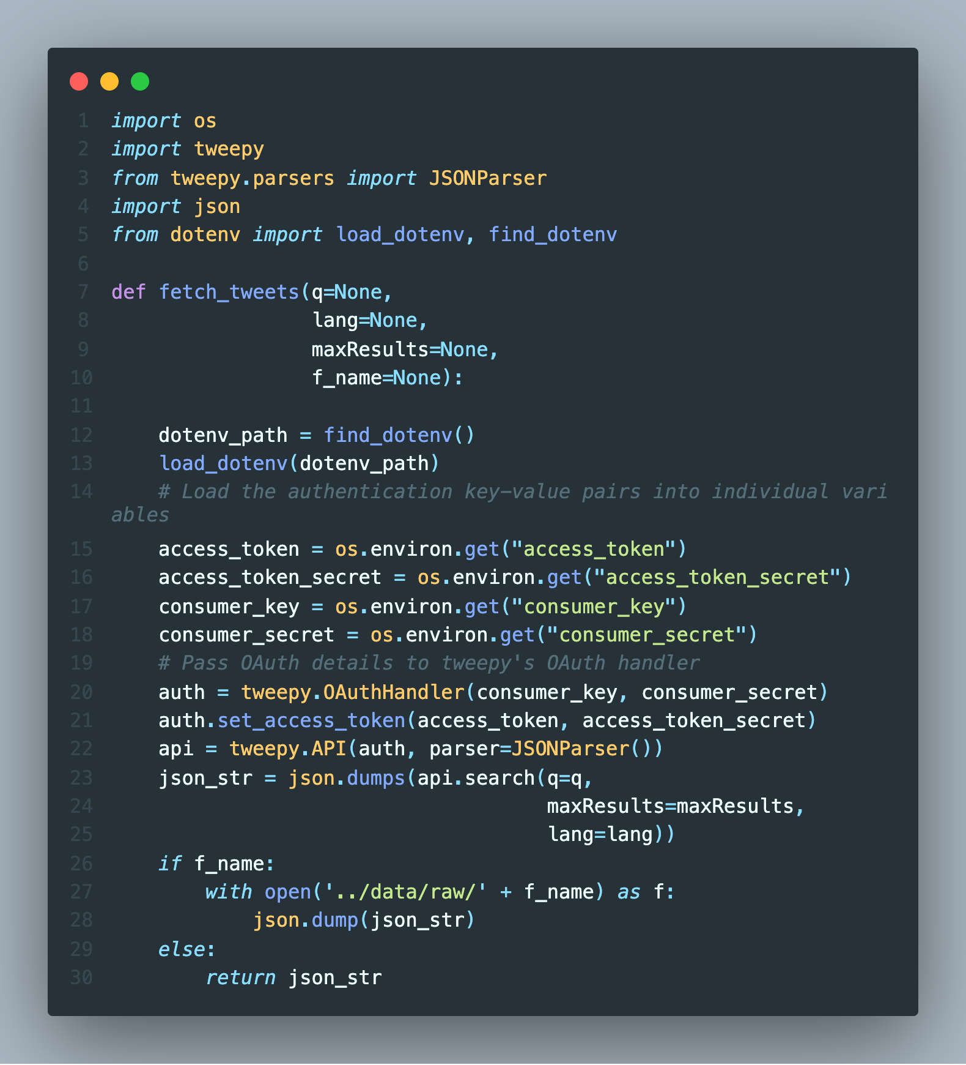
Collect Twitter Data
Springboard Capstone Two Presentation
Tweepy python package is used to scrape Twitter data with Twitter API
Sensitive information, i.e., access token, consumer key, secrets etc., are stored in .env file for easy retrieval by the code
Data can be saved as json file or converted to a pandas dataframe to store selected information.

Slide 5
Data Cleaning and Visualization
Springboard Capstone Two Presentation
Hashtags (#), URL, emoji, mentions, and numbers were removed using tweet preprocessing python package.
All the texts were converted to lowercase and any special characters were removed.
WordNetLemmatizer and TweetTokenizer from nltk package were used to lemmatize and tokenize the sentences.

Slide 6
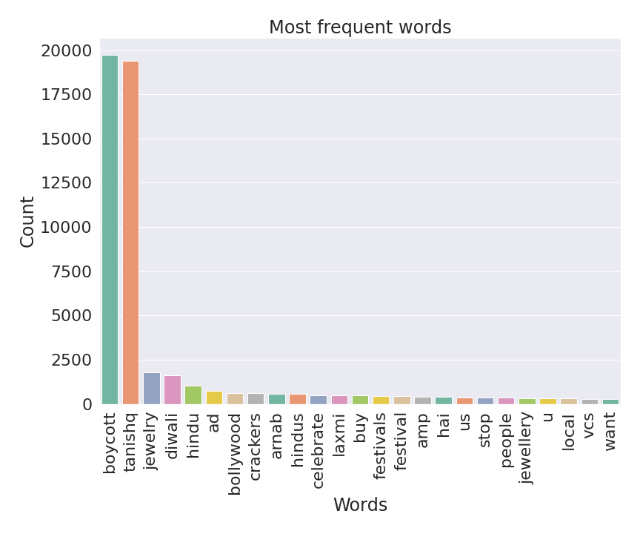
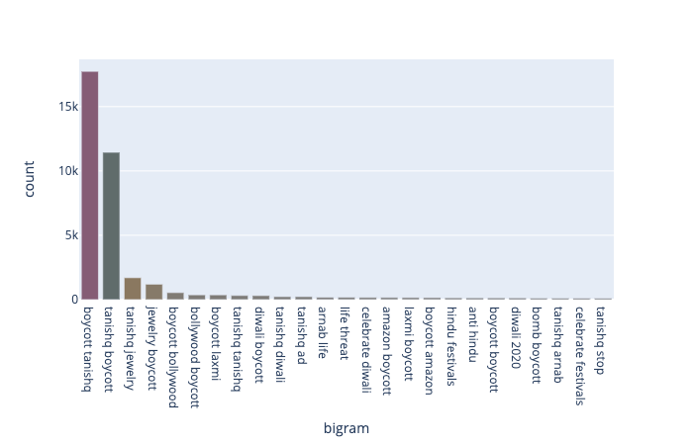
Data Cleaning and Visualization
Springboard Capstone Two Presentation
Word Frequency
Bigram Frequency

Slide 7
Manually Hand Label Data
Springboard Capstone Two Presentation
In order to quantify the performance of different approaches, I manually hand label about 1000 data. It is of note that only about 300 labels were either positive or negative.
Due to the ambiguity and sarcasmic nature of tweets, it was very difficult to label tweets as either positive or negative, even by a human observer.
For better modeling for business application, it is recommended to manually hand label about 2-3K more data. However, in the interest of time efficiency, we refrained from further hand labeling the data.

Slide 8
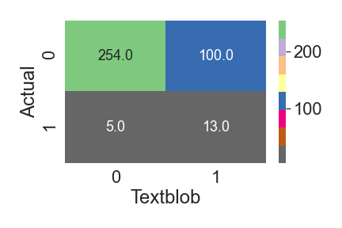
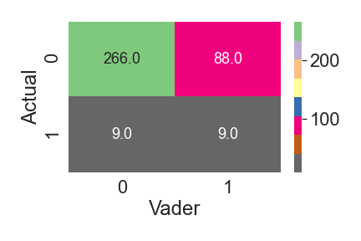
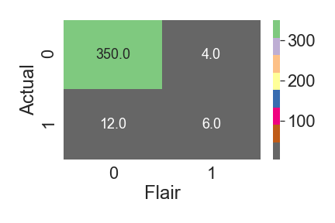
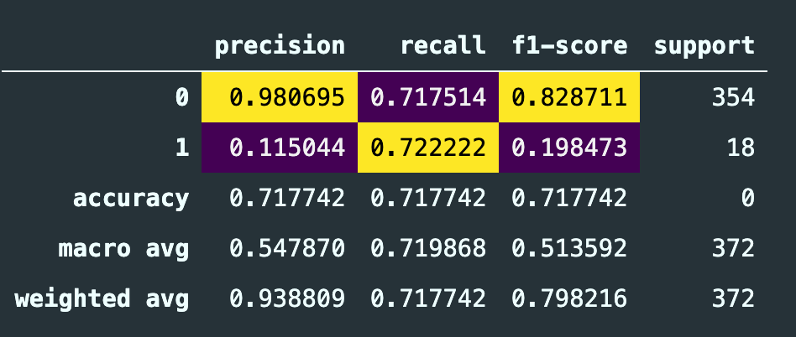
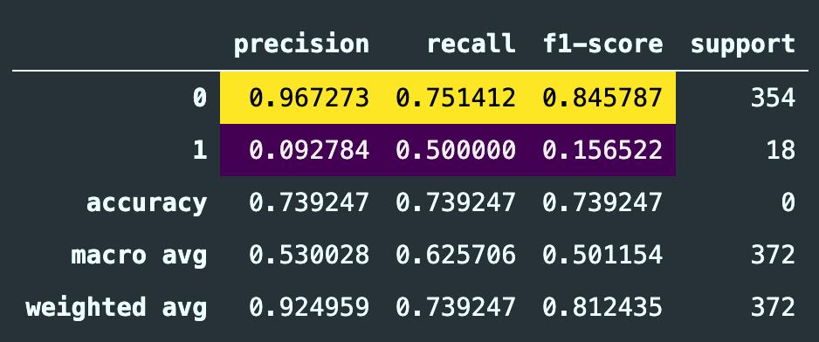
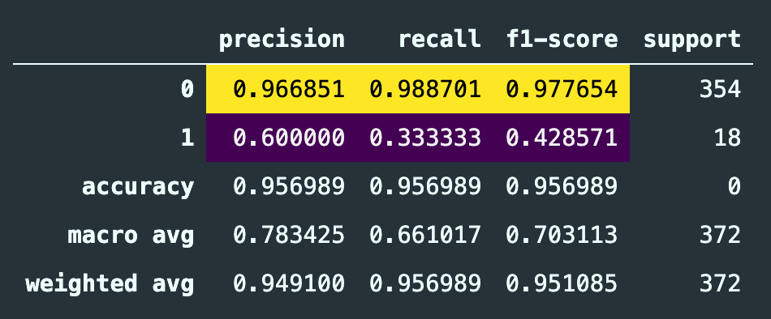
Analyze the Feasibility of Pretrained Sentiment Analyzer
Springboard Capstone Two Presentation
ROC AUC: 0.72
ROC AUC: 0.63
ROC AUC: 0.66
Textblob
Vader
Flair

Slide 9
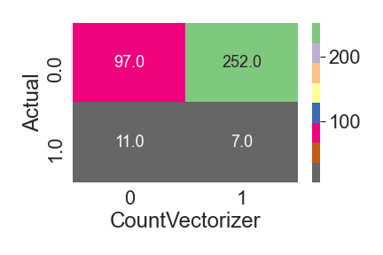
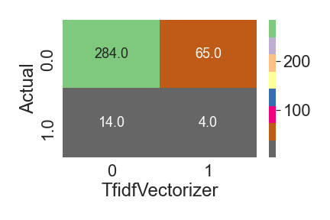
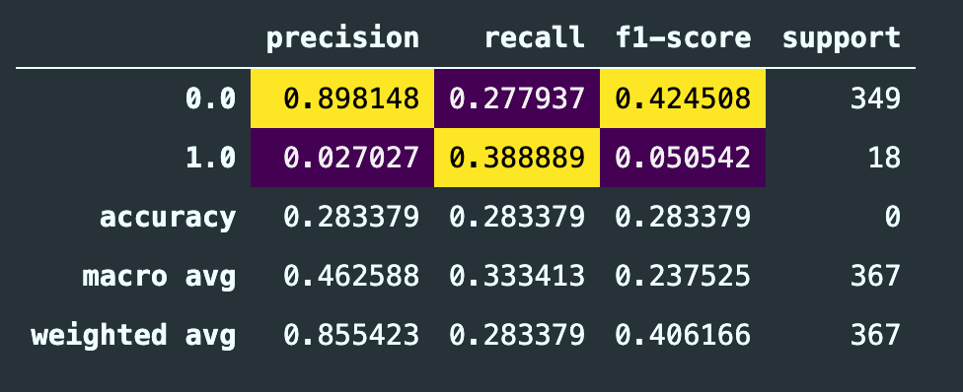
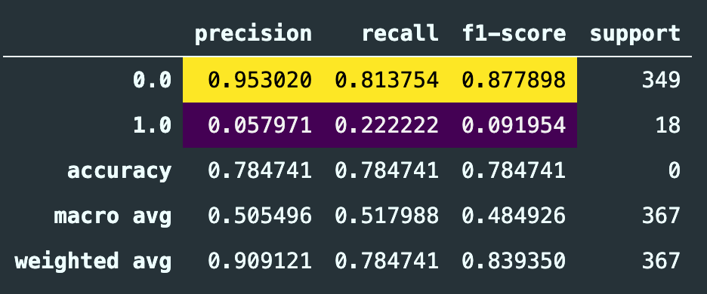
Unsupervised Learning Algorithm
Springboard Capstone Two Presentation
Pretrained Model Performance are inarguably better than the unsupervised learning algorithm.
ROC AUC: 0.33
ROC AUC: 0.51

Slide 10
Supervised Learning Algorithm
Springboard Capstone Two Presentation
In order to quantify the performance of different approaches, I manually hand label about 1000 data. It is of note that only about 300 labels were either positive or negative.
Due to the ambiguity and sarcasmic nature of tweets, it was very difficult to label tweets as either positive or negative, even by a human observer.
For better modeling for business application, it is recommended to manually hand label about 2-3K more data. However, in the interest of time efficiency, we refrained from further hand labeling the data.

Slide 11
Weak Supervised Model with Pseudo Labeling
Springboard Capstone Two Presentation
In order to quantify the performance of different approaches, I manually hand label about 1000 data. It is of note that only about 300 labels were either positive or negative.
Due to the ambiguity and sarcasmic nature of tweets, it was very difficult to label tweets as either positive or negative, even by a human observer.
For better modeling for business application, it is recommended to manually hand label about 2-3K more data. However, in the interest of time efficiency, we refrained from further hand labeling the data.

Slide 12
Synthetic Minority Oversampling Technique (SMOTE)
Springboard Capstone Two Presentation
In order to quantify the performance of different approaches, I manually hand label about 1000 data. It is of note that only about 300 labels were either positive or negative.
Due to the ambiguity and sarcasmic nature of tweets, it was very difficult to label tweets as either positive or negative, even by a human observer.
For better modeling for business application, it is recommended to manually hand label about 2-3K more data. However, in the interest of time efficiency, we refrained from further hand labeling the data.

Slide 13
Conclusion
Springboard Capstone Two Presentation
In order to quantify the performance of different approaches, I manually hand label about 1000 data. It is of note that only about 300 labels were either positive or negative.
Due to the ambiguity and sarcasmic nature of tweets, it was very difficult to label tweets as either positive or negative, even by a human observer.
For better modeling for business application, it is recommended to manually hand label about 2-3K more data. However, in the interest of time efficiency, we refrained from further hand labeling the data.

