Slide 1
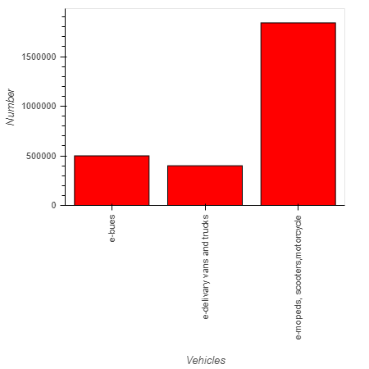
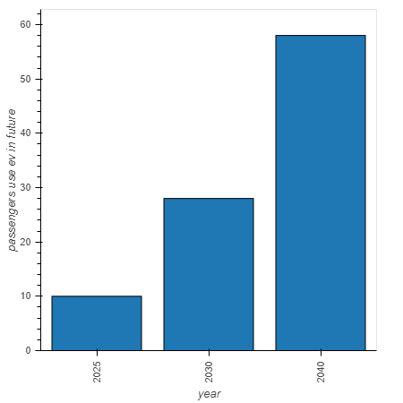
EV Outbreaks , from 2020 to 2040:
Percent of global passengers will use Evs by 2040.
EV cars in road in 2020

Slide 2
EV Outbreaks , from 2020 to 2040:
Green Hydrogen cost cut
Evs performance by 2040.
Green hydrogen costs will fall by up to 64% by 2040.
Source: wood Mackenzie
Green hydrogen costs will fall by up to 64% by 2040.
Source: wood Mackenzie

Slide 3
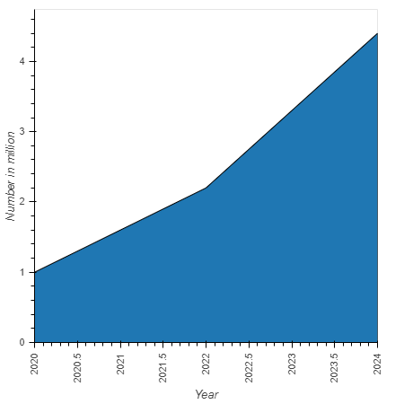
EV Outbreaks , from 2020 to 2040
Ev charging unit in North America and Europe by 2024
Ev impact on Americans private house hold incomes
USA private house hold can save $ 255 to $791 per year
In total, the private benefits for the main Aggressive and Low Cost scenarios range from $18.6 billion to $27.3 billion per year by 2035.
source: NREL

Slide 4
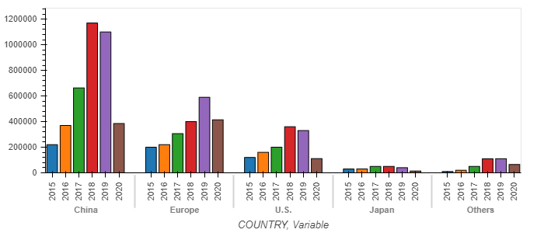
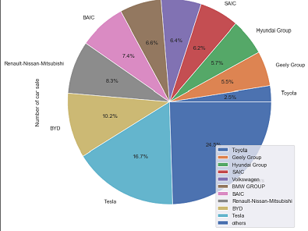
EV Outbreaks , from 2020 to 2040
TOP 10 Ev Automaker 2019
EV sale globally 2015 to 2020(H1)

