Slide 1
CSCE 580
Artificial Intelligence
Introduction and Ch.1 [P]
Spring 2015
Marco Valtorta
mgv@cse.sc.edu

Slide 2
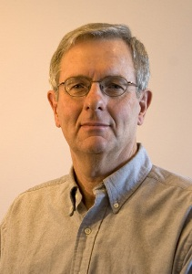
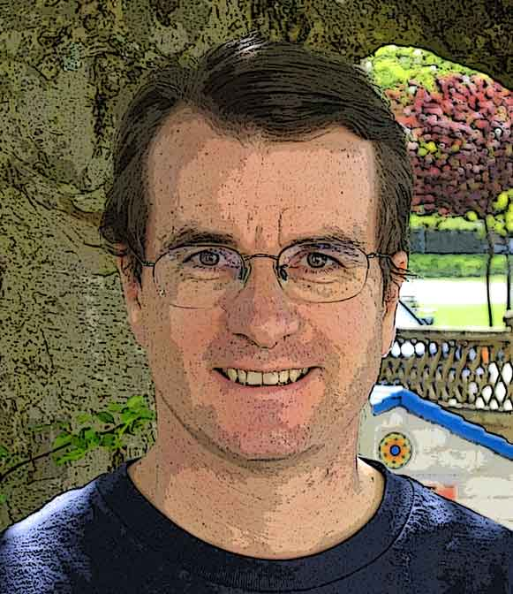
Catalog Description and Textbook
580—Artificial Intelligence. (3) (Prereq: CSCE 350) Heuristic problem solving, theorem proving, and knowledge representation, including the use of appropriate programming languages and tools.
David Poole and Alan Mackworth. Artificial Intelligence: Foundations of Computational Agents. Cambridge University Press, 2010. [P]
  Supplementary materials from the authors, including an errata list, are available
  The full text is available online from the authors, in html format

Slide 3
Course Objectives
Analyze and categorize software intelligent agents and the environments in which they operate
Formalize computational problems in the state-space search approach and apply search algorithms (especially A*) to solve them
Represent domain knowledge using features and constraints and solve the resulting constraint processing problems
Represent domain knowledge about objects using propositions and solve the resulting propositional logic problems using deduction and abduction
Represent knowledge in Horn clause form and use the AILog dialect of Prolog for reasoning
Reason under uncertainty using Bayesian networks
Represent domain knowledge about individuals and relations in first-order logic (if time allows)
Do inference using resolution refutation theorem proving (if time allows)

Slide 4
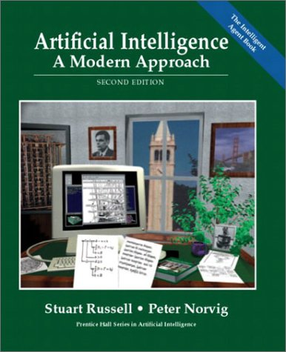
Acknowledgment
The slides are based on the draft textbook and other sources, including other fine textbooks. The other textbooks I considered are:
David Stuart Russell and Peter Norvig. Artificial Intelligence: A Modern Approach. Prentice-Hall, 2010 ([AIMA] or [R] or [AIMA-1], [AIMA-2], and [AIMA-3], when distinguishing editions; the first and second editions were published in 1995 and 2003, respectively.)
Ivan Bratko. Prolog Programming for Artificial Intelligence, Fourth Edition. Addison-Wesley, 2011.
George F. Luger. Artificial Intelligence: Structures and Strategies for Complex Problem Solving, Sixth Edition. Addison-Wesley, 2009.
Richard E. Neapolitan and Xia Jiang. Contemporary Artificial Intelligence. Taylor & Francis and CRC Press, 2013.
Ertel, Wolfgang. Introduction to Artificial Intelligence. Springer, 2011.

Slide 5
Why Study Artificial Intelligence?
It is exciting, in a way that many other subareas of computer science are not
It has a strong experimental component
It is a new science under development
It has a place for theory and practice
It has a different methodology
It leads to advances that are picked up in other areas of computer science
Intelligent agents are becoming ubiquitous

Slide 6

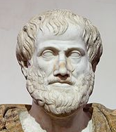
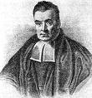
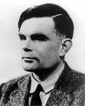
What is AI?
Systems that think like humans “The exciting new effort to make computers think… machines with minds,in the full and literal sense.” (Haugeland, 1985) “[The automation of] activities that we associate with human thinking, activities such as decision-making, problem solving, learning…” (Bellman, 1978) | Systems that think rationally “The study of mental faculties through the use of computational models.” (Charniak and McDermott, 1985) “The study of the computations that make it possible to perceive, reason, and act.” (Winston, 1972)
Systems that act like humans “The art of creating machines that perform functions that require intelligence when performed by people” (Kurzweil, 1990) “The study of how to make computers do things at which, at the moment, people are better (Rich and Knight, 1991) | Systems that act rationally “The branch of computer science that is concerned with the automation of intelligent behavior.” (Luger and Stubblefield, 1993) “Computational intelligence is the study of the design of intelligent agents.” (Poole et al., 1998) “AI… is concerned with intelligent behavior in artifacts.” (Nilsson, 1998)
Richard Bellman (1920-84)
Aristotle (384BC -322BC)
Thomas Bayes (1702-1761)
Alan Turing (1912-1954)
Notes:
[AIMA-2]

Slide 7
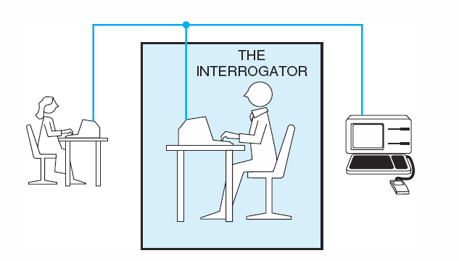
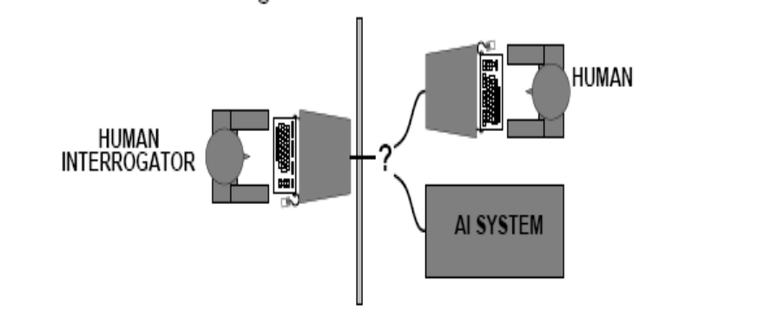
Acting Humanly: the Turing Test
Operational test for intelligent behavior: the Imitation Game
In 1950, Turing
  predicted that by 2000, a machine might have a 30% chance of fooling a lay person for 5 minutes
  Anticipated all major arguments against AI in following 50 years
  Suggested major components of AI: knowledge, reasoning, language understanding, learning
Problem: Turing test is not reproducible, constructive, or amenable to mathematical analysis
Notes:
[AIMA-2]
Turing (1950) “Computing machinery and intelligence“
The original version involved determining the sex of a correspondent; exchanging the man with a computer; comparing the performance of the interrogator in the two different situations. “We now ask the question: “What will happen when a machine takes the part of A [the man] in this game?’ Will the interrogator decide wrongly as often when the game is played like this as he does when the game is played between a man and a woman? These questions replace our original, ‘Can machines think?’”

Slide 8
Thinking Humanly: Cognitive Science
1960s “cognitive revolution": information-processing psychology replaced the prevailing orthodoxy of behaviorism
Requires scientific theories of internal activities of the brain
  What level of abstraction? “Knowledge" or “circuits"?
  How to validate? Requires
    Predicting and testing behavior of human subjects (top-down), or
    Direct identification from neurological data (bottom-up)
Both approaches (roughly, Cognitive Science and Cognitive Neuroscience) are now distinct from AI
Both share with AI the following characteristic:
  the available theories do not explain (or engender) anything resembling human-level general intelligence
Hence, all three fields share one principal direction!

Slide 9
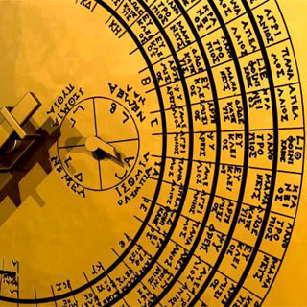
Thinking Rationally: Laws of Thought
Normative (or prescriptive) rather than descriptive
Aristotle: what are correct arguments/thought processes?
Several Greek schools developed various forms of logic:
  notation and rules of derivation for thoughts;
  may or may not have proceeded to the idea of mechanization
Direct line through mathematics and philosophy to modern AI
Problems:
  Not all intelligent behavior is mediated by logical deliberation
  What is the purpose of thinking? What thoughts should I have out of all the thoughts (logical or otherwise) that I could have?
The Antikythera mechanism, a clockwork-like assemblage discovered in 1901 by Greek sponge divers off the Greek island of Antikythera, between Kythera and Crete.

Slide 10
Acting Rationally
Rational behavior: doing the right thing
The right thing: that which is expected to maximize goal achievement, given the available information
Doesn't necessarily involve thinking (e.g., blinking reflex) but
  thinking should be in the service of rational action
Aristotle (Nicomachean Ethics):
  Every art and every inquiry, and similarly every action and pursuit, is thought to aim at some good

Slide 11
Summary of IJCAI-83 Survey
Attempt (A) 20.8
to
Build (B) 12.8
Simulate (C) 17.6
Model (D) 17.6
that
Machines (E) 22.4
Human (or People) (F) 60.8
Intelligent (G) 54.4
Behavior (I) 32.0
Processes (H) 24.0
by means of
Computers (L) 38.4
Programs (M) 13.2
Notes:
Massimo Negrotti. “How AI People Think.” Technical Report III/2203/En. Department of Sociology. University of Genoa. 1983. This is Figure 1. Negrotti recognizes the following approaches: robotic (ABECFGI), behavioristic (ACFGILM), and cognitive (ADFGHLM). The report is based on a questionnaire filled by 143 researchers at the 8th International Joint Conference on Artificial Intelligence, which took place in Karlsruhe, Germany, during the summer of 1983. Note the presence of “human” or “people” in all cases. Negrotti states that the numbers are frequencies “per 1000 terms,” but I think they are percentages indicating frequency of occurrence in the definitions given by the researchers who participated in the survey.

Slide 12
A Detailed Definition [P]
Artificial intelligence, or AI, is the synthesis and analysis of computational agents that act intelligently
An agent is something that acts in an environment
An agent acts intelligently when:
    what it does is appropriate for its circumstances and its goals
    it is flexible to changing environments and changing goals
    it learns from experience
    it makes appropriate choices given its perceptual and computational limitations. An agent typically cannot observe the state of the world directly; it has only a finite memory and does not have unlimited time to act.
A computational agent is an agent whose decisions about its actions can be explained in terms of computation
Notes:
Poole and Mackworth, 2010 (i.e., [P]) (This definition first appeared in notes for a revised version of David Poole, Alan Mackworth, and Randy Goebel. Computational Intelligence: A Logical Approach. Oxford, 1998, used by kind permission of Prof. Poole.)

Slide 13
Some Comments on the Definition
A computational agent is an agent whose decisions about its actions can be explained in terms of computation
The central scientific goal of artificial intelligence is to understand the principles that make intelligent behavior possible in natural or artificial systems. This is done by
    the analysis of natural and artificial agents
    formulating and testing hypotheses about what it takes to construct intelligent agents
    designing, building, and experimenting with computational systems that perform tasks commonly viewed as requiring intelligence
The central engineering goal of artificial intelligence is the design and synthesis of useful, intelligent artifacts. We actually want to build agents that act intelligently
We are interested in intelligent thought only as far as it leads to better performance
Notes:
[P]

Slide 14
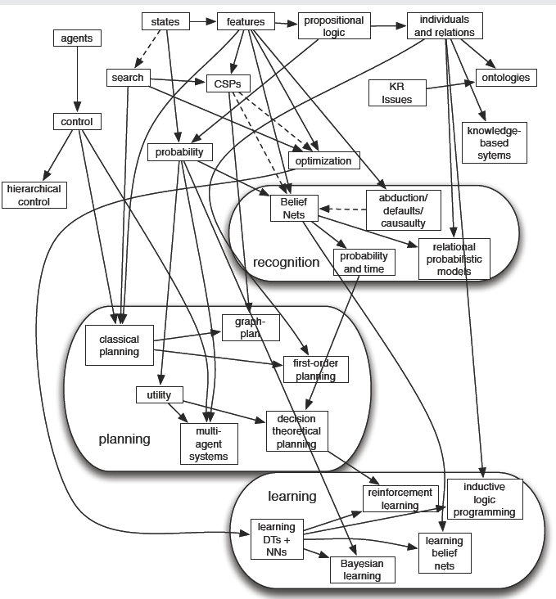
A Map of the Field
This course:
History, etc.
Problem-solving
    Blind and heuristic search
    Constraint satisfaction
    Games (maybe)
Knowledge and reasoning
    Propositional logic
    First-order logic
    Knowledge representation
Learning from observations (maybe)
A bit of reasoning under uncertainty
Other courses:
Robotics (574)
Bayesian networks and decision diagrams (582)
Knowledge representation (780) or Knowledge systems (781)
Machine learning (883)
Computer graphics, text processing, visualization, image processing, pattern recognition, data mining, multiagent systems, neural information processing, computer vision, fuzzy logic; more?
Notes:
Poole and Mackworth, 2008

Slide 15
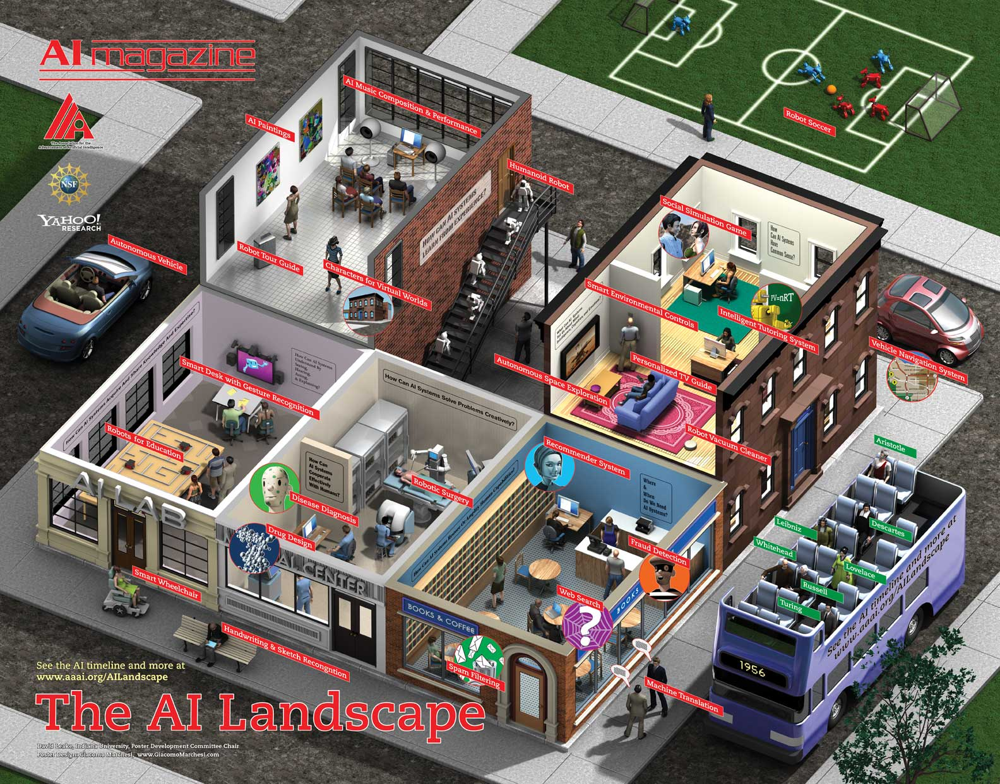
Notes:
www.aaai.org/AILandscape. This is a fancy picture, but it is not complete.

Slide 16
AI Prehistory
Philosophy
    logic, methods of reasoning
    mind as physical system
    foundations of learning, language, rationality
Mathematics
    formal representation and proof
    algorithms, computation, (un)decidability, (in)tractability
    Probability
Psychology
    adaptation
    phenomena of perception and motor control
    experimental techniques (psychophysics, etc.)
Economics
    formal theory of rational decisions
Linguistics
    knowledge representation
    Grammar
Neuroscience
    plastic physical substrate for mental activity
Control Theory
    homeostatic systems, stability
    simple optimal agent designs
Notes:
Also see Bruce G. Buchanan. “A (Very) Brief History of Artificial Intelligence.” AI Magazine, Winter 2005 (http://www.aaai.org/AITopics/assets/PDF/AIMag26-04-016.pdf).

Slide 17
Intellectual Issues in the Early History of AI (to 1982)
1640-1945 Mechanism versus Teleology: Settled with cybernetics
1800-1920 Natural Biology versus Vitalism: Establishes the body as a machine
1870- Reason versus Emotion and Feeling #1: Separates machines from men
1870-1910 Philosophy versus Science of Mind: Separates psychology from philosophy
1900-45 Logic versus Psychology: Separates logic from psychology
1940-70 Analog versus Digital: Creates computer science
1955-65 Symbols versus Numbers: Isolates AI within computer science
1955- Symbolic versus Continuous Systems: Splits AI from cybernetics
1955-65 Problem-Solving versus Recognition #1: Splits AI from pattern recognition
1955-65 Psychology versus Neurophysiology #1: Splits AI from cybernetics
1955-65 Performance versus Learning #1: Splits AI from pattern recognition
1955-65 Serial versus Parallel #1: Coordinate with above four issues
1955-65 Heuristics Venus Algorithms: Isolates AI within computer science
1955-85 Interpretation versus Compilation #1: Isolates AI within computer science
1955- Simulation versus Engineering Analysis: Divides AI
1960- Replacing versus Helping Humans: Isolates AI
1960- Epistemology versus Heuristics: divides AI (minor), connects with philosophy
1965-80 Search versus Knowledge: Apparent paradigm shift within AI
1965-75 Power versus Generality: Shift of tasks of interest
1965- Competence versus Performance: Splits linguistics from AI and psychology
1965-75 Memory versus Processing: Splits cognitive psychology from AI
1965-75 Problem-Solving versus Recognition #2: Recognition rejoins AI via robotics
1965-75 Syntax versus Semantics: Splits lmyistics from AI
1965- Theorem-Probing versus Problem-Solving: Divides AI
1965- Engineering versus Science: divides computer science, incl. AI
1970-80 Language versus Tasks: Natural language becomes central
1970-80 Procedural versus Declarative Representation: Shift from theorem-proving
1970-80 Frames versus Atoms: Shift to holistic representations
1970- Reason versus Emotion and Feeling #2: Splits AI from philosophy of mind
1975- Toy versus Real Tasks: Shift to applications
1975- Serial versus Parallel #2: Distributed AI (Hearsay-like systems)
1975- Performance versus Learning #2: Resurgence (production systems)
1975- Psychology versus Neuroscience #2: New link to neuroscience
1980- - Serial versus Parallel #3: New attempt at neural systems
1980- Problem-solving versus Recognition #3: Return of robotics
1980- Procedural versus Declarative Representation #2: PROLOG
Notes:
Allen Newell. “Intellectual Issues in the History of Artificial Intelligence.” Department of Computer Science, Carnegie-Mellon University, 10 November 1982. Marked as: to appear in: Fritz Machlup and Una Mansfield. The Study of Information: Interdisciplinary Messages. New York: John Wiley and Sons, 1983.
Version of 28 October 1982 accessed at http://diva.library.cmu.edu/Newell/ on 2008/08/13

Slide 18
Programming Methodologies and Languages for AI
Methodology: Run-Understand-Debug-Edit
Languages: Spring 2008 survey
Current use
33: Java
28: Prolog
28: Lisp or Scheme
20: C, C# or C++
16: Python
7: Other
Future use
38: Python
33: Java
27: Lisp or Scheme
26: Prolog
18: C, C# or C++
13: Other
Also see aima.cs.berkeleley.edu/code.html for AIMA-specific information
Notes:
Survey from the AIMA users list, organized by Peter Norvig
Choices for "other":
3: Matlab
2: Ruby
1: Haskell
1: ML
1: NetLogo
1: Perl
1: Protege (Java Knowledge-based framework)
1: R (Statistical package)
1: Steve

Slide 19
Central Hypotheses of AI
A symbol is a meaningful pattern that can be manipulated (e.g., a written word, a sequence of bits). A symbol system creates, copies, modifies, and destroys symbols.
Symbol-system hypothesis:
  A physical symbol system has the necessary and sufficient means for general intelligent action
    Attributed to Allan Newell (1927-1992) and Herbert Simon (1916-2001)
Church-Turing thesis:
  Any symbol manipulation can be carried out on a Turing machine
    Alonzo Church (1903-1995)
    Alan Turing (1912-1954)
The manipulation of symbols to produce action is called reasoning
Notes:
1.4.2 [P]

Slide 20
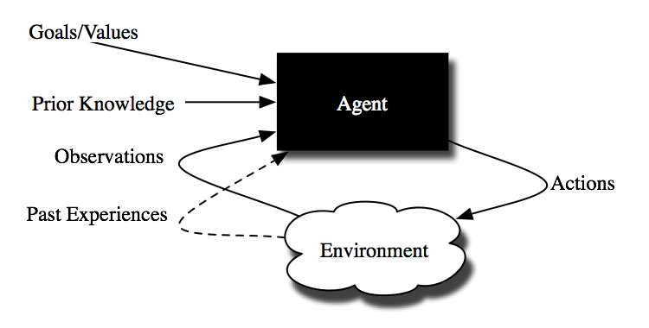
Agents and Environments
Notes:
Figure 1.3 [P]

Slide 21
Example Agent: Robot
actions:
  movement, grippers, speech, facial expressions,. . .
observations:
  vision, sonar, sound, speech recognition, gesture recognition,. . .
goals:
  deliver food, rescue people, score goals, explore,. . .
past experiences:
  effect of steering, slipperiness, how people move,. . .
prior knowledge:
  what is important feature, categories of objects, what a sensor tell us,. . .

Slide 22
Example Agent: Teacher
actions:
  present new concept, drill, give test, explain concept,. . .
observations:
  test results, facial expressions, errors, focus,. . .
goals:
  particular knowledge, skills, inquisitiveness, social skills,. . .
past experiences:
  prior test results, effects of teaching strategies, . . .
prior knowledge:
  subject material, teaching strategies,. . .

Slide 23
Example agent: Medical Doctor
actions:
  operate, test, prescribe drugs, explain instructions,. . .
observations:
  verbal symptoms, test results, visual appearance. . .
goals:
  remove disease, relieve pain, increase life expectancy, reduce costs,. . .
past experiences:
  treatment outcomes, effects of drugs, test results given symptoms. . .
prior knowledge:
  possible diseases, symptoms, possible causal relationships. . .

Slide 24
Example Agent: User Interface
actions:
  present information, ask user, find another information source, filter information, interrupt,. . .
observations:
  users request, information retrieved, user feedback, facial expressions. . .
goals:
  present information, maximize useful information, minimize irrelevant information, privacy,. . .
past experiences:
  effect of presentation modes, reliability of information sources,. . .
prior knowledge:
  information sources, presentation modalities. . .

Slide 25
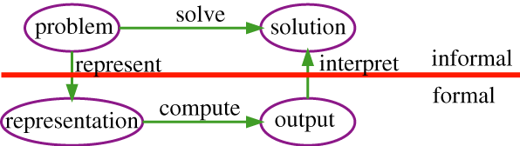
The Role of Representation
Choosing a representation involves balancing conflicting objectives
Different tasks require different representations
Representations should be expressive (epistemologically adequate) and efficient (heuristically adequate)
Notes:
[P], fig. 1.4; we will discuss representations later in the course

Slide 26
Desiderata of Representations
We want a representation to be
  rich enough to express the knowledge needed to solve the problem
    Epistemologically adequate
  as close to the problem as possible: compact, natural and maintainable
  amenable to efficient computation: able to express features of the problem we can exploit for computational gain
    Heuristically adequate
  learnable from data and past experiences
  able to trade off accuracy and computation time

Slide 27
Dimensions of Complexity
Modularity:
  Flat, modular, or hierarchical
Representation:
  Explicit states or features or objects and relations
Planning Horizon:
  Static or finite stage or indefinite stage or infinite stage
Sensing Uncertainty:
  Fully observable or partially observable
Process Uncertainty:
  Deterministic or stochastic dynamics
Preference Dimension:
  Goals or complex preferences
Number of agents:
  Single-agent or multiple agents
Learning:
  Knowledge is given or knowledge is learned from experience
Computational Limitations:
  Perfect rationality or bounded rationality

Slide 28
Modularity
You can model the system at one level of abstraction: flat
  [P] distinguishes flat (no organizational structure) from modular (interacting modules that can be understood on their own; hierarchical seems to be a special case of modular)
You can model the system at multiple levels of abstraction: hierarchical
  Example: Planning a trip from here to a resort in Cancun, Mexico
Flat representations are ok for simple systems, but complex biological systems, computer systems, organizations are all hierarchical
A flat description is either continuous or discrete.
Hierarchical reasoning is often a hybrid of continuous and discrete

Slide 29
Succinctness and Expressiveness of Representations
Much of modern AI is about finding compact representations and exploiting that compactness for computational gains.
An agent can reason in terms of:
  explicit states
  features or propositions
    It is often more natural to describe states in terms of features
    30 binary features can represent 2³⁰ = 1,073,741,824 states.
  individuals and relations
    There is a feature for each relationship on each tuple of individuals.
    Often we can reason without knowing the individuals or when there are infinitely many individuals

Slide 30
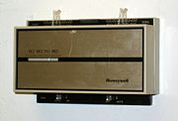
Example: States
Thermostat for a heater
  2 belief (i.e., internal) states: off, heating
  3 environment (i.e., external) states: cold, comfortable, hot
  6 total states corresponding to the different combinations of belief and environment states
Notes:
Section 1.5.2 [P]

Slide 31
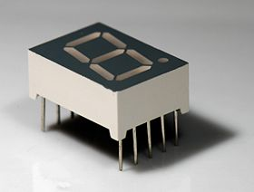
Example: Features or Propositions
Character recognition
  Input is a binary image which is a 30x30 grid of pixels
  Action is to determine which of the letters {a…z} is drawn in the image
  There are 2⁹⁰⁰ different states of the image, and so 26²⁹⁰⁰ different functions from the image state into the letters
  We cannot even represent such functions in terms of the state space
  Instead, we define features of the image, such as line segments, and define the function from images to characters in terms of these features
Notes:
A state can be described in terms of features, where a feature has a value in every state
A proposition is a Boolean feature, which means that it can have values true or false.

Slide 32
Example: Relational Descriptions
University Registrar Agent
Propositional description:
  “passed” feature for every student-course pair that depends on the grade feature for that pair
Relational description:
  individual students and courses
  relations grade and passed
  Define how “passed” depends on grade once, and apply it for each student and course. Moreover this can be done before you know of any of the individuals, and so before you know the value of any of the features
covers_core_courses(St, Dept) <- core_courses(Dept, CC, MinPass) &
passed_each(CC, St, MinPass).
passed(St, C, MinPass) <- grade(St, C, Gr) & Gr >= MinPass.

Slide 33
Planning Horizon
How far the agent looks into the future when deciding what to do
Static: world does not change
Finite stage: agent reasons about a fixed finite number of time steps
Indefinite stage: agent is reasoning about finite, but not predetermined, number of time steps
Infinite stage: the agent plans for going on forever (process oriented)

Slide 34
Uncertainty
There are two dimensions for uncertainty
  Sensing uncertainty
  Process uncertainty
In each dimension we can have
  no uncertainty: the agent knows which world is true
  disjunctive uncertainty: there is a set of worlds that are possible
  probabilistic uncertainty: a probability distribution over the worlds

Slide 35
Uncertainty
Sensing uncertainty: Can the agent determine the state from the observations?
  Fully observable: the agent knows the state of the world from the observations.
  Partially observable: many states are possible given an observation.
Process uncertainty: If the agent knew the initial state and the action, could it predict the resulting state?
  Deterministic dynamics: the state resulting from carrying out an action in state is determined from the action and the state
  Stochastic dynamics: there is uncertainty over the states resulting from executing a given action in a given state.
Notes:
Partially observable value for the sensing uncertainty dimension has two cases: several states results in the same observation, or observations are noisy.

Slide 36
Preference
Achievement goal is a goal to achieve. This can be a complex logical formula
Complex preferences may involve tradeoffs between various desiderata, perhaps at different times
  ordinal only the order matters
  cardinal absolute values also matter
Examples: coffee delivery robot, medical doctor
Notes:
1.5.5 [P]

Slide 37
Number of Agents
Single agent reasoning is where an agent assumes that any other agents are part of the environment
Multiple agent reasoning is when an agent reasons strategically about the reasoning of other agents
Agents can have their own goals: cooperative, competitive, or goals can be independent of each other
Notes:
1.5.6 [P]

Slide 38
Learning
Knowledge may be
  given
  learned (from data or past experience)
Notes:
1.5.6 [P]

Slide 39
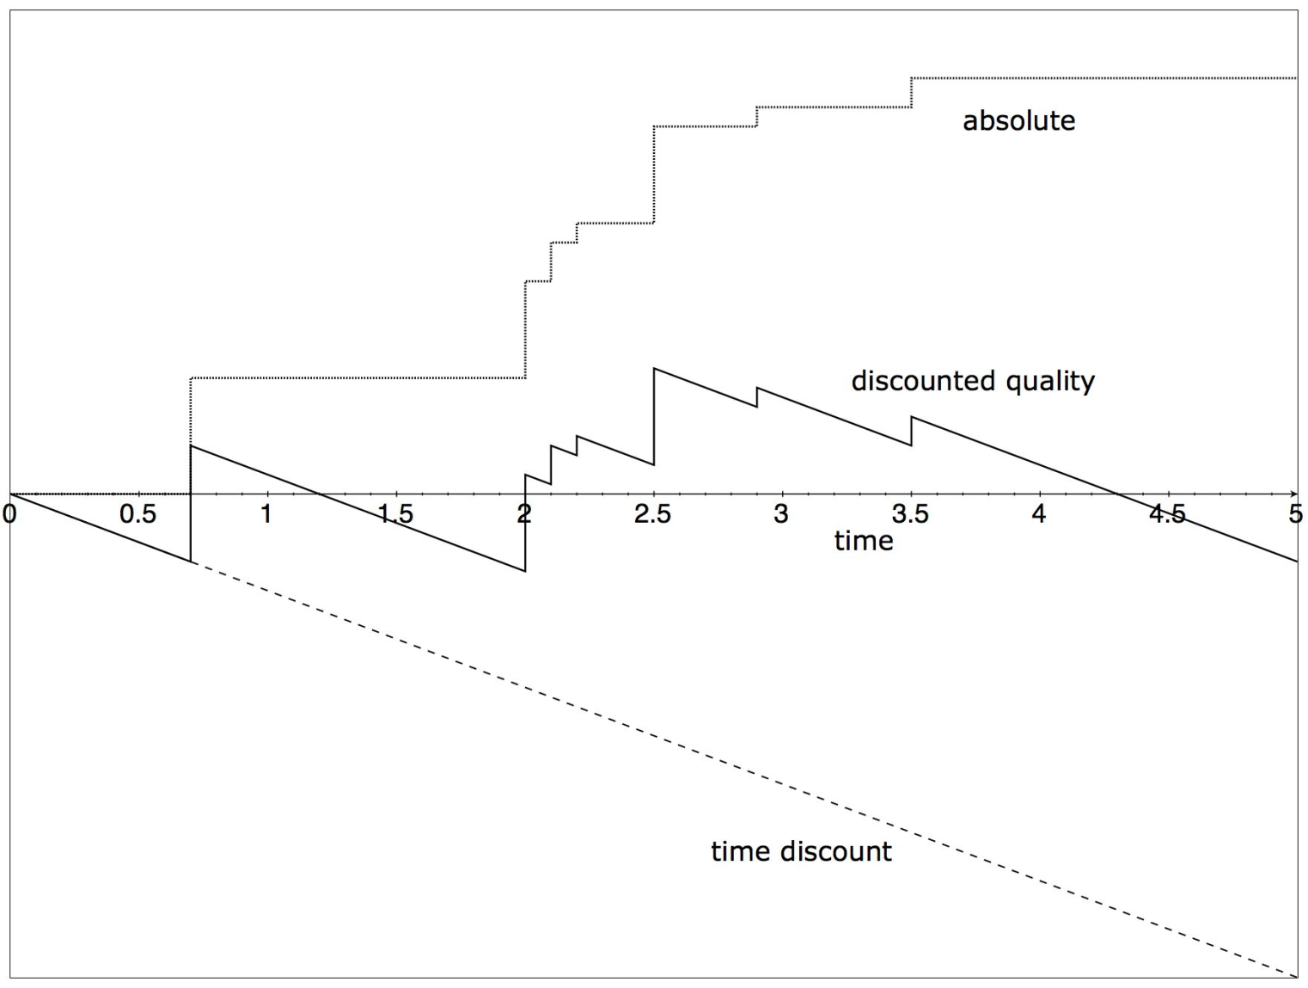
Bounded Rationality
Solution quality as a function of time for an anytime algorithm
Notes:
Note that the discount is linear in time

Slide 40
Examples of Representational Frameworks
State-space search
Classical planning
Influence diagrams
Decision-theoretic planning
Reinforcement Learning

Slide 41
State-Space Search
flat or hierarchical
explicit states or features or objects and relations
static or finite stage or indefinite stage or infinite stage
fully observable or partially observable
deterministic or stochastic actions
goals or complex preferences
single agent or multiple agents
knowledge is given or learned
perfect rationality or bounded rationality

Slide 42
Classical Planning
flat or hierarchical
explicit states or features or objects and relations
static or finite stage or indefinite stage or infinite stage
fully observable or partially observable
deterministic or stochastic actions
goals or complex preferences
single agent or multiple agents
knowledge is given or learned
perfect rationality or bounded rationality

Slide 43
Influence Diagrams
flat or hierarchical
explicit states or features or objects and relations
static or finite stage or indefinite stage or infinite stage
fully observable or partially observable
deterministic or stochastic actions
goals or complex preferences
single agent or multiple agents
knowledge is given or learned
perfect rationality or bounded rationality

Slide 44
Decision-Theoretic Planning
flat or hierarchical
explicit states or features or objects and relations
static or finite stage or indefinite stage or infinite stage
fully observable or partially observable
deterministic or stochastic actions
goals or complex preferences
single agent or multiple agents
knowledge is given or learned
perfect rationality or bounded rationality

Slide 45
Reinforcement Learning
flat or hierarchical
explicit states or features or objects and relations
static or finite stage or indefinite stage or infinite stage
fully observable or partially observable
deterministic or stochastic actions
goals or complex preferences
single agent or multiple agents
knowledge is given or learned
perfect rationality or bounded rationality

Slide 46
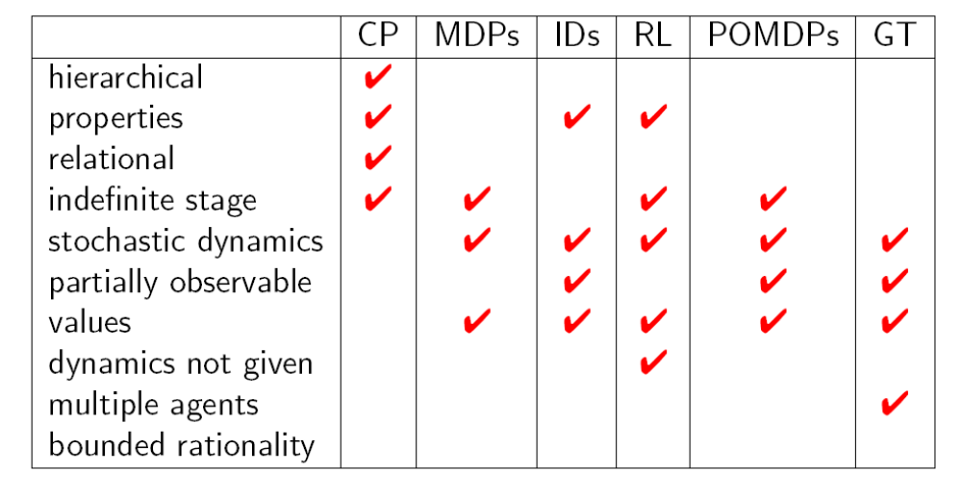
Comparison of Some Representations
Notes:
Constraint Propagation; Markov Decision Processes; Influence Diagrams; Reinforcement Learning (??); Partially Observable Markov Decision Processes; Game Theory

Slide 47
Four Application Domains
Autonomous delivery robot roams around an office environment and delivers coffee, parcels, etc.
Diagnostic assistant helps a human troubleshoot problems and suggests repairs or treatments
  E.g., electrical problems, medical diagnosis
Intelligent tutoring system teaches students in some subject area
Trading agent buys goods and services on your behalf

Slide 48
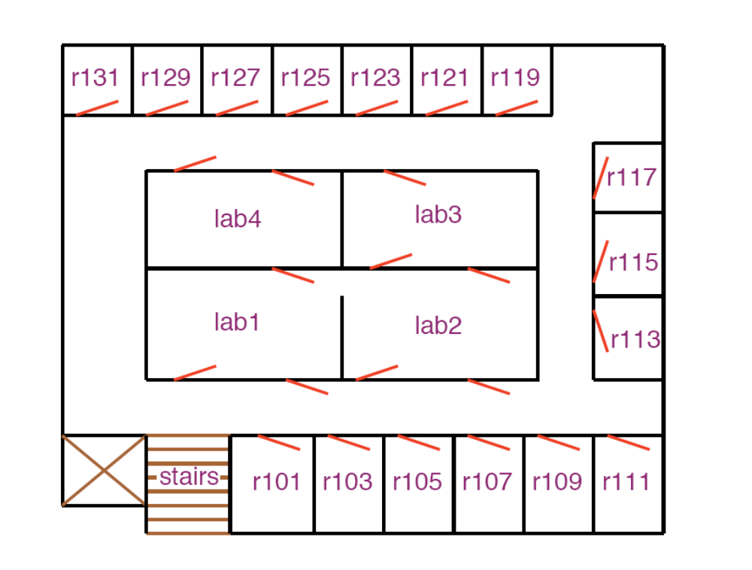
Environment for Delivery Robot

Slide 49
Autonomous Delivery Robot
Example inputs:
Prior knowledge: its capabilities, objects it may encounter, maps.
Past experience: which actions are useful and when, what objects are there, how its actions affect its position
Goals: what it needs to deliver and when, tradeoffs between acting quickly and acting safely
Observations: about its environment from cameras, sonar, sound, laser range finders, or keyboards
Sample activities:
Determine where Craig's office is. Where coffee is, etc.
Find a path between locations
Plan how to carry out multiple tasks
Make default assumptions about where Craig is
Make tradeoffs under uncertainty: should it go near the stairs?
Learn from experience.
Sense the world, avoid obstacles, pickup and put down coffee

Slide 50
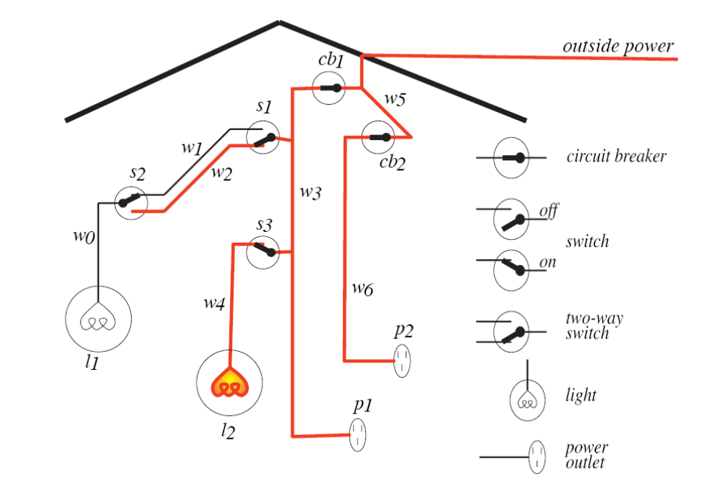
Environment for Diagnostic Assistant

Slide 51
Diagnostic Assistant
Sample activities:
Derive the effects of faults and interventions
Search through the space of possible fault complexes
Explain its reasoning to the human who is using it
Derive possible causes for symptoms; rule out other causes
Plan courses of tests and treatments to address the problems
Reason about the uncertainties/ambiguities given symptoms.
Trade off alternate courses of action
Learn what symptoms are associated with faults, the effects of treatments, and the accuracy of tests.
Example inputs:
Prior knowledge: how switches and lights work, how malfunctions manifest themselves, what information tests provide, the side effects of repairs
Past experience: the effects of repairs or treatments, the prevalence of faults or diseases
Goals: fixing the device and tradeoffs between fixing or replacing different components
Observations: symptoms of a device or patient

Slide 52
Trading Agent
Example inputs:
Prior knowledge: the ontology of what things are available, where to purchase items, how to decompose a complex item
Past experience: how long special last, how long items take to sell out, who has good deals, what your competitors do
Goals: what the person wants, their tradeoffs
Observations: what items are available, prices, number in stock
Sample activities:
Trading agent interacts with an information environment to purchase goods and services.
It acquires a users needs, desires and preferences. It finds what is available.
It purchases goods and services that t together to fulfill user preferences.
It is difficult because user preferences and what is available can change dynamically, and some items may be useless without other items.

Slide 53
Intelligent Tutoring Systems
Example inputs
Prior knowledge: subject material, primitive strategies
Past experience: common errors, effects of teaching strategies
Goals: teach subject material, social skills, study skills, inquisitiveness, interest
Observations: test results, facial expressions, questions, what the student is concentrating on
Sample activities:
Presents theory and worked-out examples
Asks student question, understand answers, assess student’s knowledge
Answer student questions
Update model of student knowledge

Slide 54
Common tasks of the Domains
Modeling the environment:
  Build models of the physical environment, patient, or information environment
Evidential reasoning or perception:
  Given observations, determine what the world is like
Action:
  Given a model of the world and a goal, determine what should be done
Learning from past experiences:
  Learn about the specific case and the population of cases

