Slide 1
Camera-only OD vs SEG latency over loopback and OAI 5G
Month 1 latency-only split-inference runs; task GT disabled during these traces.
OD OAI median RTT
74.9 ms
+66.7 ms vs loopback
SEG OAI median RTT
107.9 ms
+94.5 ms vs loopback
SEG / OD payload
4.6x
median feature payload
Runs
4 x ~180s
OD/SEG over loopback/OAI
Same front/back split pattern as the fusion OAI comparison, now isolated to camera-only OD and camera-only SEG.
OD sends compact Faster R-CNN backbone features at 720p; SEG sends denser LR-ASPP features from the 1080p camera route.
OAI increases RTT for both tasks; the larger SEG payload makes the OAI penalty more visible.
RAN mode | NR SA over OAI RFsim, single UE for OD/SEG latency runs
Carrier | band n78, DL 3.6192 GHz, 106 PRB at 30 kHz SCS
Bandwidth | 106 PRB = about 40 MHz channel class (38.16 MHz RB span)
TDD pattern | 5 ms: 7 DL slots + mixed slot (6 DL sym, 4 UL sym) + 2 UL slots
Core QoS | DNN oai, S-NSSAI SST=1, 5QI=9, AMBR UL/DL 10Gbps/10Gbps
UE path | IMSI 001010000000001, oaitun_ue1 10.0.0.2 -> perception RX 192.168.70.140
Interpretation: these traces measure transport/runtime behavior. OD/SEG task-quality numbers are taken from separate GT-enabled runs.

Slide 2
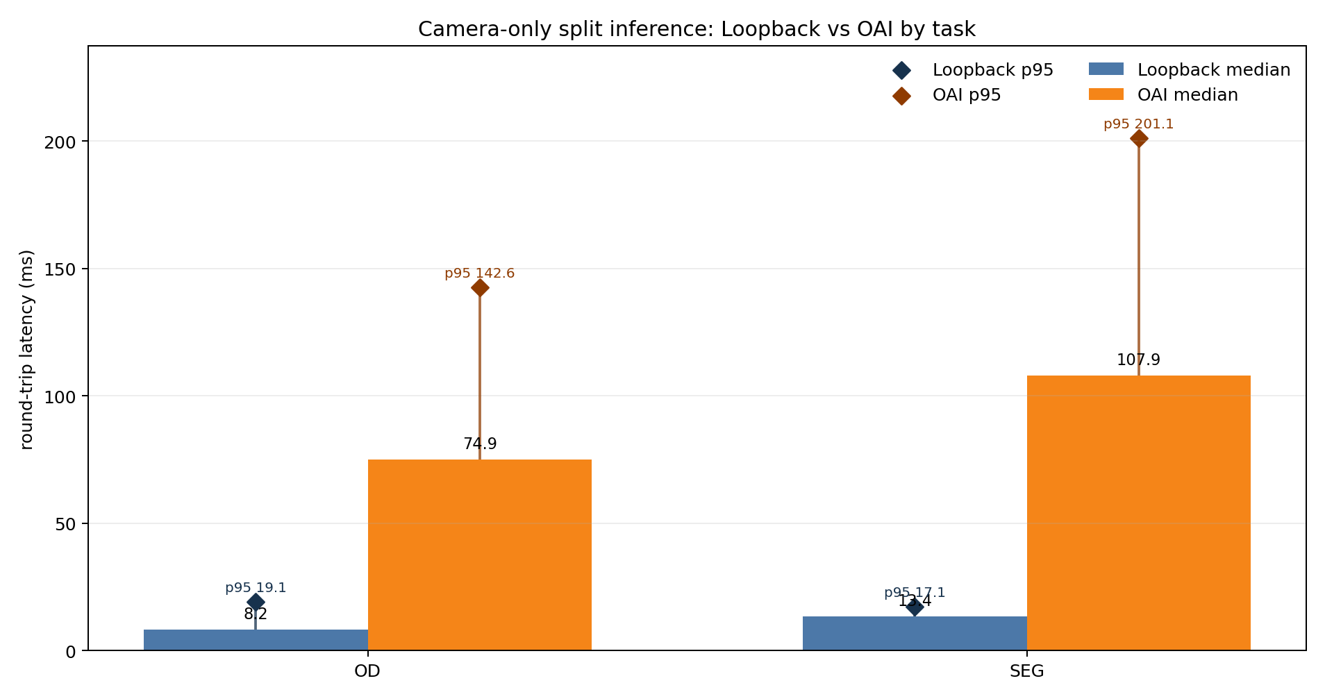
Round-Trip Latency
Median and p95 feature-send-to-result-return latency.
OD median RTT rises from 8.2 ms to 74.9 ms over OAI.
SEG median RTT rises from 13.4 ms to 107.9 ms over OAI.
SEG OAI p95 reaches 201.1 ms, the largest tail latency in this four-run comparison.
The OAI path is functional but not latency-neutral; it should be modeled as a control constraint.

Slide 3
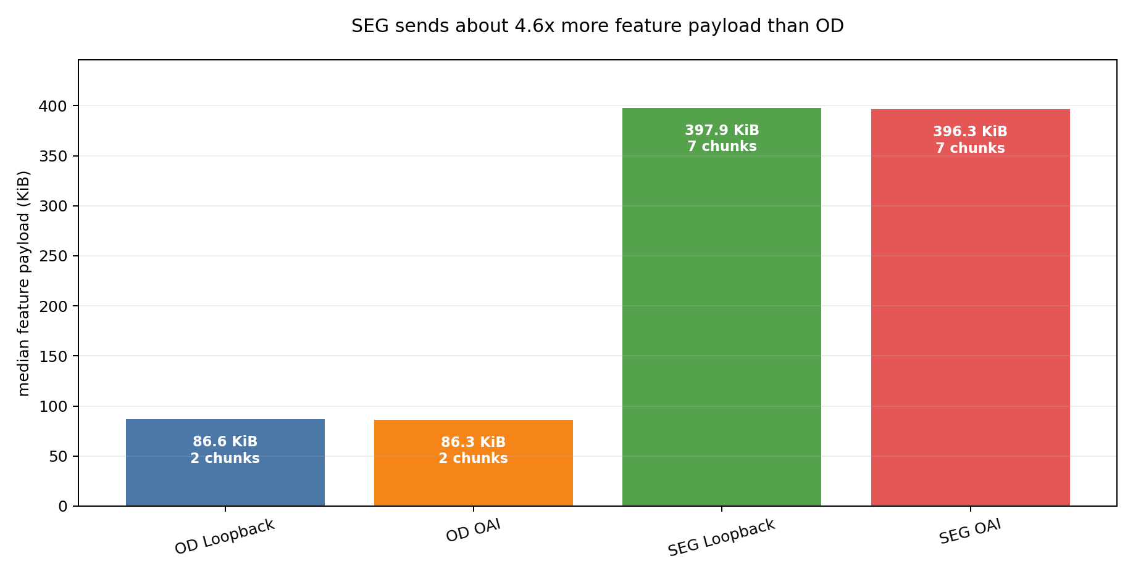
Payload Pressure
Feature payload size and UDP chunk count explain why SEG stresses the link more.
OD median payload is about 86.6 KiB and 2 chunks.
SEG median payload is about 397.9 KiB and 7 chunks.
That is roughly 4.6x larger than OD before any radio scheduling effects.
This gives the controller a clear task-dependent byte/latency tradeoff.

Slide 4
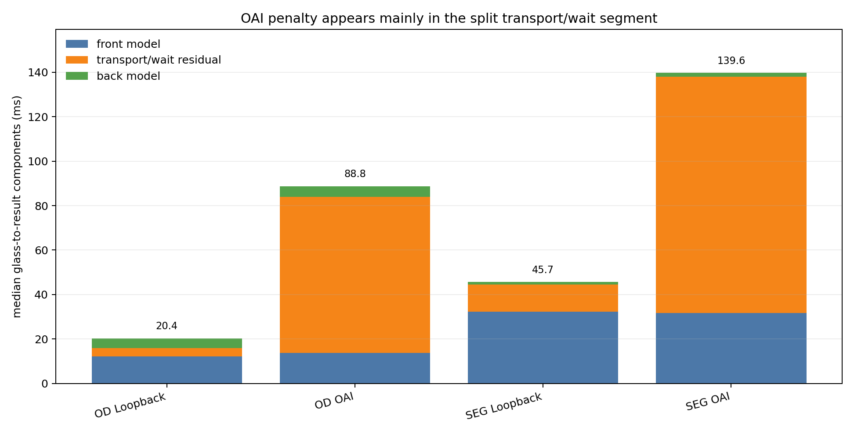
Latency Components
Median front compute plus split RTT components.
SEG front-side compute is higher than OD: 32.3 ms vs 12.1 ms in loopback.
Back-side segmentation compute is small; most SEG cost is feature extraction plus payload transport.
OAI adds a larger transport/wait residual than loopback for both tasks.
This decomposition supports an RL state with task type, payload size, RTT trend, and radio grant state.

Slide 5
Takeaway For Month 1
Camera-only OD/SEG now have the same latency story as fusion.
Loopback establishes the compute/runtime floor for each task.
OAI adds a repeatable transport penalty, and the penalty grows with payload pressure.
SEG is not just a different model: it is a different network load class, with larger feature tensors and more UDP chunks.
Current core QoS is default 5QI 9 eMBB; this is a useful baseline before 5QI, scheduling, or action-policy experiments.
Evidence | OD loopback/OAI and SEG loopback/OAI 180s latency traces
Plots | RTT median/p95, payload/chunks, front/back/transport components
Quality tie-in | Use separate GT-enabled OD/SEG summaries for recall/mIoU
Next | Pull raw CSVs for CDF/jitter plots; align with tunnel/RAN traces when available
Bottom line: task choice changes both model-side compute and network-side pressure, so the future controller should not treat OD, SEG, and fusion as one generic stream.

