Slide 1
SceneSense Fusion Model Transferability
Traffic-light-pole-trained RGB+radar fusion model tested on parked ego-vehicle sensor placement
97.0%
SEG binary IoU retention
parked ego / pole
64.4%
SEG vehicle IoU retention
parked ego / pole
7.7%
OD recall@2m retention
precise localization
21.0%
OD recall@5m retention
loose sensitivity
Bottom line: segmentation transfers partially; object detection/localization drops sharply when moving from pole cameras to parked ego cameras.
SceneSense fusion transferability
1

Slide 2
SETUP
Experiment Design
Question
The fusion model was trained with cameras/radar mounted near traffic-light poles. We moved the same checkpoint to parked ego vehicles and ask how much task accuracy transfers.
Streams
Pole S1: fusion_tl_14
Pole S2: fusion_tl_14_view_2
Ego S1: fusion_ego_front
Ego S2: fusion_ego_front_view_2
Runs were collected as pole pair first, parked-ego pair second.
Controls
Same checkpoint:
checkpoints/fusion_object_best.pt
Same loopback split transport, run logging, CARLA actor/semantic GT path, and comparable traffic settings.
SceneSense fusion transferability
2

Slide 3
HOW ACCURACY IS MEASURED
Ground Truth and Metric Definitions
Segmentation GT
A co-located CARLA semantic-segmentation camera produces per-pixel class labels. CARLA tags are mapped to three classes: background, vehicle, and person.
IoU = TP / (TP + FP + FN)
Object GT
CARLA vehicle actors provide world pose and bounding boxes. 3D boxes are projected into the RGB camera. Evaluation filters require visible center, minimum box area, and max distance for the strict OD comparison. The parked ego vehicle itself is excluded.
OD Metrics
Recall@d = matched GT / selected GT
A match is a greedy nearest-neighbor pair within d meters in global XY.
Mean XY error is the average distance over matched object centers.
SceneSense fusion transferability
3

Slide 4
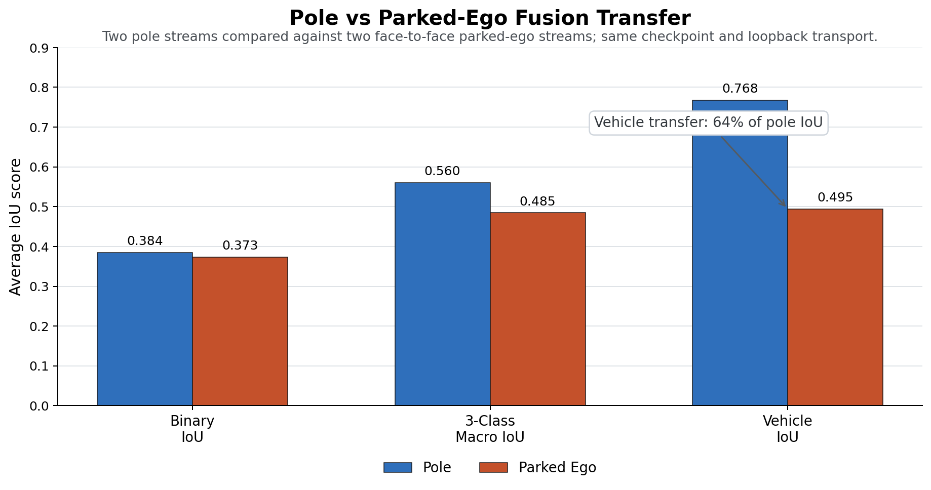
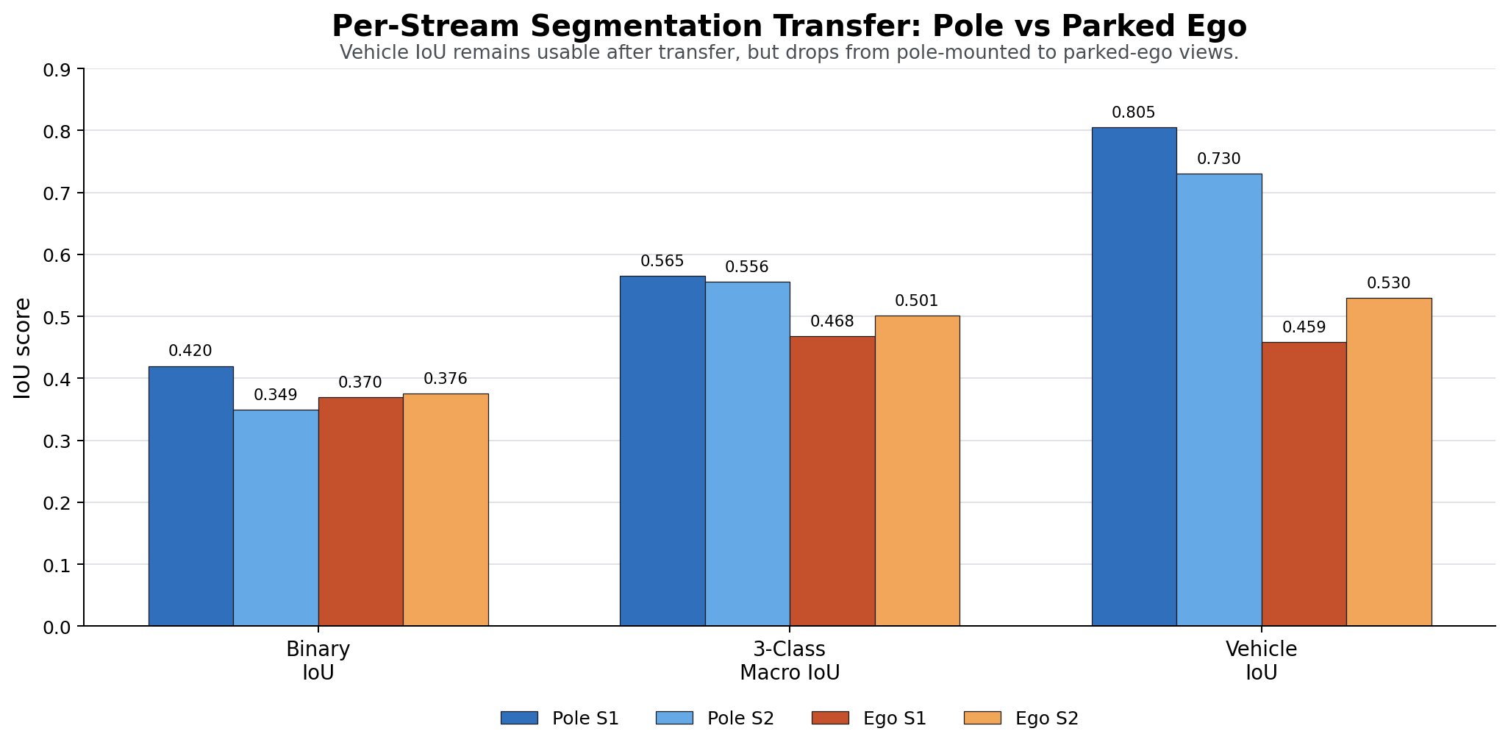
FUSION_AS_SEGMENTATION
Segmentation Transfer Result
Binary IoU
Pole 0.384 -> Ego 0.373
Retention 97.0%
Vehicle IoU
Pole 0.768 -> Ego 0.495
Retention 64.4%
Interpretation
Foreground transfer is strong, but vehicle segmentation degrades from the new viewpoint.
SceneSense fusion transferability
4

Slide 5
FUSION_AS_OD
Object Detection Evaluation
Prediction Path
The fusion object head decodes center heatmap peaks into world XYZ, yaw, size, parked score, and radar-support score. Predictions are logged per frame and stream.
Strict OD View
Recall@2m asks whether the object is found with useful localization precision. This is the main transfer metric for spatial-map usefulness.
Sensitivity View
Recall@5m asks whether the model is roughly finding the object even if localization is loose. It helps separate center-detection failure from regression precision failure.
SceneSense fusion transferability
5

Slide 6
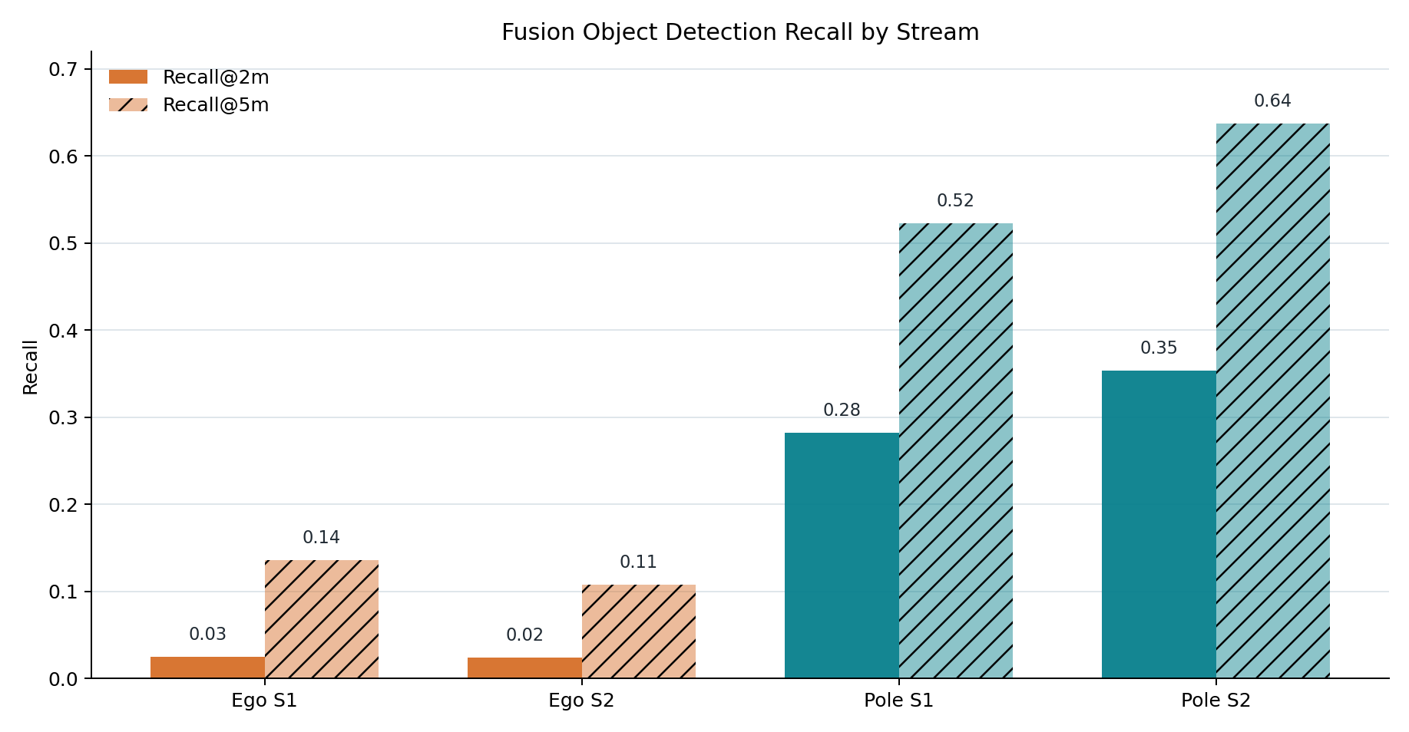
OD RESULT
Object Recall by Stream
Pole In-Domain
Recall@2m: 0.282 / 0.354
Recall@5m: 0.523 / 0.637
Parked Ego Transfer
Recall@2m: 0.025 / 0.024
Recall@5m: 0.136 / 0.108
Reading
The pole-trained object head remains much stronger on pole views. Parked-ego recall remains low even with a loose 5 m match gate.
SceneSense fusion transferability
6

Slide 7
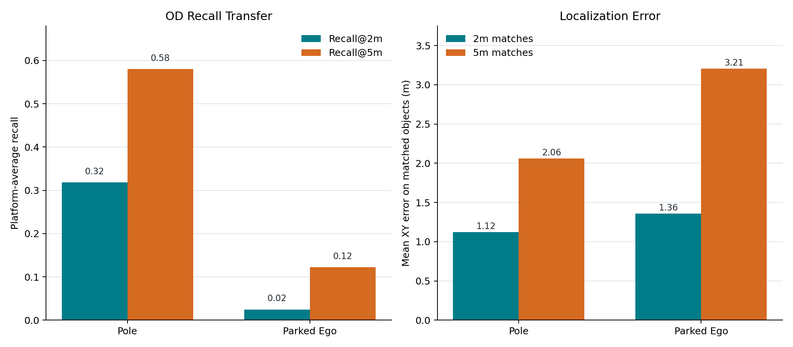
RECALL AND LOCALIZATION
OD Platform Summary
Average Recall@2m
Pole 0.318
Parked Ego 0.025
Retention 7.7%
Average Recall@5m
Pole 0.580
Parked Ego 0.122
Retention 21.0%
Mean XY Error
2m gate: Pole 1.12 m, Ego 1.36 m
5m gate: Pole 2.06 m, Ego 3.21 m
SceneSense fusion transferability
7

Slide 8
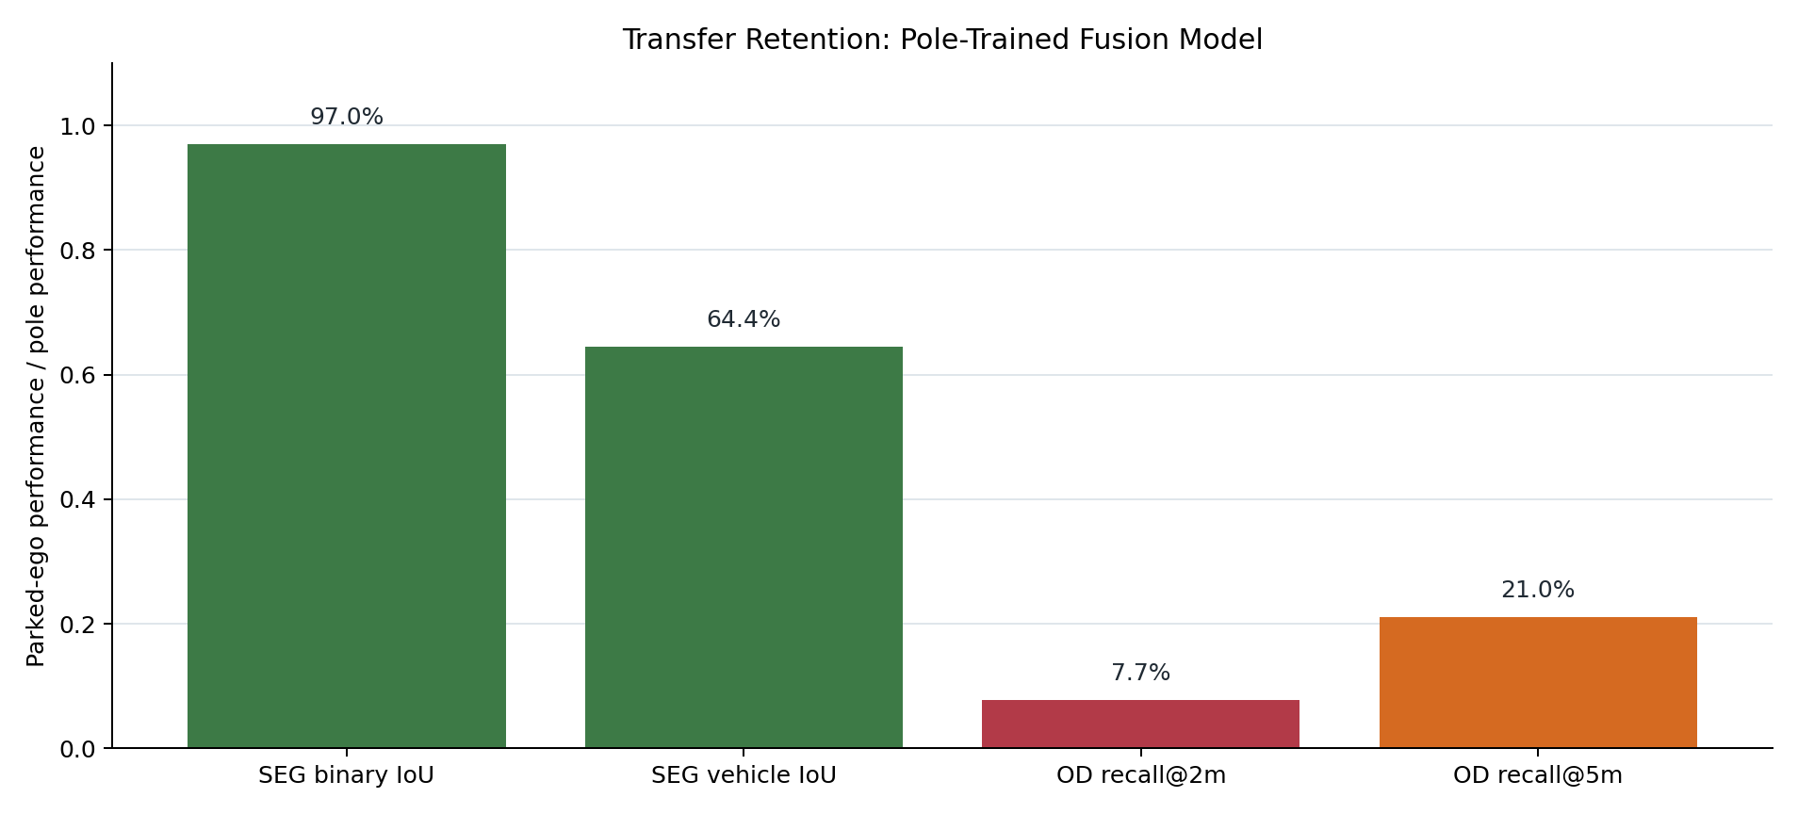
POLE-TRAINED CHECKPOINT
Transfer Retention Across Tasks
Segmentation
Binary foreground segmentation nearly transfers. Vehicle IoU transfers at about 64% of pole performance.
Object Detection
OD recall transfers poorly: about 8% retention at 2 m, about 21% retention at 5 m.
Why It Matters
Spatial maps need object centers and pose, not just foreground pixels. OD transfer is the blocker for parked-ego map sharing.
SceneSense fusion transferability
8

Slide 9
WHAT THE NUMBERS IMPLY
Interpretation
Not a Total Coordinate Failure
Matched OD predictions have reasonable XY error: about 1.1 m on pole streams at the 2 m gate. The model can localize objects it detects.
Likely Failure Mode
The object-center detector and confidence distribution do not transfer from high pole views to parked-ego front views. The segmentation head is more robust than the object head.
Checkpoint Caveat
Checkpoint metadata stores best_miou and selection score. It does not store object AP/recall, so the saved best checkpoint may be segmentation-selected rather than OD-selected.
SceneSense fusion transferability
9

Slide 10
DECISION
Conclusion and Next Steps
Conclusion: the pole-trained RGB+radar fusion model partially transfers for segmentation, but does not transfer well enough for parked-ego object detection/localization.
Use As-Is?
Segmentation: usable for baseline transfer analysis.
OD/localization: not sufficient for parked-ego spatial-map experiments.
Recommended Fix
Collect parked-ego RGB/radar/object-label samples and fine-tune or retrain the object head. Keep pole data mixed in to avoid forgetting.
Evaluation Next
Pull full OD CSVs if we want yaw/dimension plots, score calibration, false positives per frame, and confidence-threshold sweeps.
SceneSense fusion transferability
10

