Slide 1




Detecting Web Article Spin
Providing Users with Contextual Bias when reading Political Articles

Slide 2










There is no such thing as an Unbiased News Source
Left
Center
Right

Slide 3
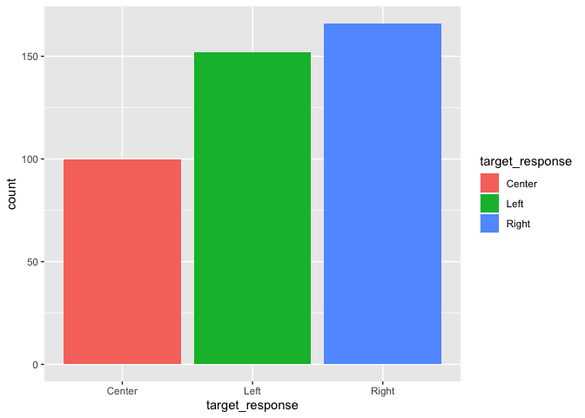
Project Summary
Data
NewsApi: web articles related to COVID19
418 URLs
Target Variable: ‘target_response’ (left, center, right)
Objectives
Build predictive classification model to optimize identification of web article bias
Provide users contextual bias when reading news content online
Optimize accuracy as primary classification metric

Slide 4
The Process
EDA
Collection / Cleaning
Feature Engineering
Feature Selection
Model Building
Article URLs collected using NewsAPI.org
URL contents scraped using specialized Newspaper3k library
Labeling sourced from allsides.com
Explored target variable ‘target_response’
Identified predictor variables with greatest impact on political leanings
Generate ideas for feature engineering
Domain knowledge combined with EDA
Hypothesis testing to determine value
LDA
2-grams
Iterated through combinations of engineered features
Regularized Logistic Regression
Random Forest
Bagged Logit
Naïve Bayes

Slide 5

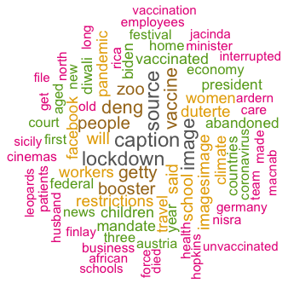
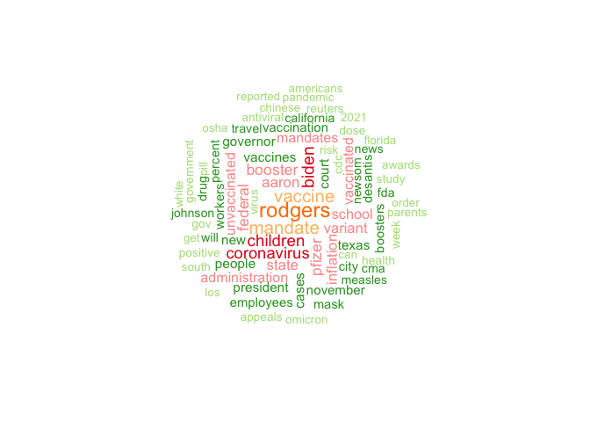
EDA – Word Clouds
Left
On the surface, it appears articles across the spectrum use similar language
Notes of Interest:
Vaccine / Omicron
Washington / Mandate
Global Words
Sports
Children
Center
Right

Slide 6
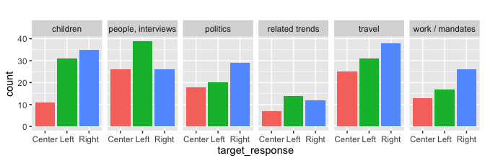
Latent Dirichlet Allocation

Slide 7
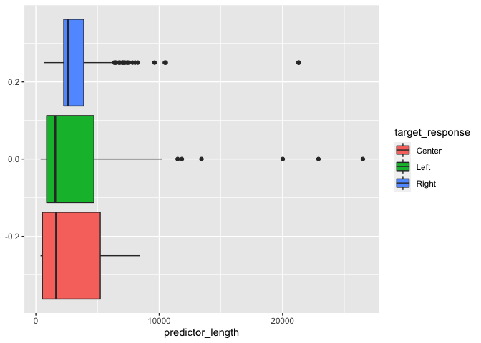
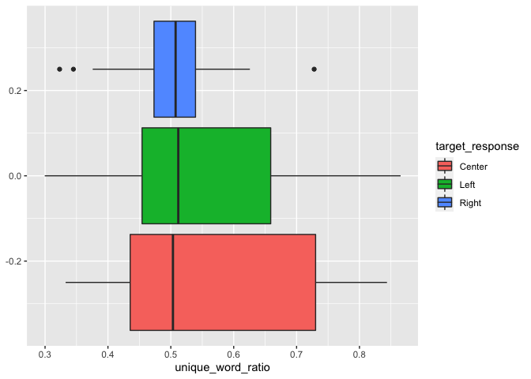
EDA – Text Stats
Generated various text stats for review:
predictor_length
Total_words
Unique_words
Unique_words_ratio
Based on our analysis, :
All engineered stats statistically significant to include in model
n_unique Significance (p = 1e-108)
n_poly Signifcance (p = 4e-145)

Slide 8
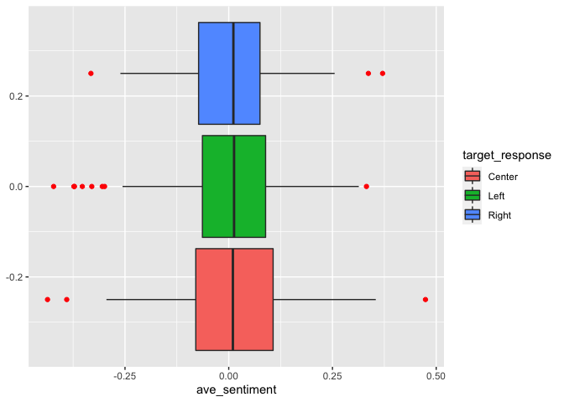
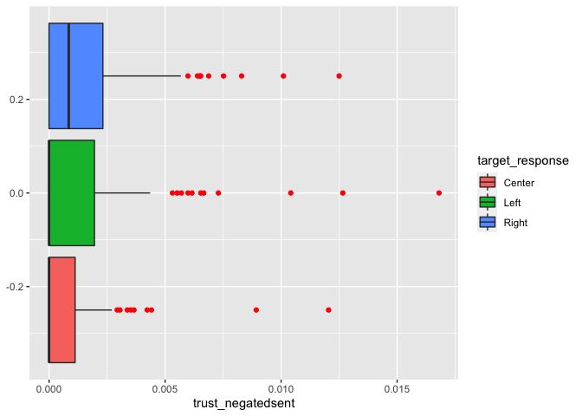
EDA – Sentiment
Tested to see if there is a difference based on sentiment across bias groups
Sentiment is comprised of two features:
Sentiment = “positivity”
Emotion = “anger vs joy”
Based on our analysis, :
Greatest difference between groups in relation to emotion
Sentiment Significance (p = 0.99)
Trust Signifcance (p = 0.03)*

Slide 9
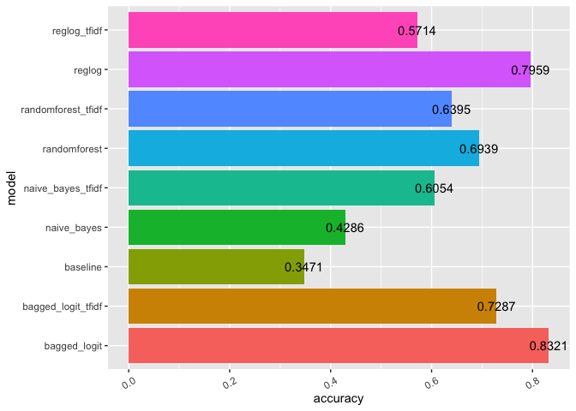
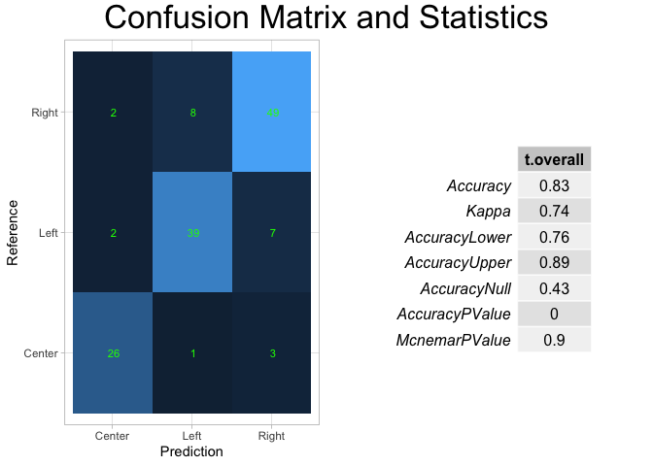
83.2% Accuracy: Bagged Logit + TFIDF + Custom Features
Of Interest:
All custom features present in top 100 features based on LogitBOOST algorithm

Slide 10
Major Next Steps
Get more data in order to better utilize deep learning models
Perform better labeling by sorting by Author
Deploy on Heroku!

