Slide 1
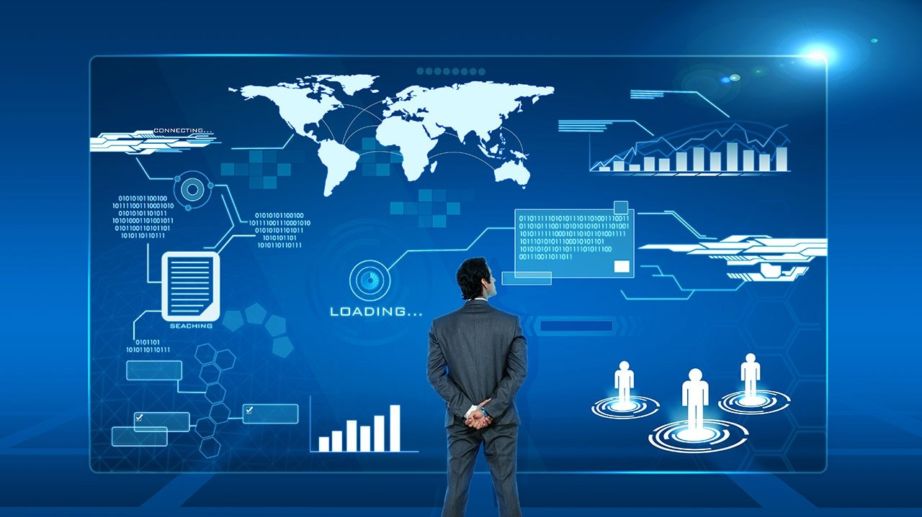
Monitoring

Slide 2
Monitoring
Monitoring is the practice of gathering and analyzing data, such as metrics (e.g., CPU usage, memory consumption) and logs (records of events), from a system to detect potential issues or anomalies.
Metrics: Quantifiable data like CPU, memory usage, disk I/O, and network traffic.
Logs: Detailed event information, error messages, and system events over time.

Slide 3
Observabililty
Observability helps you not only see what is happening in a system but also understand why it's happening.
Metrics: Numbers that represent how a system is performing (e.g., CPU usage).
Logs: Detailed records of events and errors within the system.
Traces: The journey of a request as it moves through different parts of a system.

Slide 4
Observability vs Monitoring
Observability
Monitoring
The ability to understand the internal state of a system by analyzing its outputs (metrics, logs, traces). It's a proactive approach that enables deeper insights into system behavior.
To explore and troubleshoot unknown issues by understanding how and why the system is behaving in a certain way.
Essential for complex, distributed, microservices-based architectures, where issues are harder to predict and diagnose.
The process of collecting, analyzing, and alerting based on predefined metrics and logs. It's a more reactive approach.
To detect known issues and trigger alerts when predefined conditions are met.
Suitable for simpler systems where behaviors and failures are predictable.

Slide 5







Slide 6






