Slide 1
INTRADAY STOCK TREND PREDICTION USING LSTM, ANN and Fin-BERT
Anand Nataraj Manoharan

Slide 2
Introduction
Intraday trading – trading a stock within the market opening and closing time of a day.
We can be profitable in intraday if we can buy or sell a stock by predicting its trend earlier.
The stock trend can either be Positive, Negative or Neutral.
If we buy or a stock during the positive and negative trend respectively, we will be profitable.

Slide 3
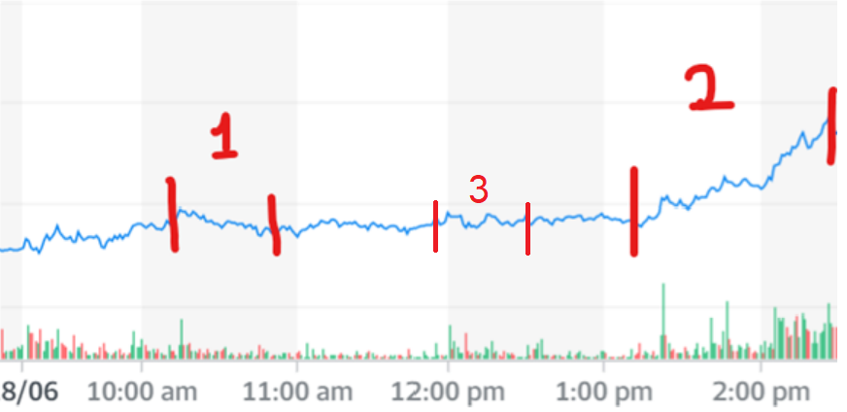
Period-1 => Shows the Negative trend
Period-2 => Shows the Positive trend
Period-3 => Shows the Neutral trend

Slide 4
Problem statement
Many experts in the past have tried to understand the stock market pattern to trade a stock profitably but failed miserably in doing so.
Till date there is no one single method to predict the stock market because it is highly volatile and multiple factors are involved in setting a price of a stock at a particular time.
Our research work is focused on achieving a novel way to trade a stock profitably in intraday market.

Slide 5
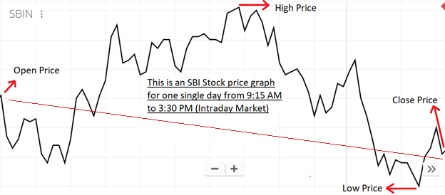
AIM
At First we try to predict the next days market trend between the opening and closing time of the market.
If the Open price is greater than the Close price It is a positive trend.
If The Close Price is greater than the Open Price it is a negative trend.

Slide 6
Secondly, we try to predict the current days sentiment for the stock using the tool: Google Alerts and the pre-trained model finBert. The sentiment predicted can be classified as Positive, Negative and Neutral if the market news about the stock is good, bad or neutral respectively.
Finally, we will build a static model to understand the overall trend for the next day based on the outcomes from the above two objectives.

Slide 7
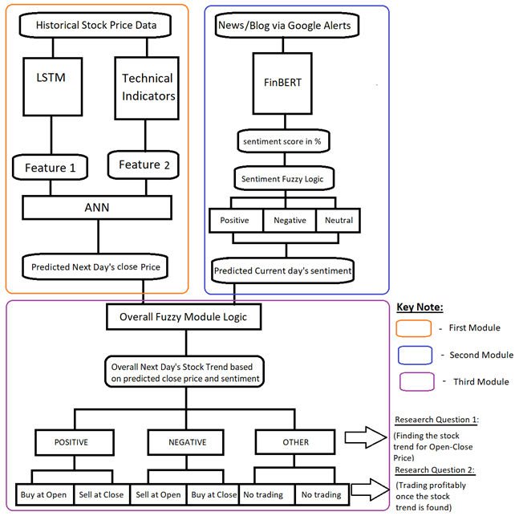

Slide 8
Objectives
The First objective of our research is to predict the next days close price using a model that has been trained on the historical stock prices for the previous days.
The Second objective is to predict current day’s sentiment (before the next day’s market opening) of the stock by analysing the news and blog articles from internet captured by google alerts.
The Third objective is to decide the next days market trend using the outcome of the First and the Second objective.

Slide 9
At the time when the intraday market opens, we know the open price and now we have the next days close price and the current days sentiment for the stock predicted. By knowing these three values we can decide the next day’s trend.
If the Price difference and stock sentiment is both positive or negative then the decided trend is positive or negative respectively, else neutral.
Example:
Predicted Close Price | Actual Open Price | Price Difference | Stock Sentiment | Decided Trend
200 | 150 | 200-100 (Positive) | Positive | Positive
160 | 210 | 160-210 (Negative) | Negative | Negative
270 | 270 | 270-270 (Neutral) | Neutral | Neutral
200 | 150 | 200-100 (Positive) | Negative | Neutral
160 | 210 | 160-210 (Negative) | Positive | Neutral
270 | 270 | 270-270 (Neutral) | Neutral | Neutral

Slide 10
Methodology
To Predict next day’s close price of a stock we have trained an LSTM model with the historical prices of that stock.
The output of the LSTM for next day’s close price is sent to an ANN model, which has been trained with the output of LSTM along with the Simple Moving Average (technical indicator) for 5 days as additional feature to improve the accuracy of next days close price predicted by LSTM.
To predict the stock sentiment we get the articles for that stock from news websites and blogs from internet using google alerts. The collected articles are preprocessed and sent to pre-trained FIN-BERT, which has been trained on top of google-BERT to improve sentiment prediction for financial statements, to predict the sentiment.

Slide 11
Literature review
Why FIN-BERT is the most needed model for our task?
But we are not going to use directly the base BERT model for our sentiment analysis purpose, instead, we are going to use FIN-BERT [31], a finance domain specific model trained on top of BASE-BERT using a large financial communication corpora of 4.9 billion tokens, including corporate reports, earnings conference call transcripts and analyst reports.
REFERENCE :
Dataset | BASE-BERT accuracy | FIN-BERT accuracy
PhraseBank | 0.835 | 0.872
FiQA | 0.730 | 0.844
AnalystTone | 0.850 | 0.877
31. Yang, Y., UY, M.C.S. and Huang, A., (2020) FinBERT: A Pretrained Language Model for Financial Communications. [online] Available at: http://arxiv.org/abs/2006.08097.

Slide 12
Continued …
Similar work in the past that is resembling our research
Apart from all the literature reviews, our entire research methodology is based on the improvement of Nisha Shetty's paper on "Indian Stock Market Prediction Using Machine Learning and Sentiment Analysis" [18] where the author has combined the prediction results of the traditional ML model and the output of the preliminary sentiments analysis model for deciding on buy/sell trend.
REFERENCE :
18. Pathak, A. and Shetty, N.P., (2019) Indian Stock Market Prediction Using Machine Learning and Sentiment Analysis. In: Advances in Intelligent Systems and Computing. Springer Verlag, pp.595–603.

Slide 13
CONTINUED …
Our novel ideas to keep the research unique and more efficient
The improvement in our model is in using the state-of-the-art deep learning model (LSTM) with technical indicators as the additional features to the ANN. Moreover, the usage of the state-of-the-art FIN-BERT for sentiment analysis has made our work unique. In addition, for sentiment analysis we are not dependent on one blog articles, as mentioned in the existing paper above [18], rather, we are going to collect the information from all the relevant blogs and news channels using google alerts for sentiment analysis.
REFERENCE :
18. Pathak, A. and Shetty, N.P., (2019) Indian Stock Market Prediction Using Machine Learning and Sentiment Analysis. In: Advances in Intelligent Systems and Computing. Springer Verlag, pp.595–603.

Slide 14
results
Date | Predicted Close Price | Date | Predicted Close Price
9/21/2020 | 197.444 | 10/15/2020 | 198.844
9/22/2020 | 189.415 | 10/16/2020 | 196.048
9/23/2020 | 184.832 | 10/19/2020 | 195.273
9/24/2020 | 183.592 | 10/20/2020 | 202.045
9/25/2020 | 178.11 | 10/21/2020 | 204.717
9/28/2020 | 179.319 | 10/22/2020 | 204.735
9/29/2020 | 185.68 | 10/23/2020 | 203.97
9/30/2020 | 186.471 | 10/26/2020 | 203.744
10/1/2020 | 185.119 | 10/27/2020 | 199.145
10/5/2020 | 188.604 | 10/28/2020 | 194.716
10/6/2020 | 189.723 | 10/29/2020 | 190.974
10/7/2020 | 190.71 | 10/30/2020 | 188.214
10/8/2020 | 190.986 | 11/2/2020 | 188.617
10/9/2020 | 192.458 | 11/3/2020 | 194.058
10/12/2020 | 196.599 | 11/4/2020 | 203.08
10/13/2020 | 201.036 | 11/5/2020 | 206.051
10/14/2020 | 198.443 | 11/6/2020 | 217.46
FIRST MODULE

Slide 15
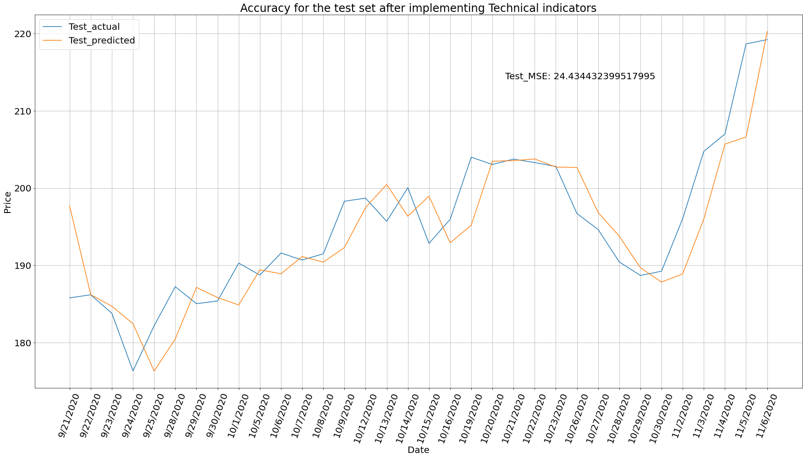

Slide 16
Module two
Date | Predicted Sentiment | Date | Predicted Sentiment
9/21/2020 | Positive | 10/14/2020 | Positive
9/22/2020 | Positive | 10/16/2020 | Positive
9/23/2020 | Positive | 10/20/2020 | Positive
9/25/2020 | Positive | 10/22/2020 | Positive
9/28/2020 | Positive | 10/23/2020 | Positive
9/29/2020 | Positive | 10/26/2020 | Positive
10/5/2020 | Positive | 10/27/2020 | Positive
10/6/2020 | Positive | 10/28/2020 | Positive
10/7/2020 | Positive | 10/29/2020 | Positive
10/8/2020 | Positive | 10/30/2020 | Positive
10/9/2020 | Positive | 11/3/2020 | Positive
10/12/2020 | Positive | 11/4/2020 | Positive
10/13/2020 | Positive | 11/6/2020 | Neutral

Slide 17


Module Three
Date | Predicted Sentiment | Actual Close Price | Predicted close price | Actual open price | Predicted Difference (Predicted Close - Actual Open) | Actual Difference (Actual Close - Actual Open) | Predicted Trend | Actual Trend
9/21/2020 | Positive | 185.8 | 197.698 | 193.05 | 4.6476 (positive) | -7.25 (negative) | buy | sell
9/22/2020 | Positive | 186.2 | 186.218 | 186.15 | 0.0682 (positive) | 0.0500 (positive) | buy | buy
9/23/2020 | Positive | 183.8 | 184.718 | 188.15 | -3.432 (negative) | -4.349 (negative) | Other | sell
9/25/2020 | Positive | 182.2 | 176.332 | 179 | -2.668 (negative) | 3.1999 (positive) | Other | buy
9/28/2020 | Positive | 187.25 | 180.493 | 184 | -3.507 (negative) | 3.25 (positive) | Other | buy
9/29/2020 | Positive | 185.05 | 187.156 | 188.5 | -1.344 (negative) | -3.45 (negative) | Other | sell
10/5/2020 | Positive | 188.75 | 189.422 | 192 | -2.577 (negative) | -3.25 (negative) | Other | sell
10/6/2020 | Positive | 191.6 | 188.921 | 191.1 | -2.179 (negative) | 0.5 (positive) | Other | buy
10/7/2020 | Positive | 190.7 | 191.148 | 192.55 | -1.401 (negative) | -1.850 (negative) | Other | sell
10/8/2020 | Positive | 191.5 | 190.424 | 191.35 | -0.925 (negative) | 0.1499 (positive) | Other | buy
10/9/2020 | Positive | 198.3 | 192.311 | 192 | 0.3113 (positive) | 6.3000 (positive) | buy | buy
10/12/2020 | Positive | 198.7 | 197.49 | 199.7 | -2.209 (negative) | -1 (negative) | Other | sell
10/13/2020 | Positive | 195.7 | 200.467 | 198.65 | 1.8173 (positive) | -2.95 (negative) | buy | sell
10/14/2020 | Positive | 200.05 | 196.35 | 194.05 | 2.2997 (positive) | 6 (positive) | buy | buy
10/16/2020 | Positive | 195.95 | 192.926 | 194 | -1.073 (negative) | 1.9499 (positive) | Other | buy
10/20/2020 | Positive | 203.05 | 203.475 | 201 | 2.4748 (positive) | 2.0500 (positive) | buy | buy
10/22/2020 | Positive | 203.3 | 203.768 | 201.9 | 1.8684 (positive) | 1.4000 (positive) | buy | buy
10/23/2020 | Positive | 202.8 | 202.727 | 204 | -1.273 (negative) | -1.2 (negative) | Other | sell
10/26/2020 | Positive | 196.7 | 202.661 | 202.7 | -0.039 (negative) | -6 (negative) | Other | sell
10/27/2020 | Positive | 194.65 | 196.851 | 197.25 | -0.398 (negative) | -2.600 (negative) | Other | sell
10/28/2020 | Positive | 190.45 | 193.772 | 195 | -1.227 (negative) | -4.55 (negative) | Other | sell
10/29/2020 | Positive | 188.7 | 189.71 | 189.35 | 0.3601 (positive) | -0.650 (negative) | buy | sell
10/30/2020 | Positive | 189.25 | 187.844 | 189.35 | -1.506 (negative) | -0.100 (negative) | Other | sell
11/3/2020 | Positive | 204.75 | 195.992 | 198 | -2.008 (negative) | 6.75 (positive) | Other | buy
11/4/2020 | Positive | 207 | 205.689 | 203.5 | 2.1887 (positive) | 3.5 (positive) | buy | buy
11/6/2020 | Neutral | 219.2 | 220.242 | 219 | 1.2423 (positive) | 0.1999 (positive) | buy | buy

Slide 18
conclusion
Total days traded = 10 days
Days traded in profits = 7 days
Days traded in loss = 3 days
Accuracy of our model in trading profitable for the trading days is as below:
= [(days traded in profits)/(Total days traded)]*100
= (7/10)*100
= 70% accuracy

Slide 19
Future enhancements
To verify our work with different stocks on different stock markets.
Using Social media posts and user comments for sentiment analysis.
Trying to predict the trend and trade between the other prices too, and not restricting to Open-Close prices only.
Building an ensemble model trained on difference stock data to capture novel variations.

Slide 20
Thank you

