Slide 1
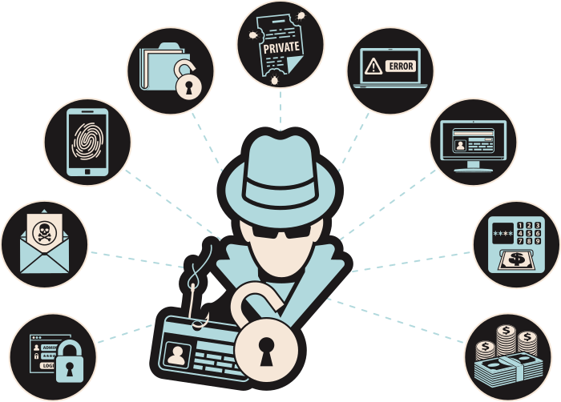
MANAI MED AMIN
PHISHING 101
Think Before You Click!

Slide 2
OBJECTIVES
By the end of this lesson, students will be able to:
1
2
3
4
Define phishing and identify common methods used by scammers
Most common types of phishing and how avoid them
Recognize red flags
Develop critical thinking skills to discern legitimate requests from potential phishing attempts

Slide 3
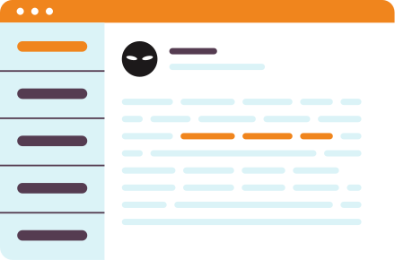
WHAT IS PHISHING?
Phishing is when someone tries to trick you into revealing personal information like your password, credit card numbers, or social security number.
Phishing can happen through emails, text messages, or other online platforms.
The concept of ‘phishing’ came from traditional ‘fishing’, in which the fish baits the fisherman's hook. Similarly, ‘phisher’ tricks the victim by using any communication method and uses bait to steal user’s credentials.
Think of an email or message you received that asked for personal information. What made it suspicious?

Slide 4

SOCIAL
ENGINEERING
Social engineering is like fishing. To get a catch, you need bait, and this is the basis for all social engineering attacks. It's no wonder its most common form is called 'phishing'. Asides enticement, it exploits your tendency to take quick action when you sense urgency

Slide 5

ORIGIN OF
THE TERM
In 1996 the term was used the first time by hackers who stole the password of America On-line’s users.
In 1998 phishers begun to use message boards (like topics in an online forum) and newsgroups to attack their victims.
In 2000 they have started using mass mailers to spread Phishing emails .

Slide 6
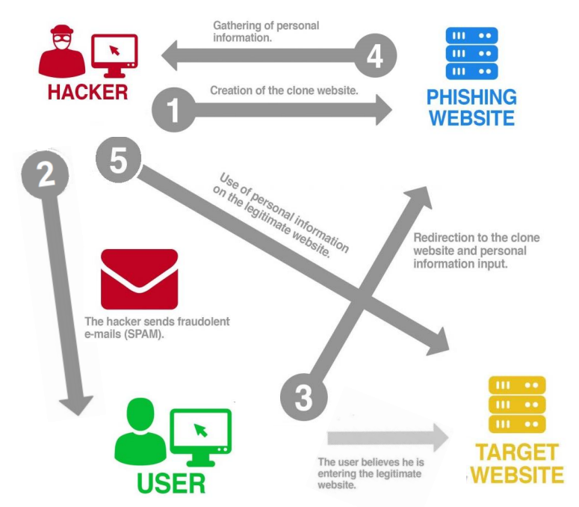
PHISHING PHASES

Slide 7



TYPES OF PHISHING
Phishing attacks come in different forms
EMAIL PHISHING
SMS PHISHING
SOCIAL MEDIA PHISHING
Scammers send fake emails pretending to be a trustworthy organization
Scammers send text messages with fake links or requests for personal information
Scammers create fake profiles or posts to trick you into clicking on links or sharing personal informaion

Slide 8


SPEAR PHISHING
Spear phishing emails are sent to a select target, which could be an individual or organization.
Spear phishing attacks are extremely effective because the attackers spend a lot of time studying the victims and the email sent appear to come from a trusted source. It is the most common phishing on social media websites.
EXAMPLE:
PayPal has millions of users so it is a hot target for hackers. There were been a few instances of spear phishing attacks. Instead of using blanket emails, hackers were using targeted email with no impersonal messages. This strategy is more powerful since the emails look legitimate.

Slide 9





HOW TO AVOID SPEAR PHISHING
Don't rely only on traditional security (no protection against zeroday link).
Use multi-factor authentication: additional layer to enforce security.
Take advantage of artificial intelligence (AI).
Train staffers to recognize and report attacks (do simulations).
Maximize data-loss prevention policies.

Slide 10

WHALING OR BUSINESS EMAIL COMPROMISE
A whaling or (BEC) attack is essentially a spear-phishing attack, but the targets are bigger. Often targets are companies who conduct wire transfers and have suppliers abroad
Cybercriminals impersonate senior managers in companies, asserting their authority and thus gaining access to sensitive data or money. They use the data they find on the internet (and often social media) to trick high-level employees into replying with fraudulent transfers or personal data.
EXAMPLE:
In 2016, a high-level employee at Snapchat made known all salary data to a scammer: he had responded to an email that looked to be from the CEO.

Slide 11



HOW TO AVOID WHALING ATTACK
HAVE PRIVATE PROFILES IN SOCIAL MEDIA
MARK EXTERNAL EMAILS
IMPLEMENT DATA PROTECTION AND DATA SECURITY POLICIES

Slide 12

CLONE PHISHING
The attacker creates an almost identical replica of a message previously received by the victims to make them think it is real.
The e-mail is sent from an address similar to the legitimate sender. The only difference is that the attachment or link in the message is exchanged for something malicious. It may claim to be a re-send of the original or an updated version to the original.

Slide 13

VISHING AND SMISHING
Vishing and smishing are phishing over the phone.
In vishing the victim receives a call with a voice message that looks like a communication from a known institution. It creates a sense of urgency for the user who for this reason provides information, like the PIN of a card.
In smishing malicious text messages are sent to induce users to click on a malicious link or to deliver personal information.
VISHING EXAMPLE:
SMISHING EXAMPLE:
Recently, criminals have started calling victims pretending to be Apple tech support and providing users with a number to call to resolve the “security problem.” These scams take advantage of user fears of their devices getting hacked.
In February 2019 digital attackers posed as the Finnish multinational telecommunications and sent out text messages informing Nokia’s users that they had won a car or money. The bad actors then asked recipients to send over money as a registration payment for their new car.

Slide 14




PREVENT VISHING AND SMISHING
BE AWARE: LEGITIMATE BUSINESS DON’T MAKE UNSOLICITED REQUESTS FOR SENSITIVE DATA.
DON’T ANSWER PHONE CALLS/SMS FROM UNKNOWN NUMBERS.
DON’T ANSWER PHONE CALLS/SMS FROM UNKNOWN NUMBERS.
BE SKEPTICAL AT ALL TIMES. CALL THE REAL COMPANY FOR ANY DOUBTS.

Slide 15

PHARMING
Some fraudsters are abandoning the idea of “baiting” their victims. Instead, they switched to pharming.
This phishing method exploits the cache poisoning compared to the Domain Name System (DNS), a naming system that the Internet uses to convert the alphabetical names of websites into numeric IP addresses in a way that can identify and then direct visitors to IT services and devices

Slide 16
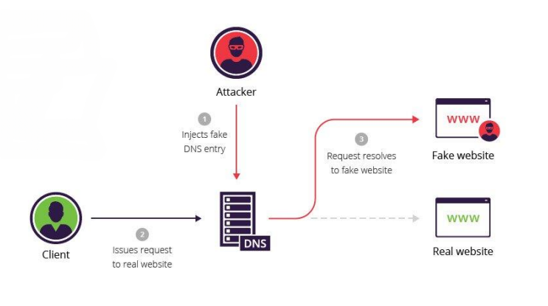
CACHE POISONING
Under a DNS cache poisoning attack, a pharmer "poisons" a DNS server and changes the IP address associated with a website name. This means that an attacker can redirect users to a malicious website of his choice. This is the even if the victim enters the correct name of the site.

Slide 17


HOW TO AVOID PHARMING
Enter login credentials only on HTTPS-protected sites
DON’T ANSWER PHONE CALLS/SMS FROM UNKNOWN NUMBERS.
Stay on top of security upgrades issued by a trusted Internet Service Provider.
Implement virus database updates on a regular basis

Slide 18

RED FLAGS
Red flags in phishing attempts are warning signs or indicators that help individuals identify potential scams. Some common read flags in phishing include:
1
Urgent or threatening language
2
Suspicious sender information
3
Requests for personal information
4
Misspellings or grammatical errors
5
Suspicious links or attachments
6
Generic greetings
7
Too good to be true

Slide 19
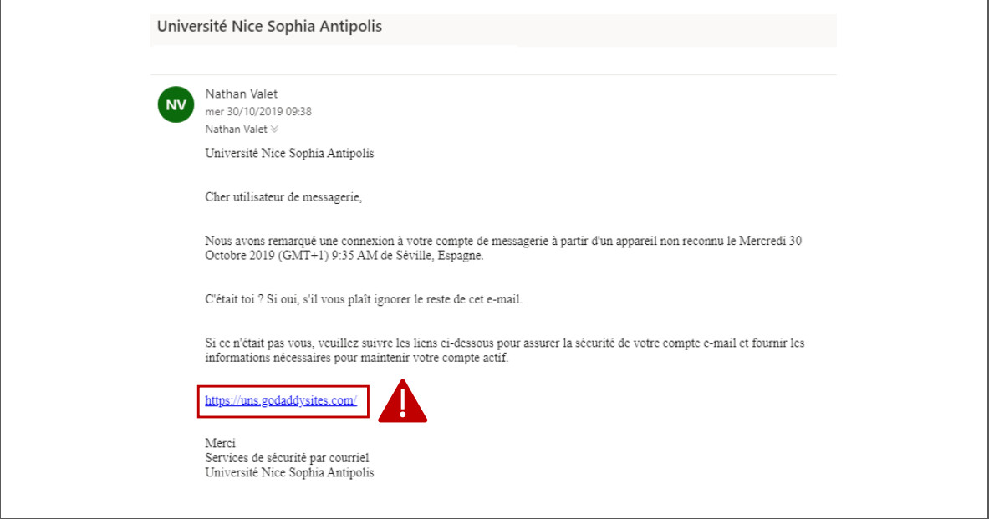

Slide 20
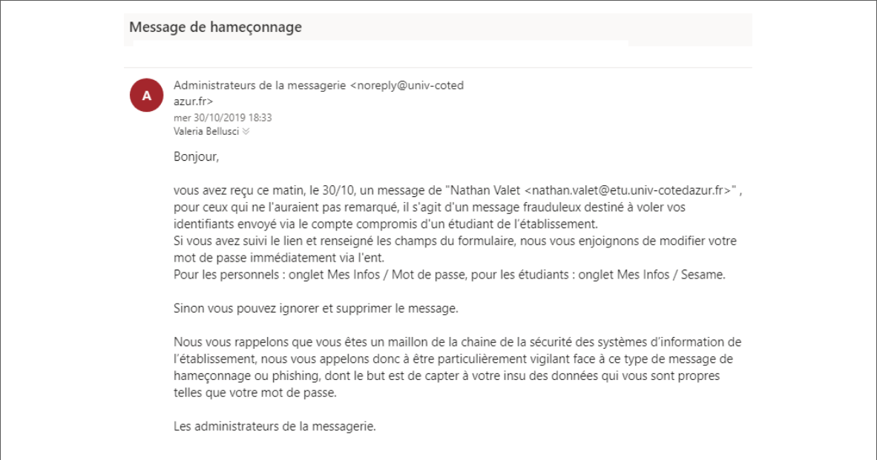

Slide 21

01
URGENT OR THREATENING LANGUAGE
03
REQUESTS FOR PERSONAL INFORMATION
Phishing attempts often create a sense of urgency or use threatening language to prompt immediate action. Phases like "urgent action required," "account suspended," or "your account will be deleted" may indicate a phishing attempt.
Legitimate organizations do not request personal information, such as usernames, passwords, or credit card numbers, via email, social media, or other online means. Be cautious of any request for personal information.
02
SUSPICIOUS SENDER INFORMATION
04
MISSPELLINGS OR GRAMMATICAL ERRORS
Check the sender's email address or social media profile. Phishing emails or messages often use generic or suspicious email addresses that do not match the legitimate entity they claim to represent.
Phishing emails or messages may contain misspellings, grammatical errors, or awkward phrasing. Legitimate organizations usually have professional communications and do not contain obvious errors.

Slide 22
05
SUSPICIOUS LINKS OR ATTACHMENTS
07
TOO GOOD TO BE TRUE
Be cautious of links or attachments in emails or messages from unknown or untrusted sources. Hover over links to check their actual destinations, and do not click on suspicious links or download attachments that you were not expecting.
Phishing attempts may lure individuals with enticing offers, such as winning a prize or getting a huge discount. If an offer seems too good to be true, it may be a phishing attempt.
06
GENERIC GREETINGS
Which of the seven red flags do you think is the hardest to detect? What makes you say that?
Phishing emails may use generic greetings like "Dear Customer" instead of addressing you by your name. Legitimate organizations often personalize their communications with your name or other relevant information.

Slide 23
CONSIDER THESE RED FLAGS
EXAMPLE 1
You come across a pop-up window while browsing a website that asks you for your credit card information to claim a prize or discount within the next 10 minutes. The website looks legitimate, but you only have 10 minutes to submit your personal information.
EXAMPLE 2
Read the examples and then identify which form of phishing it is and what red flags make it a phishing attempt.
You receive a message on social media from someone claiming to be a friend or family member, asking for your address and phone number. You've never met this person and don't see photos of them with your family or friends.

Slide 24

REPORT PHISHING ATTEMPTS
If you suspect a phishing attempt, report it to a trusted adult, teacher, or the school's IT department. Please don't forward the phishing email or message to another user. You can show them on your device. Forwarding phishing emails could lead to others being phished.
Reporting phishing attempts helps protect others from falling victim to the scam.

Slide 25

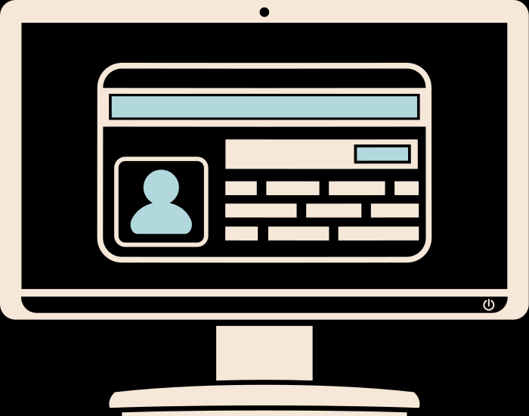
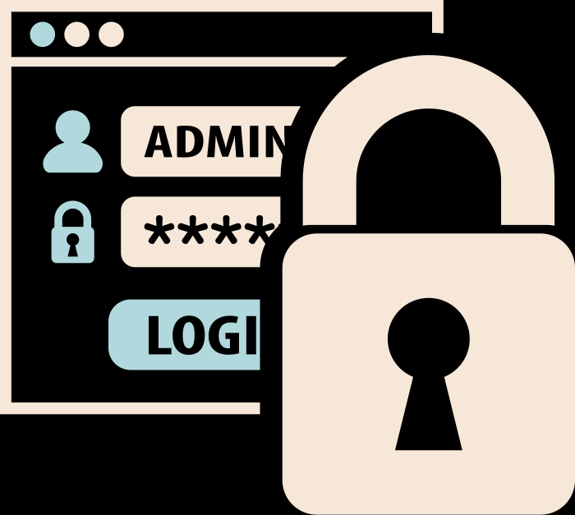
THINK CRITICALLY
Be skeptical of emails, messages, or posts that seem too good to be true or too urgent. Remember, if it sounds too good to be true, it probably is!
Think before clicking on any links, sharing personal information online, or opening any suspicious attachments. Ask yourself if it seems legitimate and if you were expecting it.
Verify the authenticity of the sender and the information provided before taking any action. Trust your instincts and be cautious when sharing information online.

Slide 26
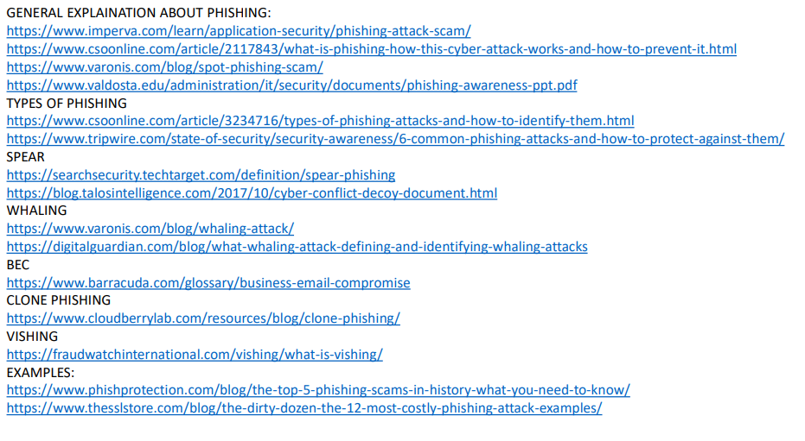
REFERENCES:

Slide 27
THINK BEFORE YOU CLICK!
PROTECT YOURSELF FROM PHISHING
Don't share your personal information online!

