Slide 1

Initial commit
How to use git in the typycal workflow
Notes:
typical workflow, pratico

Slide 2
What is git?
Git (/ɡɪt/) is a distributed version-control system for tracking changes in source code during software development. It is designed for coordinating work among programmers, but it can be used to track changes in any set of files. Its goals include speed, data integrity, and support for distributed, non-linear workflows[1].
Notes:
Ripasso, definizione, keywords

Slide 3
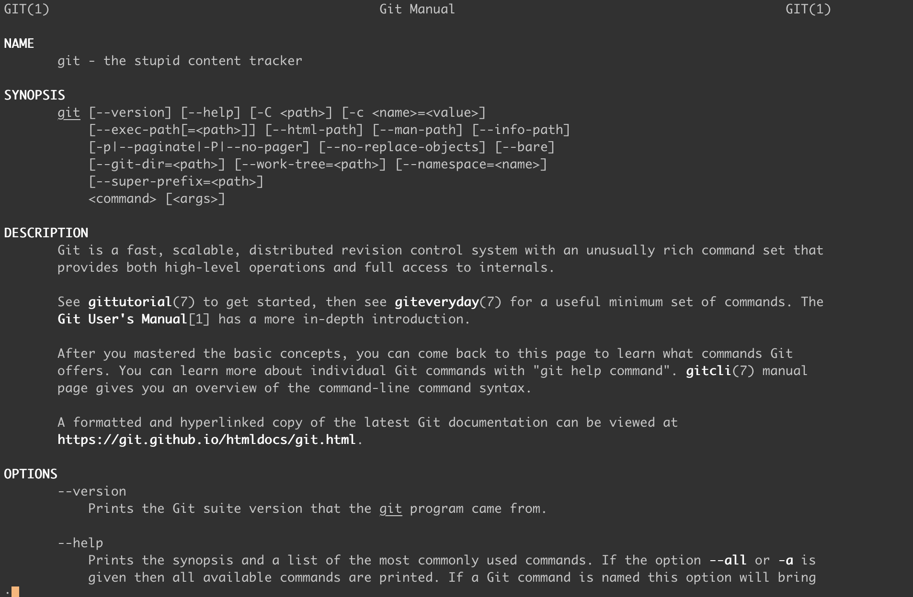
Notes:
Man page

Slide 4
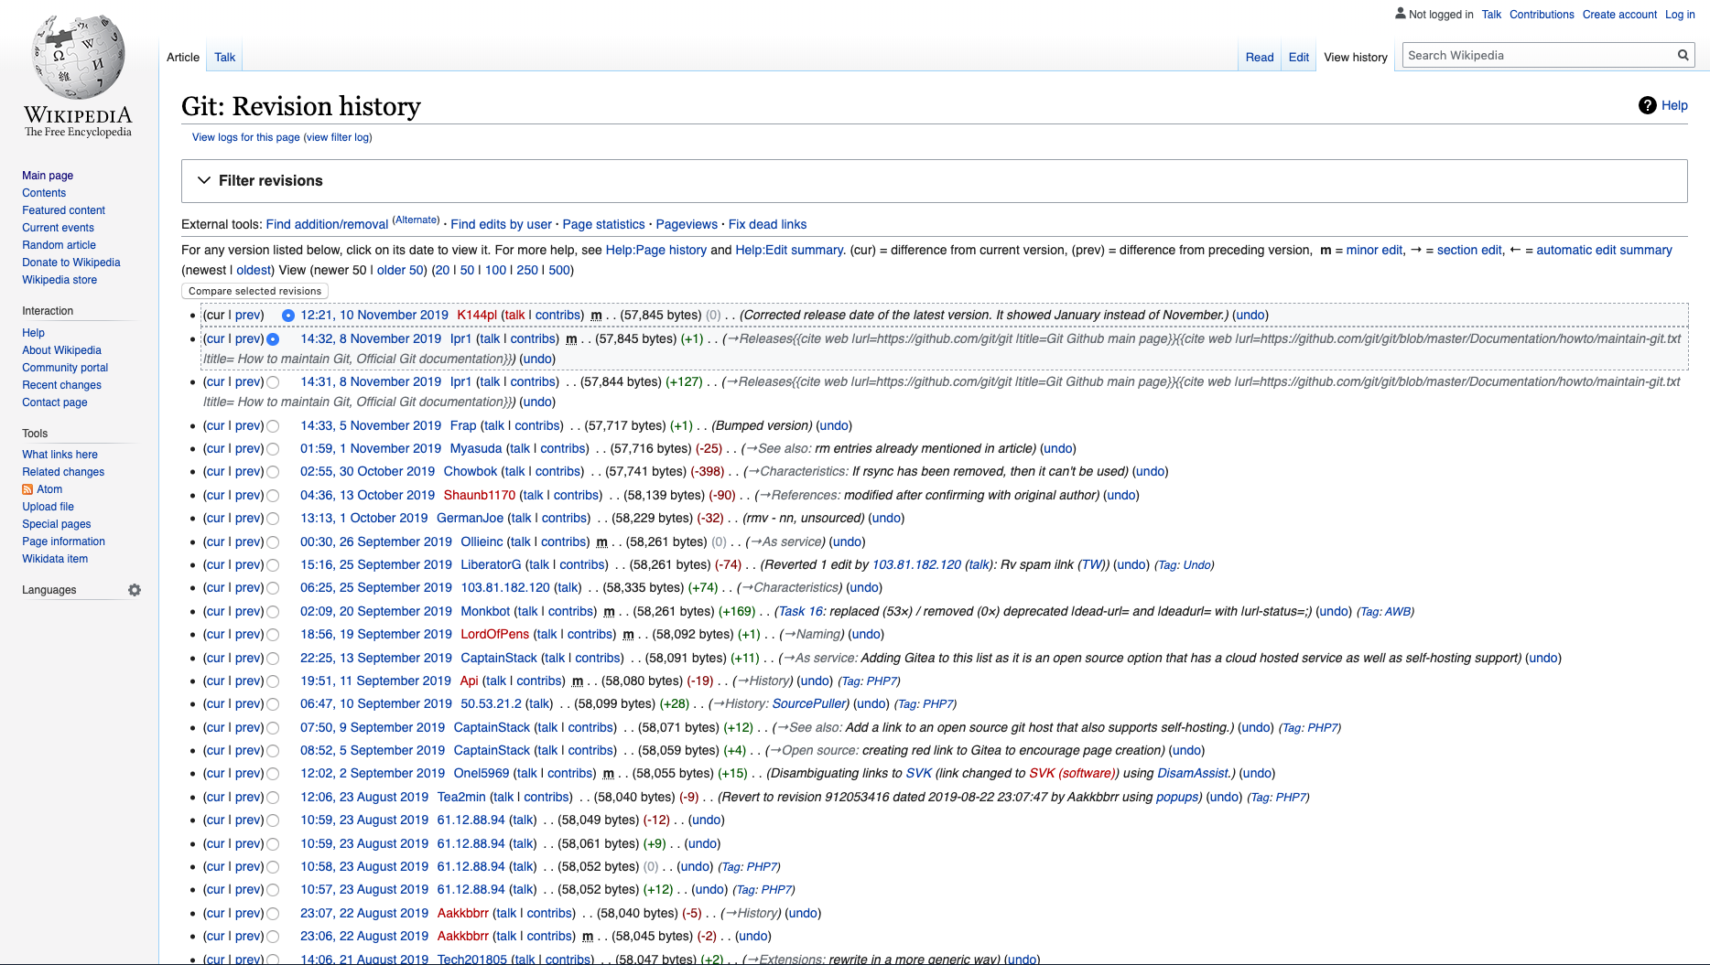
Version Control
A component of software configuration management, version control, also known as revision control or source control, is the management of changes to documents, computer programs, large web sites, and other collections of information[2].

Slide 5

Who made git?
Git was created by Linus Torvalds in 2005 for development of the Linux kernel, with other kernel developers contributing to its initial development. Its current maintainer since 2005 is Junio Hamano[1].

Slide 6
What is for
Tracking changes in source code
The primary use case for git is to track changes in the source code during software development.
Non-linear workflows
This means that we can develop the software on different parallel contexts without worrying about concluding this or that feature first.
Collaboration
Non-linear workflows combined with the distributed nature of the repositories allow collaboration among teams on different computers.

Slide 7
What is NOT for
Tracking changes of non-textual files
Aimed at tracking changes in source code files, git is not intended for binary and compressed files, especially if large. The indexing mechanism works on text differences among versions, which cannot be exploited when using files created by the machine.
File synchronization
Born as a development tool, git should not be used to synchronize files between machines. The history should reflect the development cycle of the software.
Sensitive information
As the repository could be accessible by the most different kinds of users, it should contain only information enabling the development of the software while any sensitive information should not be added.

Slide 8

Hands-on

Slide 9
init
We begin by creating an empty repository using the init command.
marco@macbook ~/gittutorial> git init
Initialized empty Git repository in /Users/marco/gittutorial/.git/

Slide 10
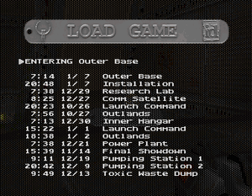
Tracking changes

Slide 11
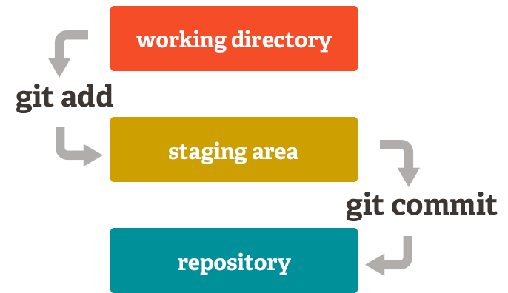
Reviewing changes
Before taking a snapshot and freezing a point in time we want to review the changes first. To achieve this, git implements
a tracking index which gives us evidence of the changes in the code base and
a staging area, in which we can temporarily put the changes we want to commit.
Each change in the directory then can be in one of these states:
Untracked
Tracked and not staged for commit
Tracked and staged for commit

Slide 12
status
After creating a file in the working directory, we are going to check the tracking INDEX.
The tracking INDEX is empty as the file just created has to be added to it with the add command.
marco@macbook ~/gittutorial> touch hello.py
marco@macbook ~/gittutorial> git status
On branch master
No commits yet
Untracked files:
(use "git add <file>..." to include in what will be committed)
hello.py
nothing added to commit but untracked files present (use "git add" to track)

Slide 13
add
We are going to start tracking the modifications in the file and add it to the staging area by calling the add command.
marco@macbook ~/gittutorial> git add hello.py
marco@macbook ~/gittutorial> git status
On branch master
No commits yet
Changes to be committed:
(use "git rm --cached <file>..." to unstage)
new file: hello.py

Slide 14
commit
To create a persistent snapshot of this state we have to commit the changes in the staging area. To perform this operation we rely on the commit command.
marco@macbook ~/gittutorial> git commit -m "hello.py added"
[master (root-commit) 488f920] hello.py added
1 file changed, 0 insertions(+), 0 deletions(-)
create mode 100644 hello.py

Slide 15
log
Now we can have a look at the commit history of the current repository by invoking the log command.
marco@macbook ~/gittutorial> git log
commit 488f92022e914b619fddc42937a3a4e71a4c2794 (HEAD -> master)
Author: marco <marco.nazzari@euclidea.com>
Date: Mon Nov 18 12:57:39 2019 +0100
hello.py added

Slide 16
log
The previous history was a bit meager, as we had just one commit. A real-world scenario would look like this:
marco@macbook ~/brave-browser> git log --oneline
* f046083 (HEAD -> master) run npm install for muon
* 0fa0bcd cleanup options
* e266172 add readme
* b4b0fd7 use git urls
* 3f67923 muon build
* f0b159e default submodule sync to the root dir
* 2f915db cleanup
* ce6fa47 update node build config
* 35cadfb add build script
* fb92683 change name to sync
* 696b977 bootstrap script

Slide 17
What is HEAD?
The HEAD is the commit we are referring to at the present moment. It is the point in time we are pointing to and the files in the working directory (except not tracked ones) will be at that point in time.

Slide 18
checkout
The checkout command allows us to move the HEAD to a different point in time, once specified the relative hash in the commit history.
marco@macbook ~/brave-browser> git checkout 0fa0bcd
Note: checking out '0fa0bcd’.
You are in 'detached HEAD' state. You can look around, make experimental changes and commit them, and you can discard any commits you make in this state without impacting any branches by performing another checkout.
If you want to create a new branch to retain commits you create, you may do so (now or later) by using –b with the checkout command again. Example:
git checkout -b <new-branch-name>
HEAD is now at 0fa0bcd cleanup options

Slide 19
checkout
marco@macbook ~/brave-browser> git log --oneline
* 0fa0bcd (HEAD) cleanup options
* e266172 add readme
* b4b0fd7 use git urls
* 3f67923 muon build
* f0b159e default submodule sync to the root dir
* 2f915db cleanup
* ce6fa47 update node build config
* 35cadfb add build script
* fb92683 change name to sync
* 696b977 bootstrap script
The checkout command allow also to move to different branches of the repository, but we’ll talk about that later.

Slide 20
Undoing changes

Slide 21
Undoing Changes – Working Directory
To restore changes in the working directory at the last commit, we perform a checkout on the single files or on the entire project directory and eventually perform a clean.
WARNING: after this operation all uncommitted and unstaged modifications will be lost!
marco@macbook ~/gittutorial> git checkout .
marco@macbook ~/gittutorial> git clean
marco@macbook ~/gittutorial> git status
On branch master
nothing to commit, working tree clean

Slide 22
Undoing Changes – Working Directory
If we want to keep them to reapply them later we can store them in a temporary commit with the stash command.
marco@macbook ~/gittutorial> git stash
Saved working directory and index state WIP on master: 488f920 hello.py added
These modifications will be added in a list of temporary commits which could be reapplied later. This list is a LIFO (Last In First Out) queue which means that when calling stash pop the last commit added will be applied
marco@macbook ~/gittutorial> git stash list
stash@{0}: WIP on master: 488f920 hello.py added
stash@{1}: WIP on master: 488f920 hello.py added
marco@macbook ~/gittutorial> git stash pop
Dropped refs/stash@{0} (b5f40d23dca6363771421d2e0a1399ce261697e2)

Slide 23
Undoing Changes – Staging Area
To remove all changes in the staging area, we perform a reset without specifying any parameter. We can reset also single files and folders by appending their paths after the command.
marco@macbook ~/gittutorial> git reset
Unstaged changes after reset:
M hello.py

Slide 24
Undoing Changes – Commit History
To get back to a previous commit, we are going to perform a reset --hard command.
WARNING: This operation will restore the working directory and the staging area to the specified commit but we are going to loose FOREVER the commit history from that point onwards.
marco@macbook ~/brave-browser> git reset --hard 0fa0bcd
HEAD is now at 0fa0bcd cleanup options

Slide 25
Undoing Changes – Commit History
A safer way to undo commits is represented by the revert command.
revert does not erase any commits, instead it creates a new commit that reverts the previous ones, in order to restore the tracked files to the desired point.
marco@macbook ~/brave-browser> git log --oneline
* 8412a1b47 (HEAD -> master) Revert "add readme"
* f04608392 run npm install for muon
* 0fa0bcdd9 cleanup options
* e26617272 add readme
* b4b0fd736 use git urls
* 3f6792320 muon build
* f0b159eb5 default submodule sync to the root dir
* 2f915dbb5 cleanup
* ce6fa4789 update node build config
* 35cadfb71 add build script
* fb9268326 change name to sync
* 696b977eb bootstrap script

Slide 26
Undoing Changes – Commit History
A safer way to undo commits is represented by the revert command.
revert does not erase any commits, instead it creates a new commit that reverts the previous ones, in order to restore the tracked files to the desired point.
marco@macbook ~/brave-browser> git revert e26617272
error: could not revert e26617272... add readme
hint: after resolving the conflicts, mark the corrected paths
hint: with 'git add <paths>' or 'git rm <paths>'
hint: and commit the result with 'git commit’
marco@macbook ~/brave-browser> git rm README.md
rm 'README.md'
marco@macbook ~/brave-browser> git commit
[master 8412a1b47] Revert "add readme"
1 file changed, 7 deletions(-)
delete mode 100644 README.md

Slide 27
Undoing Changes – Commit History
marco@macbook ~/brave-browser> git revert --continue
On branch master
Your branch is behind 'origin/master' by 2239 commits, and can be fast-forwarded.
(use "git pull" to update your local branch)
You are currently reverting commit e26617272.
nothing to commit, working tree clean
marco@macbook ~/brave-browser> git log --oneline
* 8412a1b47 (HEAD -> master) Revert "add readme"
* f04608392 run npm install for muon
* 0fa0bcdd9 cleanup options
* e26617272 add readme
* b4b0fd736 use git urls
* 3f6792320 muon build
* f0b159eb5 default submodule sync to the root dir
* 2f915dbb5 cleanup
* ce6fa4789 update node build config
* 35cadfb71 add build script
* fb9268326 change name to sync
* 696b977eb bootstrap script

Slide 28
Review of the commands
Working directory
(modify files) vs checkout, clean
Tracking index
add vs reset
Commit history
commit vs revert, reset --hard

Slide 29

Danger zone
git checkout
git clean
git reset --hard

Slide 30
Cheats
Description | Command
Add to staging area in patch mode | git add –p [ <file> ]
Commit with message | git commit –m "<messagge>"
Amend commit (for local repos) | git commit --amend
Log on one line | git log --oneline --graph

Slide 31

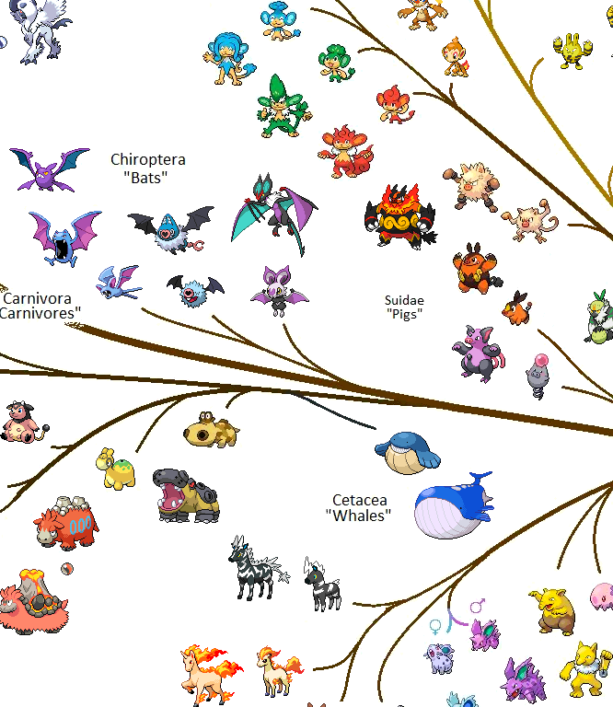
Parallel development

Slide 32
Branching and merging
With git it is possible to develop simultaneously on parallel environments, called branches, starting from a common starting point.
Each branch will then have its own commit history and these environments could be reconciled one in the other, by performing an operation called merge.
A special satus goes to the master branch which identifies the main branch which every other one should be merged into. This branch contains the agreed version of the software and it is the most accessed by developers therefore it should be the most stable and the most protected of the branches.

Slide 33
branch
Branches are created based on another branch. The branch command takes an existing branch and creates a separate branch to work in.
If no starting branch is specified the active one is considered.
marco@macbook ~/gittutorial> git branch test_branch
To list local branches we simply call branch without any argument.
marco@macbook ~/gittutorial> git branch
* master
new
The active branch is indicated by the asterisk.

Slide 34
checkout
To switch to the branch we’ve just created we use the checkout command.
marco@macbook ~/gittutorial> git checkout test_branch
Hence checkout can be used to navigate through the branches and through the commits inside the branches.
Note that if we have changes in the staging area we won’t be able to checkout to a different branch and we will have to undo the modifications or put them in a stash with the stash command.

Slide 35
merge
Each branch has its own commit history, starting from the root point which is shared with the branch it was originated from.
At a certain point we would like to include the modifications made on a branch into another branch. This operation is called merge and if underestimated can be the source of many migraines.

Slide 36
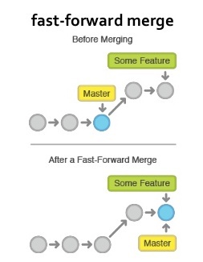
Fast-forward merge
In the simplest case, the source branch which we started developing from hasn’t changed.
In this case merging is like copying the history of a branch into the other, as if we had developed directly on the target branch.

Slide 37
merge
To perform a merge we put ourselves into the destination branch and we specify the branch we want to merge inside it with the merge command.
Note that if we have changes in the staging area we won’t be able to checkout to a different branch and we will have to undo the modifications or put them in a stash with the stash command.
marco@macbook ~/gittutorial> git checkout master
Switched to branch 'master'
Your branch is up to date with 'origin/master'.
marco@macbook ~/gittutorial> git merge test_branch
Updating 515abc8..14d0c3b
Fast-forward
test.py | 0
1 file changed, 0 insertions(+), 0 deletions(-)
create mode 100644 test.py

Slide 38
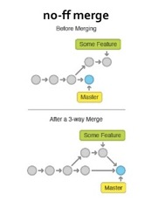
Non fast-forward merge
Typically, however, when we start developing on a new branch, we’ll continue to work parallely on the other branches.
In this case when merging we will have to compare the modifications made on both branches and determine if the modifications conflict in any way.

Slide 39
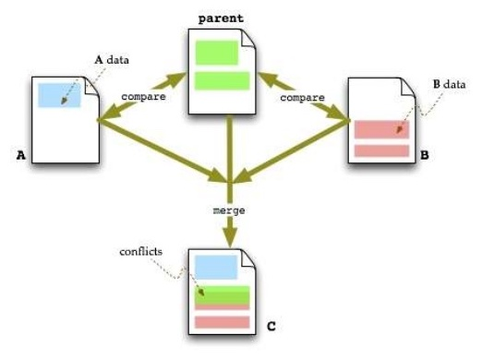
3-way merge
Git executes a 3-way comparison, which means that it compares the modifications from the root of the ramification for both branches and if the same portion of the code has been modified in both branches reports the conflict.

Slide 40
3-way merge
Say you and your friend both checked out a file, and made some changes to it and you need to merge his changes into your copy.
If you were doing a two-way merge, the tool could compare the two files, and see that the files are different. But how would it know what to do with the differences?
With a three-way merge, it can compare the two files, but it can also compare each of them against the original copy (before either of you changed it) and it can use that information to produce the merged version[3][4].

Slide 41
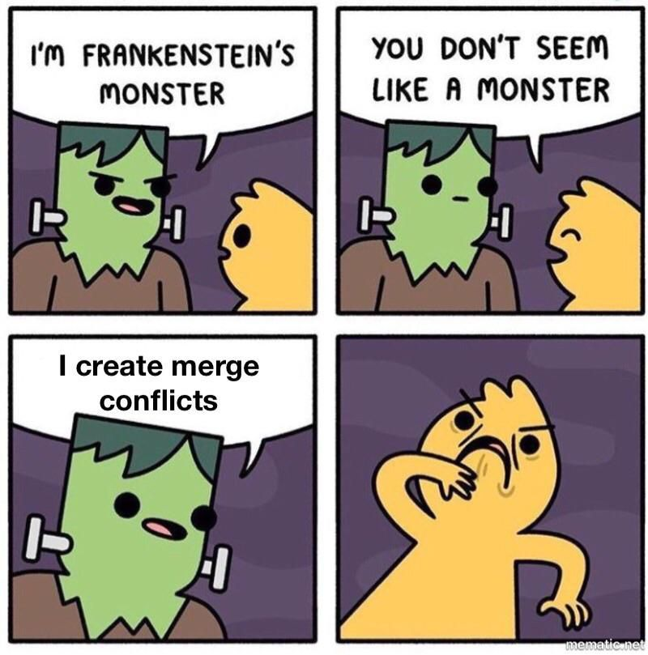
Conflicts
When working simultaneously on code the main issue that can arise is that changes could overlap, creating conflicts.
Conflicts cannot be resolved automatically and each one has to be carefully considered and resolved manually.

Slide 42
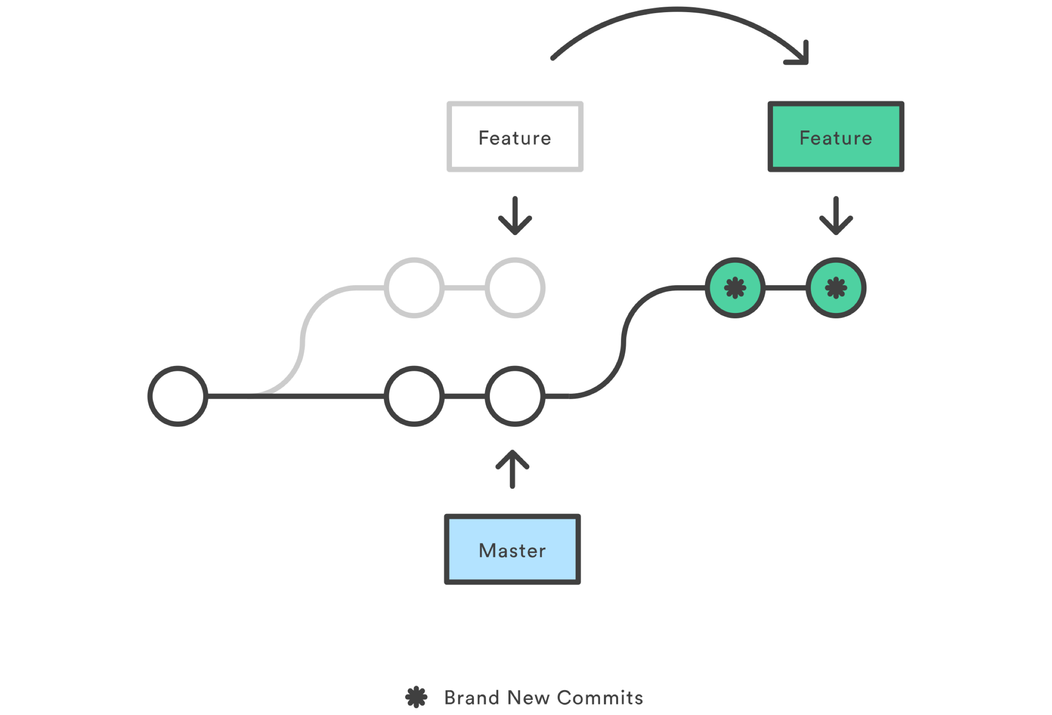
Rebasing
It is usually recommended to maintain a linear project history which means recurring to fast-forward merge whenever possible.
When developing a new feature this is rarely the case as the branch onto which we want to merge – tipically the master branch – has progressed in the meantime.
To achieve this we use the rebase command, which moves the root of the branch to the HEAD of the branch.
Eventual conflicts that may occur have to be solved when moving the starting point of the branch and once solved a fast forward merge will be performed.

Slide 43
rebase
marco@macbook ~/gittutorial> git log --oneline --graph --all
* f5eabe0 (test_branch) world.py added
| * 9cae9d0 (HEAD -> master) hello.py modified
|/
* be81027 hello.py added
marco@macbook ~/gittutorial> git checkout test_branch
Switched to branch 'test_branch'
marco@macbook ~/gittutorial> git rebase -i 9cae9d0
Successfully rebased and updated refs/heads/test_branch.
marco@macbook ~/gittutorial> git log --oneline --graph --all
* b3ef0a8 (HEAD -> test_branch) world.py added
* 9cae9d0 (master) hello.py modified
* be81027 hello.py added

Slide 44
rebase
marco@macbook ~/gittutorial> git checkout master
Switched to branch 'master'
marco@macbook ~/gittutorial> git merge test_branch
Updating 9cae9d0..b3ef0a8
Fast-forward
world.py | 2 ++
1 file changed, 2 insertions(+)
create mode 100644 world.py
marco@macbook ~/gittutorial> git log --oneline --graph --all
* b3ef0a8 (HEAD -> master, test_branch) world.py added
* 9cae9d0 hello.py modified
* be81027 hello.py added

Slide 45
Cheats
Description | Command
Create new branch and checkout | git checkout –b <branch-name>
List local and remote branches | git branch -a
Include commit message at HEAD of each branch | git branch -v

Slide 46
Distributed

Slide 47
Local vs Remote repositories
Git is a distributed version control system. This means that we have a central repository that can be copied on any number of local machines and modified locally. The modifications can then be re-sended to the central repository.
The local vs remote repository distinction is fundamental. The remote repository will be considered the official version of the repository.
Receiving and sending modifications to the remote repository are delicate operations, especially if done on the master branch.

Slide 48
Commit history
The commit history on the central repository should never be altered locally otherwise the synchronization operations will fail.
This is desidered, as we don’t want to corrupt the history of the project which is shared with the other users.

Slide 49
remote
After creating a remote repository on a server (we’ll skip this part), we can link our local repository to that one through the remote command.
We can add, rename, remove multiple repositories, but the typical workflow generally involves just one repository.
marco@macbook ~/gittutorial> git remote add origin git@gitlab.com:euclidea/gittutorial.git

Slide 50
push
At this point we want to push our local data to the remote repository.
Best practice is to checkout to the branch that we want to push and then call push.
marco@macbook ~/gittutorial> git push
Enumerating objects: 4, done.
Counting objects: 100% (4/4), done.
Delta compression using up to 4 threads
Compressing objects: 100% (2/2), done.
Writing objects: 100% (3/3), 305 bytes | 305.00 KiB/s, done.
Total 3 (delta 0), reused 0 (delta 0)
To gitlab.com:euclidea/gittutorial.git
b3ef0a8..3f68758 master -> master
If we have set multiple remote repositories we can also specify the repo to push on.

Slide 51
Pushing commits
Note that before pushing our local commits, we should have already pulled all the remote commits on our local branch.
If this is not the case and we try to push to the remote repository the operation will fail.
Solving the issue is a bit tricky as we have to create a new branch, restore the old branch to the last remote commit we have on disk, pull and merge the new branch.
That’s why it is recommended to work on separate branches when developing new features.

Slide 52
fetch
The fetch command retrieves data from the remote repository and indexes it, enabling the possibility to merge it locally.
Note that if we have a disalignment with the local commit history we will have to be careful when performing the merge.
marco@macbook ~/brave-browser> git fetch
remote: Enumerating objects: 142, done.
remote: Counting objects: 100% (142/142), done.
remote: Compressing objects: 100% (27/27), done.
remote: Total 208 (delta 130), reused 123 (delta 115), pack-reused 66
Receiving objects: 100% (208/208), 126.23 KiB | 839.00 KiB/s, done.
Resolving deltas: 100% (141/141), completed with 20 local objects.
From github.com:brave/brave-browser
080985095..9ffe603ac master -> origin/master
6b1cd664e..05b38984a 1.1.x -> origin/1.1.x

Slide 53
pull
Tipically we want to fetch the data and perform a merge, especially if no modification has been made locally and we want to make the current branch progress.
To perform this we can use the pull command which is equivalent to executing a fetch followed by a merge origin/<branch>.
marco@macbook ~/gittutorial> git pull
From gitlab.com:euclidea/gittutorial
* branch master -> FETCH_HEAD
Updating 60d460d..567ab3f
Fast-forward
Pipfile | 1 +
Pipfile.lock | 135 +++++++-------
2 files changed, 32 insertions(+), 28 deletions(-)

Slide 54
clone
If a git repository is published on a server we can copy the project with its entire history with the clone command.
marco@macbook ~> git clone git@github.com:brave/brave-browser.git
Cloning into 'brave-browser'...
remote: Enumerating objects: 9, done.
remote: Counting objects: 100% (9/9), done.
remote: Compressing objects: 100% (7/7), done.
remote: Total 87512 (delta 5), reused 4 (delta 2), pack-reused 87503
Receiving objects: 100% (87512/87512), 135.76 MiB | 1.68 MiB/s, done.
Resolving deltas: 100% (61768/61768), done.

Slide 55
Recommendations
Do not modify commit histories that have already been pushed.
revert is the best tool for undoing shared public changes.
reset is best used for undoing local private changes.
Operate locally and push only at the end of the day.
Make the commit history readable.
Parameters values shouldn’t be versioned.
Maintain a linear project history (prefer fast-forward merge, rebase whenever possible).
Do not use git as a synchronization tool.

Slide 56
Useful resources
https://www.atlassian.com/git/tutorials
https://www.atlassian.com/git/tutorials/atlassian-git-cheatsheet
https://git-scm.com/docs
https://learning.oreilly.com/scenarios/

Slide 57
Extra
https://www.atlassian.com/git/tutorials/merging-vs-rebasing
https://open.spotify.com/playlist/0MJBni0UzdnML1amikx0Rc

Slide 58
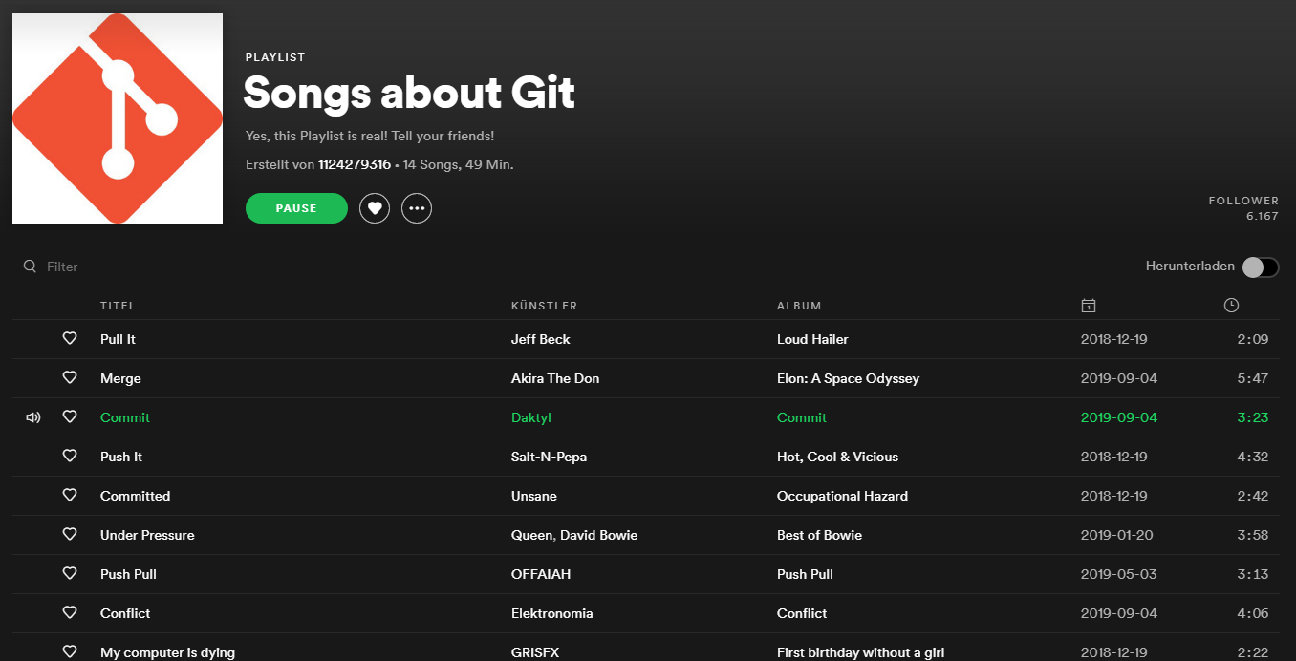

Slide 59
Credits
[1] https://en.wikipedia.org/wiki/Git
[2] https://en.wikipedia.org/wiki/Version_control
[3] https://stackoverflow.com/a/4129145

