Slide 1

InfoCOVID A COVID-19 Database
Image: https://www.ksby.com/
Group 7
Manasa Acharya
Jia Jin Koh
Cheick Konta

Slide 2
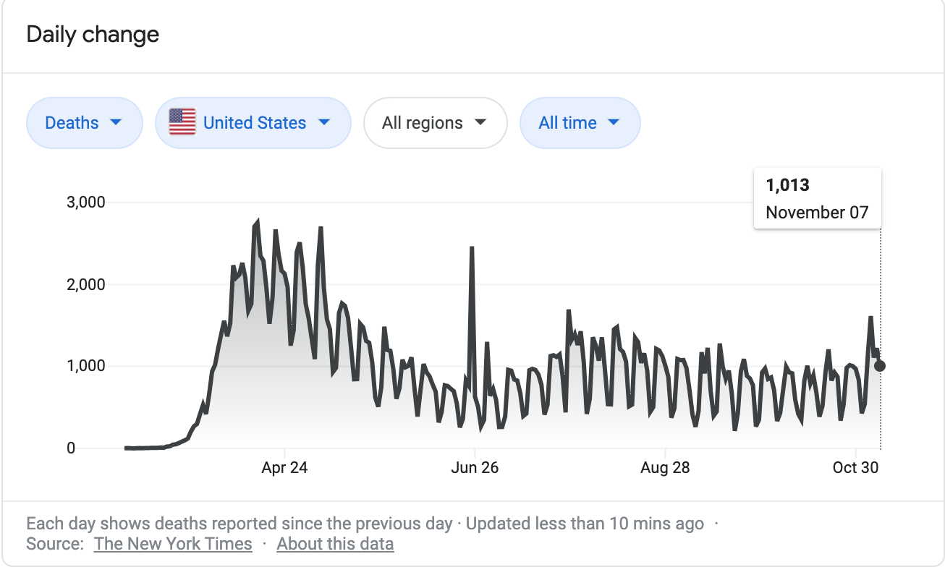
Mission Statement
The goal of our project is to combine publicly available data on the current infection rate and epidemiology on COVID-19 and create a database that allows the client to find trends and relationships based on their interest in the virus.

Slide 3

Problem - too many sources of information
SARS-COV-2 (COVID-19) has not only devastated our economy and caused the deaths of over 200,000 Americans - it also has reshaped the way that we live our everyday lives. As the pandemic continues to affect us all, it has become imperative that data modeling and epidemiology come together.

Slide 4
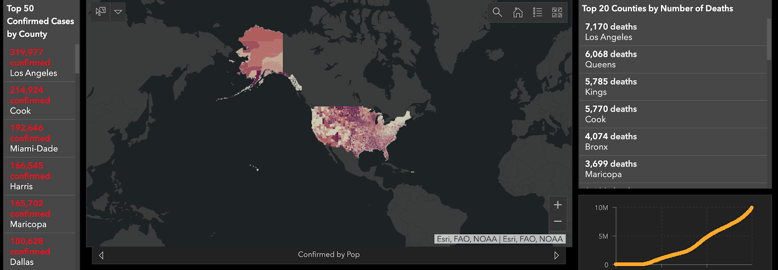
https://coronavirus.jhu.edu/us-map
Currently have many dashboards and sites generating COVID information
Does not include more sophisticated relationships between the data
This project brings together information from different contributors to allow synergy between different data

Slide 5
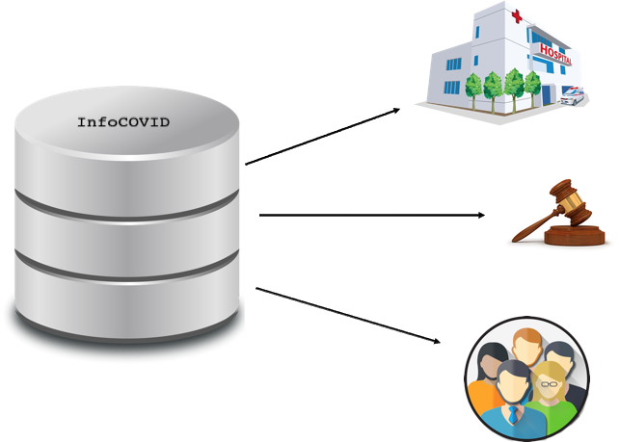

Slide 6
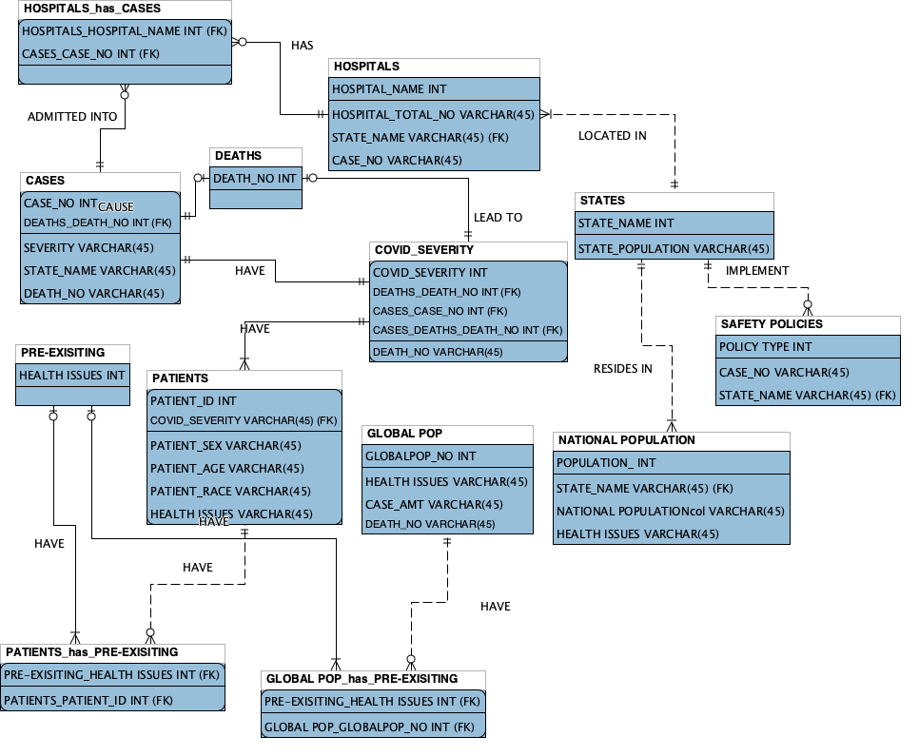
Overall EER Diagram

Slide 7
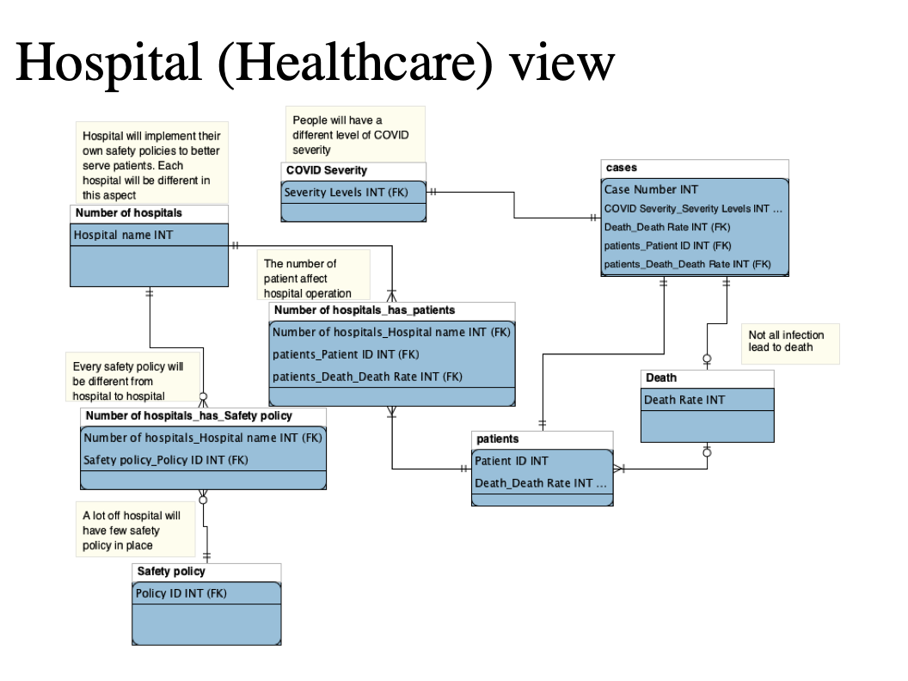

Slide 8
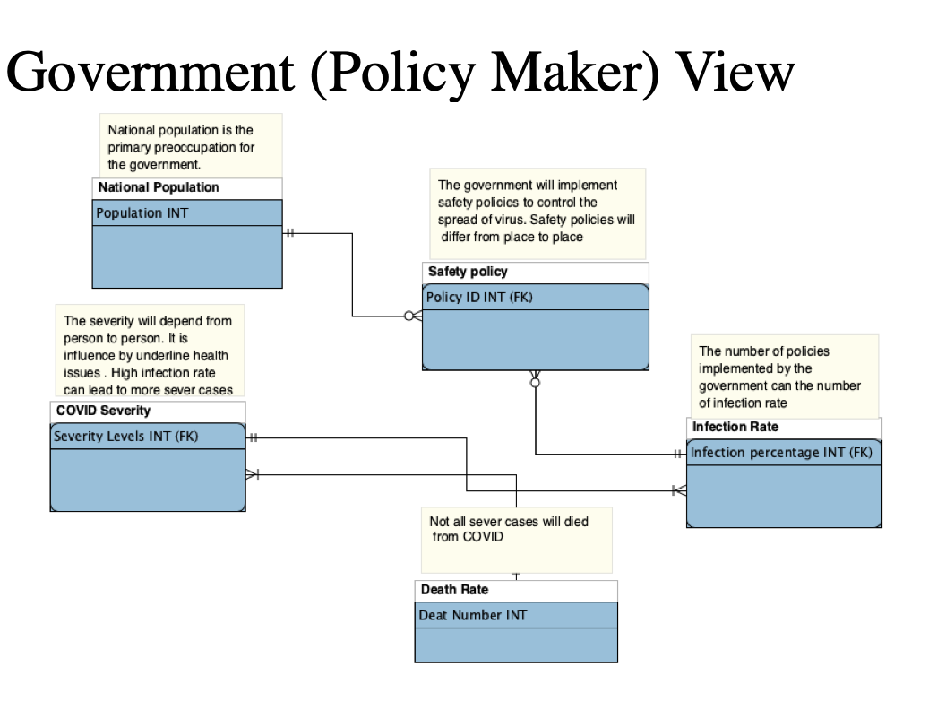

Slide 9
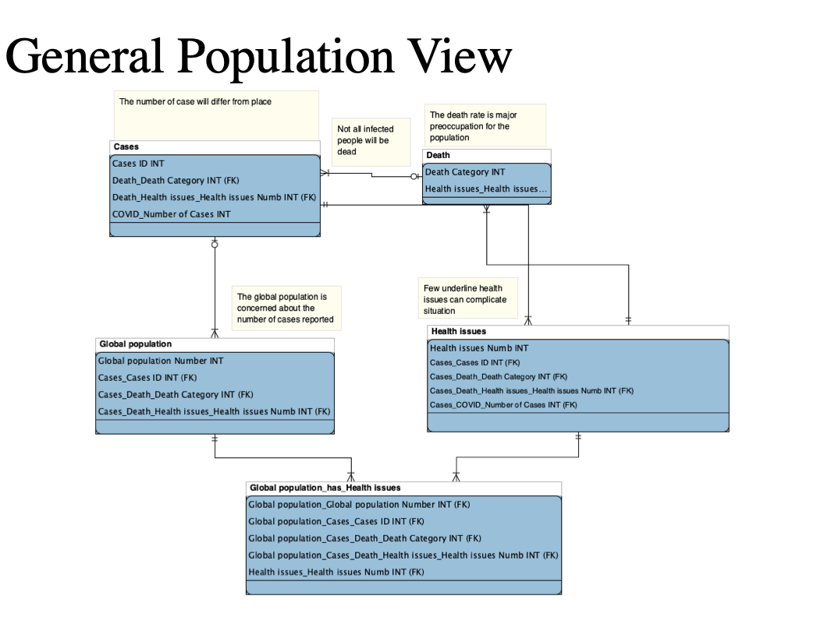

Slide 10
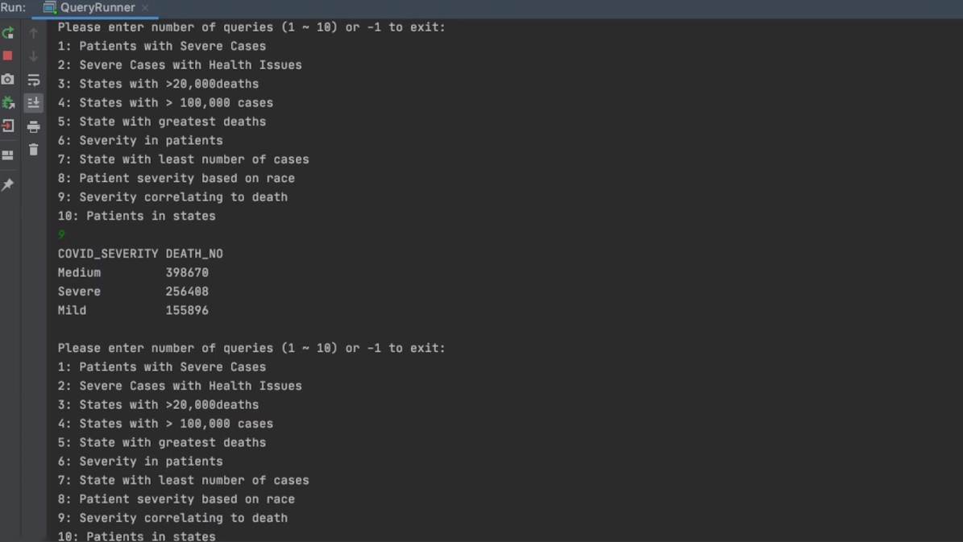
Application Console View

Slide 11
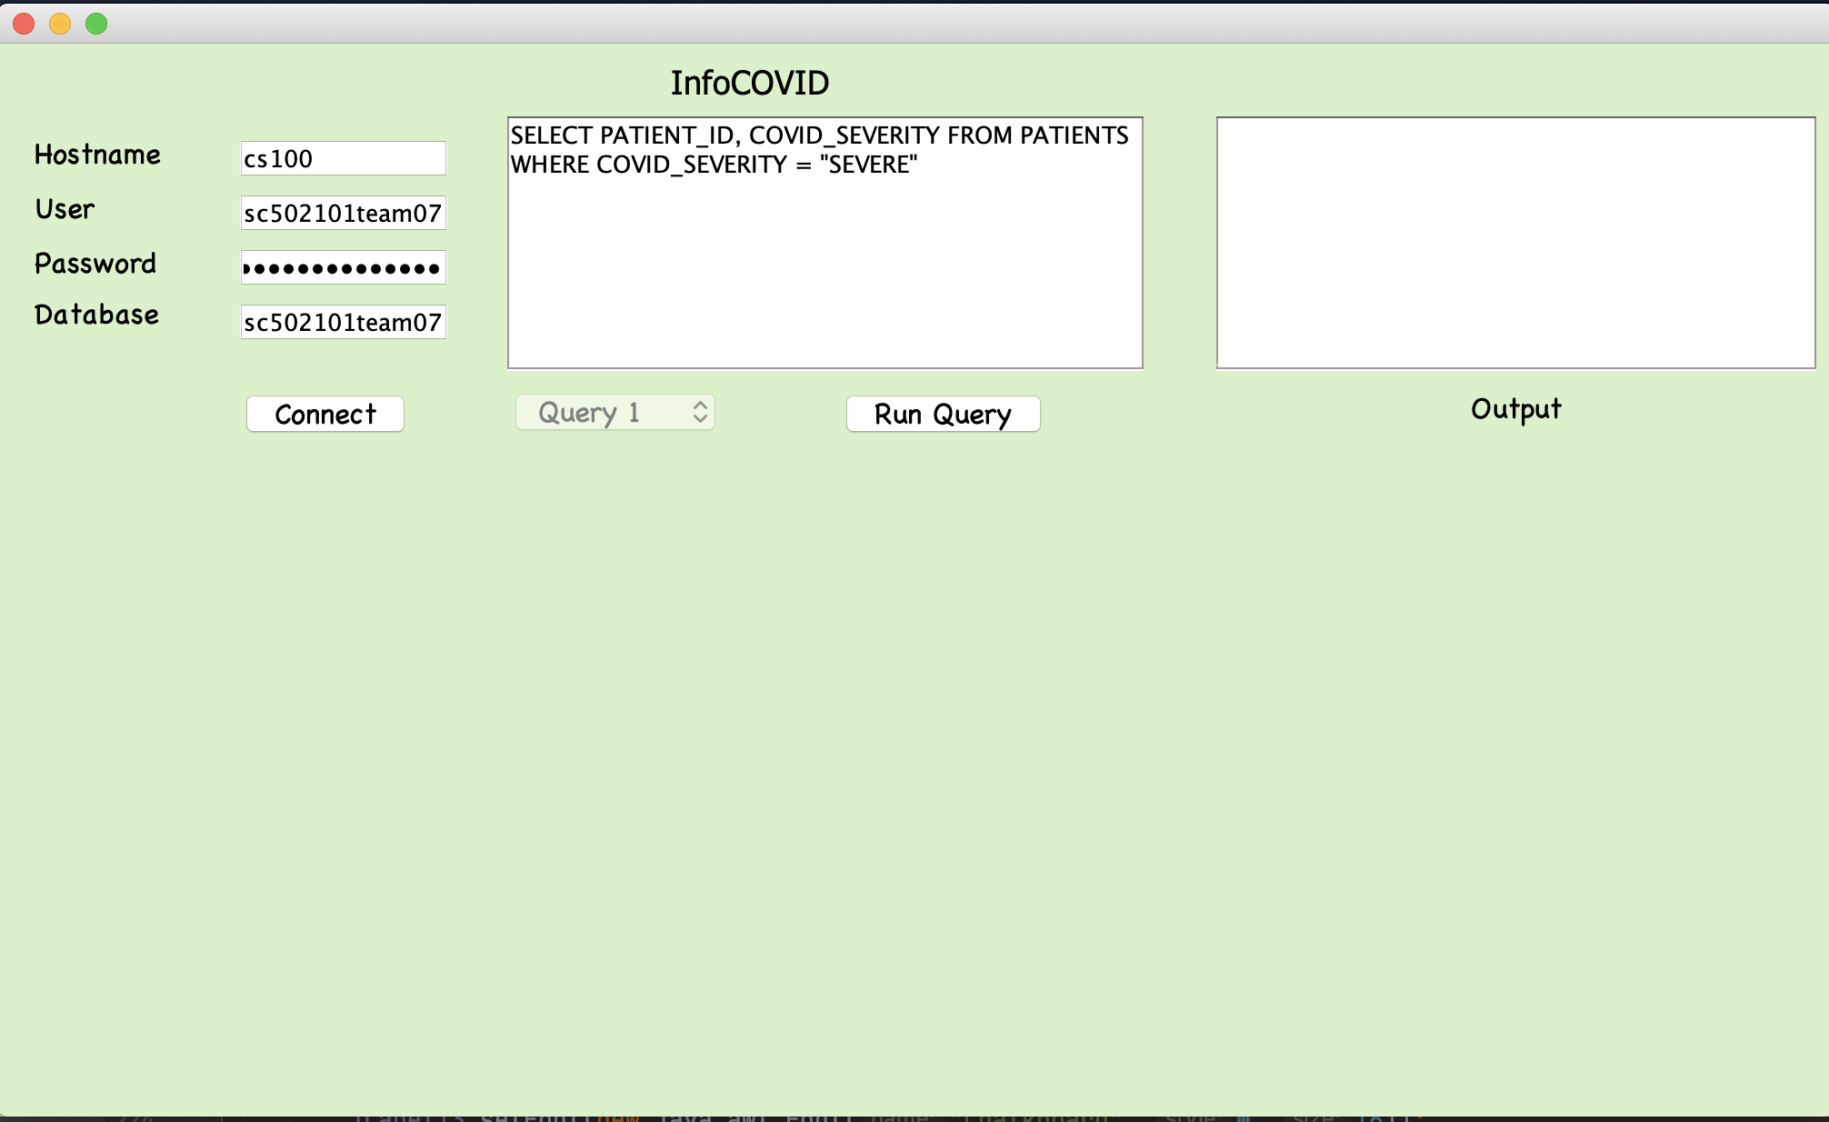
Application GUI View

Slide 12
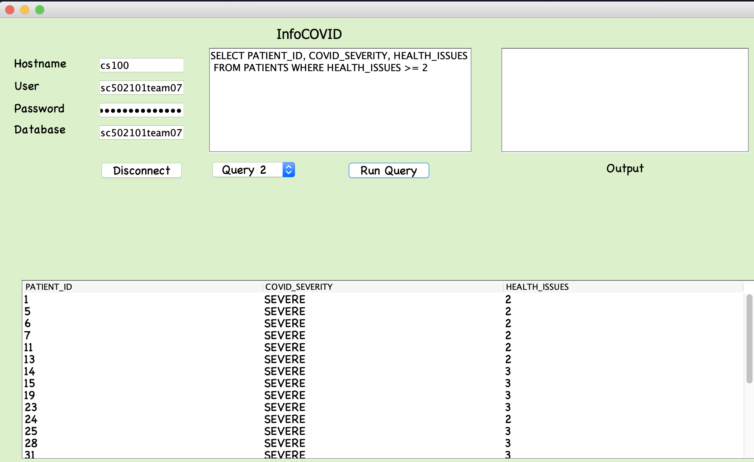

Slide 13

Demo…

