Slide 1
The rHEALPix Discrete Global Grid System Robert Gibb Informatics Science Leader

Slide 2
Introduction – Ideal vs Standard
Ideal set of ‘perfect DGGS criteria’
… acknowledges that all DGGS are a compromise
Standard set of ‘minimum achievable criteria’
… acknowledges that a standard must be met
Focus primarily on Ideal Geometry
Focus on standards for Interoperability
… implies function in addition to geometry

Slide 3
HEALPix DGGS History
Comes from Astronomical community,
whole sky cosmic background studies – COBE
more recently many other whole sky studies
… data management + data analysis + viewer
… spherical solution … implemented as libraries on FITS files
Hierarchical Equal Area isoLatitudinal Pixelisation
Now: +ellipsoidal solution .. implemented in proj.4

Slide 4
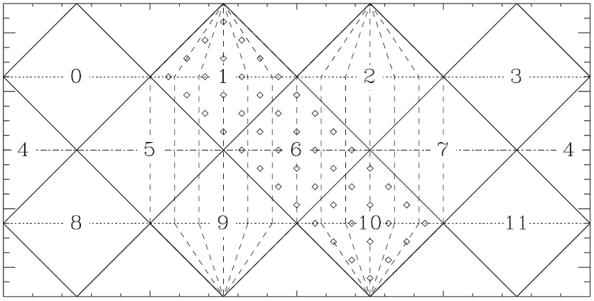
HEALPix—cube as rhombic dodecahedron
12-faced
Rhombic Dodecahedron
- faces from cube’s edges
N3
N0
N1
N2
E0
E1
E2
E3
S0
S1
S2
S3

Slide 5

Face-Cell tessellation alternatives
2x Nested
2x NOT aligned
3x Nested and Aligned

Slide 6
Face-Cell tessellation alternatives
2x Aligned
2x NOT Nested

Slide 7
HEALPix to rHEALPix—rearranging the cube
6x faced
Cube
3x Nested & Aligned
N
O
P
Q
R
S

Slide 8
rHEALPix & HEALPix interleaved
Interleaving 6x faced Cube and
12-faced Rhombic Dodecahedron
Each 3x Nested & Aligned, sharing iso-Latitudes
N
O
P
Q
R
S

Slide 9
rHEALpix—rearranged cube
R | O | P | Q
N
N3
N0
N1
N2
S3
S0
S1
S2
S

Slide 10
rHEALPix–recursive tessellation
N6 | N3 | N0
N7 | N4 | N1
N8 | N5 | N2
R0 | R1 | R2
R3 | R4 | R5
R6 | R7 | R8
O0 | O1 | O2
O3 | O4 | O5
O6 | O7 | O8
P0 | P1 | P2
P3 | P4 | P5
P6 | P7 | P8
Q0 | Q1 | Q2
Q3 | Q4 | Q5
Q6 | Q7 | Q8
hierarchical
congruent
aligned
constant aperture
equal-area
global coverage
lat, long aligned
minimal # of latitudes
S0 | S1 | S2
S3 | S4 | S5
S6 | S7 | S8

Slide 11
Nominal cell dimensions
Level | Cube | Rhombic Dodecahedron | Cube | Rhombic Dodecahedron
 | x2 | x2 | x3 | x3
0 | 9,225km | 6,523km | 9,225km | 6,523km
1 | 4,612km | 3,261km | 3,075km | 2,174km
2 | 2,306km | 1,630km | 1,025km | 724km
3 | 1,153km | 815km | 341km | 241km
4 | 576km | 407km | 113km | 80km
5 | 288km | 203km | 37km | 26km
6 | 144km | 101km | 12.6km | 8,948m
7 | 72km | 50km | 4.2km | 2,982m
8 | 36km | 25km | 1,406m | 994m
9 | 18km | 12.7km | 468m | 331m
10 | 9,009m | 6,370m | 156.2m | 110.5m
11 | 4,504m | 3,185m | 52.1m | 36.8m
12 | 2,252m | 1,592m | 17.4m | 12.3m
13 | 1,126m | 796m | 5.8m | 4.1m
14 | 563m | 398m | 1.9m | 1.4m
15 | 281m | 199m | 0.6m | 0.5m
16 | 140.8m | 99.5m
17 | 70.4m | 49.8m
18 | 35.2m | 24.9m
19 | 17.6m | 12.4m
20 | 8.8m | 6.2m
21 | 4.4m | 3.1m

Slide 12
Nominal cell dimensions
Level | Cube |  | Rhombic Dodecahedron
 | x2 | x3 | x2 | x3
0 | 9,225km | 9,225km | 6,523km | 6,523km
1 | 4,612km | 3,075km | 3,261km | 2,174km
2 | 2,306km | 1,025km | 1,630km | 724km
3 | 1,153km | 341km | 815km | 241km
4 | 576km | 113km | 407km | 80km
5 | 288km | 37km | 203km | 26km
6 | 144km | 12.6km | 101km | 8,948m
7 | 72km | 4.2km | 50km | 2,982m
8 | 36km | 1,406m | 25km | 994m
9 | 18km | 468m | 12.7km | 331m
10 | 9,009m | 156.2m | 6,370m | 110.5m
11 | 4,504m | 52.1m | 3,185m | 36.8m
12 | 2,252m | 17.4m | 1,592m | 12.3m
13 | 1,126m | 5.8m | 796m | 4.1m
14 | 563m | 1.9m | 398m | 1.4m
15 | 281m | 0.6m | 199m | 0.5m
16 | 140.8m |  | 99.5m
17 | 70.4m |  | 49.8m
18 | 35.2m |  | 24.9m
19 | 17.6m |  | 12.4m
20 | 8.8m |  | 6.2m
21 | 4.4m |  | 3.1m

Slide 13
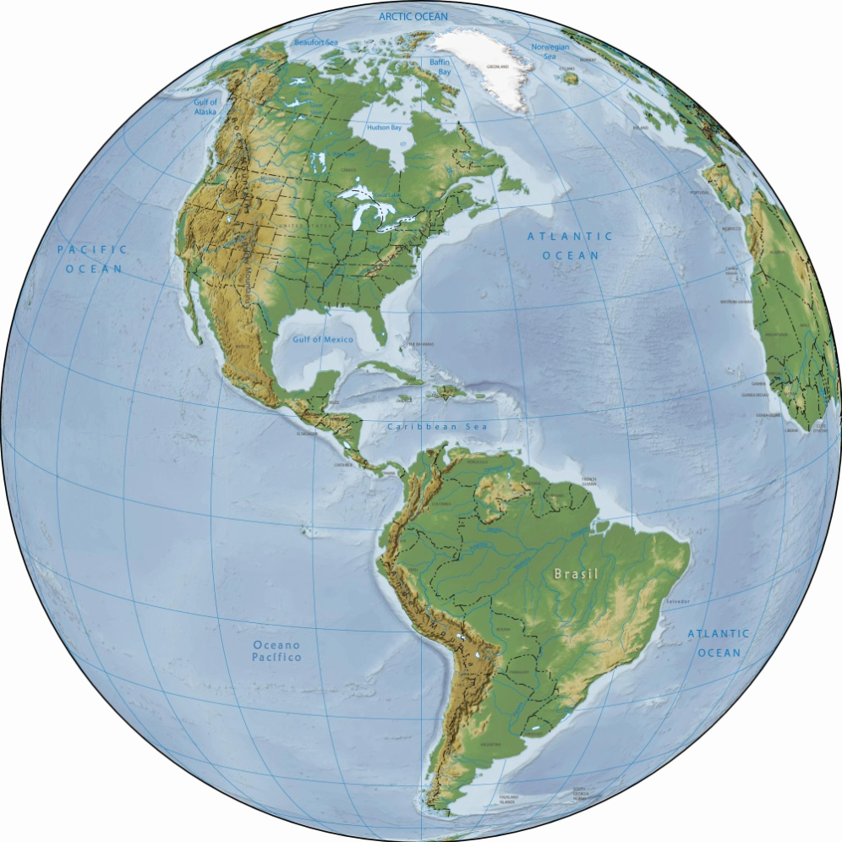
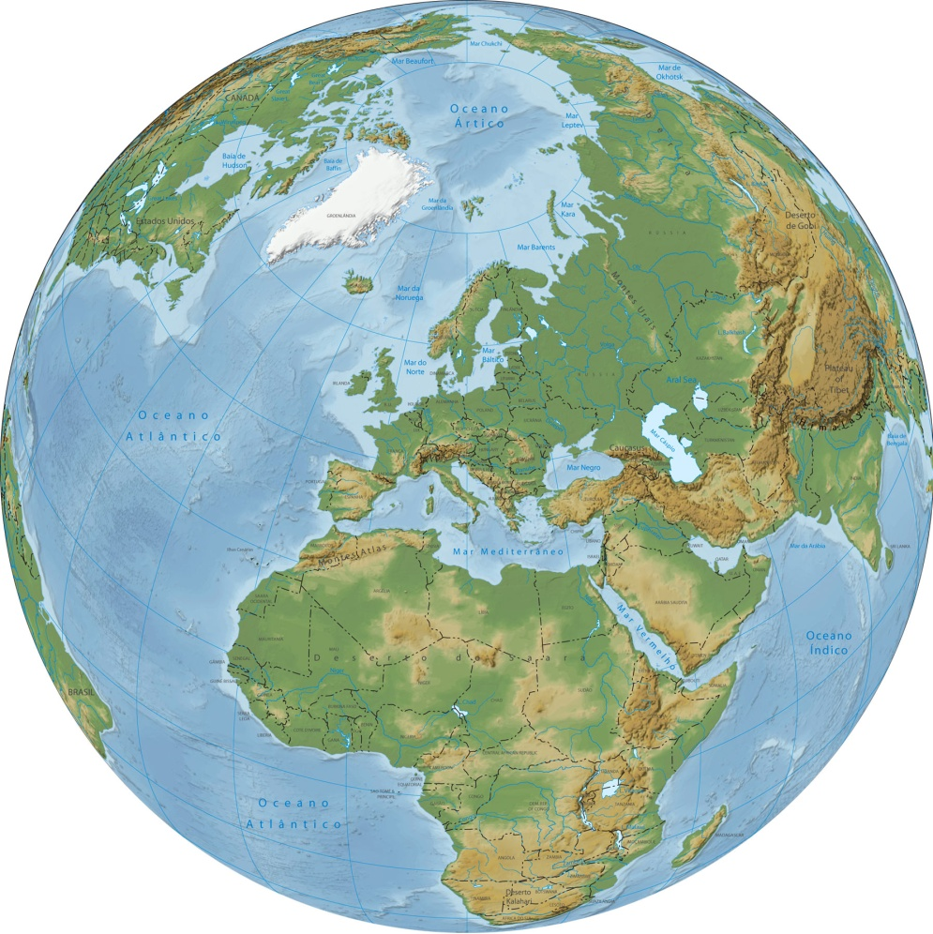
rHEALPix–cube projection on ellipsoid
N
N
P
R
Q
O
R
S
North
Orient-Pacific-Amerique-Africa
South

Slide 14
N
N
P
R
Q
O
R
S
Sphere
Level 0 Cubic Cells & Nuclei

Slide 15
Q0
Q1
Q2
Q3
Q4
Q5
Q6
Q7
Q8
Level 0
Level 1 Nuclei

Slide 16
Q0
Q2
Q1
43
44
45
Q6
Q8
Q7
Level 1
Level 2 Nuclei

Slide 17
Q0
Q1
Q2
Q40
Q41
Q42
Q3
Q43
Q5
Q44
Q45
Q46
Q47
Q48
Q6
Q8
Q7
Level 1
Level 2 Nuclei

Slide 18
rHEALpix—Relational Geometry in IDs
Q3Q4Q5
Q40 Q41 Q42
Q43 Q44 Q45
Q440 Q441 Q442
Q443 Q444 Q445
Q446 Q447 Q448
Q4480 Q4481 Q4482
Q4483 Q4484 Q4485
Q4486 Q4487 Q4488
Q540 Q541 Q542
Q543 Q544 Q545
Q546 Q547 Q548
Q5480 Q5481 Q5482
Q5483 Q5484 Q5485
Q5486 Q5487 Q5488

Slide 19
rHEALpix—Relational Geometry in IDs
Q3Q4Q5
Q40₉ Q41₉ Q42₉
Q43₉ Q44₉ Q45₉
Q46₉ Q47₉ Q48₉
=
Q4(0₃,0₃)Q4(0₃,1₃)Q4(0₃,2₃)
Q4(1₃,0₃)Q4(1₃,1₃)Q4(1₃,2₃)
Q4(2₃,0₃)Q4(2₃,1₃)Q4(2₃,2₃)
row neighbours of Q45₉
Q4(1₃,2₃-1₃) = Q4(1₃,1₃) = Q44₉ and Q4(1₃,2₃+1₃) = Q5(1₃,0₃) = Q53₉
column neighbours of Q45₉
Q4(1₃-1₃,2₃) = Q4(0₃,2₃) = Q42₉ and Q4(1₃+1₃,2₃) = Q4(2₃,2₃) = Q48₉
Q53₉
Q5(1₃,0₃)
Notes:
Computing row & column neighbours

Slide 20
rHEALpix—Relational Geometry in IDs
Q3Q4Q5
Q40₉ Q41₉ Q42₉
Q43₉ Q44₉ Q45₉
Q46₉ Q47₉ Q48₉
=
Q4(0₃,0₃)Q4(0₃,1₃)Q4(0₃,2₃)
Q4(1₃,0₃)Q4(1₃,1₃)Q4(1₃,2₃)
Q4(2₃,0₃)Q4(2₃,1₃)Q4(2₃,2₃)
diagonal neighbours of Q45₉
Q4(1₃-1₃,2₃-1₃) = Q4(0₃,1₃) = Q41₉
Q4(1₃+1₃,2₃-1₃) = Q4(2₃,1₃) = Q47₉
etc
Notes:
Computing diagonal neighbours

Slide 21
rHEALpix—Relational Geometry in IDs
Q4
Q40 Q41 Q42
Q43 Q44 Q45
Q46 Q47 Q48
Q443 Q444 Q445
Q43 and Q445 have Q4 as a common parent
Q43’s relative child is ‘3’ and Q445’s relative child is ‘45’
Q4’s relative child to itself is the null string
Cell A is within Cell B if they share a common parent AND Cell B’s relative child is null
So Q43 and Q445 are within Q4, and Q445 is not within Q43
Notes:
Defining terms common parent and relative child by example
Definition of within

Slide 22
rHEALpix—Relational Geometry in IDs
Q4
Q40 Q41 Q42
Q43 Q44 Q45
Q46 Q47 Q48
Q443 Q444 Q445
If Cell A is within Cell B then Cell A touches Cell B if Cell A’s relative child satisfies (0|1|2)⁺| (2|5|8)⁺| (0|3|6)⁺ | (6|7|8)⁺
Q445’s relative child wrt Q4 is ‘45’ therefore Q445 doesn’t touch Q4,
Q43’s relative child wrt Q4 is ‘3’ therefore it touches Q4,
Notes:
Test for touch – case 1, cell A within cell B

Slide 23
rHEALpix—Relational Geometry in IDs
Q3Q4Q5
Q40 Q41 Q42
Q43 Q44 Q45
Q46 Q47 Q48
If Cell A is NOT within Cell B and Cell A’s neighbour is within Cell B then Cell A touches Cell B
Q53 is NOT within Cell Q4 and Q53’s neighbour Q45 is within Q4, therefore Q53 touches Q4
Q53
Notes:
Test for touch – case 2, cell A not within cell B
touch can be refined by distinguishing edge touch vs vertex touch, by determining the type of neighbour

Slide 24
Conclusion–rHEALPix & the Standard
Ideal set of ‘perfect DGGS criteria’
… like all DGGS rHEALPix is a compromise, but it meets a useful subset of ‘perfect DGGS criteria’
Standard set of ‘minimum achievable criteria’
… rHEALPix meets proposed standard’s criteria
rHEALpix’s IDs meet geometric functional requirements of the proposed OGC DGGS Standard
rHEALPix & HEALPix are in the Proj.4 library

Slide 25
Acknowledgments
Dr Alex Raichev
… of University of Auckland for ellipsoidal solution
Landcare Research
… for funding support

