Slide 1


Deep Learning assisted Cross-Family Profiled Side-Channel Attacks using Transfer Learning
Dhruv Thapar, Manaar Alam, Debdeep Mukhopadhyay
Indian Institute of Technology Kharagpur
The 22nd International Symposium on Quality Electronic Design (ISQED'21)
Virtual Conference, April 7-9, 2021

Slide 2

About Me
I am a PhD scholar in the Department of Computer Science and Engineering at Indian Institute of Technology Kharagpur, India.
I am pursuing my PhD under the supervision of Prof. Debdeep Mukhopadhyay.
I am currently interested in various security aspects of Deep Learning techniques like fault-resistance, privacy leakages, adversarial attacks, model-extraction, etc.
I was awarded IBM PhD Fellowship for the Academic Year 2019-2021.

Slide 3

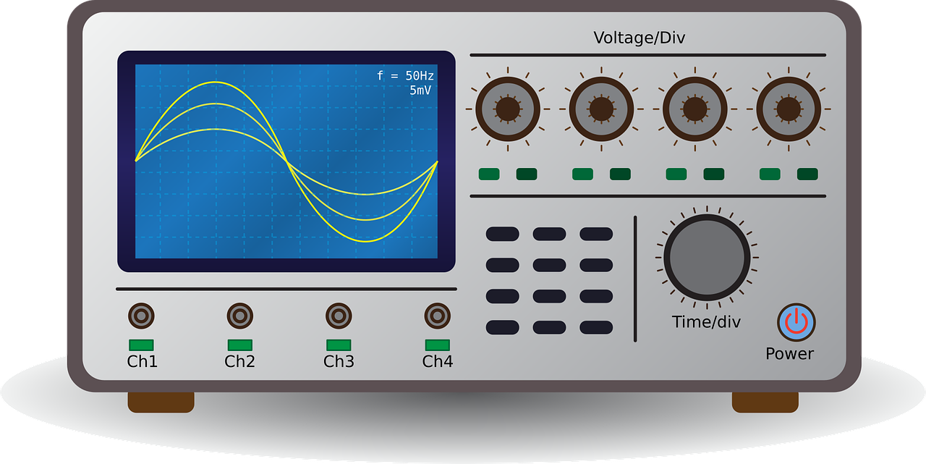

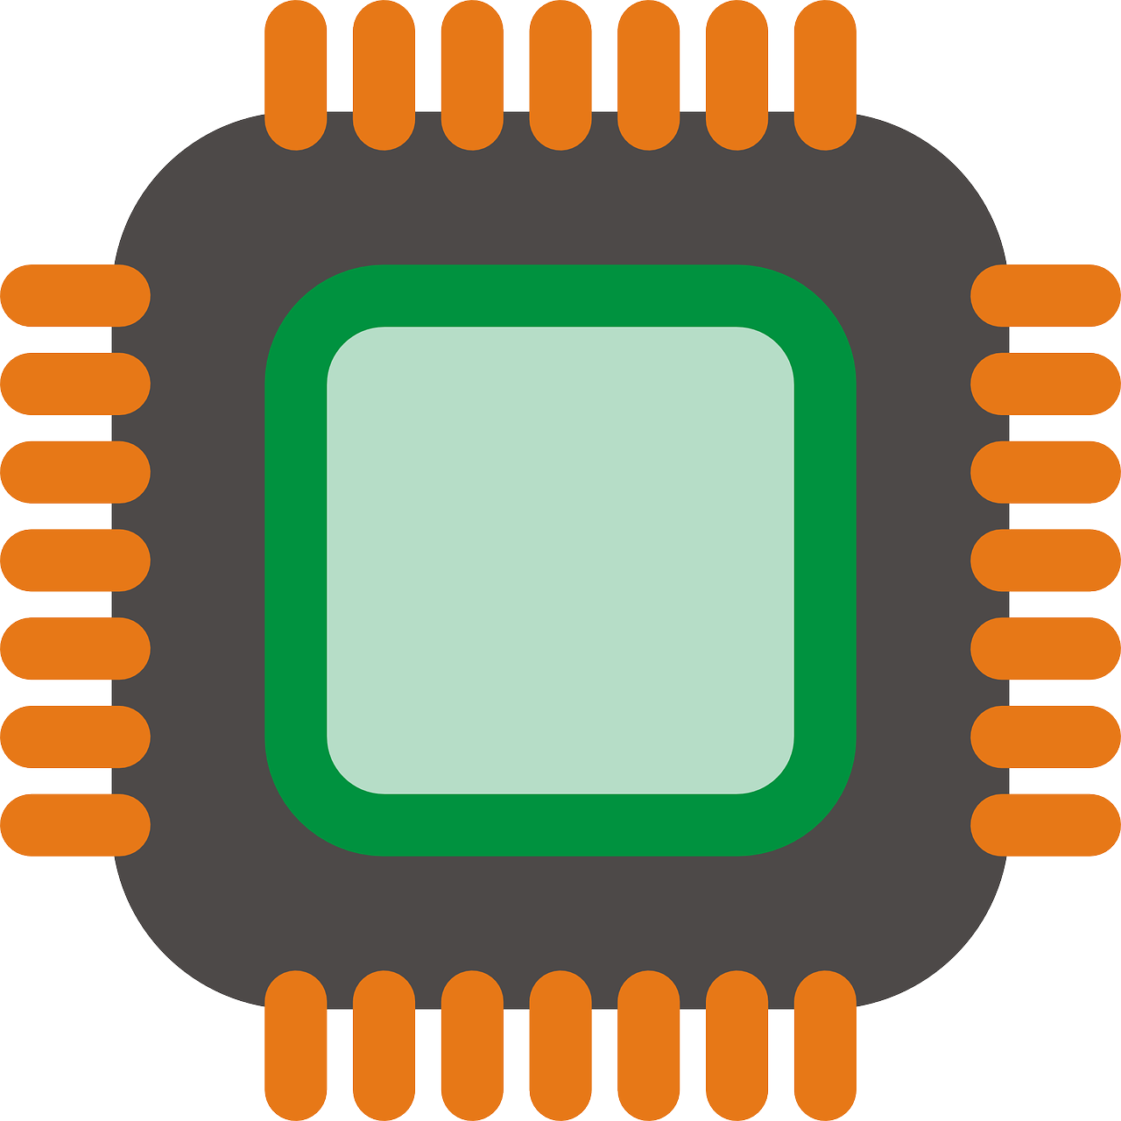




What are Side Channel Attacks (SCA)?
Encryption
Time
Heat
Current
EM radiations
Acquired Traces
Leakage
Plaintext
Analysis
Trace Acquisition
Side-Channel Attacks are performed through an indirect measurement of a computation result via an auxiliary mechanism.
Retrieved Secret Key
Image Credits: Google Images

Slide 4
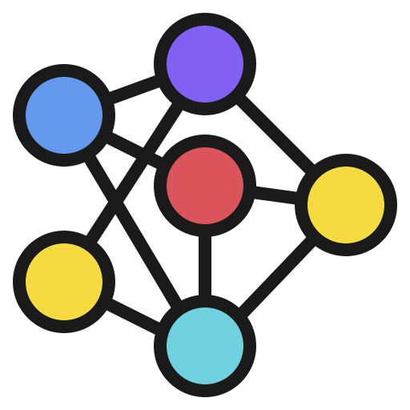
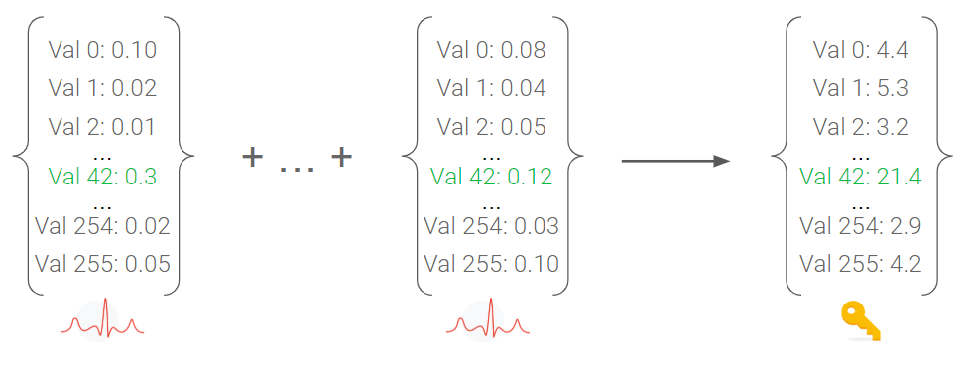
Deep Learning based SCA
Encryption
Encryption
Plaintext = 0x12ab8f..
Secret Key = 0x3ff90..
Plaintext = 0x347ef..
Secret Key = ?
Train the Model
Predict the Label
Label the Trace depending
on Target Round
Image Credits: Google Images

Slide 5
Cross Device SCA
Initially profiling and testing were done on the same device [1].
In reality, data collected from these devices is different due to the influence of temperature, noise, and other external uncontrollable parameters [2].
Makes it difficult to execute the attack!
Hence, recent research mostly focuses on profiling with dummy device(s) and testing on a different attack device [3].
Dummy Device 1
Target Device
Predicted Label
Dummy Device N
Profiled Model
[1] H. Maghrebi et al., “Breaking cryptographic implementations using deep learning techniques” -- SPACE 2016
[2] M. Renauld et al., “A formal study of power variability issues and side-channel attacks for nanoscale devices” --
EUROCRYPT 2011
[3] D. Das et. al. “X-deepsca: Cross-device deep learning side channel attack” -- DAC 2019

Slide 6

Time Requirement Issues!
The profiling of dummy device(s) needs to be done every time we encounter a new family of target device.
Success probability depends on the availability of large profiled dataset from the dummy device(s).
Needs a huge amount of time for each different target device!
Is it possible to do this in less time?
Dummy Device 1
Target Device
Need training for new
dummy target devices
Predicted Label
Dummy Device N
Profiled Model

Slide 7
Transfer Learning Strategy
Inherent ability to cross-utilize the knowledge about one task to solve related tasks
No need to rebuild the models from scratch every time, the previous knowledge of a similar task can be utilized!
Dataset A
Huge
profiling data
Base
Model
Task A
Dataset B
Less
profiling data
Base
Model
Fine
Tuning
Transfer Learned for Task B

Slide 8
How the strategy works in SCA context?
One-Time Profiling
Adversary selects any device, of his choice
Collects a large number of profiled power traces
Performs a one time profiling to create a base model.
Large
profiling data
Fine Tuning for the target device
Adversary procures a copy of target device
Fine tunes the base model with less number of traces with the aid of transfer learning strategy.
Create
base model
Less
profiling data
Fine tuning
base model
Attack the target device
Adversary uses the fine tuned model to attack the target device

Slide 9
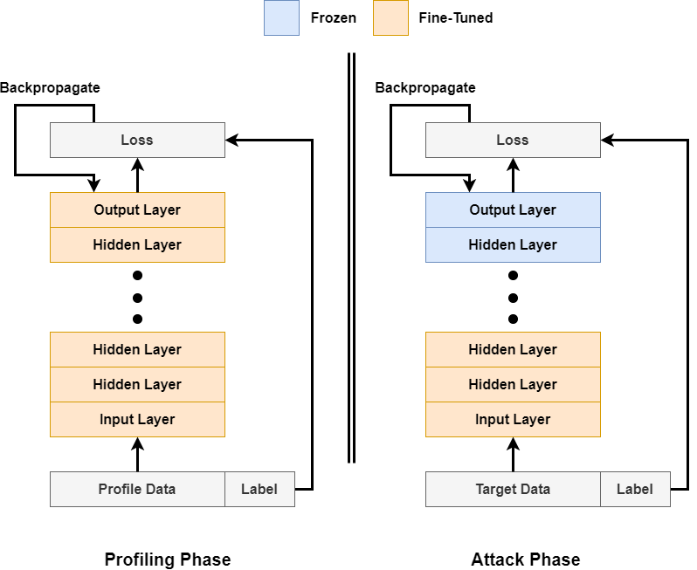
How to Transfer Learn?
In the profiling phase the whole network is trained with traces from profiling device
In the fine tuning phase, the last few layers are frozen. The remaining initial layers are fine-tuned with traces from target device

Slide 10
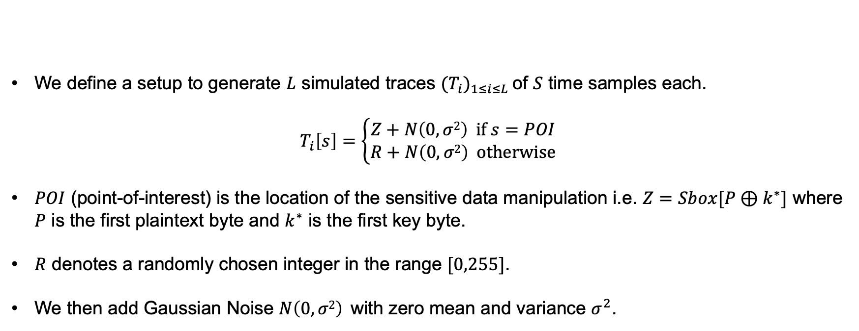
Simulated Unprotected AES Trace
We define a setup to generate $L$ simulated traces ${(T_{i})}_{1≤i≤L}$ of $S$ time samples each.
$$T_{i}\left[s\right]=\left\{\begin{aligned}Z+N\left(0, σ2\right) if s=POI \\ R+N\left(0, σ2\right) otherwise\end{aligned}\right.$$
$POI$ (point-of-interest) is the location of the sensitive data manipulation i.e. $Z=Sbox[P⊕k^{∗}]$ where $P$ is the first plaintext byte and $k^{∗}$ is the first key byte.
$R$ denotes a randomly chosen integer in the range $[0,255]$.
We then add Gaussian Noise $N\left(0, σ2\right)$ with zero mean and variance $σ^{2}$.

Slide 11
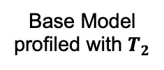

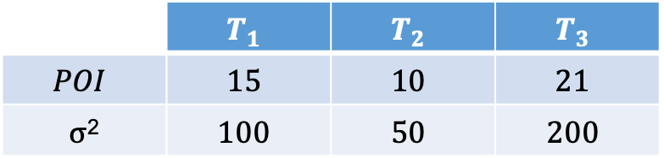

Results on Unprotected Traces
Base Model
profiled with $T_{1}$
Parameters of different sets of simulated traces for three different platforms
 | $$T_{1}$$ | $$T_{2}$$ | $$T_{3}$$
$$POI$$ | $$15$$ | $$10$$ | $$21$$
$σ$² | $$100$$ | $$50$$ | $$200$$
Base Model
profiled with $T_{2}$
Base Model
profiled with $T_{3}$

Slide 12
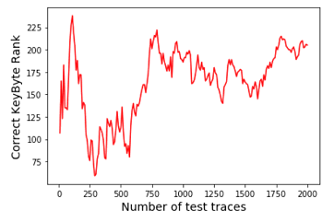
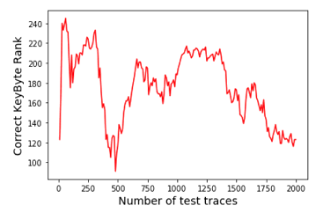
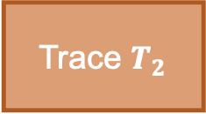

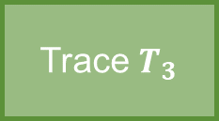

Results on Unprotected Traces
What if we test the model profiled with $T_{1}$ directly on $T_{2}$and $T_{3}$?
Trace $T_{2}$
Base Model
profiled with $T_{1}$
Trace $T_{3}$
Base Model
profiled with $T_{1}$
As expected, the model does not predict the correct key-byte

Slide 13
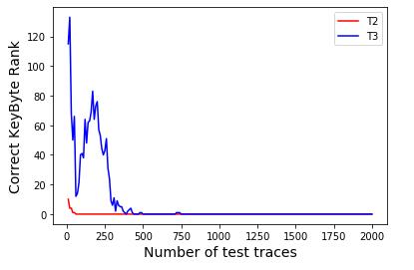
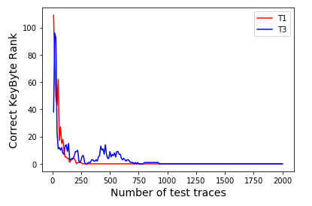
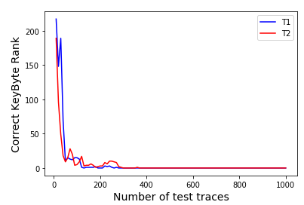



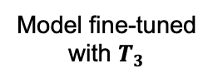


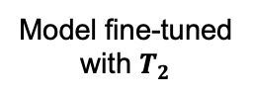
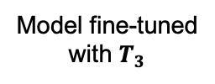
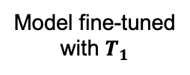
Results on Unprotected Traces
Base Model profiled with $T_{1}$
Base Model profiled with $T_{2}$
Base Model profiled with $T_{3}$
Model fine-tuned
with $T_{2}$
Model fine-tuned
with $T_{3}$
Model fine-tuned
with $T_{1}$
Model fine-tuned
with $T_{3}$
Model fine-tuned
with $T_{1}$
Model fine-tuned
with $T_{2}$

Slide 14
Impact of Transfer Learning
 | DL-SCA (No. of Profiling Traces) | TranSCA (No. of Fine-Tuning Traces) | No. of Attack Traces
T₁ | 5,000 | 1,000 (T₂), 500 (T₃) | 350 (DL-SCA), 250 (TranSCA from T₂), 300 (TranSCA fromT₃)
T₂ | 1,000 | 500 (T₁), 500 (T₃) | 600 (DL-SCA), 50 (TranSCA from T₁), 275 (TranSCA fromT₃)
T₃ | 15,000 | 1,000 (T₁), 6,000 (T₂) | 875 (DL-SCA), 750 (TranSCA from T₁), 925 (TranSCA fromT₂₎
() denotes base model
TranSCA requires less number of traces for profiling as compared to DL-SCA
The difference in the required number of profiling traces between DL-SCA and TranSCA become more significant as the traces tend to be more noisy (T₂ → T₁ → T₃)

Slide 15
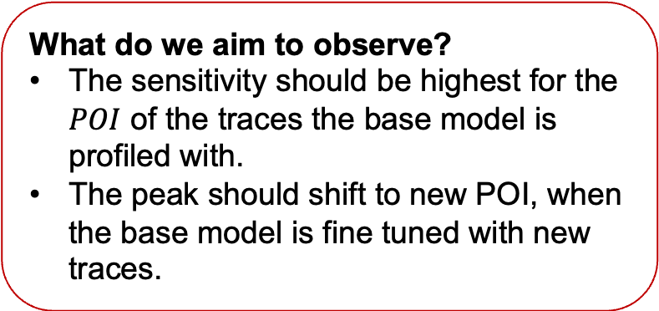
Sensitivity Analysis
What does it measure?
Measures which samples in the input contribute most towards the output prediction
What do we aim to observe?
The sensitivity should be highest for the $POI$ of the traces the base model is profiled with.
The peak should shift to new POI, when the base model is fine tuned with new traces.

Slide 16
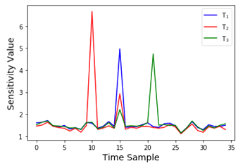
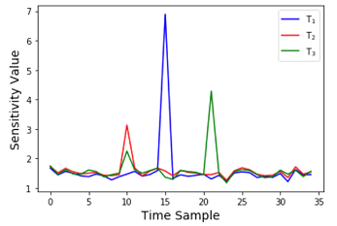
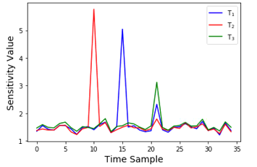
Sensitivity Analysis
Base Model profiled with $T1$
Base Model profiled with $T1$ fine tuned with $T2$
Base Model profiled with $T1$ fine tuned with $T3$
Base Model profiled with $T2$
Base Model profiled with $T2$ fine tuned with $T1$
Base Model profiled with $T2$ fine tuned with $T3$
Base Model profiled with $T3$
Base Model profiled with $T3$ fine tuned with $T1$
Base Model profiled with $T3$ fine tuned with $T2$

Slide 17
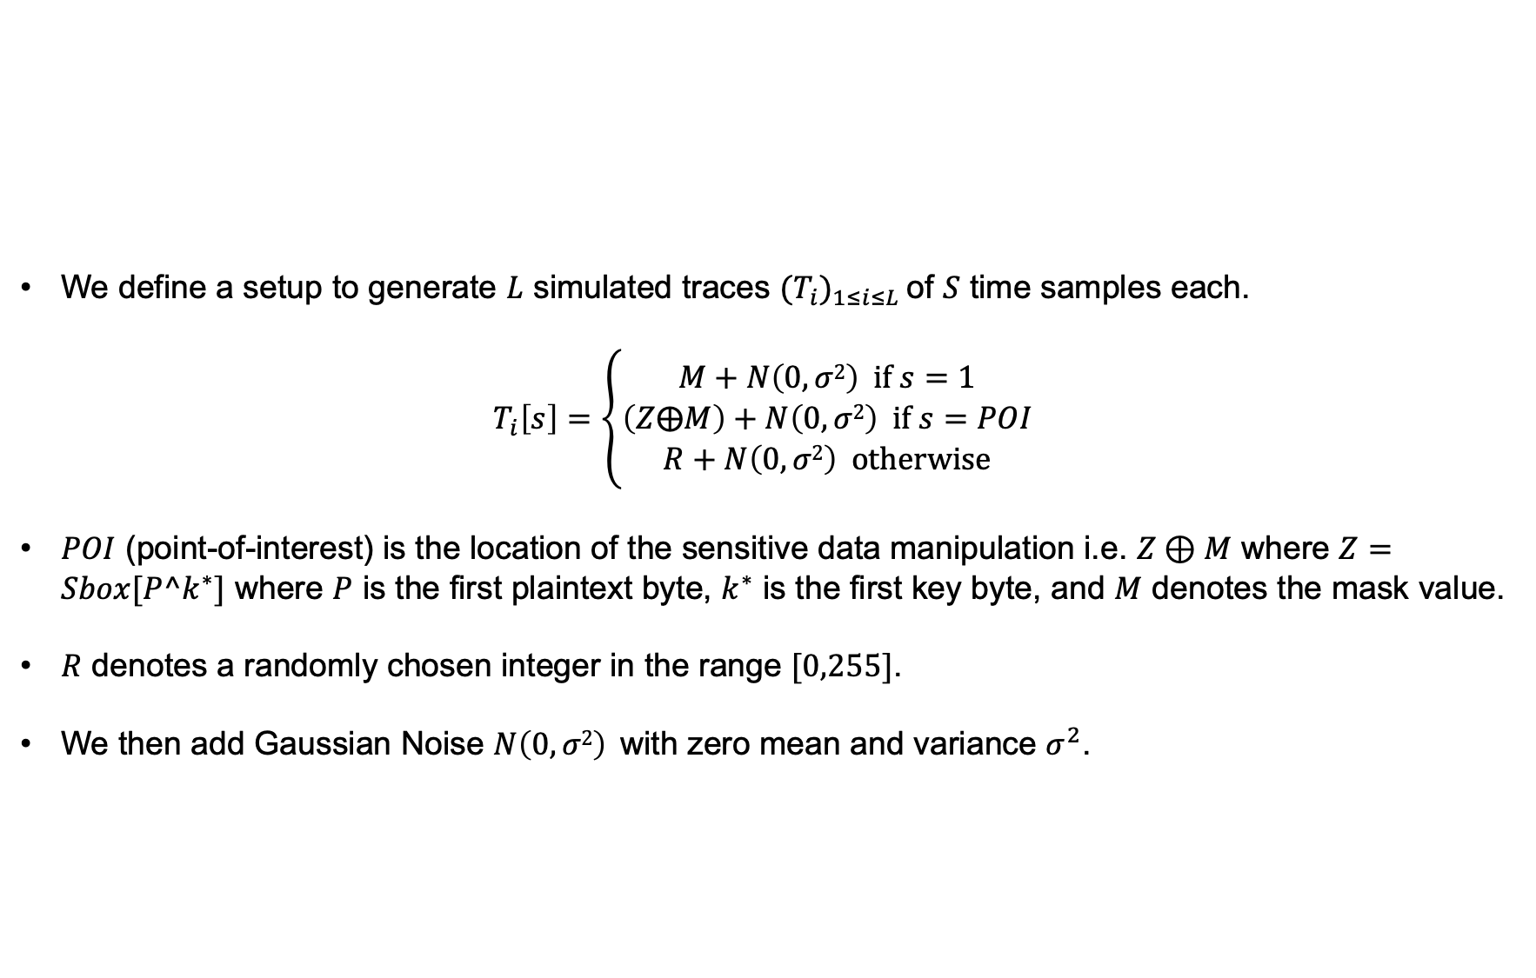
Simulated First order Masked AES Trace
We define a setup to generate $L$ simulated traces ${(T_{i})}_{1≤i≤L}$ of $S$ time samples each.
$$T_{i}\left[s\right]=\left\{\begin{aligned}M+N\left(0, σ2\right) if s=1 \\ \left(Z⨁M\right)+N\left(0, σ2\right) if s=POI \\ R+N\left(0, σ2\right) otherwise\end{aligned}\right.$$
$POI$ (point-of-interest) is the location of the sensitive data manipulation i.e. $Z⊕M$ where $Z=Sbox[P^k^{∗}]$ where $P$ is the first plaintext byte, $k^{∗}$ is the first key byte, and $M$ denotes the mask value.
$R$ denotes a randomly chosen integer in the range $[0,255]$.
We then add Gaussian Noise $N\left(0, σ2\right)$ with zero mean and variance $σ^{2}$.

Slide 18
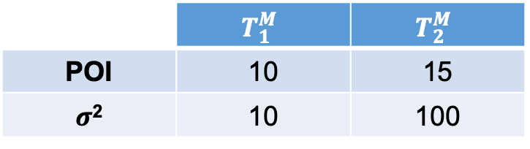
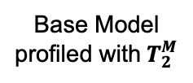
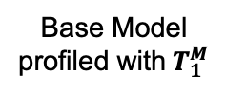
Results on Unprotected Traces
Base Model
profiled with${ T}_{1}^{M}$
Parameters of different sets of simulated traces for two different platforms
 | $$T_{1}^{M}$$ | $$T_{2}^{M}$$
POI | 10 | 15
$σ$² | 10 | 100
Base Model
profiled with$T_{2}^{M}$

Slide 19
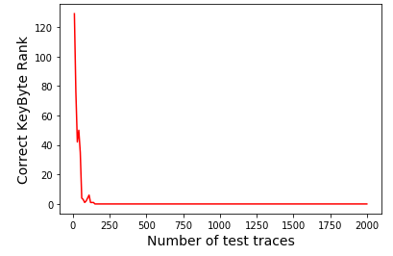
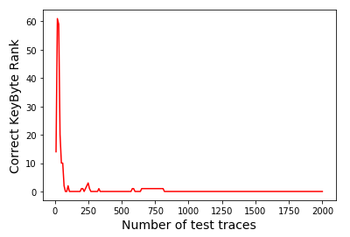




Results on Unprotected Traces
Base Model profiled with${ T}_{1}^{M}$
Model fine-tuned with${ T}_{2}^{M}$
Base Model profiled with${ T}_{2}^{M}$
Model fine-tuned with${ T}_{1}^{M}$

Slide 20
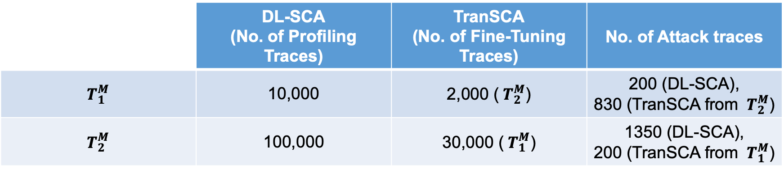
Impact of Transfer Learning
 | DL-SCA (No. of Profiling Traces) | TranSCA (No. of Fine-Tuning Traces) | No. of Attack traces
$${ T}_{1}^{M}$$ | 10,000 | 2,000 (${ T}_{2}^{M}$) | 200 (DL-SCA), 830 (TranSCA from ${ T}_{2}^{M}$)
$${ T}_{2}^{M}$$ | 100,000 | 30,000 (${ T}_{1}^{M}$) | 1350 (DL-SCA), 200 (TranSCA from ${ T}_{1}^{M}$)
() denotes base model
The difference in the required number of profiling traces between DL-SCA and TranSCA become more significant as the traces tend to be more noisy (${ T}_{1}^{M}$ → ${ T}_{2}^{M}$)

Slide 21
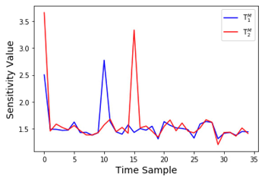
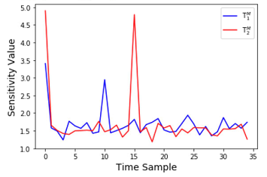
Sensitivity Analysis
Base Model profiled with${ T}_{1}^{M}$
Base Model profiled with${ T}_{1}^{M}$ fine tuned with${ T}_{2}^{M}$
Base Model profiled with${ T}_{2}^{M}$
Base Model profiled with${ T}_{2}^{M}$ fine tuned with${ T}_{1}^{M}$

Slide 22
Conclusions
Transfer Learning strategy eases the requirement of having large number of traces from a similar device for an adversary in a profiled attack scenario.
The experimental results on different simulated environments show the effectiveness of transfer learning over conventional profiling.
Sensitivity analysis results demonstrate the appropriateness of cross-knowledge utilization of the transfer learning approach.

Slide 23
Thank You
For any query please feel free to contact
Dhruv Thapar: dhruvthapar97@gmail.com
Manaar Alam: alam.manaar@gmail.com
Debdeep Mukhopadhyay: debdeep.mukhopadhyay@gmail.com

