Slide 1


Deep Learning based Diagnostics for Rowhammer Protection of DRAM Chips
Anirban Chakraborty, Manaar Alam and Debdeep Mukhopadhyay
Indian Institute of Technology, Kharagpur
2019 Asian Test Symposium
12/12/19
Notes:
The slide guide is available in the following file:
LDSlidesV21.1.ppt Slide guide for light detail on a dark background.
Note: We have saved this presentation in the older 2003 format, because PowerPoint 2003, 2007 through 2016 can read it.
For this year’s test conference we will use PowerPoint (Office) 2016 in our projection computers.

Slide 2
Purpose
Threat: The Rowhammer Bug
Motivation: Immediate and long-term solution
Available countermeasures are not sufficient
Requires considerable changes in existing hardware and kernel modules
Objective: An online detection mechanism for Rowhammer attacks on existing vulnerable systems
Notes:
The purpose of this presentation is threefold:
1. It documents standards which must be met and guidelines for good practice.
2. This presentation follows the standards and guidelines that it contains. With the obvious exception of the “Bad examples” portion, the slide guide is an example of a presentation that conforms to both standards and guidelines.
3. This presentation may be used as a starting point for your own ITC slides. Simply replace the text and diagrams that you see here with your own information.

Slide 3
Outline
DRAM Architecture
Rowhammer – An Introduction
Convolutional Neural Network
Our Approach – Online detection tool
Profiler and Analyzer
Experimental Setup and Results
Conclusion
Notes:
The Outline slide is an outline for the major areas of your presentation -- what you’re going to talk about. You should not include the title, introduction or conclusion in your outline. Just highlight the major areas of your talk.
The outline slide you are seeing is an outline for our ITC presentation guide.

Slide 4
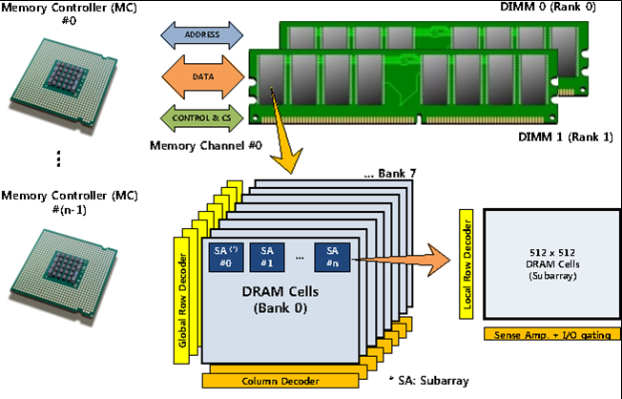
DRAM Organization
DIMM is divided into ranks which is further subdivided into banks
Banks contain memory cells arranged in rows and columns
A simplified DRAM system (DIMM) structure
Notes:
.

Slide 5
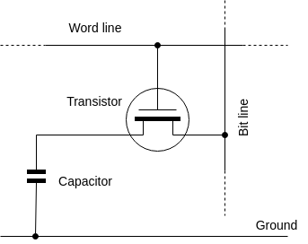
Reading and Writing into DRAM cells
Row 3
Row 2
Row 1
Row 0
Row buffer
Inside a DRAM bank
A typical memory cell
Reading and writing is done through row buffer
Three steps – opening row, read/write to cell, closing row
Charge in cells decay – Needs refreshing every 64ms
Notes:
The word “standard” in this document refers to a mandatory requirement or practice. Failure to follow all ITC standards for visual presentation can result in your presentation being dropped from the ITC program.
A “guideline” is a strongly suggested good practice that you should follow unless you see a compelling reason otherwise. The guidelines we present result from ITC’s experience with hundreds of successful and unsuccessful visual presentations at past conferences.
In order to distinguish between standards and guidelines, we show standards in a special font:
Standards appear with white italic text.
Guidelines are displayed with ordinary yellow text

Slide 6
The Rowhammer bug
Repeated activation of DRAM rows lead to loss of charge in neighbouring cells
Due to loss in charge, a bit value stored might get flipped
Must be activated with high frequency, much larger than the automatic refresh rate of 64ms
A large number of DDR3 and DDR4 DRAMs are vulnerable
Notes:
ITC requires one file per presentation, and uses an internal file naming convention to ensure that the correct visuals will appear when you begin your presentation. We do not have the resources to support customized file setups for each author.
When uploaded, the site automatically assigns an algorithmic file name, based on log number, date and time.
Prior to the conference, presentation files are renamed according to the assigned session and speaker number, and the extent changed to “.pps or .ppsx” so that the presentation automatically comes up in slide show mode at the start of your presentation.
The file naming convention is “Session #”.”Speaker #”.ppsx. For example, if you are the third speaker in session 24 your slide file will be named “24.3.ppsx”. Another example: the first lecture series presentation in Lecture 2 would be named L2.1.ppsx.
You can obtain your session and speaker numbers from your topic coordinator.

Slide 7
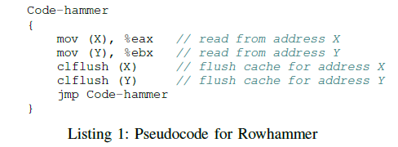
How to Rowhammer?
Row i-1
Row i-1
Row i-1
Row i-1
Row i
Row i
Row i
Row i
Row i+1
Row i+1
Row i+1
Row i+1
Kim et. al, Flipping bits in memory without accessing them: An experimental study of
DRAM disturbance errors, ISCA 14.
Notes:
ITC supplies the projection computer for your session and pre loads your visual presentation on its hard disk. You should design your presentation keeping in mind the fact that the projection computer may have low end specifications.
The projection computer will use the Windows 10 operating system. Slides will be projected with Microsoft Office PowerPoint, version 2016.
Note that it will not be possible to make changes to your presentation at ITC. Your PowerPoint presentation will be preloaded onto the hard disk of several presentation computers, and changes after preloading will not be permitted.

Slide 8


Objective is to design a detection mechanism to thwart Rowhammering on existing vulnerable systems without significant hardware or software modification
Notes:
It’s OK if you develop your presentation with an different version of PowerPoint, but be aware that your file will be projected with PowerPoint 2016 for review and for presentation at ITC.
In the electronic presentations at previous conferences we experienced problems with presentations developed with other PowerPoint versions, especially those which were developed on Macintosh computers.
We strongly urge you to develop your presentation on a PC with Windows 10 and PowerPoint 2016. At previous conferences we saw numerous problems with bullets and animation effects: what the author saw with an earlier version of PowerPoint is not the same as what projected at the conference.
Versions of this template earlier than version 3.2 will project incorrectly. If you are reading this statement, you’re OK. If not, you may have problems.
If you must use a different PowerPoint version, allow extra time for review and problem correction. Test view the slides on a PC with PowerPoint 2016/Win 10 before you upload. Be especially alert for unexpected color changes (such as yellow text on a dark yellow background), bullet font changes and incorrect animation effects.

Slide 9
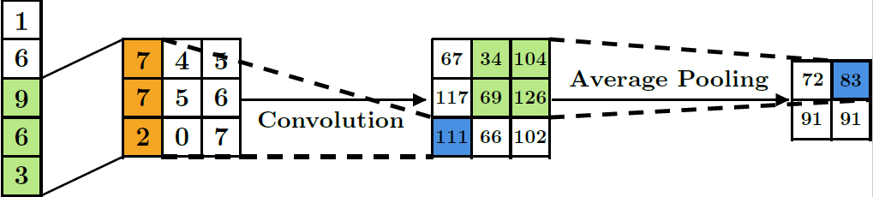
Convolutional Neural Network
Convolution Layer
Pooling Layer
Fully Connected
Performs a series of convolution operation by sliding filters
Non-linear sub-sampling layer which slides a window over input data
Combines the output of each neuron from previous stage
Notes:
The fonts on the computer where you prepare your presentation will not necessarily all be present on ITC projection computers. During recent conferences, some authors were surprised to discover that bullet fonts and scientific character fonts displayed differently when loaded on the conference presentation computers.
Problems were especially common with “Wingdings”, “MS Line Draw” and “Monotype Sorts” fonts. Also, some Asian language fonts were problem sources.
If your presentation has special fonts, you can include the fonts in your upload by selecting “Save->Embed Fonts In the File”/”Embed all Characters” from the dialog box that appears when the “Office->PowerPoint Options…” menu is selected.
Note: Use of this option increases the size of your presentation file by as much as 5X. Large presentation files take a long time to upload. Use embedded fonts only if necessary.

Slide 10
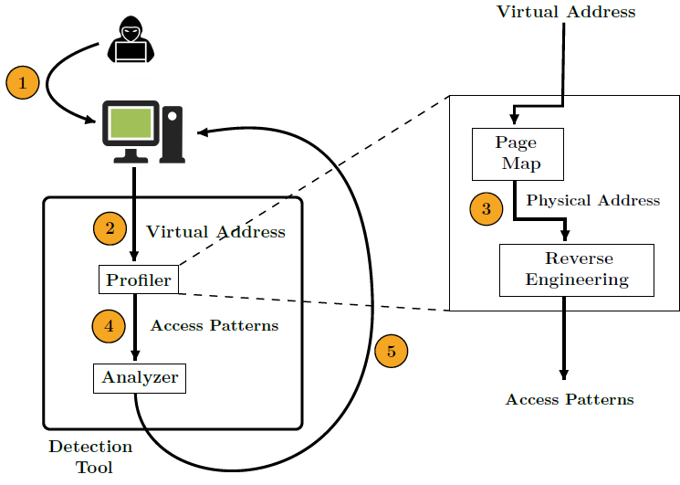
Overview of our Approach
Five Step Approach
Access
Address Map
Access Map
Data Preparation
Authorization
Notes:
Let your slides highlight your talk, not be a substitute for what you have to say. You, the speaker, deliver the message and let your slides augment your talk.
Use fonts that do not have a burred appearance or look like antique “computer characters”. Arial and Helvetica fonts are two fonts that project well. If you use other fonts, we suggest you project them electronically to get a feel for what your audience will see.
36 point titles with 28 point supportive text are visible from the rear of the session room. Smaller fonts may be visible at the front of the session room or on your monitor, but are difficult to read from the rear half of the session room.
Make your text large enough that your audience instantly reads your message. If they have to concentrate to read your slides they will be concentrating on the screen, not on what you are saying.

Slide 11
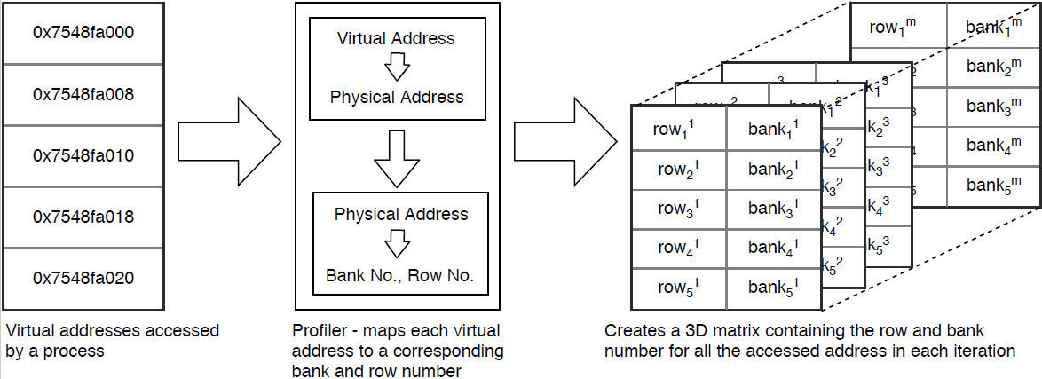
Profiler: Generating Access Patterns
Identification of a probable Adversary
Generation of Access Patterns
Notes:
Your first slide must be the title slide. Your company or university logo may appear on this, and only this slide.
Next, have one slide that states the purpose of the work described in your paper. Describe the big picture of why you did the work, not the detailed technical objectives your work accomplished.
Outline the high points of the presentation you are giving. Don’t include the title, purpose or conclusion in your outline.
After the outline of your talk come the slides that detail your presentation. Most speakers will use between 11 and 21 slides.
Finally, have one or two slides that conclude your talk.

Slide 12
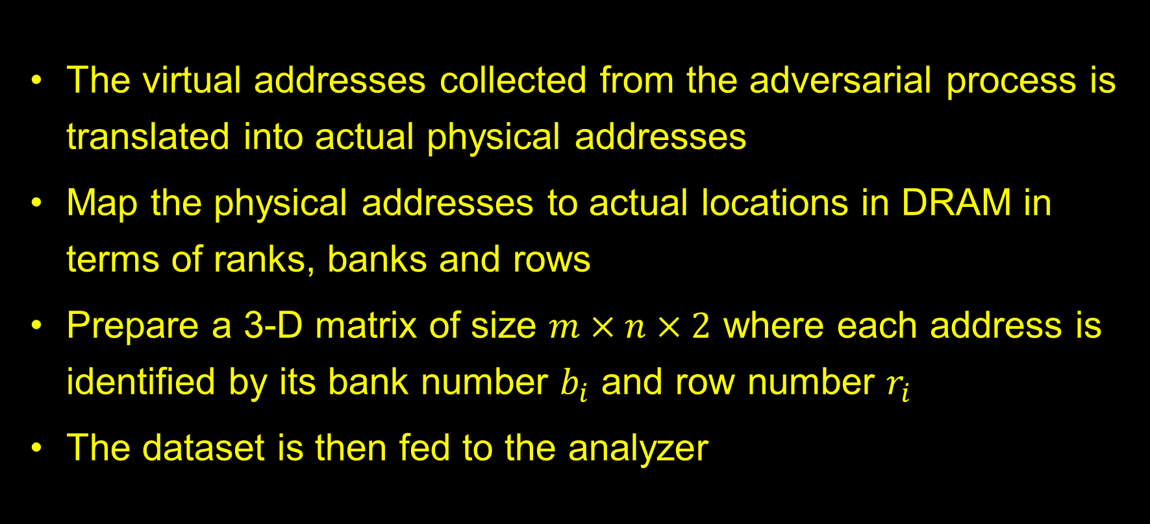
Address Map and Data Preparation
The virtual addresses collected from the adversarial process is translated into actual physical addresses
Map the physical addresses to actual locations in DRAM in terms of ranks, banks and rows
Prepare a 3-D matrix of size $m×n×2$ where each address is identified by its bank number $b_{i}$ and row number $r_{i}$
The dataset is then fed to the analyzer
Notes:
If you use a transition effect between phrases or lines, the transition should be instantaneous. Focus your audience on the current line or phrase.
In this slide we use an effect that is rapid and not distracting: The current line is highlighted, and previous lines are shown in a faded color. This is one effective technique, but certainly not the only way to present your ideas. Use what you are comfortable with, and be consistent in your use of effects.
It is especially distracting when the next phrases move onto the slide from seemingly random directions. The result is that the audience concentrates on the slides, rather than on what the speaker is saying.

Slide 13
Analyzer: Determining Rowhammer Process
Offline Phase
Online Phase
Obtains data for both benign and malicious patterns
Trains a CNN to differentiate patterns that induce bit flips
Obtains access pattern for unknown process
Uses the already trained CNN to classify the process
Notes:
High visual contrast is very important. If your slides are difficult to read, then the audience will concentrate on reading them and not concentrate on what you have to say.
We suggest a few tried and proven color schemes that will produce highly visible visual aids.
Every year a few authors ignore warnings about red, orange and light blue. Each year there are negative attendee comments about the authors who use these color schemes.
Colors that look good on computer monitors do not necessarily project well. The best advice is: Do not use red, orange or blue slide lettering under any circumstances. Other colors, including medium greens or browns are also a common problem.

Slide 14
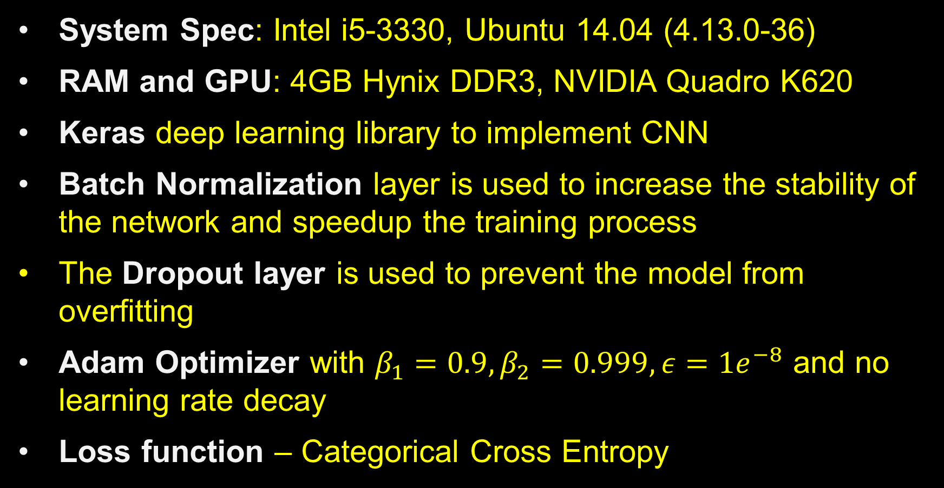
Experimental Setup and Details

Slide 15
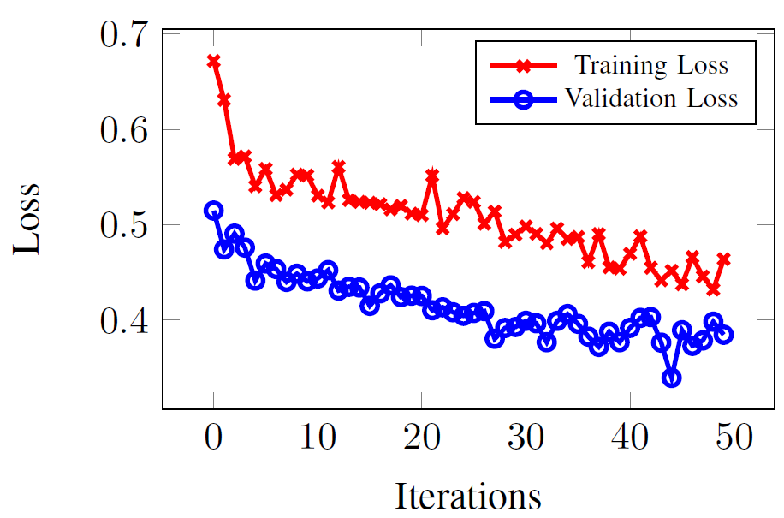
Experimental Results
Training loss and Validation loss are decreasing with each iteration
74.94% Average accuracy obtained from K-fold Cross Validation
Overall detection time 1.512 secs
Training and validation loss of CNN while training

Slide 16
Conclusion
Rowhammer – a serious security concern
Available countermeasures not suitable for existing systems
We propose a Deep Learning based detection methodology
Does not require any hardware or kernel-level modification
Can detect a probable Rowhammer attack before its successful completion with considerably high accuracy
Notes:
Contact your topic coordinator if you have any questions. Please route any comments on this slide guide to artdowney@cruzio.com

