Slide 1



In-situ Extraction of Randomness from Computer Architecture through Hardware Performance Counters
Manaar Alam, Astikey Singh, Sarani Bhattacharya, Kuheli Pratihar,
and Debdeep Mukhopadhyay
Secure Embedded Architecture Lab(SEAL)
Indian Institute of Technology, Kharagpur

Slide 2
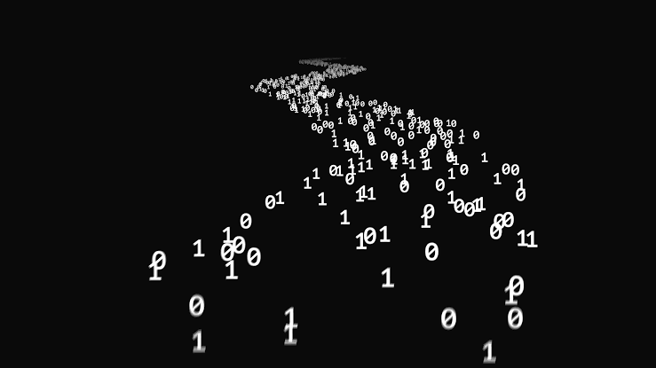
Introduction
TRNGs are essential building blocks of modern embedded security systems
Enables various cryptographic algorithms, protocols and secured implementations
True randomness cannot be obtained via computational methods
TRNGs derive its randomness from physical parameters
Security relies on the unpredictability and uniformity of the random numbers
Image Source: Google Image

Slide 3
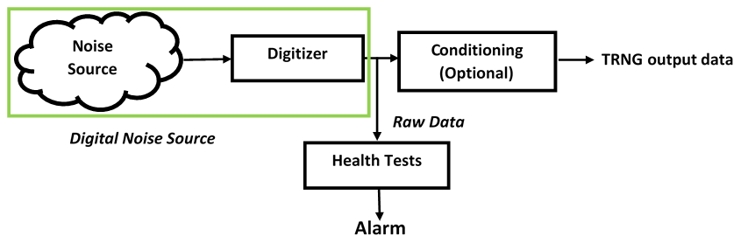
Generic Architecture of a TRNG
Entropy/ Noise Source: The only component with non-deterministic behaviour
Digitization Module: Converts analog signals into a digital form
Post-processing: Improves the statistical and security characteristics of the raw random numbers
Online tests: Detects failure in generating raw random numbers
Total Failure Tests: Implemented for the fast detection of the total breakdown of the entropy source
Total Failure Tests
Alarms

Slide 4
Traditional TRNG Designs
Thermal noise, also known as Johnson–Nyquist noise [68], is intrinsic electronic noise which occurs regardless of any applied voltage.
[1] A low power, low voltage Truly Random Number Generator (TRNG) for EPC Gen2 RFID tag was proposed and realized in in SMIC 0.18 µm standard CMOS process
[4] Presents the design of a mixed-signal RNG IC suitable for integration with hardware cryptographic systems
Metastability is the most commonly used entropy source for both FPGA and ASIC TRNGs. TRNGs of this type rely on the circuit symmetry to achieve unbiased outputs.
[3] Utilizes the write collisions in Block Memory (BRAM)s of TRNGs as entropy sources. Due to the lack of the low-level understanding of BRAM, as it is a company secret, it is almost impossible to characterize the randomness-generating process and to evaluate its security.
[5] The last passage time of ring oscillators is utilized as the entropy source. Fabricated in 0.13-μm CMOS technology
Timing Jitter is deﬁned as the deviation from a periodic signal, such as a reference clock signal
[2] Exploits the jitter of events propagating in a self-timed ring (STR) to generate random bit sequences at a very high bit rate. Implemented using Altera and Xilinx FPGA
[6]TRNG based on high-precision edge sampling. Implemented using Xilinx Spartan 6 and Intel Cyclone V FPGAs
CMOS Designs:
Not preferred for high speed applications
Not easily portable to FPGA families
Source of Randomness: Underlying Hardware Architectural Events
No external hardware i.e. SoC design
OUR WORK

Slide 5
TRNGs implemented using external hardware are susceptible to physical attacks
[7] Presents a contactless and local active attack on ring oscillators (ROs) based TRNGs using electromagnetic fields. It is possible to lock them on the injected signal and thus to control the monobit bias of the TRNG output even when low power electromagnetic fields are exploited
[8] A frequency injection attack which is able to destroy the source of entropy in ring-oscillator-based true random number generators (TRNGs).
It would be desirable to develop TRNG sources which are available to a program without resorting to an external component
In-situ TRNG design would also make physical attacks more challenging
On- the fly testing of TRNGs
A design methodology for embedded tests of entropy sources.
[9] The proposed solution uses canary numbers which are an extra output of the entropy source of lower quality. This enables an early-warning attack detection before the output of the generator is compromised.
[10] Design of on-the-fly tests based on the attack effects. Uses an empirical design methodology consisting of two phases: collecting the data under attack and finding a useful statistical feature.

Slide 6
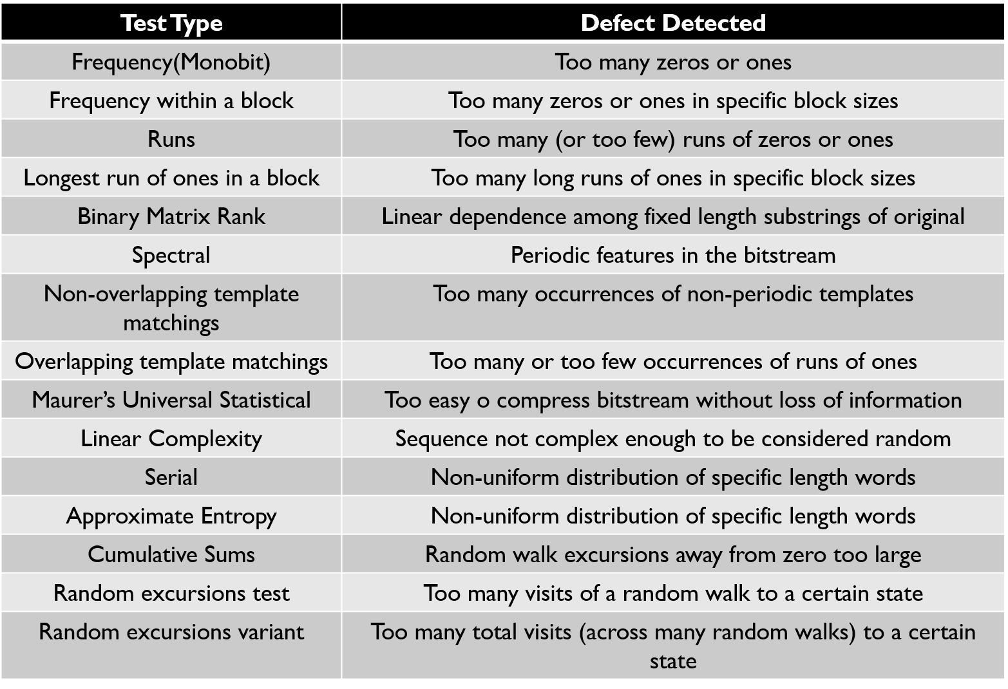
NIST SP 800-22 STATISTICAL TEST SUITE

Slide 7
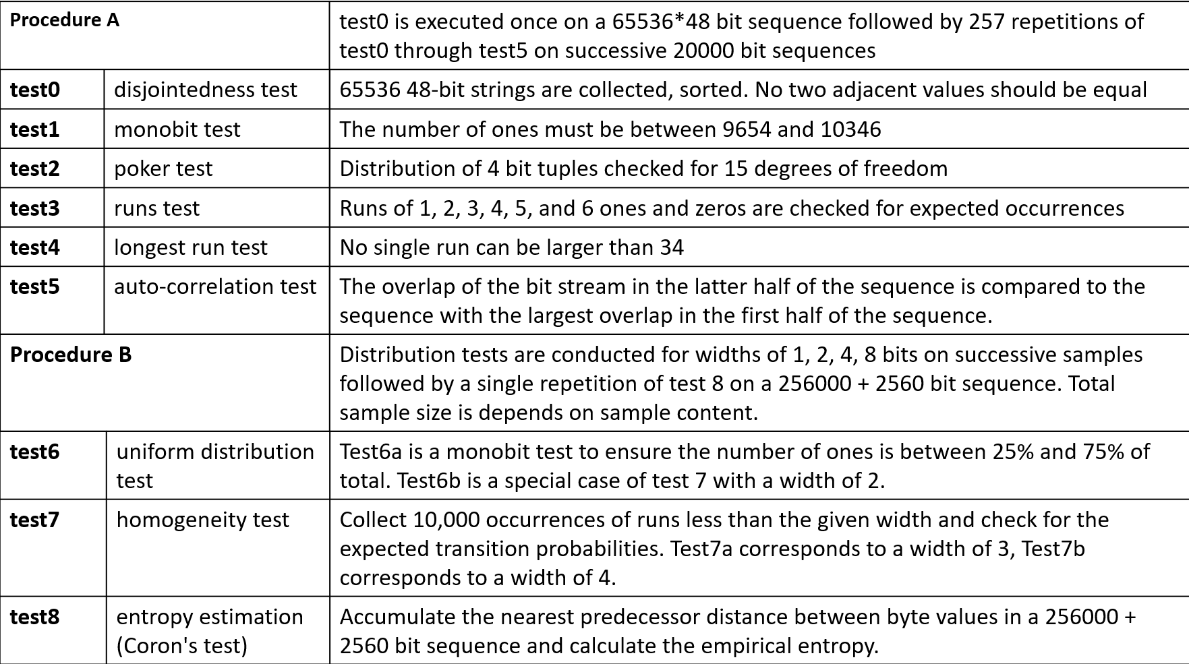
AIS 20/31 TESTS

Slide 8
Contributions
TRNG derived from computer architecture, which thrives on the randomness observed through the Hardware Performance Counters. HPC event counters provide a cumulative count to the architectural events and thus proposed to be a high source of entropy.
It was also observed that the randomness was highest in the Least Significant bits (LSBs) for the observed values from these counters.
These event counter statistics over the monitored application along with the background noise can only be observed at periodic intervals. In order to increase the throughput of the overall random number generation, we pair the proposed TRNG with a secured hash implementation using the Keccak algorithm.

Slide 9
Hardware Performance counters
Set of special purpose registers, present in most of microprocessor’s Performance Monitoring Unit(PMU)
Store hardware and software events related to the execution of a program, such as cache misses, retired instructions, retired branch instructions, etc.
Type and number of hardware interrupts vary across different Instruction Set Architectures(ISA)
Various open-source tools can measure this HPC values: perf tools, PAPI, Oprofile, Valgrind and many more

Slide 10

COMMAND LINE LINUX TOOLS
perf : accesses and reads the HPC registers through the perf event system call for Linux versions above 2.6.31.
Syntax:
perf stat -e <event name> -I <interval duration> <executable name>
mpstat: a utility that collects and displays information about CPU utilization and performance statistics.
/proc/interrupts records the number of interrupts per IRQ on the x86 architecture.
taskset: sets or retrieves the CPU affinity of a running process given its PID (Process ID)
Image Source: Google Images

Slide 11
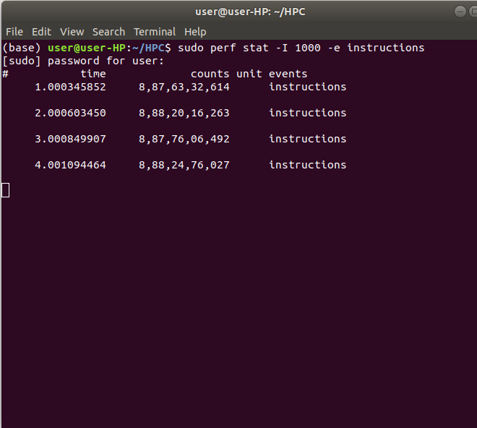
Monitoring the HPCs
An infinite loop C code snippet was taken and allowed to run indefinitely
Various event counts such as instructions, bus-cycles etc. were observed
Measured the total number of interrupts received per second
(Note: The experiment was performed on a per-core approach)
Event name
Event count

Slide 12
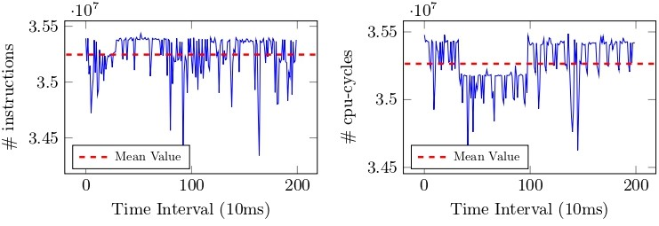
NON-DETERMINISM IN HPCs
Source of Non-Determinism:
Hardware Interrupts
Ideal case: The HPC events instructions and cpu-cycles should report constant values over the duration of time
Observation: The number of instructions and the number of CPU cycles is not constant over time
Fig: Performance counter events (i) instruction and (ii) cpu-cycles over the executable of inﬁnite loop with 10ms∗ interval of time
Significant amount of non-determinism is exhibited by these performance counters

Slide 13
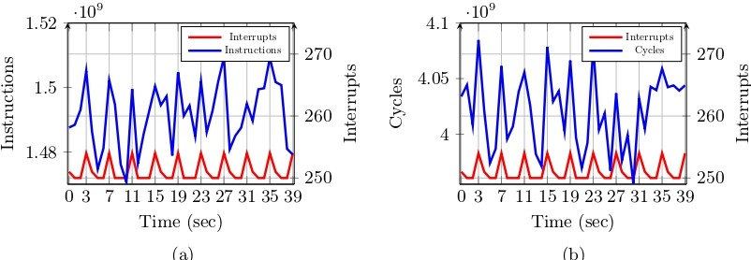
EFFECT OF HARDWARE INTERRUPTS ON HPC EVENTS
Observation:
Whenever there is a surge in the number of interrupts, the count of the events also increase
Validation:
There exists an association between hardware interrupts and HPC events.
Fig: Eﬀect of hardware interrupts on the HPC events (i) instructions and (ii) cpu-cycles monitored over an inﬁnite loop on diﬀerent time instances
There are several types of interrupts affecting these HPC events such as Local Timer Interrupts (LOC), IRQ Work Interrupts (IWI), Rescheduling Interrupts (RES), Function Call Interrupts (CAL), and TLB Shootdowns (TLB).
The effect of these interrupts can be monitored eciently using /proc/interrupts

Slide 14
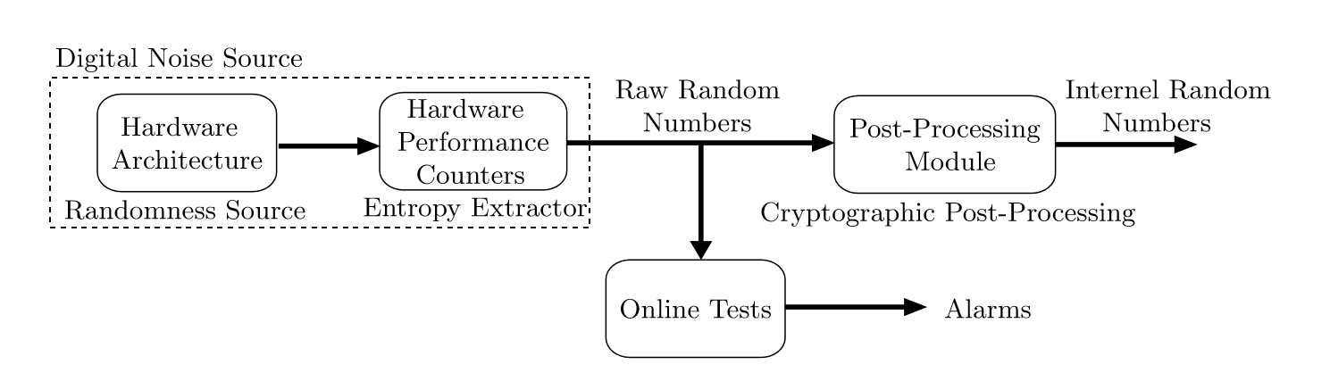
PROPOSED TRNG DESIGN

Slide 15
RANDOMNESS EXTRACTION USING HPCS
Selection of Least Significant Bits
Observed 500,000 instances of the performance counter events instructions and cpu-cycles, and calculated the entropy for each bit position.
Entropy of each bit position is not same for the binary sequences of the monitored values
Entropy is highest with LSB while MSB is highly predictable
Transformation of the data to binary sequences and considered the last 9† bits for further analysis
†: We empirically selected last 9 least signiﬁcant bits for our experimental setup as for most of the events the last 9 bits provide highest entropy values

Slide 16
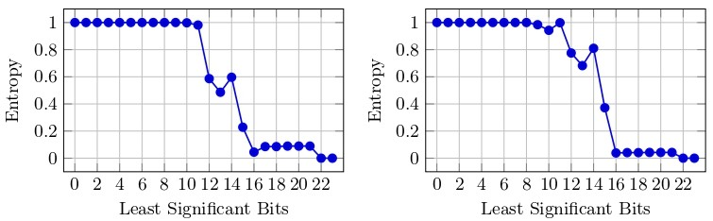
Choosing bits from the LSB
Selection of Least Significant Bits(Contd.)
Observation: LSBs have the highest entropy, and as we move towards the MSBs, the entropy gets reduced
Fig: Entropy of each LSBs for HPC event (i) instructions, and (ii) cpu-cycles

Slide 17
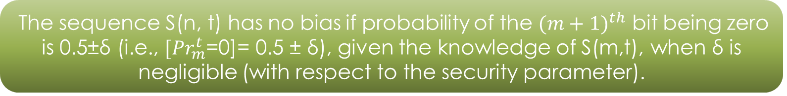

Next-bit Test for HPC events
Selection of HPC events using Yao’s Next-Bit Test
In order to estimate the probability, N sequences of an HPC event at N successive intervals of time were considered
Given ﬁrst m-bits of the n possible bits for any sequence S(n, t), i.e., the sequence S(m, t) is already given (where m < n)
According to Yao’s Next Bit test,
No. of possibilities for S(m,t)= $2^{m}$
The sequence S(n, t) has no bias if probability of the ${(m+1)}^{th}$ bit being zero is 0.5±δ (i.e., ${[Pr}_{m}^{t}$=0]= 0.5 ± δ), given the knowledge of S(m,t), when δ is negligible (with respect to the security parameter).

Slide 18
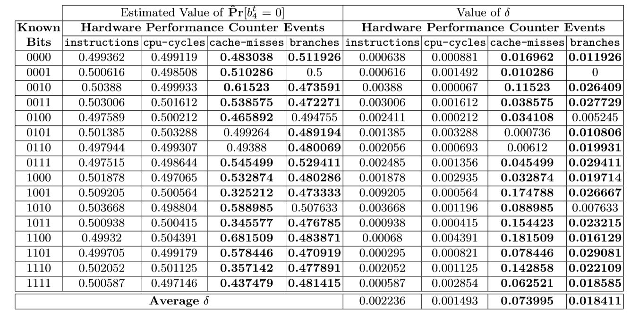
Selection of HPC events using Yao’s Next-Bit Test (Contd.)
Consider the case m=4, i.e. first 4 bits of the binary sequence is known
Observed N = 500,000 values for the events and estimated the probability
If the ﬁrst 4 bits are 0000, then the estimated probability that the next bit will be 0 is 0.499362 with a bias of 0.000638
2⁴ possible combinations
Events instructions and cpu-cycles can act as better candidate for source of randomness
Table: Next-bit test for diﬀerent HPC events for m = 4

Slide 19
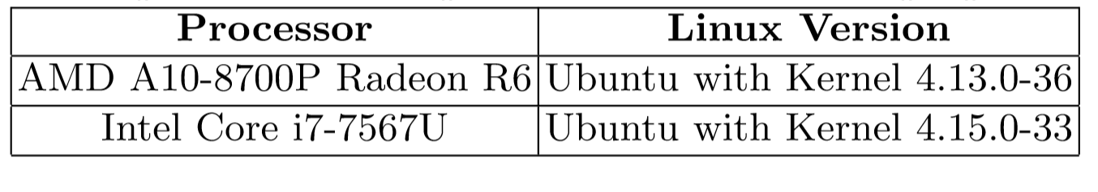
Experimental Validation
Results on TRNG output obtained from HPC Events
Experiments were conducted on two different processors
Access to HPC events is available to users with administrative privilege
Table: Experimental Setup for Validation of the proposed claim
Primitive events such as instructions, cpu-cycles, bus-cycles, cache-misses, branches etc. were considered.

Slide 20
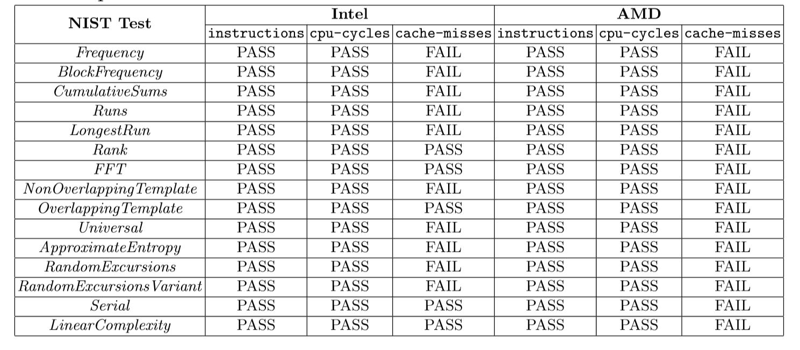
EXPERIMENTAL VALIDATION(Contd.)
Table: NIST Test Results on TRNG Output for Diﬀerent HPC Events on two diﬀerent processors

Slide 21
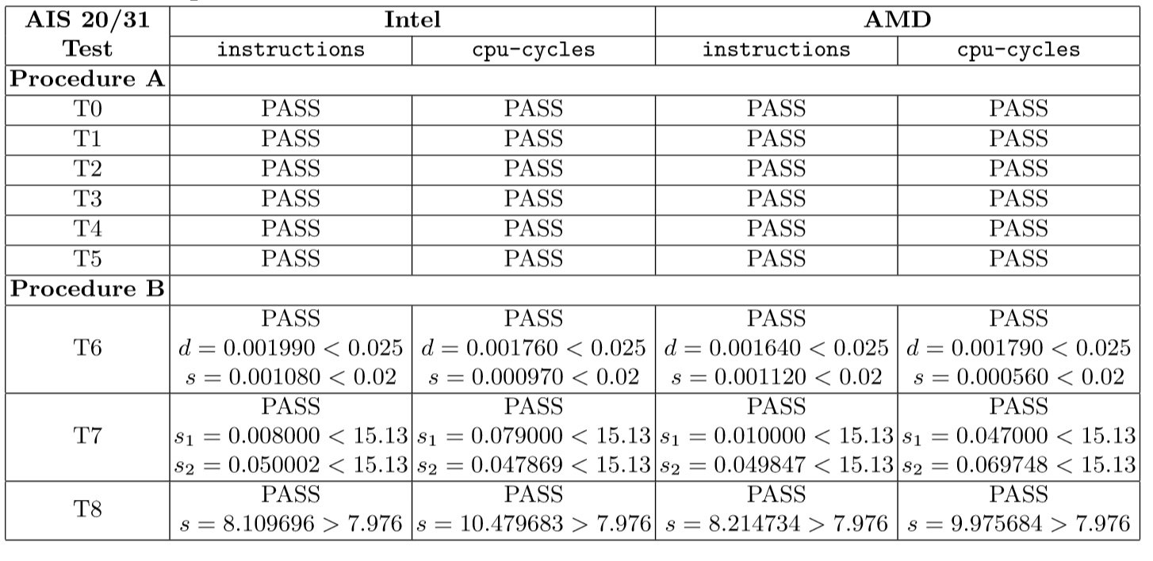
EXPERIMENTAL VALIDATION (Contd.)
Table: AIS 20/31 Test Results on TRNG Output for Diﬀerent HPC Events on two diﬀerent processors

Slide 22


EXPERIMENTAL VALIDATION (Contd.)
Perturbation in TRNG Output in presence of an Adversary
Observation: Adversarial manipulation hampers the instruction counts but does not have any impact on the entropy of the least signiﬁcant bits of the counter values
Attack scenario: An adversary running on the same processor core as the TRNG module can modify these HPC values in regular time intervals
ADMIN
Reason: inherent chaos of a large number of concurrent process executions and optimization constructs of the Operating System and their eﬀect on the underlying computer architecture modules

Slide 23
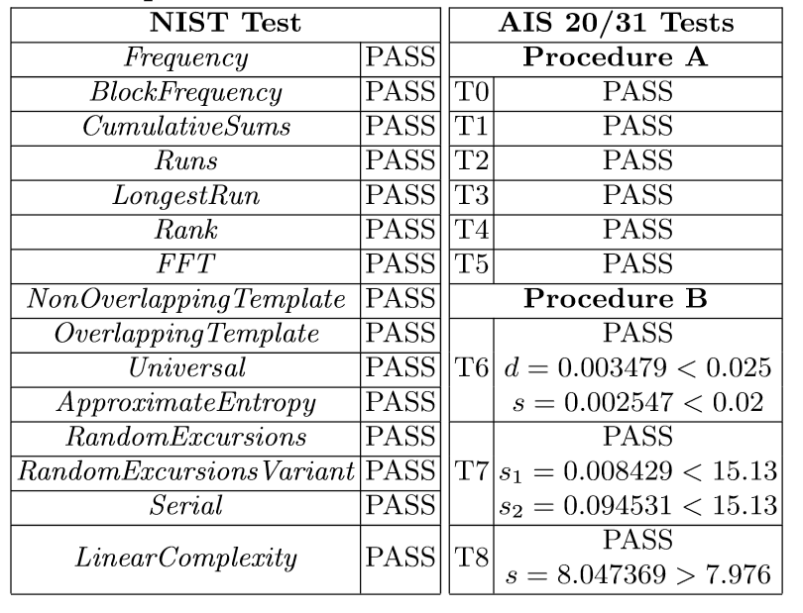
EXPERIMENTAL VALIDATION (Contd.)
Perturbation in TRNG Output in presence of an Adversary
Table: NIST and AIS 20/31 Test results on TRNG Output for the HPC event instructions on Intel processor after adversarial modiﬁcation

Slide 24
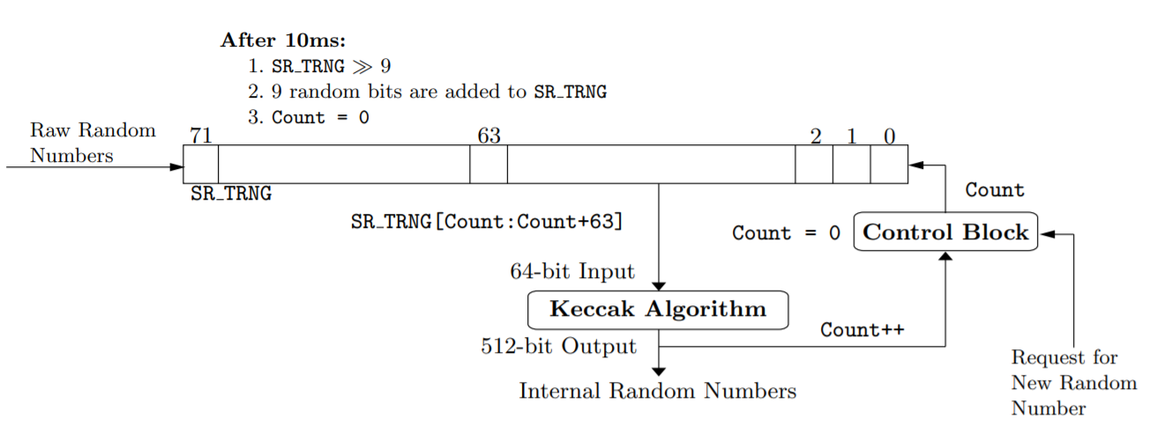
Hybrid Construction to Enhance Throughput
Secured Hash implementation using Keccak algorithm
Proposed design considers only the last 9 significant bits from the LSB at a periodic interval of 10ms
Latency of 10ms of the generation of 9 random bits is inappropriate
Solution: Hybrid model which uses a shift register, the Keccak algorithm, and a control block by considering the random bits obtained from HPCs as input.
Fig: Hybrid Construction for generating internal random numbers
Operational Modes: Initialization and Generation
Maximum Throughput: 46,080 bits per second (or 45 Kbps)

Slide 25
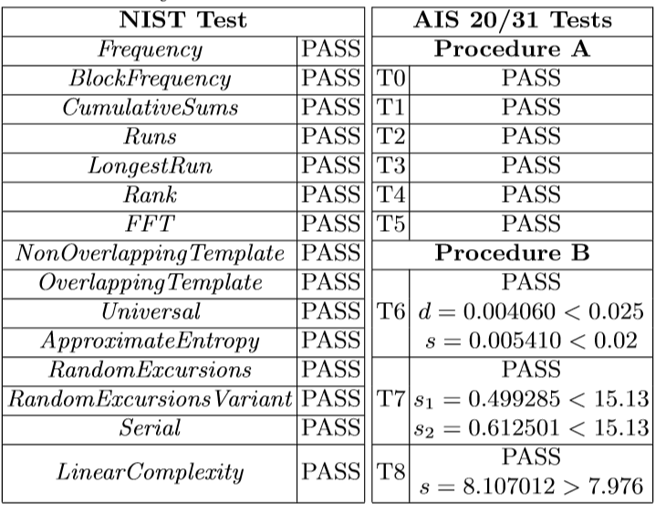
Results for the Hybrid Construction
Table: NIST and AIS 20/31 Test results on TRNG Output for the HPC event instructions on Intel processor obtained from the hybrid construction

Slide 26
Comparing to Linux’s RNG
Linux based systems have special character file /dev/urandom providing an interface to the kernel's random number generator.
However, several weaknesses of such random number generation is already reported in [Gutterman et. al.; S&P 2006].
In order to stress the weakness, we collected random data using /dev/urandom and applied NIST Test suite on the output
Thus our proposed approach can be used as a TRNG source in modern Linux based systems as an alternative to apparently weaker random number generator using /dev/urandom.
Table: NIST test results of Linux /dev/urandom on both Intel and AMD

Slide 27
Summary
Components of architecture infuse a huge level of randomness because of Operating System optimization constructs and unpredictability of hardware interrupts.
Hardware Performance Counters digitize the randomness of the architectural constructs and various experimental results using standard NIST, and AIS 20/31 Test suites show that these counters can indeed be considered as a TRNG source.
Proposed TRNG construction is robust and fault tolerant in the presence of a powerful adversary
Throughput Enhancement of the design is done by combining the TRNG module with Keccak hash implementation and a shift register to design a hybrid module which also qualiﬁes NIST and AIS 20/31 Tests.

Slide 28
References
Chen, W., Che, W., Bi, Z., Wang, J., Yan, N., Tan, X., Wang, J., Min, H., Tan, J.: A 1.04 µW truly random number generator for Gen2 RFID tag. In: 2009 IEEE Asian Solid-State Circuits Conference. pp. 117–120. IEEE (2009)
Cherkaoui, A., Fischer, V., Fesquet, L., Aubert, A.: A very high speed true random number generator with entropy assessment. In: International Workshop on Cryptographic Hardware and Embedded Systems. pp. 179–196. Springer (2013)
Gu¨neysu, T.: True random number generation in block memories of reconﬁgurable devices. In: 2010 International Conference on Field-Programmable Technology. pp. 200–207. IEEE (2010)
Petrie, C.S., Connelly, J.A.: A noise-based IC random number generator for applications in cryptography. IEEE Transactions on Circuits and Systems I: Fundamental Theory and Applications 47(5), 615–621 (2000)
Robson, S., Leung, B., Gong, G.: Truly random number generator based on a ring oscillator utilizing last passage time. IEEE Transactions on Circuits and Systems II: Express Briefs 61(12), 937–941 (2014)
Yang, B., Roˇzic, V., Grujic, M., Mentens, N., Verbauwhede, I.: ES-TRNG: A Highthroughput, Low-area True Random Number Generator based on Edge Sampling. IACR Transactions on Cryptographic Hardware and Embedded Systems pp. 267– 292 (2018)
Bayon, P., Bossuet, L., Aubert, A., Fischer, V., Poucheret, F., Robisson, B., Maurine, P.: Contactless electromagnetic active attack on ring oscillator based true random number generator. In: International Workshop on Constructive Side-Channel Analysis and Secure Design. pp. 151–166. Springer (2012)
Markettos, A.T., Moore, S.W.: The frequency injection attack on ring-oscillator based true random number generators. In: Cryptographic Hardware and Embedded Systems-CHES 2009, pp. 317–331. Springer (2009)
Roˇzi´c, V., Yang, B., Mentens, N., Verbauwhede, I.: Canary numbers: Design for light-weight online testability of true random number generators. In: Cryptol. ePrint Arch., NIST RBG Workshop, Gaithersburg, MD, USA, Tech. Rep. vol. 386, p. 2016 (2016)
Yang, B., Roˇzi´c, V., Mentens, N., Dehaene, W., Verbauwhede, I.: TOTAL: TRNG on-the-ﬂy testing for attack detection using lightweight hardware. In: Proceedings of the 2016 Conference on Design, Automation & Test in Europe. pp. 127–132. EDA Consortium (2016)

Slide 29

Thank You!
This work was supported by the Defence Research and Development Organization (DRDO) through JCBCAT, Kolkata, India

