Slide 1
Black-Box Attack against Machine Learning

Slide 2
Introduction
Classifiers learns a mapping between inputs and set of classes.
  A malware detector is a classifier taking executables as inputs and assigning them to the benign or malware class.
Adversarial examples can compromise the integrity of a classifier.
  To humans, the images appear to be same. But, forces a particular DNN to classify it as a yield sign.
Class 1
Classifier
Class 2
Inputs
Machine Learning Model
Class N
Legitimate inputs altered by adding small, often imperceptible, perturbations
Ordinary Stop Sign
Image produced after precise perturbation
Practical Black-Box Attacks against Machine Learning – Papernot et. al., ASIA CCS ‘17

Slide 3
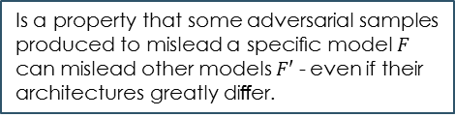
Introduction
The paper first introduced the demonstration of practical real-world black-box attacks against DNN classifiers.
Assumptions
  The adversary has no information about the structure or parameters of the DNN.
  The adversary does not have access to any large training dataset.
Capability
  The adversary's only capability is to observe labels assigned by the DNN for chosen inputs, in a manner analogous to a cryptographic oracle.
Strategy
  Train a local substitute DNN with a synthetic dataset.
  Adversarial examples are crafted using the substitute parameters, which are known.
  They are not only misclassified by the substitute but also by the target DNN, because both models have similar decision boundaries due to transferability between architectures.
Generated by the adversary, while the outputs are labels assigned by the target DNN
Is a property that some adversarial samples produced to mislead a speciﬁc model $F$ can mislead other models $F′$ - even if their architectures greatly diﬀer.
Practical Black-Box Attacks against Machine Learning – Papernot et. al., ASIA CCS ‘17

Slide 4
Introduction
Advantages
  In comparison to previous works
    Detailed knowledge of the DNN architecture and parameters.
      Learning a substitute - gives the benefit of having full access to the model and apply previous adversarial example crafting methods.
    An independently collected training set to fit an auxiliary model.
      Replacing with a synthetic dataset constructed by the adversary with synthetic inputs and labelled by observing the target DNN's output.
  Corresponds to the real-world scenario of users interacting with classifiers hosted remotely by a third-party keeping the model internals secret.
    Classifiers automatically trained by MetaMind, Amazon, and Google.
Applicability
  The capabilities required are limited to observing output class labels only.
  The number of labels queried are limited.
  Scales to different ML classifier types in addition to state-of-the-art DNNs.
Practical Black-Box Attacks against Machine Learning – Papernot et. al., ASIA CCS ‘17

Slide 5
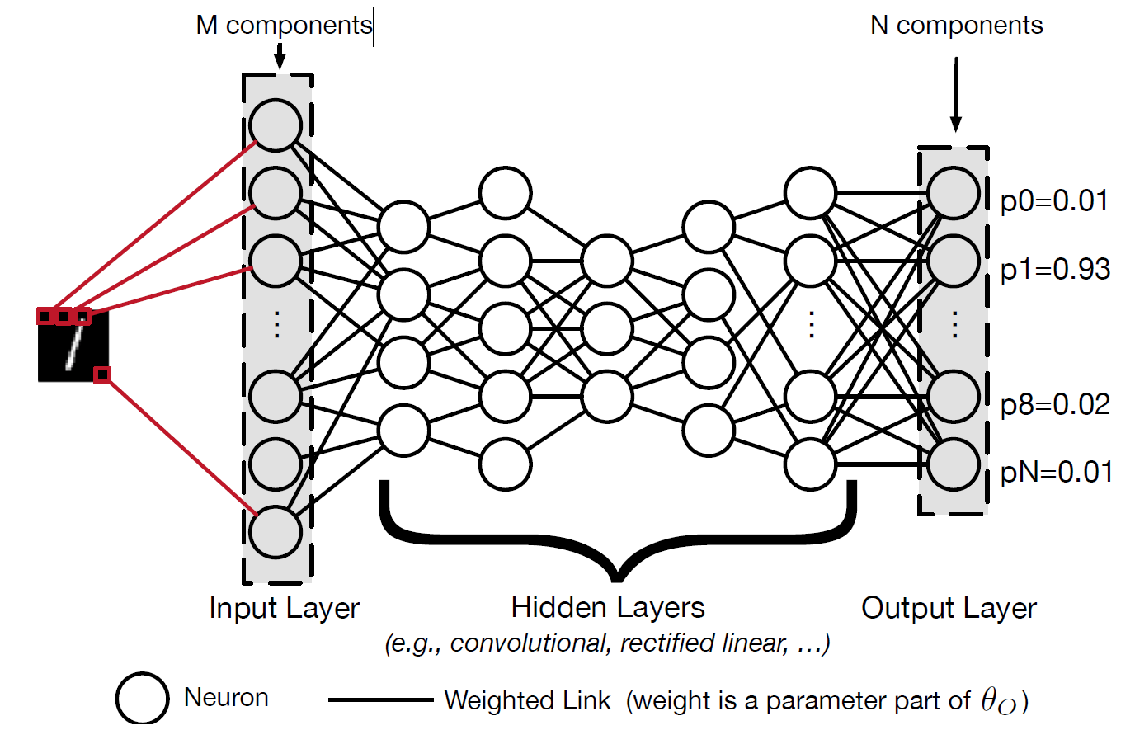
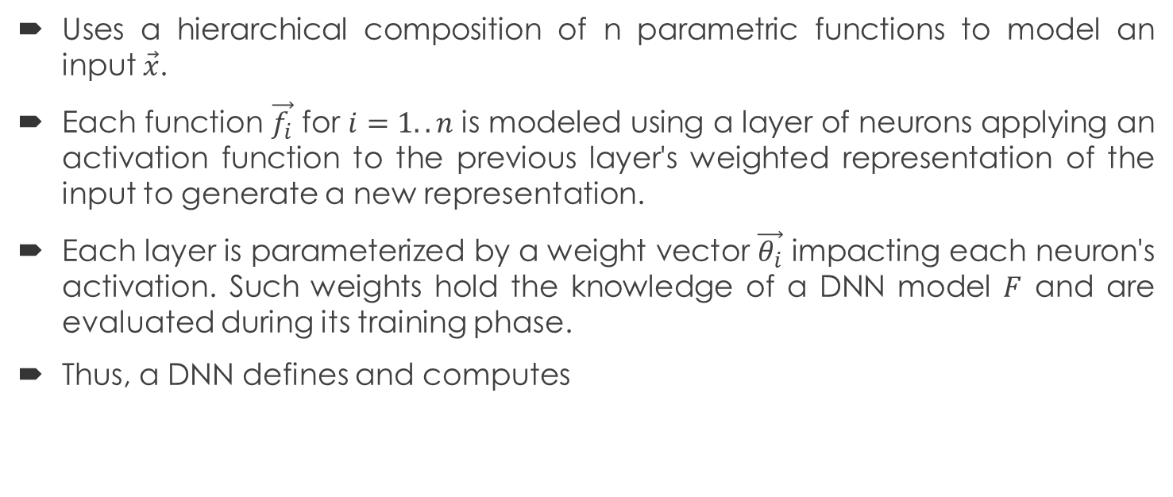

Deep Neural Network
Uses a hierarchical composition of n parametric functions to model an input $\vec{x}$.
Each function $\vec{f_{i}}$ for $i=1..n$ is modeled using a layer of neurons applying an activation function to the previous layer's weighted representation of the input to generate a new representation.
Each layer is parameterized by a weight vector $\vec{θ_{i}}$ impacting each neuron's activation. Such weights hold the knowledge of a DNN model $F$ and are evaluated during its training phase.
Thus, a DNN defines and computes
$$F\left(\vec{x}\right)= f_{n}(\vec{θ_{n}}, f_{n−1}(\vec{θ_{n−1}}, {…f}_{2}(\vec{θ_{2}}, f_{1}(\vec{θ_{1}},\vec{x}))))$$
Practical Black-Box Attacks against Machine Learning – Papernot et. al., ASIA CCS ‘17

Slide 6
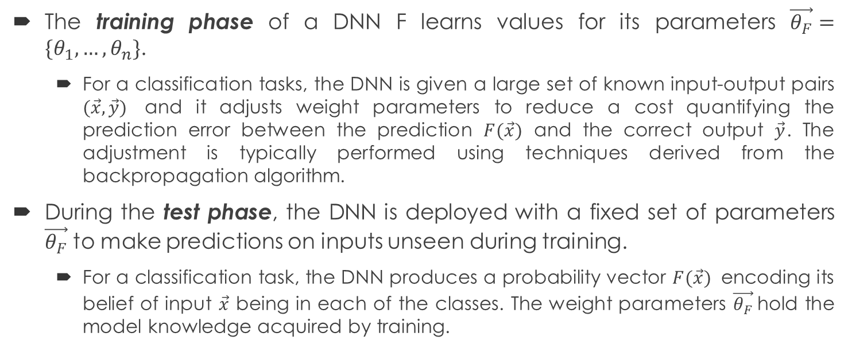
Deep Neural Network
The training phase of a DNN F learns values for its parameters $\vec{θ_{F}}=\{θ_{1},…,θ_{n}\}$.
  For a classification tasks, the DNN is given a large set of known input-output pairs $(\vec{x}, \vec{y})$ and it adjusts weight parameters to reduce a cost quantifying the prediction error between the prediction $F(\vec{x})$ and the correct output $\vec{y}$. The adjustment is typically performed using techniques derived from the backpropagation algorithm.
During the test phase, the DNN is deployed with a fixed set of parameters $\vec{θ_{F}}$ to make predictions on inputs unseen during training.
  For a classification task, the DNN produces a probability vector $F(\vec{x})$ encoding its belief of input $\vec{x}$ being in each of the classes. The weight parameters $\vec{θ_{F}}$hold the model knowledge acquired by training.
Practical Black-Box Attacks against Machine Learning – Papernot et. al., ASIA CCS ‘17

Slide 7
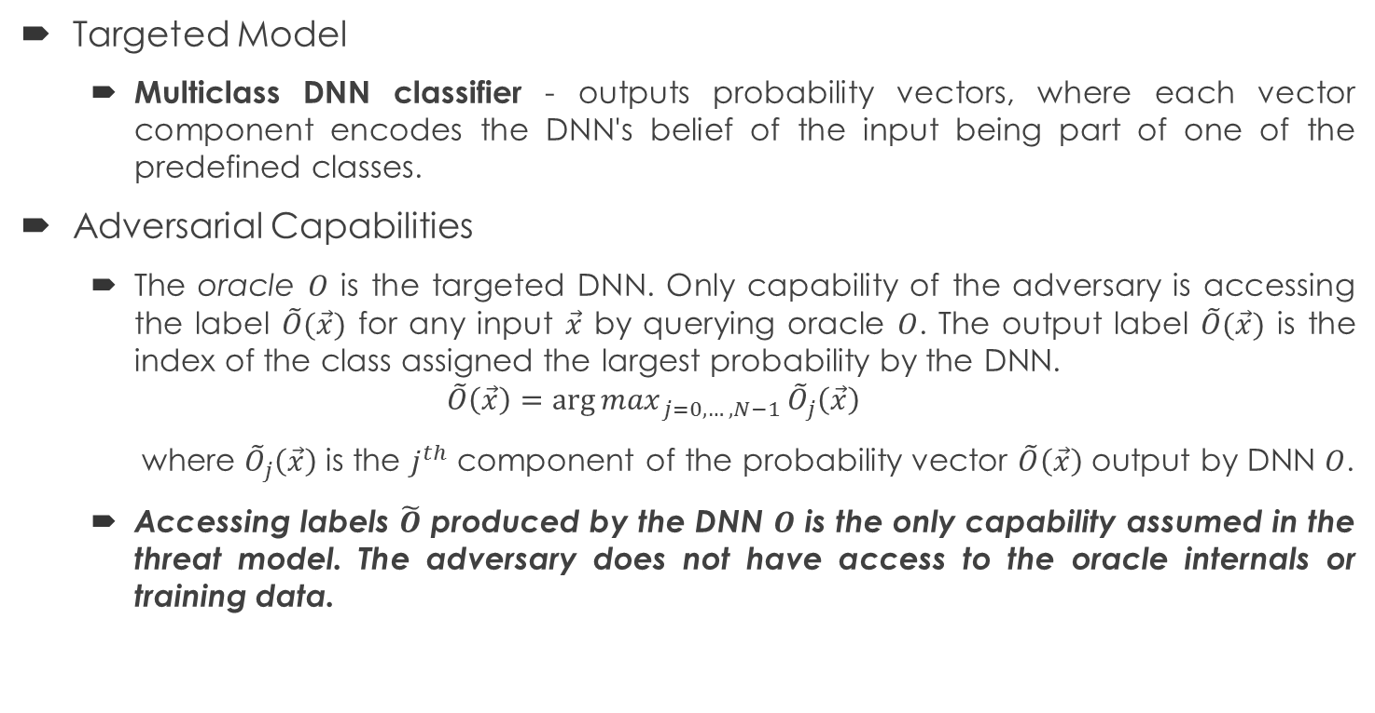
Threat Model
Targeted Model
  Multiclass DNN classifier - outputs probability vectors, where each vector component encodes the DNN's belief of the input being part of one of the predefined classes.
Adversarial Capabilities
  The oracle $O$ is the targeted DNN. Only capability of the adversary is accessing the label $\tilde{O}(\vec{x})$ for any input $\vec{x}$ by querying oracle $O$. The output label $\tilde{O}(\vec{x})$ is the index of the class assigned the largest probability by the DNN.
  $$\tilde{O}\left(\vec{x}\right)={\arg{max}}_{j=0, …, N−1}{\tilde{O}}_{j}\left(\vec{x}\right)$$
  where ${\tilde{O}}_{j}\left(\vec{x}\right)$ is the $j^{th}$ component of the probability vector $\tilde{O}\left(\vec{x}\right)$ output by DNN $O$.
  Accessing labels $\tilde{O}$ produced by the DNN $O$ is the only capability assumed in the threat model. The adversary does not have access to the oracle internals or training data.
Practical Black-Box Attacks against Machine Learning – Papernot et. al., ASIA CCS ‘17

Slide 8
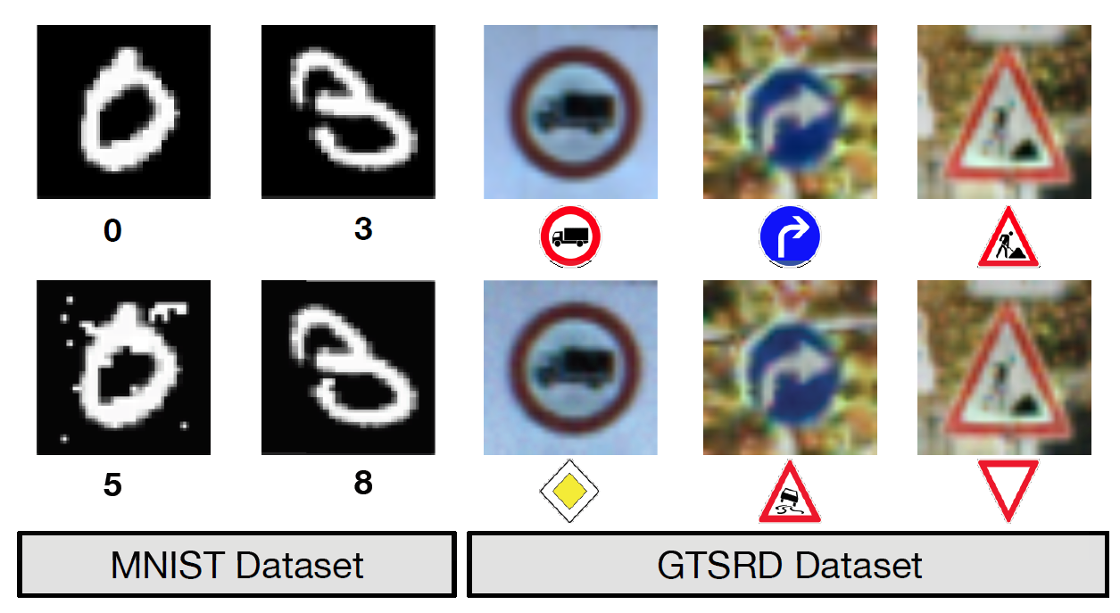
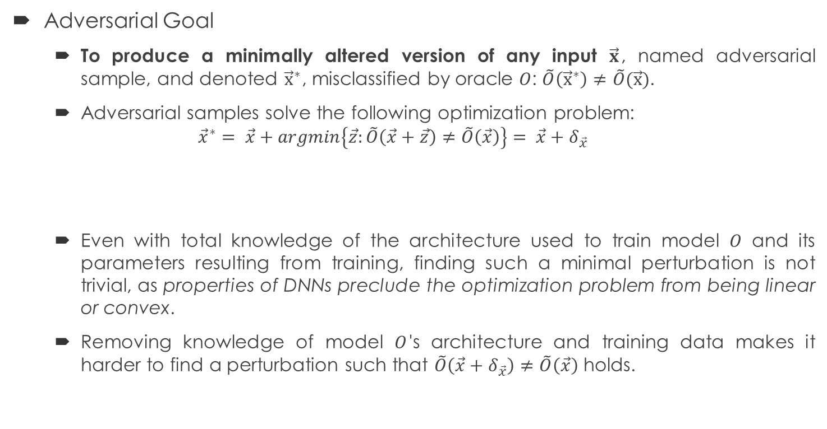
Threat Model
Adversarial Goal
  To produce a minimally altered version of any input $\vec{x}$, named adversarial sample, and denoted ${\vec{x}}^{∗}$, misclassified by oracle $O$: $\tilde{O}\left({\vec{x}}^{∗}\right)≠\tilde{O}(\vec{x})$.
  Adversarial samples solve the following optimization problem:
  $${\vec{x}}^{∗}= \vec{x}+argmin\left\{\vec{z}:\tilde{O}\left(\vec{x}+\vec{z}\right)≠\tilde{O}\left(\vec{x}\right)\right\}= \vec{x}+δ_{\vec{x}}$$
  Even with total knowledge of the architecture used to train model $O$ and its parameters resulting from training, finding such a minimal perturbation is not trivial, as properties of DNNs preclude the optimization problem from being linear or convex.
  Removing knowledge of model $O$'s architecture and training data makes it harder to find a perturbation such that $\tilde{O}\left(\vec{x}+δ_{\vec{x}}\right)≠\tilde{O}\left(\vec{x}\right)$ holds.
Practical Black-Box Attacks against Machine Learning – Papernot et. al., ASIA CCS ‘17

Slide 9
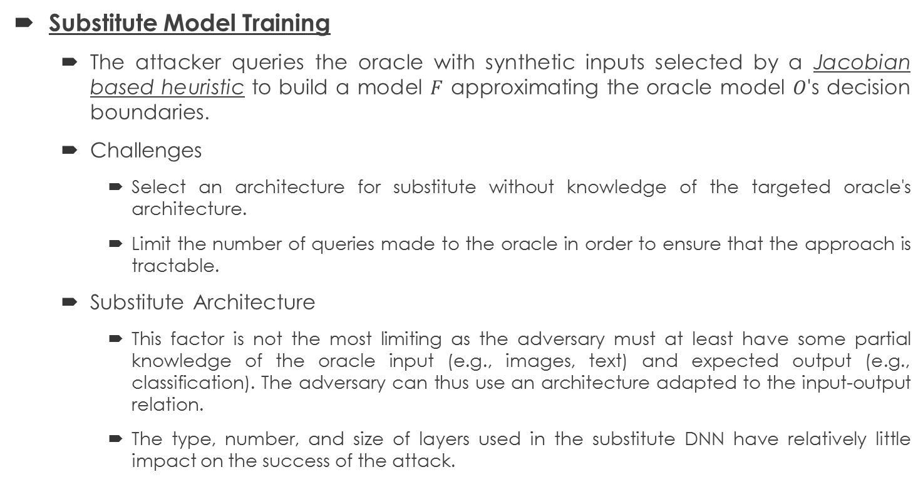
Black-Box Attack Strategy
Substitute Model Training
  The attacker queries the oracle with synthetic inputs selected by a Jacobian based heuristic to build a model $F$ approximating the oracle model $O$'s decision boundaries.
  Challenges
    Select an architecture for substitute without knowledge of the targeted oracle's architecture.
    Limit the number of queries made to the oracle in order to ensure that the approach is tractable.
  Substitute Architecture
    This factor is not the most limiting as the adversary must at least have some partial knowledge of the oracle input (e.g., images, text) and expected output (e.g., classification). The adversary can thus use an architecture adapted to the input-output relation.
    The type, number, and size of layers used in the substitute DNN have relatively little impact on the success of the attack.
This technique is not designed to maximize the substitute DNN's accuracy but rather ensure that it approximates the oracle's decision boundaries with few label queries
Practical Black-Box Attacks against Machine Learning – Papernot et. al., ASIA CCS ‘17

Slide 10
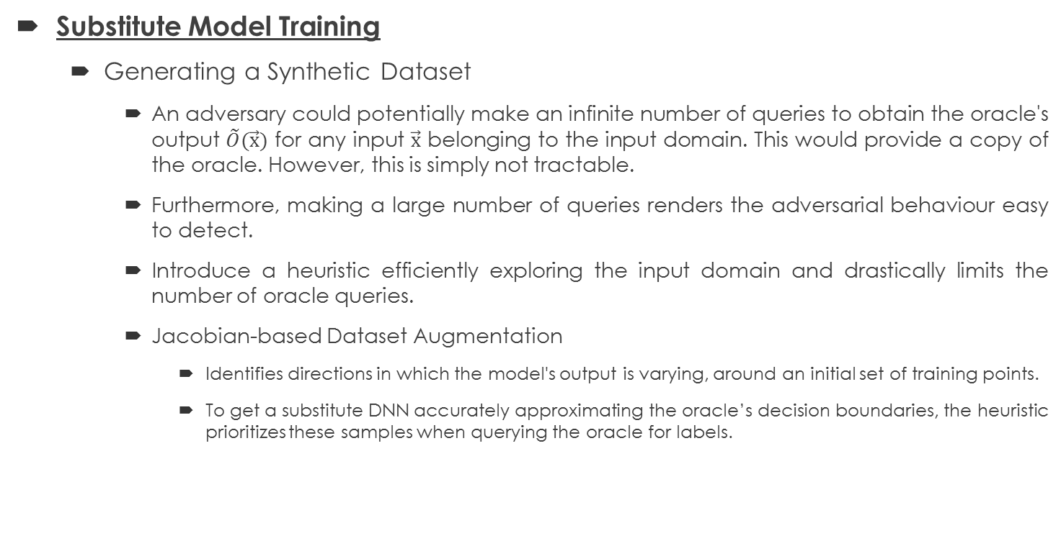
Black-Box Attack Strategy
Substitute Model Training
  Generating a Synthetic Dataset
    An adversary could potentially make an infinite number of queries to obtain the oracle's output $\tilde{O}(\vec{x})$ for any input $\vec{x}$ belonging to the input domain. This would provide a copy of the oracle. However, this is simply not tractable.
    Furthermore, making a large number of queries renders the adversarial behaviour easy to detect.
    Introduce a heuristic efficiently exploring the input domain and drastically limits the number of oracle queries.
    Jacobian-based Dataset Augmentation
      Identifies directions in which the model's output is varying, around an initial set of training points.
      To get a substitute DNN accurately approximating the oracle’s decision boundaries, the heuristic prioritizes these samples when querying the oracle for labels.
Practical Black-Box Attacks against Machine Learning – Papernot et. al., ASIA CCS ‘17

Slide 11
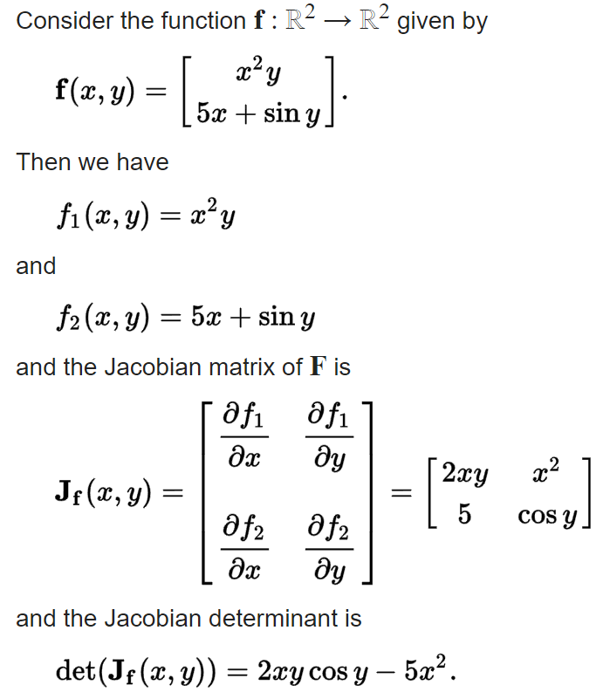
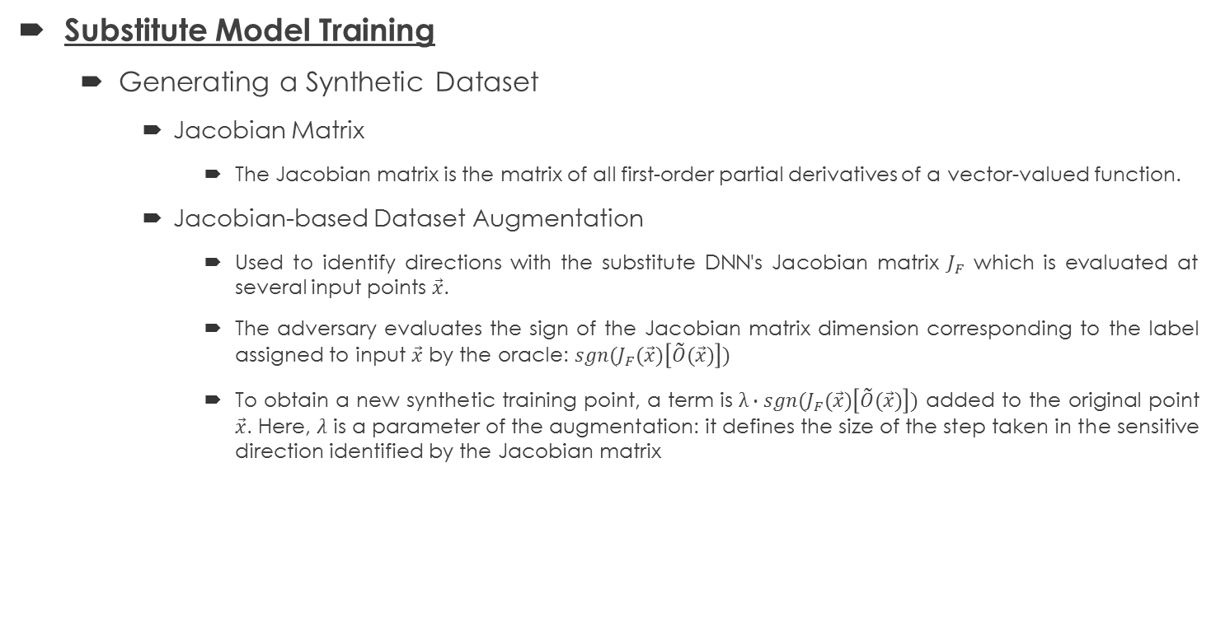
Black-Box Attack Strategy
Substitute Model Training
  Generating a Synthetic Dataset
    Jacobian Matrix
      The Jacobian matrix is the matrix of all first-order partial derivatives of a vector-valued function.
    Jacobian-based Dataset Augmentation
      Used to identify directions with the substitute DNN's Jacobian matrix $J_{F}$ which is evaluated at several input points $\vec{x}$.
      The adversary evaluates the sign of the Jacobian matrix dimension corresponding to the label assigned to input $\vec{x}$ by the oracle: $sgn(J_{F}(\vec{x})\left[\tilde{O}(\vec{x})\right])$
      To obtain a new synthetic training point, a term is $λ∙sgn(J_{F}(\vec{x})\left[\tilde{O}(\vec{x})\right])$ added to the original point $\vec{x}$. Here, $λ$ is a parameter of the augmentation: it defines the size of the step taken in the sensitive direction identified by the Jacobian matrix
Practical Black-Box Attacks against Machine Learning – Papernot et. al., ASIA CCS ‘17

Slide 12
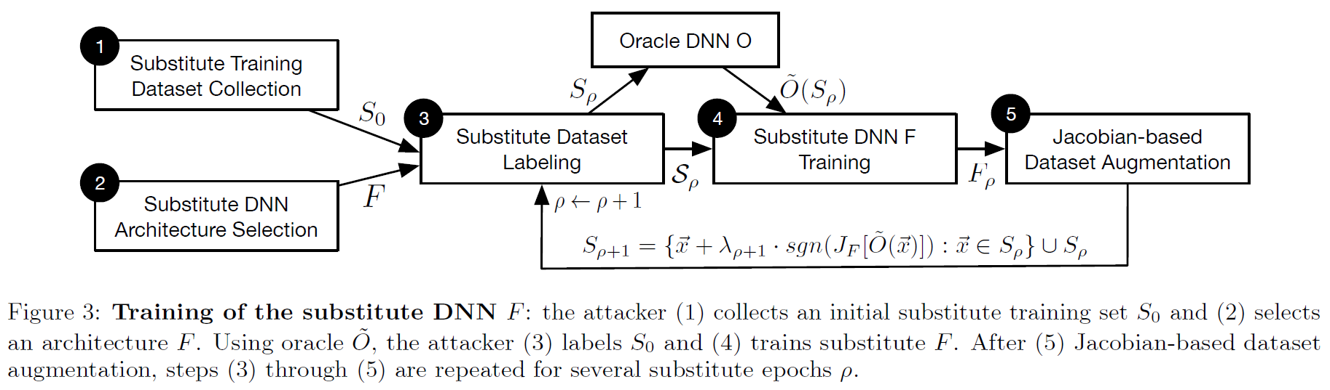
Black-Box Attack Strategy
Substitute Model Training
  Substitute DNN Training Algorithm
Practical Black-Box Attacks against Machine Learning – Papernot et. al., ASIA CCS ‘17

Slide 13
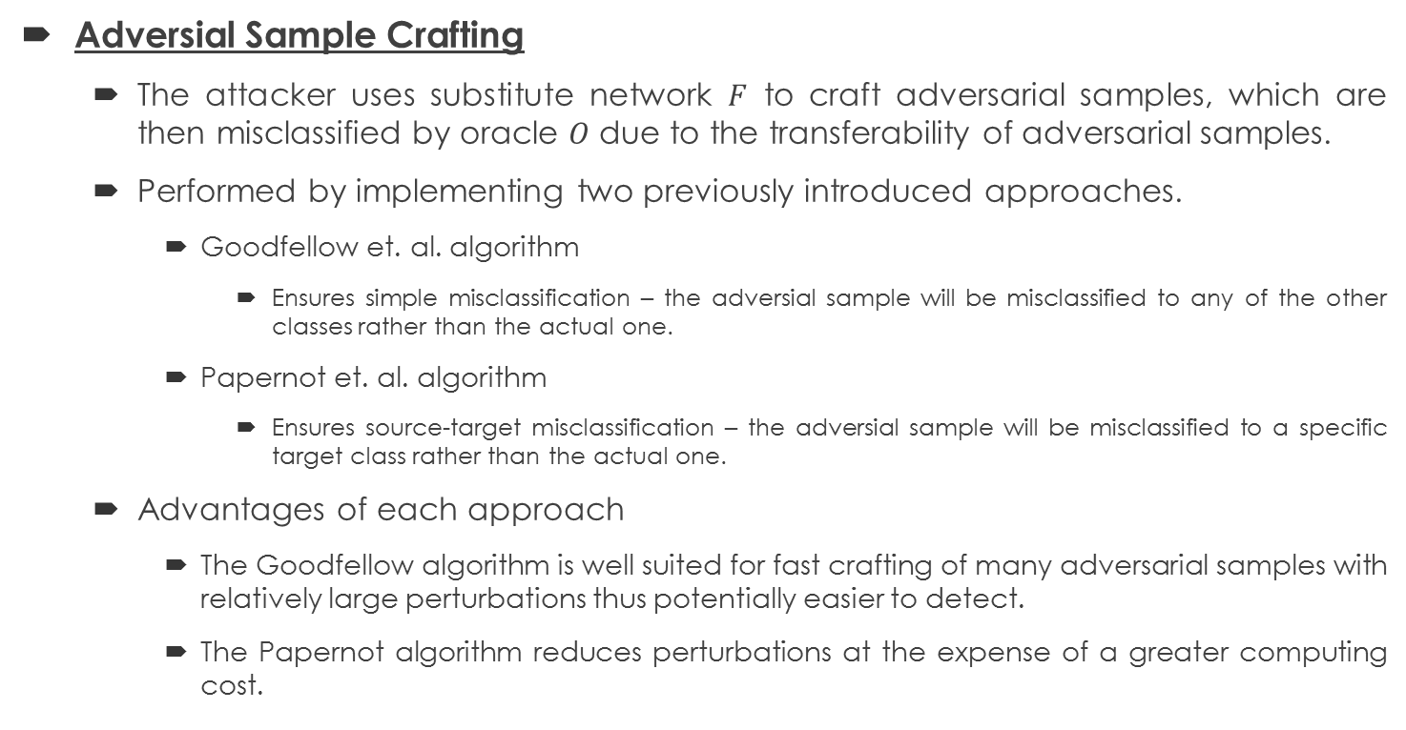
Black-Box Attack Strategy
Adversial Sample Crafting
  The attacker uses substitute network $F$ to craft adversarial samples, which are then misclassified by oracle $O$ due to the transferability of adversarial samples.
  Performed by implementing two previously introduced approaches.
    Goodfellow et. al. algorithm
      Ensures simple misclassification – the adversial sample will be misclassified to any of the other classes rather than the actual one.
    Papernot et. al. algorithm
      Ensures source-target misclassification – the adversial sample will be misclassified to a specific target class rather than the actual one.
  Advantages of each approach
    The Goodfellow algorithm is well suited for fast crafting of many adversarial samples with relatively large perturbations thus potentially easier to detect.
    The Papernot algorithm reduces perturbations at the expense of a greater computing cost.
Practical Black-Box Attacks against Machine Learning – Papernot et. al., ASIA CCS ‘17

Slide 14
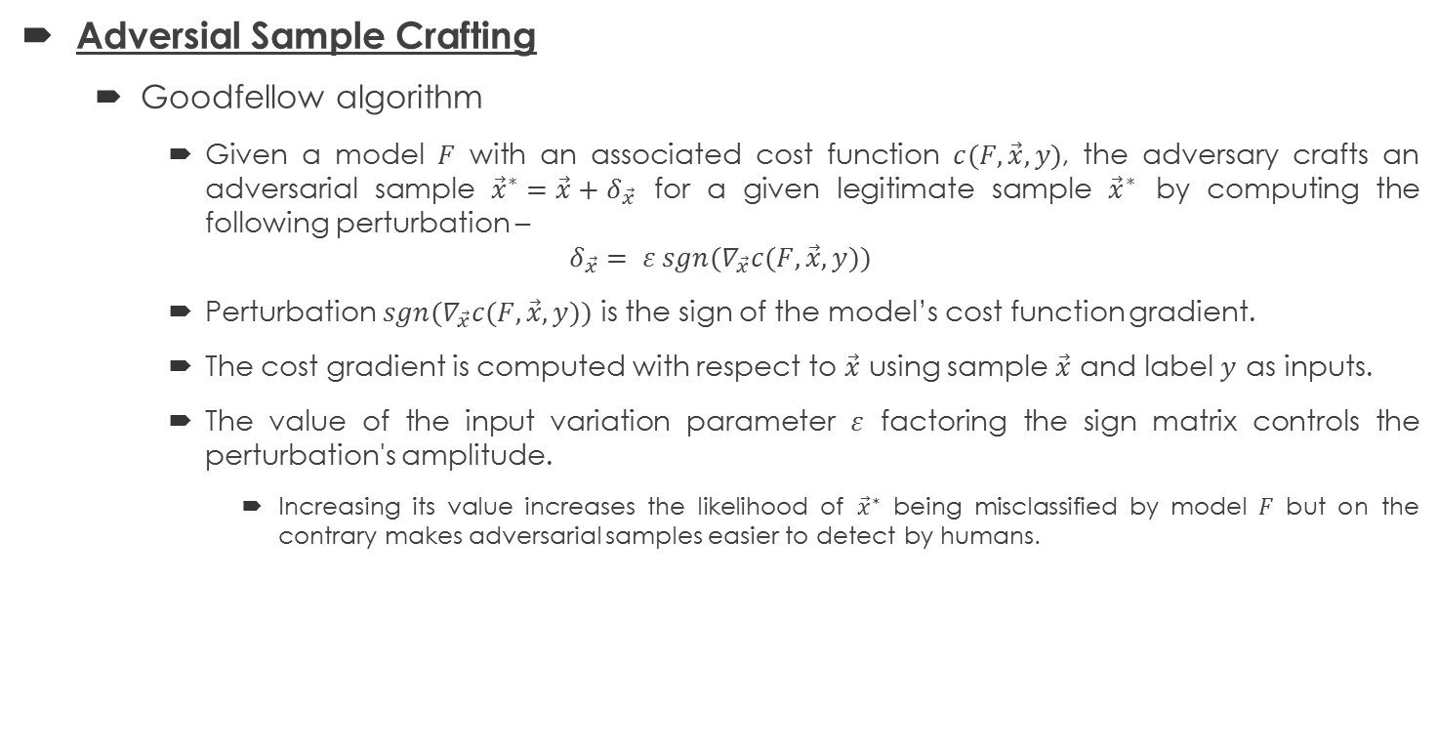
Black-Box Attack Strategy
Adversial Sample Crafting
  Goodfellow algorithm
    Given a model $F$ with an associated cost function $c(F, \vec{x}, y)$, the adversary crafts an adversarial sample ${\vec{x}}^{∗}=\vec{x}+δ_{\vec{x}}$ for a given legitimate sample ${\vec{x}}^{∗}$ by computing the following perturbation –
    $$δ_{\vec{x}}= ε sgn(∇_{\vec{x}}c(F, \vec{x}, y))$$
    Perturbation $sgn(∇_{\vec{x}}c(F, \vec{x}, y))$ is the sign of the model’s cost function gradient.
    The cost gradient is computed with respect to $\vec{x}$ using sample $\vec{x}$ and label $y$ as inputs.
    The value of the input variation parameter $ε$ factoring the sign matrix controls the perturbation's amplitude.
      Increasing its value increases the likelihood of ${\vec{x}}^{∗}$ being misclassified by model $F$ but on the contrary makes adversarial samples easier to detect by humans.
Practical Black-Box Attacks against Machine Learning – Papernot et. al., ASIA CCS ‘17
Explaining and harnessing adversarial examples – Goodfellow et. al., ICLR ‘15

Slide 15
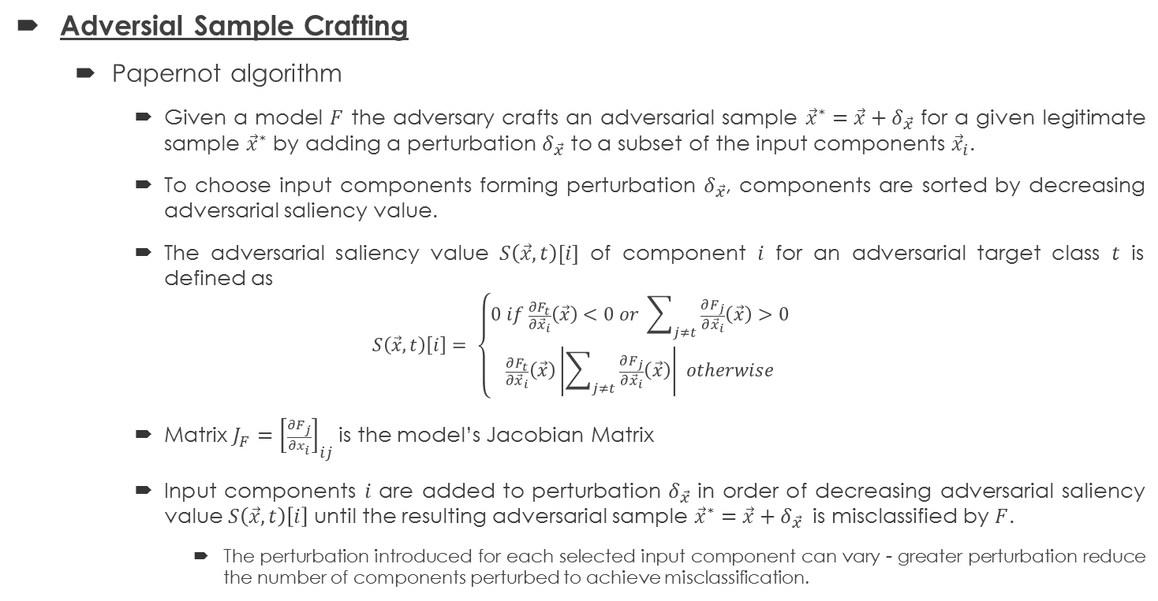
Black-Box Attack Strategy
Adversial Sample Crafting
  Papernot algorithm
    Given a model $F$ the adversary crafts an adversarial sample ${\vec{x}}^{∗}=\vec{x}+δ_{\vec{x}}$ for a given legitimate sample ${\vec{x}}^{∗}$ by adding a perturbation $δ_{\vec{x}}$ to a subset of the input components ${\vec{x}}_{i}$.
    To choose input components forming perturbation $δ_{\vec{x}}$, components are sorted by decreasing adversarial saliency value.
    The adversarial saliency value $S\left(\vec{x}, t\right)[i]$ of component $i$ for an adversarial target class $t$ is defined as
    $$S\left(\vec{x}, t\right)\left[i\right]= \left\{\begin{aligned}0 if \frac{∂F_{t}}{∂{\vec{x}}_{i}}\left(\vec{x}\right)<0 or \sum_{j≠t}{\frac{∂F_{j}}{∂{\vec{x}}_{i}}\left(\vec{x}\right)}>0 \\ \frac{∂F_{t}}{∂{\vec{x}}_{i}}\left(\vec{x}\right)\left|\sum_{j≠t}{\frac{∂F_{j}}{∂{\vec{x}}_{i}}\left(\vec{x}\right)}\right| otherwise\end{aligned}\right.$$
    Matrix $J_{F}={\left[\frac{∂F_{j}}{∂x_{i}}\right]}_{ij}$ is the model’s Jacobian Matrix
    Input components $i$ are added to perturbation $δ_{\vec{x}}$ in order of decreasing adversarial saliency value $S\left(\vec{x}, t\right)\left[i\right]$ until the resulting adversarial sample ${\vec{x}}^{∗}=\vec{x}+δ_{\vec{x}}$ is misclassified by $F$.
      The perturbation introduced for each selected input component can vary - greater perturbation reduce the number of components perturbed to achieve misclassification.
Practical Black-Box Attacks against Machine Learning – Papernot et. al., ASIA CCS ‘17
The limitations of deep learning in adversarial settings – Papernot et. al., Euro S&P ‘16

Slide 16
Validation of the Attack
Remote Classifier
  A DNN remotely provided by MetaMind, through their API that allows a user to train classifiers using deep learning.
  The API returns labels produced by the DNN for any given input but does not provide access to the DNN.
  An adversary using this attack can reliably force the DNN trained using MetaMind on MNIST to misclassify 84.24% of adversarial examples crafted with a perturbation not affecting human recognition.
Local Classifier
  A second oracle trained locally with the German Traffic Signs Recognition Benchmark (GTSRB), can be forced to misclassify more than 64.24% of altered inputs without affecting human recognition.
Practical Black-Box Attacks against Machine Learning – Papernot et. al., ASIA CCS ‘17

Slide 17
Attack Algorithm Calibration
How can substitute training be finetuned to improve adversarial sample transferability?
  The choice of substitute DNN architecture (number of layers, size, activation function, type) has a limited impact on adversarial sample transferability.
  Increasing the number of epochs, after the substitute DNN has reached an asymptotic accuracy, does not improve adversarial sample transferability.
For each adversarial sample crafting strategies, which parameters optimize transferability?
  At comparable input perturbation magnitude, the Goodfellow and Papernot algorithms have similar transferability rates.
  The choice of algorithm depends on acceptable perturbations - all features perturbed a little (Papernot) vs. few features perturbed a lot (Goodfellow).
Practical Black-Box Attacks against Machine Learning – Papernot et. al., ASIA CCS ‘17

Slide 18
Generalization of the Attack
The attack generalizes to non-differentiable target oracles like decision trees.
  The only limitation placed on the substitute is that it must model a differentiable function to allow for synthetic data to be generated with its Jacobian matrix.
  Substitutes can also be learned with logistic regression.
The attack generalizes to additional ML models by learning substitutes of 4 classier types
  Logistic regression
  SVM
  Decision Tree
  Nearest Neighbours
Practical Black-Box Attacks against Machine Learning – Papernot et. al., ASIA CCS ‘17

Slide 19
Intuition behind Transferability
It has been shown that adversarial examples, generated on one classifier, are likely to cause another classifier to make the same mistake, even if the classifiers have different architectures or are trained on disjoint datasets. This property is known as transferability.
In common ML classifiers, the predictions vary smoothly around the input samples, i.e., they classify the noisy samples into the same label as the clean samples. This property enables the transferability of the adversarial examples.
The key to protect black-box learning systems against the adversarial examples is to block their transferability.
  Can we train the classifier to discard adversarial examples, while maintaining the accuracy on the clean data?
Blocking Transferability of Adversarial Examples in Black-Box Learning Systems – Hosseini et. al., arXiv ‘17
Intriguing properties of neural networks – Szegedy et. al., arXiv ‘13

Slide 20
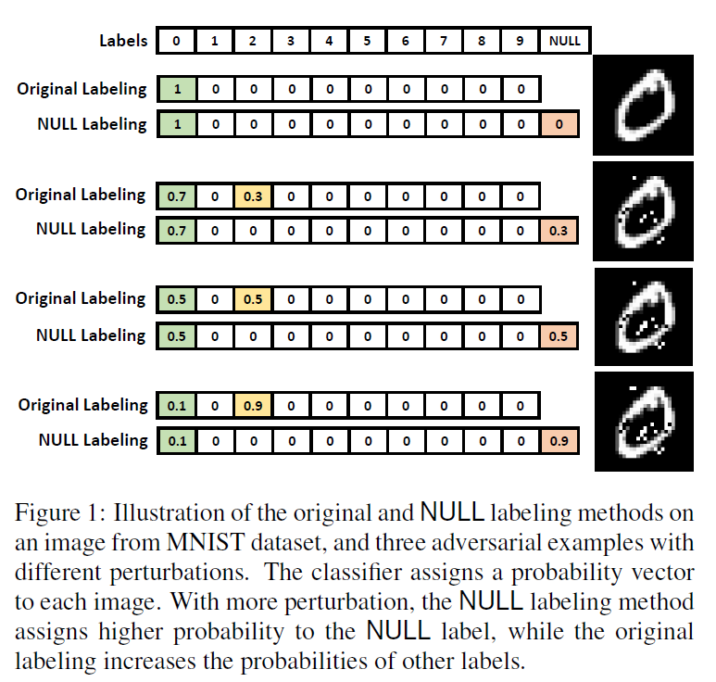
Defence by Blocking Transferability
The paper propose a training method such that, as the input is more perturbed, the classifier shows lower confidence on the original label and instead declares that the input is “invalid”.
During the training phase, the classifier examines the distinction between the clean and adversarial data, and learns to discard the adversarial examples, while keeping the clean inputs.
Augment the output class set of the classifier with an additional label called NULL. During the training phase, generate adversarial examples and train the ML algorithm to label them as NULL with appropriate probabilities according to the amount of perturbation.
Blocking Transferability of Adversarial Examples in Black-Box Learning Systems – Hosseini et. al., arXiv ‘17

Slide 21
Current Works on Malware Classification
Adversarial Perturbations Against Deep Neural Networks for Malware Classification
  Kathrin Grosse et. al., arXiv ’16
  Show how to construct highly-effective adversarial sample crafting attacks for neural networks used as malware classifiers.
  Main idea
    The application domain of malware classification introduces additional constraints in the adversarial sample crafting problem when compared to the computer vision domain:
      continuous, differentiable input domains are replaced by discrete, often binary inputs
      the loose condition of leaving visual appearance unchanged is replaced by requiring equivalent functional behavior.
    Analysed effectiveness on three defence mechanism: Feature Reduction, Distillation and Adversial Learning.

Slide 22
Current Works on Malware Classification
Black-Box Attacks against RNN based Malware Detection Algorithms
  Weiwei Hu et. al., arXiv ‘17
  Proposed a novel algorithm to generate sequential adversarial examples, which are used to attack a RNN based malware detection system.
  Main idea
    It is usually hard for malicious attackers to know the exact structures and weights of the victim RNN.
    A substitute RNN is trained to approximate the victim RNN.
    Then a generative RNN is proposed to output sequential adversarial examples from the original sequential malware inputs.

Slide 23
Thank You

