Slide 1
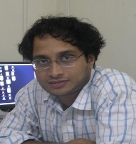
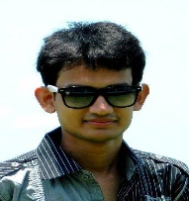
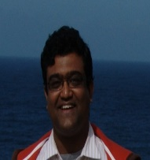
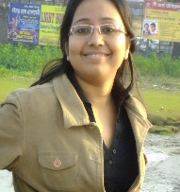
Project PI
Student Member
Dr. Debdeep Mukhopadhyay
Manaar Alam
Associate Professor
Full-Time Ph. D. Scholar
Project co-PI
Student Member
Dr. Sourangshu Bhattacharya
Sarani Bhattacharya
Assistant Professor
Full-Time Ph. D. Scholar

