Slide 1
Material Available
Jul 28
Phase 2 Electrical
Testing Completed
Certification
Production
May 19
Aug 9
Sep 30
December 4, 2017
2017
May
Jun
Jul
Aug
Sep
Oct
Nov
Dec
2017
Today
May 11
Phase 1 Mechanical
Aug 3
Sep 16
Oct 16
Units Available
CUA Pending
Performance Results
Aug 13
Drawings Released
Aug 25
Build Start
Sep 3
Conditional Release

Slide 2
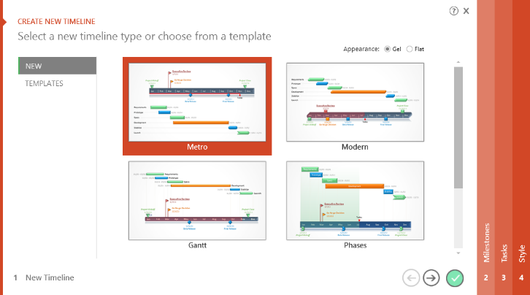

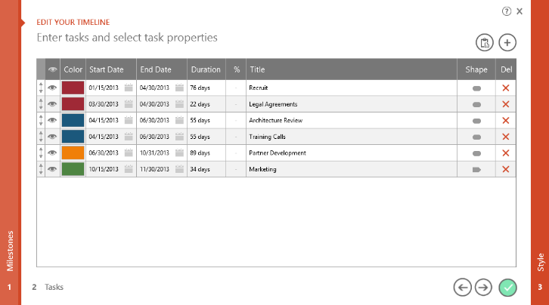
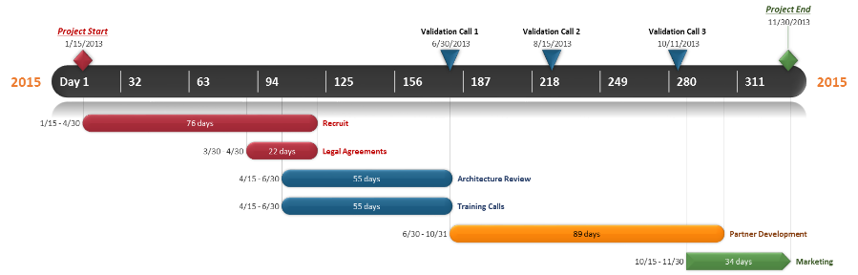
To change and update this template automatically,
download the free Office Timeline PowerPoint add-in!
Office Timeline is a free, award winning, Gantt chart maker that's easy to use.
Simple, easy-to-use wizards.
Professional, quick results.
Built directly into PowerPoint

