Slide 1

Food and Beverage Department
FAB 333 Culture & Cuisine
How we Taste
Notes:
Can anyone tell me what the five tastes are?

Slide 2
How We Taste
Taste #1: Sweet - The sweet taste is due to the sugars (glucose, lactose, and artificial sweeteners) in food and drinks, and sometimes alcohols and amino acids.
Taste #2: Sour - When food tastes sour, there’s a high chance it has acids in it. Think citrus fruits or vinegar, and the resulting flinch when you have either in large quantities.
Taste #3: Salty - Sodium chloride leaves a distinctive taste on people’s palates, and just like sourness, this particular taste is enjoyable in tiny quantities.
Taste #4: Bitter - The bitter taste evokes a strong response. It is wholly unpleasant and caused by several substances—commonly described by the taste of coffee, leafy greens, and cocoa.
Taste #5: Umami - Taste of glutamate, known as ‘umami’, this taste is linked to protein. It can’t be described by any of the other four tastes. Umami is sensed in food like mushrooms, meat, and tomatoes, often defining Eastern cuisine thought the use of MSG (monosodium glutamate).

Slide 3
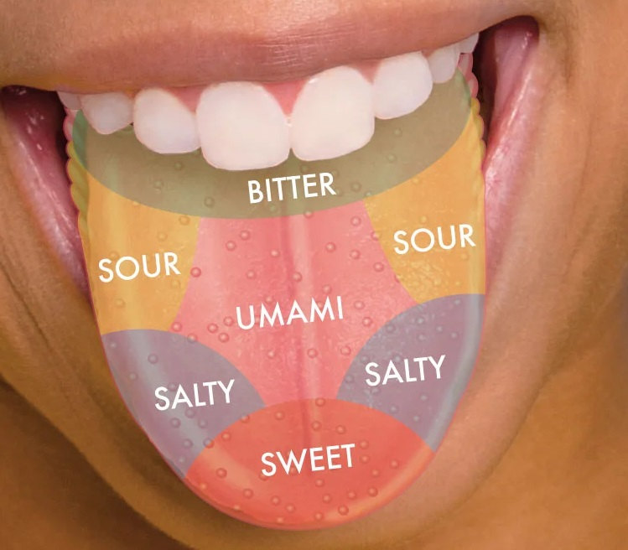
How We Taste

Slide 4
Facts: UMAMI in Western Culture
Umami, often described as a savory or meaty taste, was first identified by Japanese chemist Kikunae Ikeda in 1908.
Was not widely recognized by Western scientific community as a fifth basic taste until the late 1980s, when specific taste receptors for glutamate were identified on the human tongue.
Umami serves an important physiological role by signaling the presence of proteins in food, an essential nutrient for survival

Slide 5
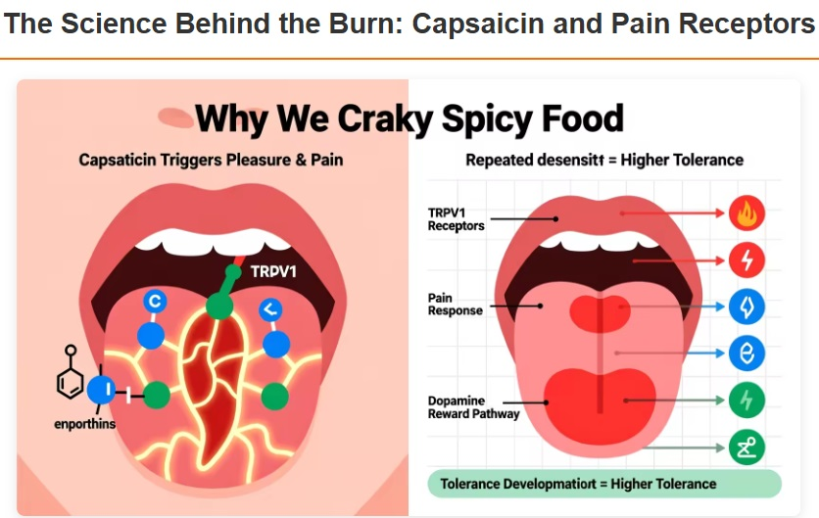
SPICY Is “NOT” one of the 5 Tastes

Slide 6
SPICY Is “NOT” one of the 5 Tastes
Capsaicin, the active component in chili peppers, doesn't activate taste buds.
It binds to a specific receptor called TRPV1 (transient receptor potential vanilloid 1), which is primarily designed to detect heat and physical pain.
When capsaicin hits this receptor, typically on the tongue
or in the mouth, the brain interprets the signal as actual
burning even though no tissue damage occurs.

Slide 7
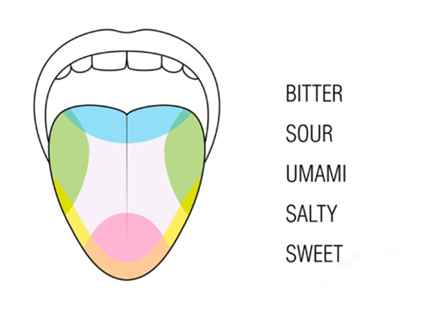
Do you Remember ?

Slide 8
References
Accounting for taste. Science History Institute. (2023, November 14).
https://www.sciencehistory.org/stories/disappearingpod/accounting-for-
Spivack, E. (2021, September 24). Spiciness isn’t a taste, and more burning
facts about the mysterious sensation. Popular Science.
https://www.popsci.com/science/spicy-basic-taste/

