Slide 1
Wine 101

Slide 2
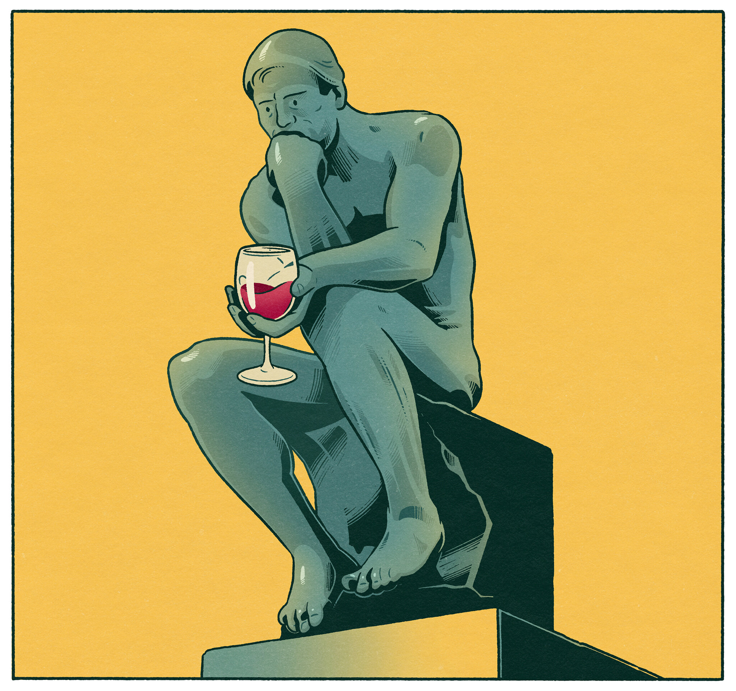
Philosophy of Wine
Wine is about the journey and the discovery
Be open minded!!
Don’t be intimidated
Wine is about sharing
Wine is about appreciation
Wine is social and enriches the soul
Wine is FUN

Slide 3
What is wine?
Wine is an alcoholic beverage made from fermentation of grape juice
Dates back to around 6000 BC and originated in somewhere around Iran/Gerogia
Moved to Europe in about 4500BC in Bulgaria and Greece
Wine has played an important role in religion and culture
Green god Dionysos
Roman Bacchus
Many formal religious ceremonies around wine

Slide 4
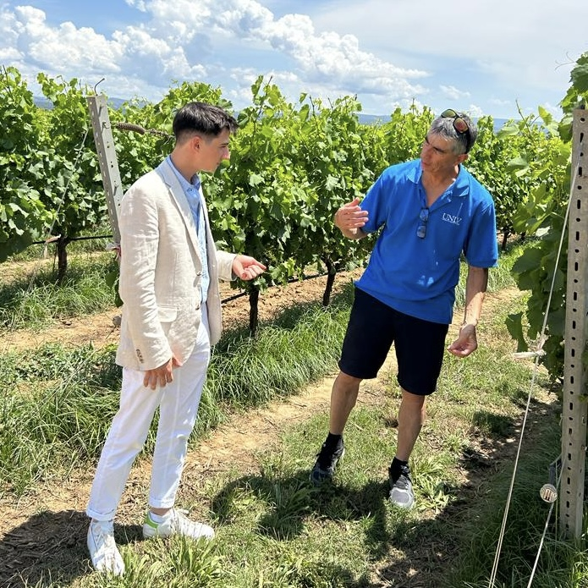
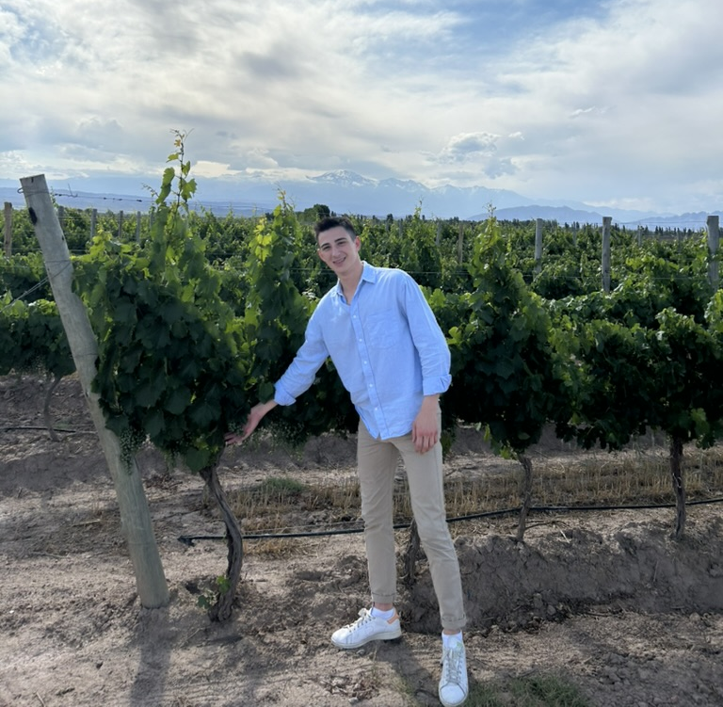
What is Wine?
Fermentation
Sugar + Yeast = Alcohol + Co2
Grapes
Vitis vinifera (Chardonnay, Cabernet Sauvignon, Merlot)
Vitis labrusca (Concord, Niagara, Catawba)
Hybrids

Slide 5
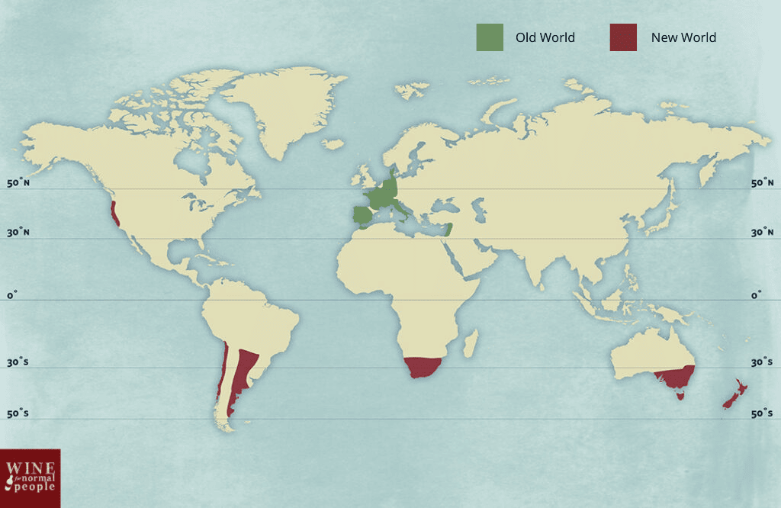
Where is wine made?
Grapes require specific growing conditions
Geography
Growing season = frost free days
Number of sunny days
Soils -> terroir
Climate
Sunlight, termperature, rainfall

Slide 6
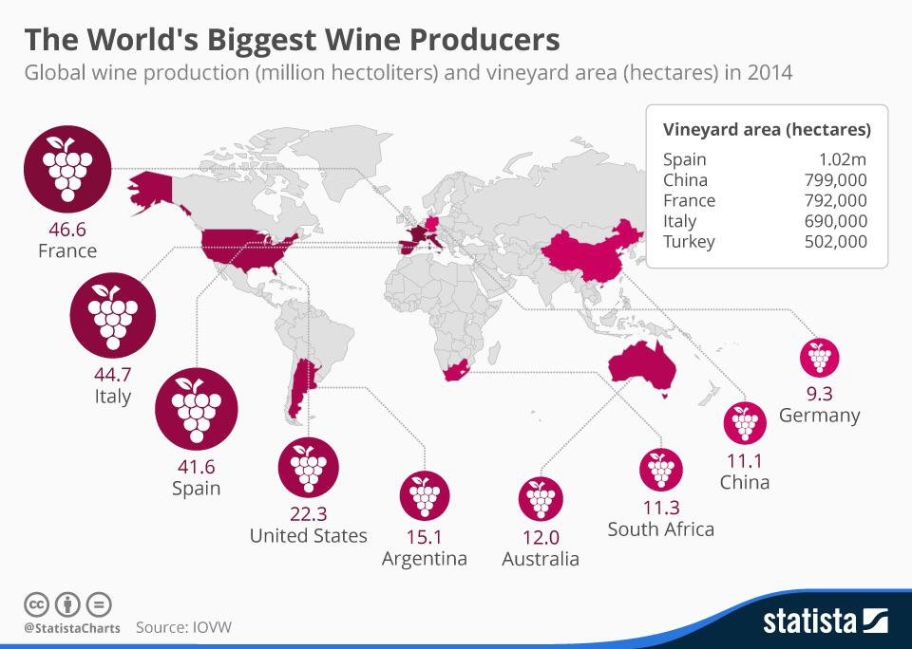

Slide 7
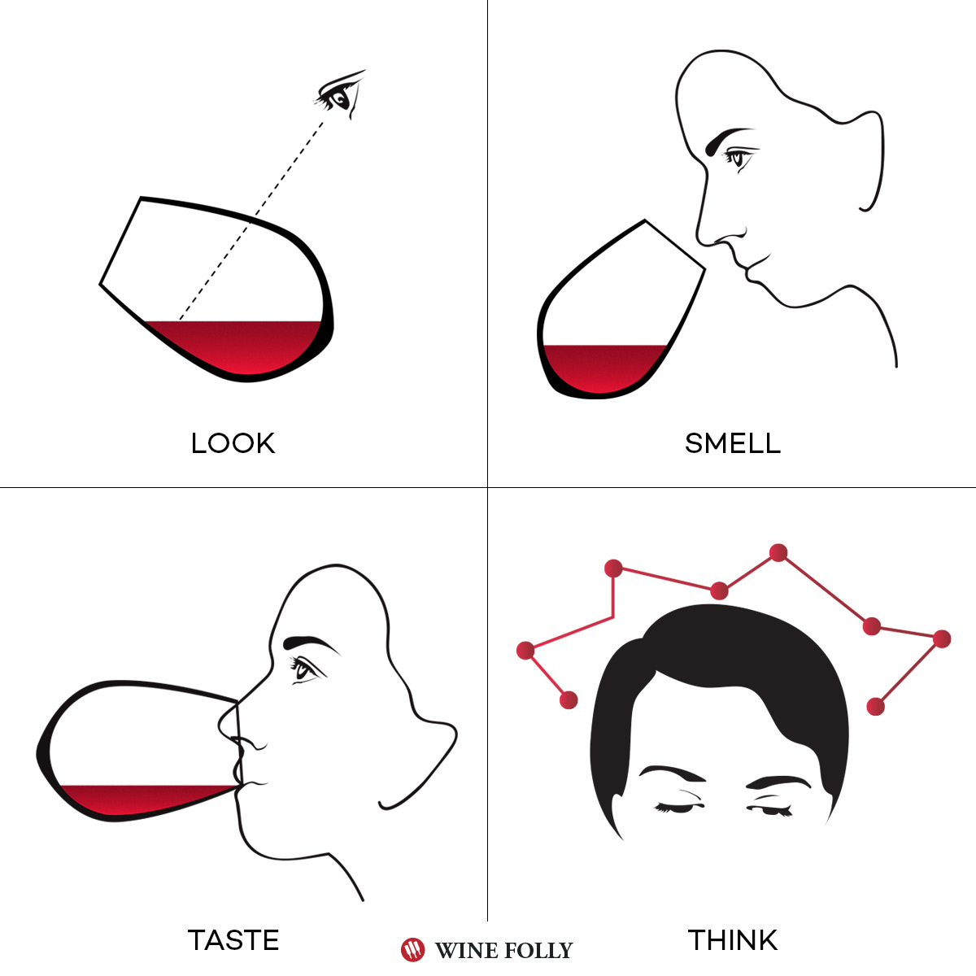
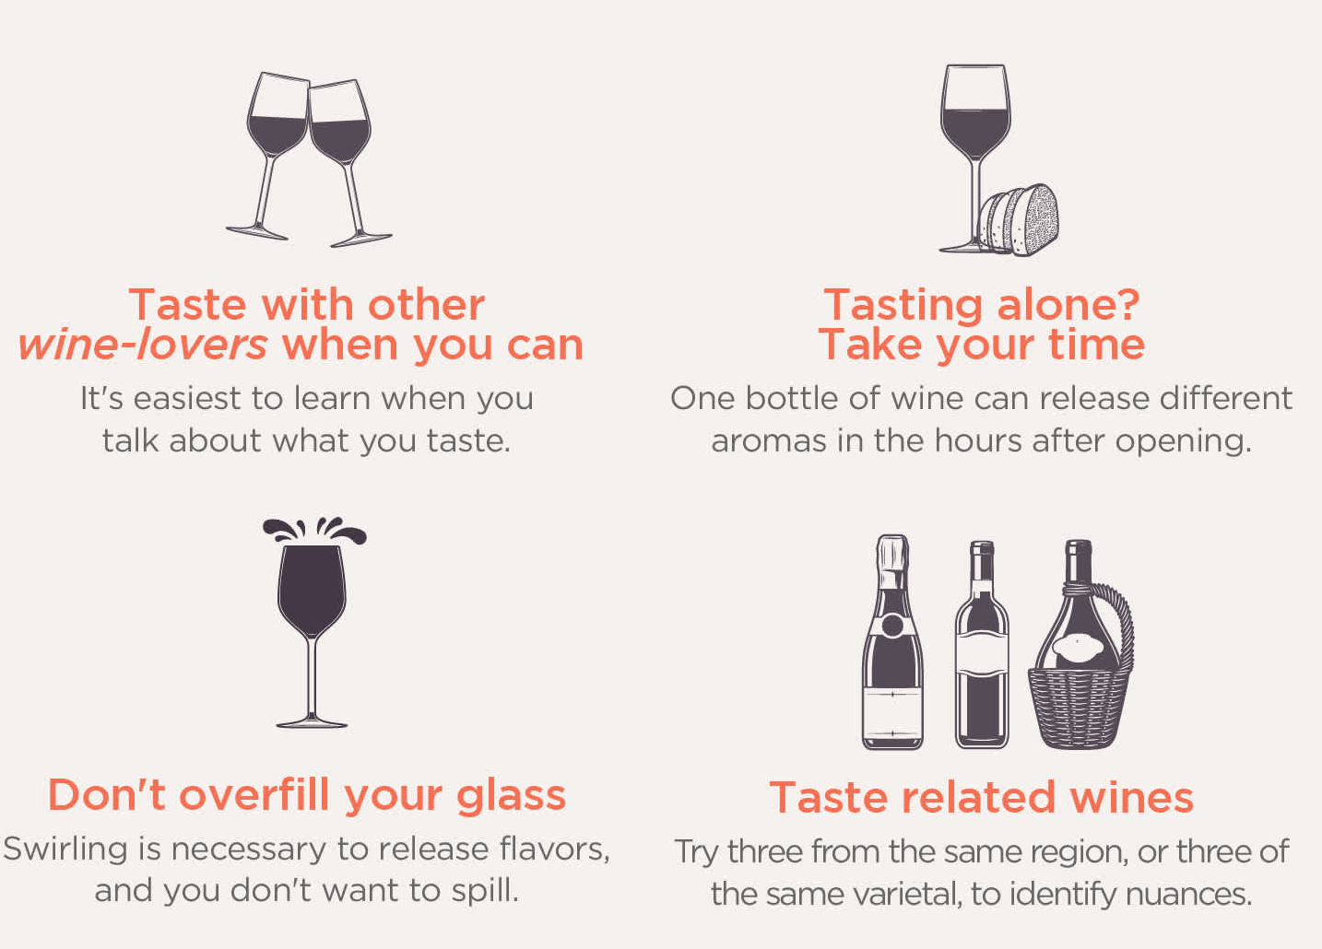
How to taste wine

Slide 8
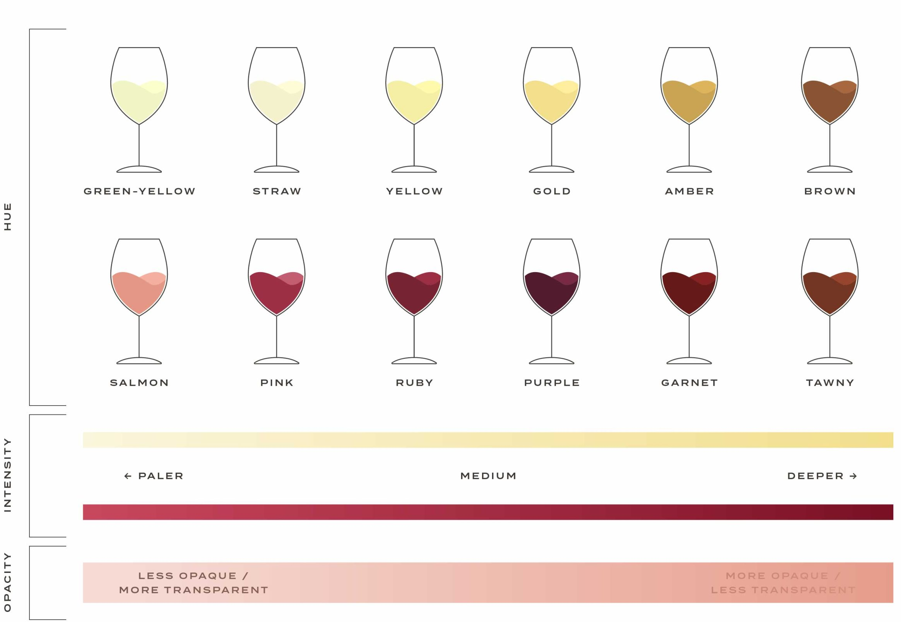
Appearance
Observe color from core to rim
Assess intensity: pale, medium, deep
Evaluate clarity: clear, hazy, sediment present
Examine rim variation for signs of youth or age
Swirl and assess viscosity and leg formation
Consider what visual cues suggest about alcohol, residual sugar, or development

Slide 9
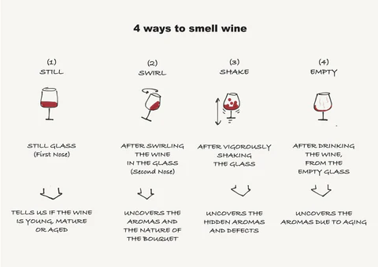
Smell
Smell before swirling, then after swirling
Evaluate aromatic intensity
Identify fruit characteristics
Identify non fruit characteristics such as floral, herbal, spice, mineral
Distinguish fresh versus developed notes
Consider overall aromatic complexity and integration

Slide 10
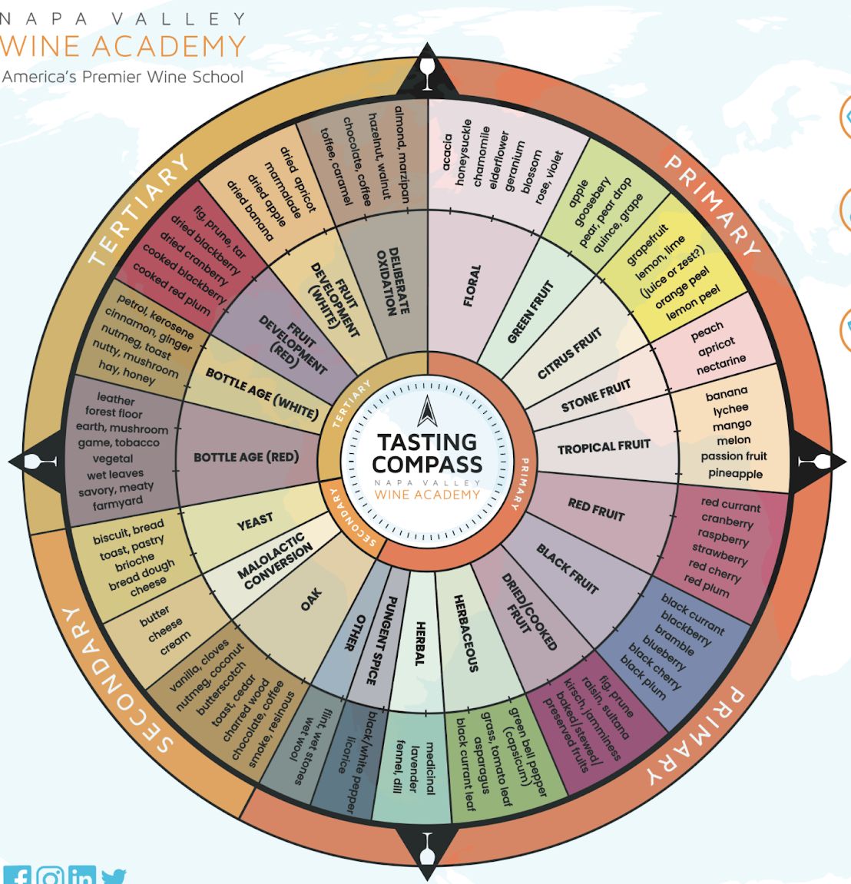
Taste and mouthfeel
Assess sweetness level
Evaluate acidity through salivation response
Detect bitterness and where it appears
Determine body: light, medium, full
Evaluate texture: crisp, round, creamy, lean
Notice alcohol warmth and weight
Consider how structural elements interact and balance

Slide 11
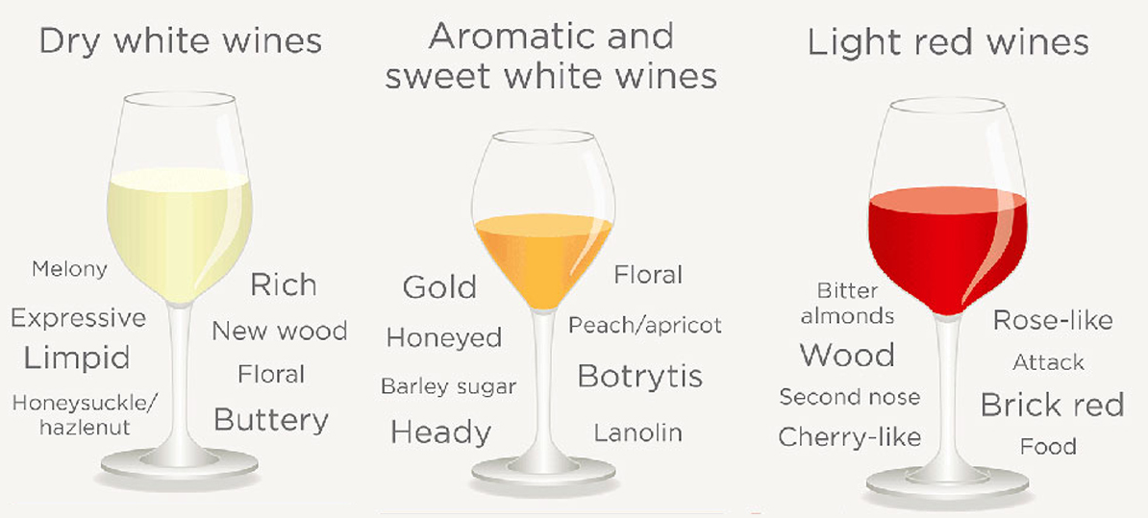
Finish
Measure length: short, medium, long
Observe how flavors evolve after swallowing
Note whether acidity increases or fades
Identify lingering sweetness or building bitterness
Evaluate persistence and clarity of structure

